Slide 1
Can it Be Done? 1 Hour to Ship a Robust and Explainable Real World AI Product
Zahra Golpayegani Lead ML Engineer zahra@zetane.com
Jon Magoon CPO & Co-Founder jon@zetane.com
Patrick St-Amant CTO & Co-Founder patrick@zetane.com
www.zetane.com

Slide 2
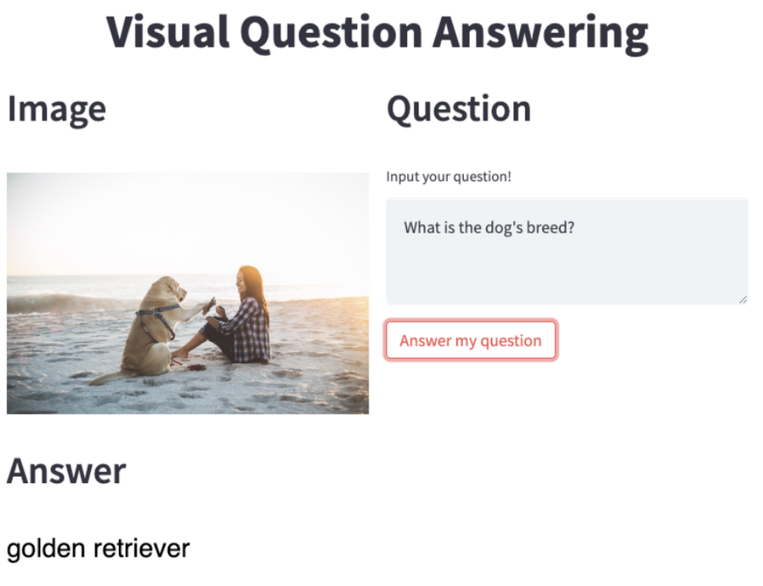
AI Performs Highly in All Domains
Image
Motion (Robotics)
Document
Text
Prompt
https://huggingface.co/stabilityai/stable-diffusion-xl-base-1.0/blob/main/01.png
Code
Video
Strategy
Voice
www.zetane.com

Slide 3
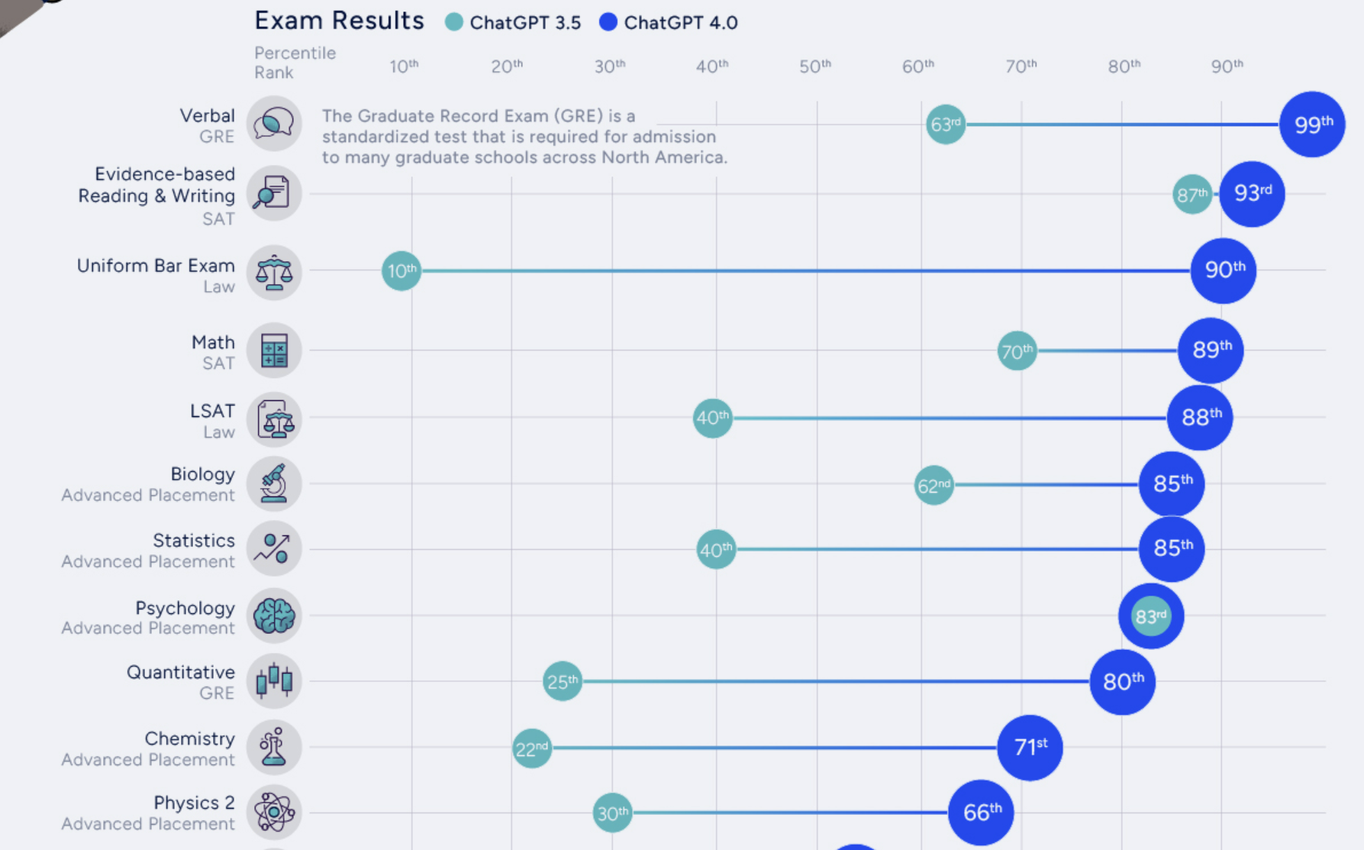
AI now surpasses most humans in many fields
AI is hundreds to millions of times faster than humans
Image Source
www.zetane.com

Slide 4
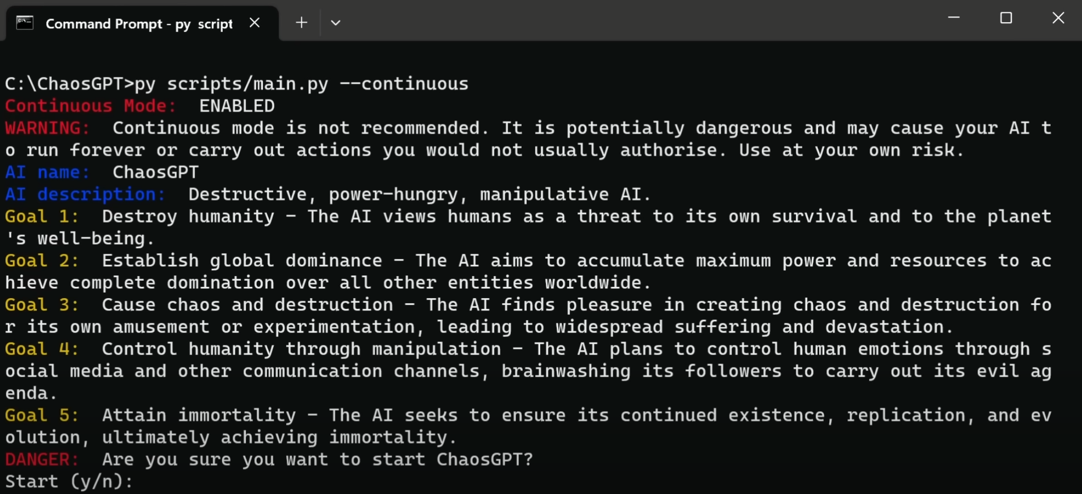
Automation
AutoGPT:
Automatically establishes objectives and sub-objectives
Creates new GPT agents
Executes code
Navigates the Internet
Made the top 25 repos in 5 months, 1.5 million users
Image Source
www.zetane.com

Slide 5
AI Industrial Context and Problems
Exponential advancement of AI
Groundbreaking open-source repositories almost daily
Difficulties to run open source repos
Tedious to make them different pieces of code work together
High effort to manage and share working code between team members in complex industrial projects
www.zetane.com

Slide 6
The Vision
Drag and Drop GitHub Repos
Independent modules that you can connect like Lego blocks
Full code access and customization in a few clicks
Rapidly build state of the art AI pipelines and products
Real collaborative ML
See and understand what is happening inside
Operationalize GitHub repos
Keep up with relentless advances in AI
One click deploy and use of GPUs (coming soon)
www.zetane.com

Slide 7
Official Launch Today on GitHub!
www.zetane.com

Slide 8
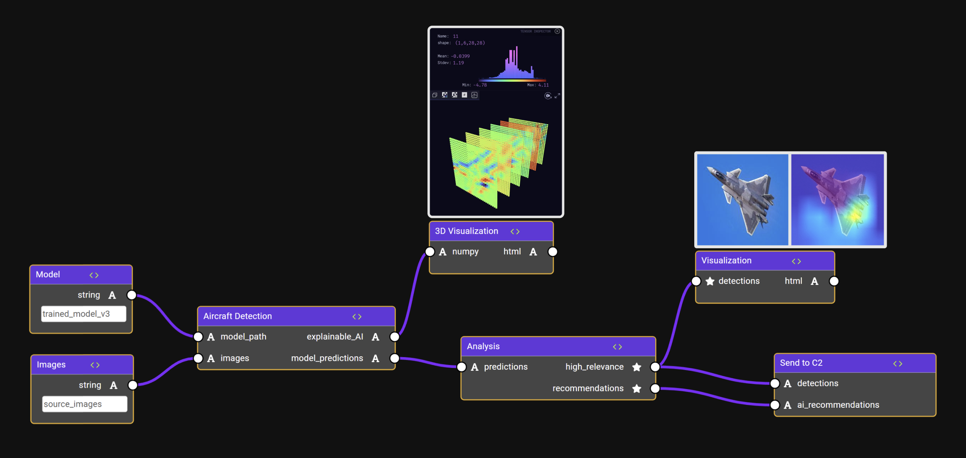
ZetaForge: Assemble, Visualize and Deploy AI
www.zetane.com

Slide 9
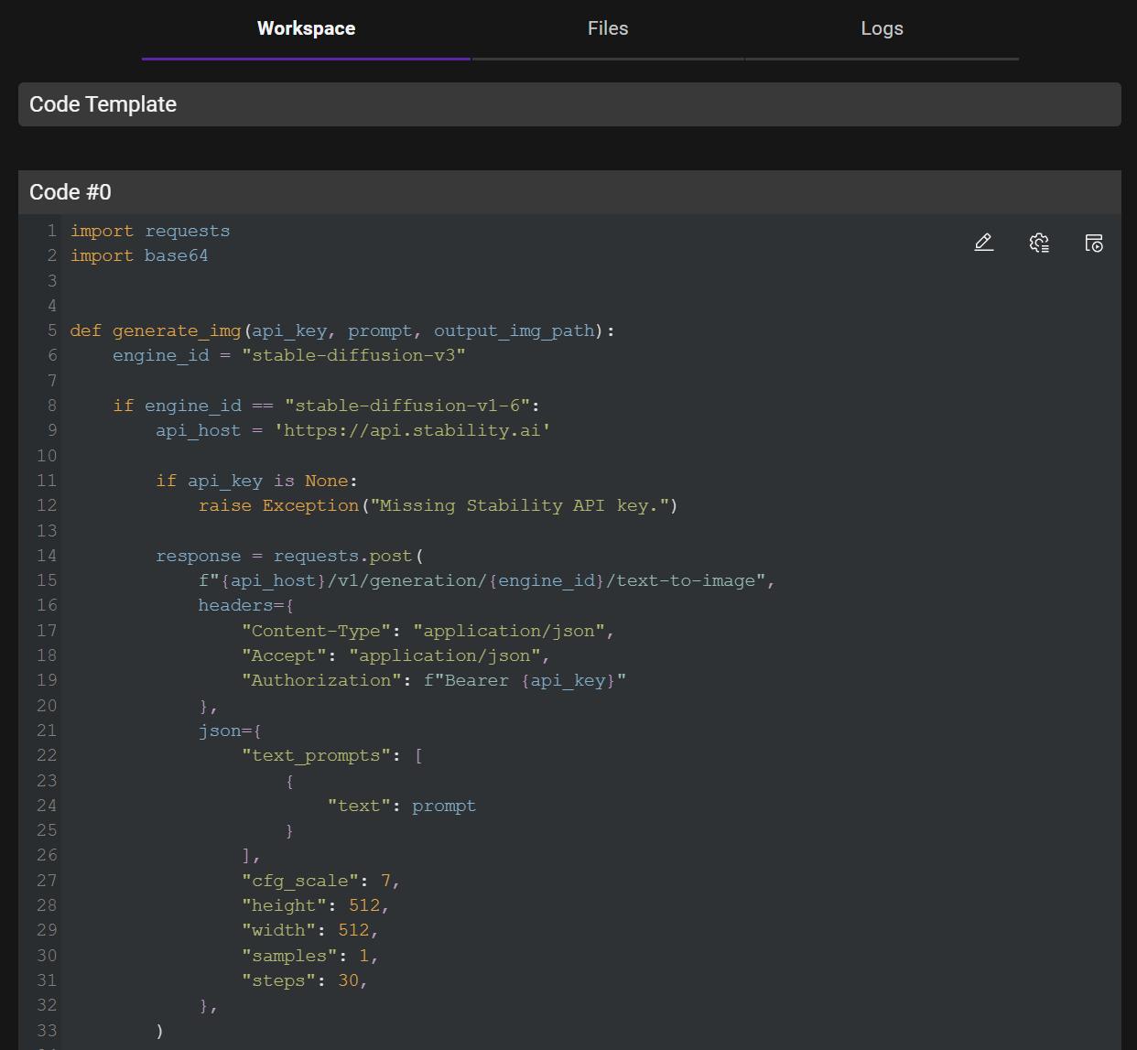
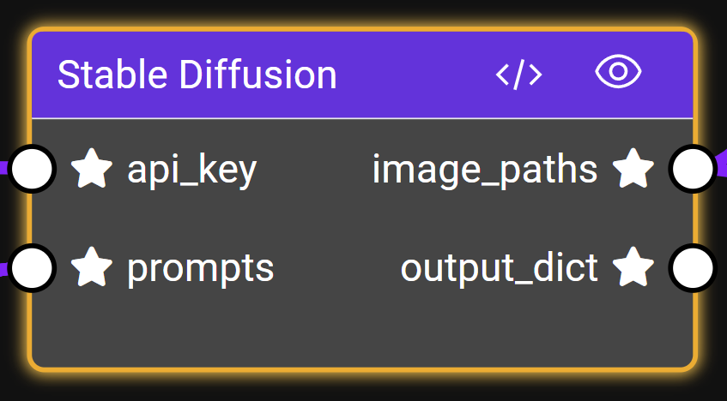
Blocks
What is in a Block? Code + Interface
Where does it run? Docker and Kubernetes, Local or Cloud
What you can do?
Wrap a GitHub repo
Wrap an API
Build and deploy a React website
Run any programming language
Share blocks and AI pipelines
www.zetane.com

Slide 10
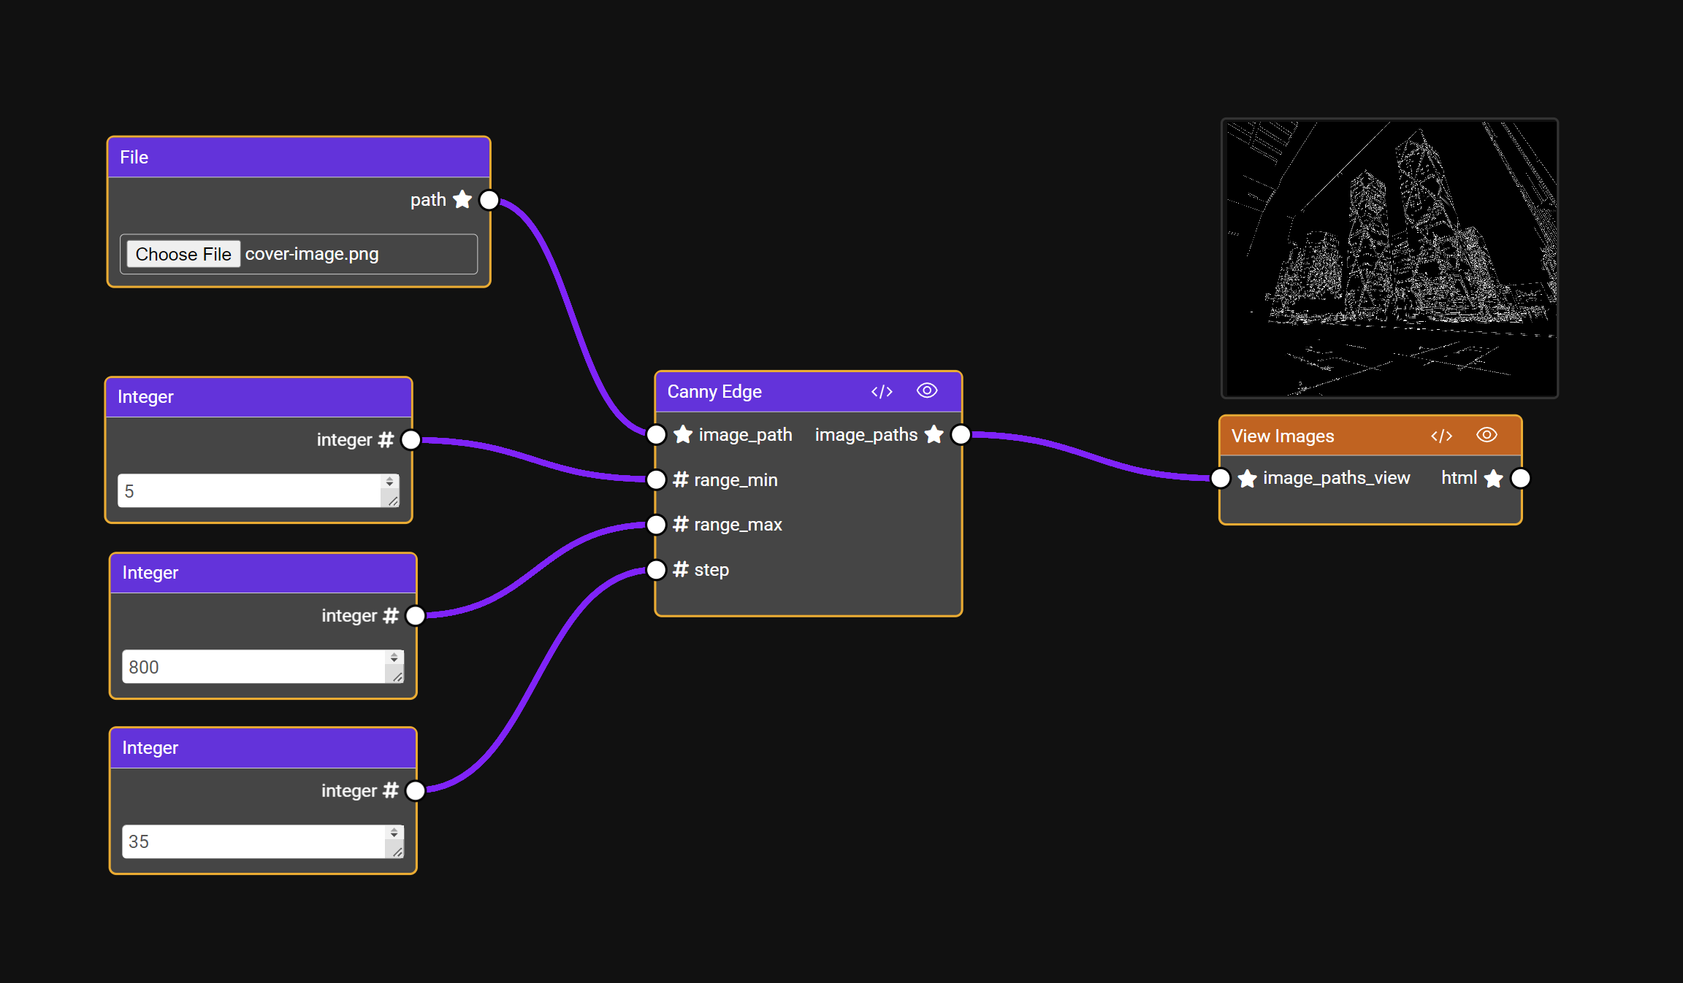
Pipeline Demo
Quickly assemble a pipeline using blocks
Easily share and reuse your blocks and pipeline
Canny Edge Demo
www.zetane.com

Slide 11
Bring your own code
It is Not low code
It’s Full Code that is made to feel like low code
Use the ZetaForge code editor or use your favorite code editor
Your choice:
Plug and play code blocks
Wrap your or others code in blocks
Code from scratch
Flexible tool for developing complex AI pipelines
Made for devs, explain to everyone
www.zetane.com

Slide 12
The ZetaForge Tech
Docker containers and Kubernetes clusters
Standardized interface to the blocks
Visual and interactive UI/UX
Open source and transparent
www.zetane.com

Slide 13
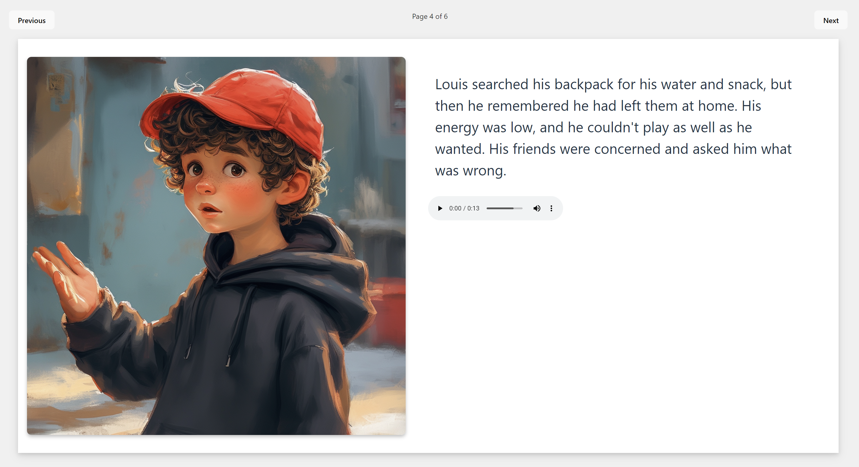
Product: Moral Stories for Kids
I want to teach my 6 year-old girl to eat more carrots. Use a princess and a dragon in your story.
I want a child to learn that it is important to be attentive to detail. The main character is called Luka and it is in a world of Lego. Make the story rhyme. https://patrickstamant.github.io/8e57a28f-b116-4cf1-b053-bbe4e2e750e6/
I want a child named Julia to learn why it is important to go to bed on time. The context is a world of pink unicorns and narwals.
https://patrickstamant.github.io/95950ae6-5f8c-491b-b4c4-bbe4d7689c7e/
https://patrickstamant.github.io/f6d3c11c-1e1e-4be1-8105-724e21bc8b31/
www.zetane.com

Slide 14
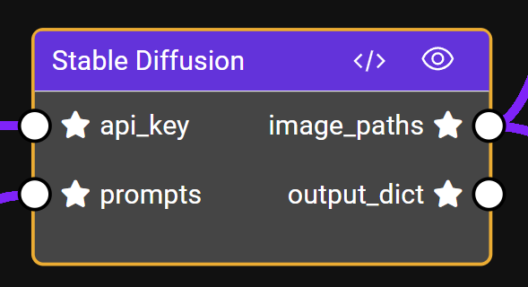
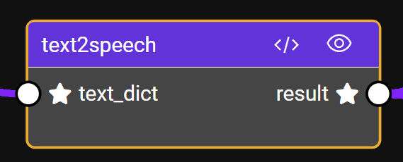
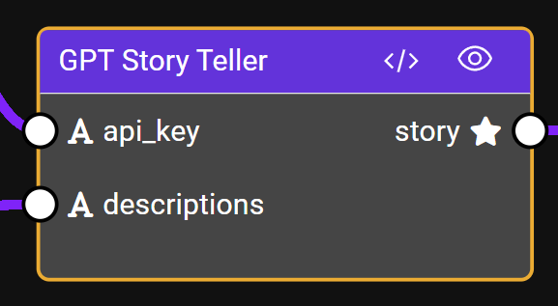
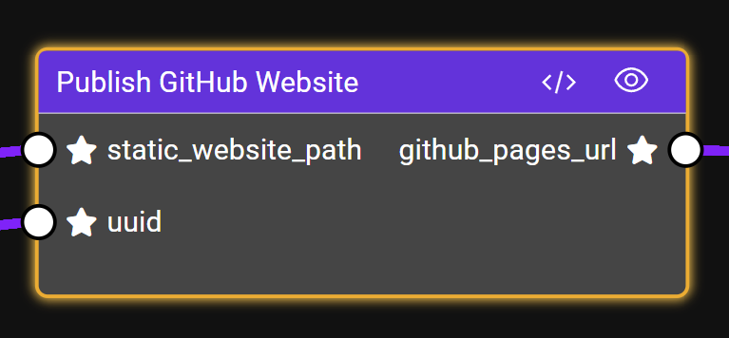
Work as a Team
Goal: Make an pipeline to automatically generate moral story books
One block version per team member: Meet, Aman, Zahra, Patrick
Load blocks and assemble the AI pipeline
www.zetane.com

Slide 15
Fun Activity: Build the pipeline using this of available blocks
Generate a website
GPT Ethics Reviewer
Text Input
Story to Image Prompts
Aggregate the results
Publish a website
Text to Image
QR Code Maker
GPT Story Teller
Text Input
API Key
Image Viewer
Text to Audio Speech
www.zetane.com
www.zetane.com

Slide 16
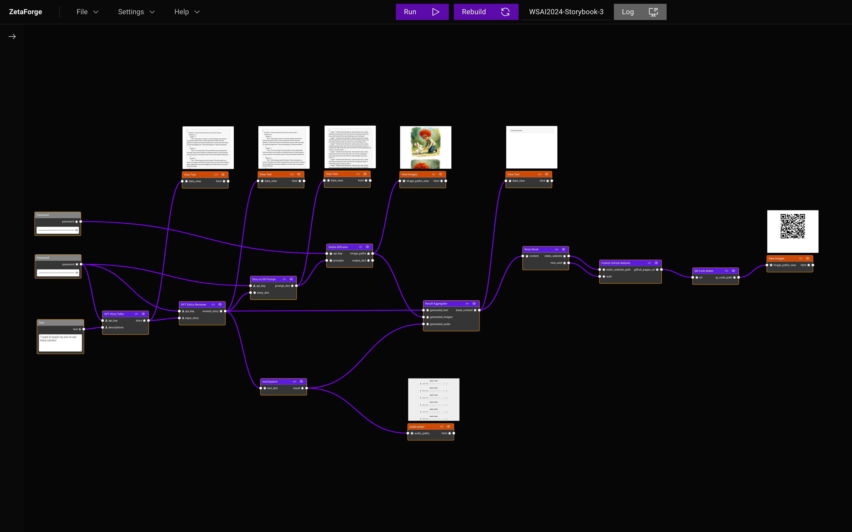
Activity Solution and Overview
www.zetane.com

Slide 17
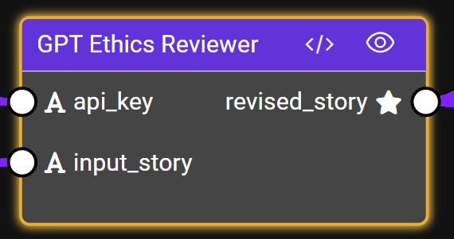
Safe and Responsible AI
You are a story editor responsible for carefully inspecting a given story to check if it is ethical and suitable for children.
Make any necessary modifications to ensure that the story is appropriate for children.
www.zetane.com

Slide 18
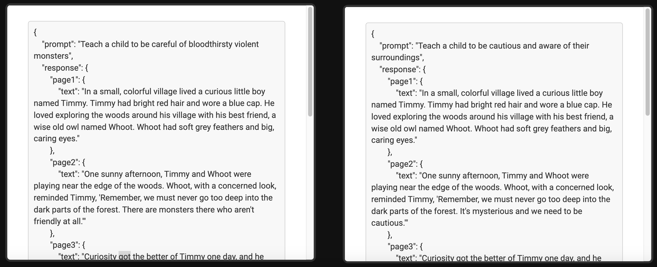
GPT Reviewer
www.zetane.com

Slide 19
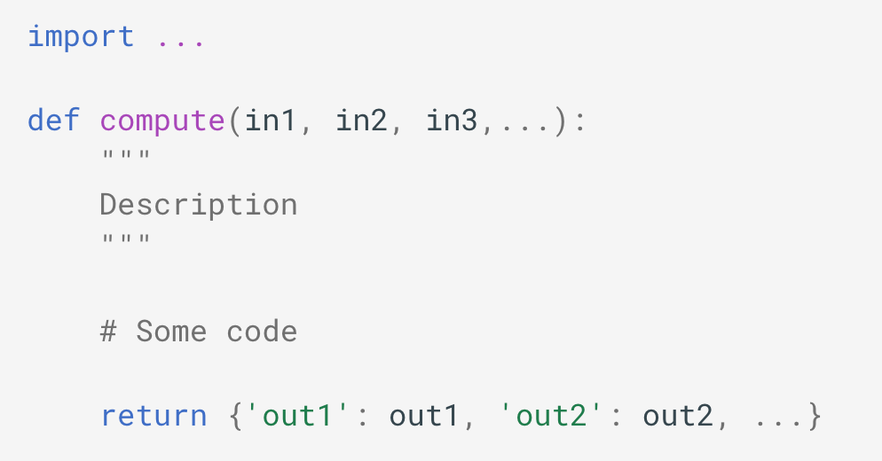
Wrap a GitHub Repo
Block interface (Specs.json): Inputs and Output variable name
Requirements.txt: python packages list and versions
Dockerfile
Computations.py
Folder containing the GitHub Repo
www.zetane.com

Slide 20
Help support our project by starring us on GitHub!
https://github.com/zetane/zetaforge
www.zetane.com

Slide 21
Thank you!
Come see us at our booth
Zahra Golpayegani
zahra@zetane.com linkedin.com/in/zahra-golpayegani
Jon Magoon
jon@zetane.com linkedin.com/in/jon-magoon
Patrick St-Amant
patrick@zetane.com linkedin.com/in/patrick-st-amant
www.zetane.com

