Slide 1
Generative AI – LLMs Applications in Mining Industry
  World Summit AI Americas 2024

Slide 2
Cautionary and supporting statements
This presentation has been prepared by Rio Tinto plc and Rio Tinto Limited (together with their subsidiaries, “Rio Tinto”). By accessing/attending this presentation you acknowledge that you have read and understood the following statements.
Forward-looking statements
This presentation includes “forward-looking statements” within the meaning of the Private Securities Litigation Reform Act of 1995. All statements other than statements of historical facts included in this report, including, without limitation, those regarding Rio Tinto’s financial position, business strategy, plans and objectives of management for future operations (including development plans and objectives relating to Rio Tinto’s products, production forecasts and reserve and resource positions), are forward-looking statements. The words “intend”, “aim”, “project”, “anticipate”, “estimate”, “plan”, “believes”, “expects”, “may”, “should”, “will”, “target”, “set to” or similar expressions, commonly identify such forward-looking statements.
Such forward-looking statements involve known and unknown risks, uncertainties and other factors which may cause the actual results, performance or achievements of Rio Tinto, or industry results, to be materially different from any future results, performance or achievements expressed or implied by such forward-looking statements, particularly in light of the current economic climate and the significant volatility, uncertainty and disruption arising in connection with the Ukraine conflict. Such forward-looking statements are based on numerous assumptions regarding Rio Tinto’s present and future business strategies and the environment in which Rio Tinto will operate in the future. Among the important factors that could cause Rio Tinto’s actual results, performance or achievements to differ materially from those in the forward-looking statements include, but are not limited to: an inability to live up to Rio Tinto’s values and any resultant damage to its reputation; the impacts of geopolitics on trade and investment; the impacts of climate change and the transition to a low-carbon future; an inability to successfully execute and/or realise value from acquisitions and divestments; the level of new ore resources, including the results of exploration programmes and/or acquisitions; disruption to strategic partnerships that play a material role in delivering growth, production, cash or market positioning; damage to Rio Tinto’s relationships with communities and governments; an inability to attract and retain requisite skilled people; declines in commodity prices and adverse exchange rate movements; an inability to raise sufficient funds for capital investment; inadequate estimates of ore resources and reserves; delays or overruns of large and complex projects; changes in tax regulation; safety incidents or major hazard events; cyber breaches; physical impacts from climate change; the impacts of water scarcity; natural disasters; an inability to successfully manage the closure, reclamation and rehabilitation of sites; the impacts of civil unrest; the impacts of the Ukraine conflict; breaches of Rio Tinto’s policies, standard and procedures, laws or regulations; trade tensions between the world’s major economies; increasing societal and investor expectations, in particular with regard to environmental, social and governance considerations; the impacts of technological advancements; and such other risks identified in Rio Tinto’s most recent Annual Report and accounts in Australia and the United Kingdom and the most recent Annual Report on Form 20-F filed with the United States Securities and Exchange Commission (the “SEC”) or Form 6-Ks furnished to, or filed with, the SEC. Forward-looking statements should, therefore, be construed in light of such risk factors and undue reliance should not be placed on forward-looking statements. These forward-looking statements speak only as of the date of this report. Rio Tinto expressly disclaims any obligation or undertaking (except as required by applicable law, the UK Listing Rules, the Disclosure Guidance and Transparency Rules of the Financial Conduct Authority and the Listing Rules of the Australian Securities Exchange) to release publicly any updates or revisions to any forward-looking statement contained herein to reflect any change in Rio Tinto’s expectations with regard thereto or any change in events, conditions or circumstances on which any such statement is based.
Nothing in this presentation should be interpreted to mean that future earnings per share of Rio Tinto plc or Rio Tinto Limited will necessarily match or exceed its historical published earnings per share. Past performance cannot be relied on as a guide to future performance.
Disclaimer
Neither this presentation, nor the question and answer session, nor any part thereof, may be recorded, transcribed, distributed, published or reproduced in any form, except as permitted by Rio Tinto. By accessing/ attending this presentation, you agree with the foregoing and, upon request, you will promptly return any records or transcripts at the presentation without retaining any copies.
This presentation contains a number of non-IFRS financial measures. Rio Tinto management considers these to be key financial performance indicators of the business and they are defined and/or reconciled in Rio Tinto’s annual results press release, Annual Report and accounts in Australia and the United Kingdom and/or the most recent Annual Report on Form 20-F filed with the SEC or Form 6-Ks furnished to, or filed with,
the SEC.
Reference to consensus figures are not based on Rio Tinto’s own opinions, estimates or forecasts and are compiled and published without comment from, or endorsement or verification by, Rio Tinto. The consensus figures do not necessarily reflect guidance provided from time to time by Rio Tinto where given in relation to equivalent metrics, which to the extent available can be found on the Rio Tinto website.
By referencing consensus figures, Rio Tinto does not imply that it endorses, confirms or expresses a view on the consensus figures. The consensus figures are provided for informational purposes only and are not intended to, nor do they, constitute investment advice or any solicitation to buy, hold or sell securities or other financial instruments. No warranty or representation, either express or implied, is made by Rio Tinto or its affiliates, or their respective directors, officers and employees, in relation to the accuracy, completeness or achievability of the consensus figures and, to the fullest extent permitted by law, no responsibility or liability is accepted by any of those persons in respect of those matters. Rio Tinto assumes no obligation to update, revise or supplement the consensus figures to reflect circumstances existing after the date hereof.

Slide 3
Generative AI
Who we are?
  What is Generative AI?
  Enabling Generative AI in Rio Tinto
  Our success in developing Generative AI products
  Illustrating our use cases
        Sharing our key learnings

Slide 4
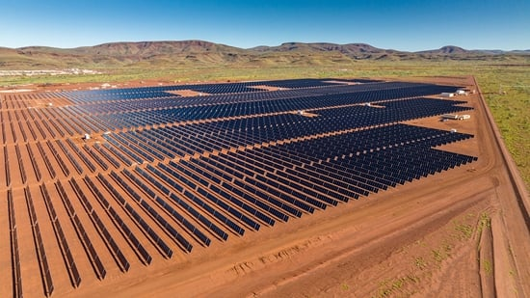


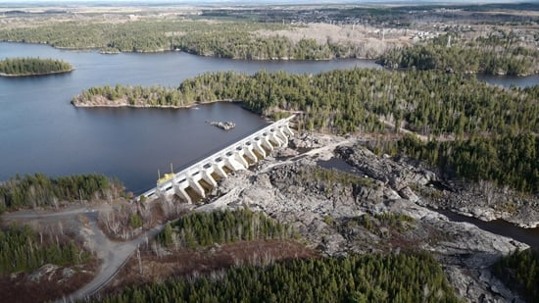


Rio Tinto: Who we are?
What do we do?
Rio Tinto is a leading global mining group that focuses on finding, mining, and processing the earth's mineral resources
Our Values
Care: for people, for the communities in which we operate and for our environment
Courage: to try new things, speak up and do what’s right
Curiosity: to collaborate, learn and innovate
Innovation at the heart of what we do
Artificial intelligence
Automation
Smart mining
Zero emission

Slide 5





What is Generative AI?
Text Generation
Automate text content creation: language translation, marketing, chatbot support, personalized e-commerce suggestions, creative writing enhancement, medical/legal report assistance, artistic inspiration, and news article creation etc.
Visual Generation
Diverse applications, including creating art, transforming images, generating human faces, aiding medical imaging, designing products, enhancing video game environments
Audio Generation
Create sound and music using algorithms, finding applications in music, media, and communication by producing realistic audio and even simulating entire auditory environments
Generative
Code Generation
Streamline coding tasks, offers suggestions for software development, aids in debugging, and provides language-specific code snippets, boosting efficiency and productivity in programming

Slide 6




Enabling Generative AI in Rio Tinto Safely and Sustainably
Enterprise enablement within Rio Tinto environment
Understanding and managing cost, privacy, security and legal challenges
Development of solution architecture
Partnering on standards & communication
Partnering on use case development
Facilitating understanding and identification of use case opportunities (considering options for internal build, co-pilots, plug-ins)
Collaborative Discovery & Proof-of-Concepts
Enablement
Use Case Engagement
Technical Discovery
Reusability & Scalability
Dedicated team on technical discovery
Assessment of different platforms and tools
Determining strengths, limitations and risks
Iterating from internal use case learnings
Building the community and playbook
Facilitating community sessions on updates, capability and hackathons
Building playbook of guidelines and re-usable components

Slide 7






Co-commitments & Iterative Process for Generative AI Product Success
Cross-functional Collaboration
Through Iterative Process
Technical
AI expertise
Data Foundations & Architecture
An agile product mindset will ensure the vision, structure and support will be available to create a successful AI solution
Identify sources of data and prepare environment in collaboration with Business Data Owners, Data Engineers, Cloud Architects
Mathematics & Statistics
Information Technology
Start small with a Minimum Viable Product (MVP) and improve continuously
Artificial
Intelligence
Have a Product Vision (your North Star) but be iterative and flexible, at ease with uncertainty
Subject matter knowledge
Incorporate End-users feedback early on to create value & usefulness
Domain
Knowledge
Map processes, build & validate AI model hypothesis with Subject Matter Experts to improve performance and build trust
Create and test the ideal product with product owner and end users to increase adoption and value

Slide 8




Rio Tinto Use Cases of Generative AI
Value
Generic Content
Query
Specific Content
Query
Advanced Analytics
Query
Knowledge Graph
Query
Business Outcome:
Increase Rio Tinto personal productivity under Enterprise Microsoft 365
Business Outcome:
Accelerate document reading in a limited amount of time to allow users to focus on key areas of conversation
Business Outcome:
Explore a variety of unstructured data sources and analyze the data using human language
Business Outcome:
Summarize quickly and accurately historic documents to help users to make quick decision
Technical Features:
Content summarization
Content generation
Search and citation
Data visualization
Technical Features:
Perform narrow-scope question-answering
Cite resources and highlight the relevant text
Technical Features:
Query the underlying database using natural language
Chatbot with analytics and operation agent
Technical Features:
Hierarchical information tree filling
Mineral report generation
Question answering on reports
Mapping the Evolving Landscape of Use Case Complexity and Value at Rio Tinto

Slide 9






Key Lessons Learned in Developing Generative AI Products
Heavy Domain Expert Involvement
Incorporate a complex end-to-end workflow that necessitates heavy involvement with SMEs (Subject Matter Experts) for validation, especially in scenarios lacking clear ground truths. This ensures that the workflow is robust and well-informed by expert knowledge.
Reusability and Agile Approaches
Highlight the significance of reusability in accelerating deliverables and the benefits of adopting an agile approach, such as starting small and moving fast. This point emphasizes the need for efficient product management and the ability to scale efforts effectively.
Collaboration and Technological Evolution Continued investment in managing, maintaining, and improving our source data will drive higher returns on our developed AI products.
Generative AI for Stakeholder Engagement
Given the growing interest in Generative AI and its capacity for interactive and impressive results, showcasing these capabilities to stakeholders would be an excellent starting point for the entire analytics engagement journey.
Education and Upskilling
Focus on educating and upskilling end-users to enhance their comfort and understanding of indeterministic results, which are common in advanced technological applications. This education will help in managing expectations and improving user interaction with the technology.
Stakeholder Expectation Management
Address the need for new infrastructure and team dynamics to support generative AI products, while also managing stakeholder expectations through clear communication about the scope and potential outcomes of the technology.

