Slide 1
GenAI: Applications in Insurance Industry
April 2024
Sushma Niwalkar, Senior Director, AI/ML Strategy
Northwestern Mutual
Northwestern Mutual is the marketing name for The Northwestern Mutual Life Insurance Company (NM) and its subsidiaries in Milwaukee, WI.

Slide 2
PEOPLE BECOMING EXPERTS IN AI

Slide 3
“The world is moving so fast these days that
the man who says it can't be done is generally
interrupted by someone doing it.“
– Elbert Hubbard

Slide 4
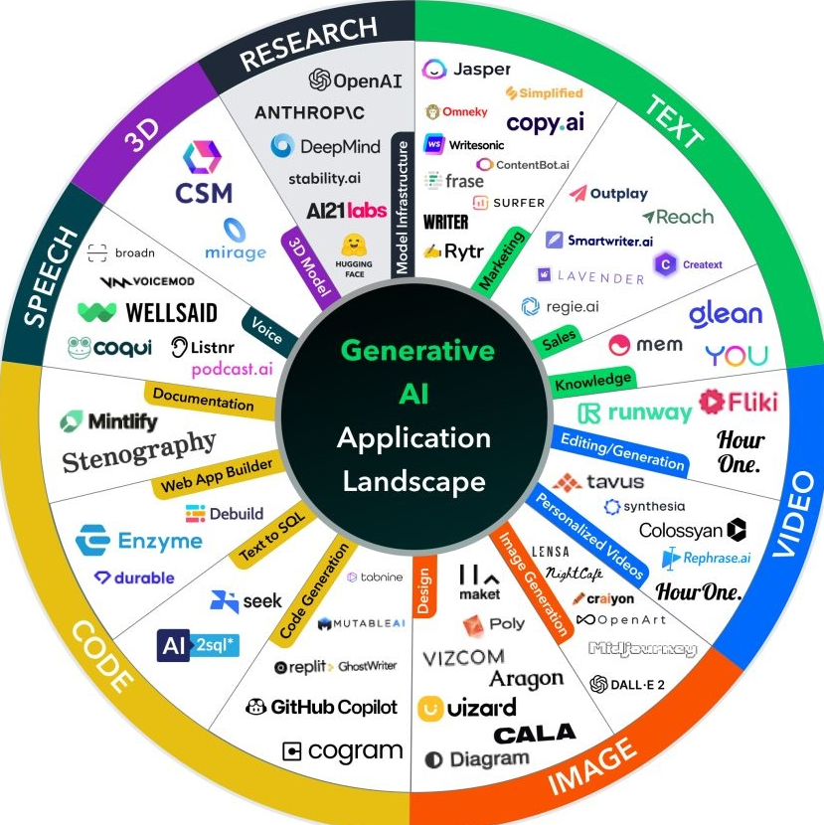
Generative AI can be overwhelming…
+$6-8
Trillion
Annually
The deluge of entrants
The estimated impact to global economy¹
The ethical responsibilities
¹ McKinsey & Company. “The economic potential of generative AI: The next productivity frontier” June 2023

Slide 5
As GenAI impacts all aspects of society, it is also impacting the insurance business
INCREMENTAL
TRANSFORMATIONAL
Productivity
Experience
Decision Making
Mortality / Morbidity
“I can quickly create new functionality in a third of the time with pair-programming capabilities.”
- Technical Engineer
“I received the perfect plan, for my unique needs, and I was able to act on those recommendations the same day.”
- New Prospect
“I was underwritten immediately – Wow! The products were easy to understand, with the right suite of options.”
- Busy client
“I’m healthy and worked into my 70s, but I still look forward to a long, active retirement”
- Client with 120-year life expectancy
For illustrative purposes. Not based on actual testimonials.

Slide 6
Northwestern Mutual is leveraging GenAI across the enterprise to transform the customer experience
INCREMENTAL
TRANSFORMATIONAL
Now (2024) Build Foundation and Learn | Near (2025) Augment Everything, Build Differentiators | Next (2025+) Evolve Business Model
Proprietary GPTs for Customer Service & Field Advisors | Productivity Tools | Personalized AI-guided Planning
We’re prioritizing Service & Operations, Advisor Planning and Workforce Effectiveness

Slide 7
To coordinate and standardize GenAI development, an AI Council was created to oversee this cross-functional effort
AI Council
Technical Capabilities
Organizational Capabilities
Data Architecture
Build and deploy industrialized pipelines to enable rapid iterative GenAI capabilities.
Technology
Create a scalable tech stack and infrastructure to support multiple GenAI use cases.
Experimentation
Continuously exploring to stay ahead of trends and prepare for a faster pace of change.
Risk & Governance
Manage regulatory, legal and ethical considerations and adhere to company standards.
Change Management
Drive user adoption of GenAI solutions with an effective enterprise change strategy.
Talent Ecosystem
Develop training, upskilling and ongoing employee support while hiring new talent.
These teams work together to expand internal expertise, meet evolving ethical considerations, evolve data infrastructure and prioritize experiments that position Northwestern Mutual for future changes.
7

Slide 8
What have we learned?

Slide 9
Technical Capabilities
Data Architecture
Technology
Experimentation
Need for rapid iteration across the GenAI lifecycle
Industrialized Pipelines
Microservices
Decision fatigue develops from constant technology evolution: Data labelling, LLMs, Vector databases, UI
Know your token costs!
Human-in-loop feedback is critical
Continuous fine tuning and reinforcement learning
Organizational Capabilities
Risk & Governance
Change Management
Talent Ecosystem
Cross Functional partnerships to develop fail proof systems and processes.
Steady state requires long-term business commitment
Don’t underestimate the time and resources needed
Need for skilling across functions and hierarchy
Intellectual curiosity paramount to embrace change

Slide 10
10 Key Takeaways
Business commitment is fundamental to the success of all AI adoption and deployments
Executive buy-in has accelerated Northwestern Mutual's path to success with AI
Gen AI is still data centric: Content quality, meta data enrichment is critical
Cross Functional Collaboration and execution across business, data, technology, operations & risk
Data Architecture – Microservices, Infrastructure as Code across the life cycle
Technology – Trusted partnerships, incremental value, know your token costs
Experimentation – Organized, Flexible and Controlled for Rapid Prototyping
Comprehensive Risk and Governance Approach
Successful AI deployment requires robust change management techniques
Active focus on training, upskilling and leadership education across the enterprise

Slide 11
Questions?
Photo or graphic
Photo by Lindsay Heywood

Slide 12
Thank you!
Northwestern Mutual is the marketing name for The Northwestern Mutual Life Insurance Company (NM) and its subsidiaries in Milwaukee, WI.

