Slide 1
ADD COVER PAGE FROM WORLD AI SUMMIT

Slide 2
Let’s connect on LinkedIN
Notes:
Good evening everyone
I am absolutely delighted to be with you today. What a great way to meet with all of you from the BR and AR leadership team for the first time.
I think I met all of you but to formally introduce myself I am Sebastien Rozanes. I joined Carrefour back in April as Global Chief Data & Analytics based out of Paris HQ… but expect to see me in our markets since this is where the true value in my world of data & analytics can be generated. I am here today to introduce you to Data Analytics at Carrefour
Let me tell you a bit more about ourwill tell you about my role in a couple of minutes so that you uncover what you can expect from me but first a bit about myself
I joined Carrefour in April t
Finally, to conclude, as a Computer Engieneer by training, I am also a truly personally passionate about all things tech and data driven. I hope I will be be able to communicate this passion to your teams … hence why I could not be happier to be in this role

Slide 3
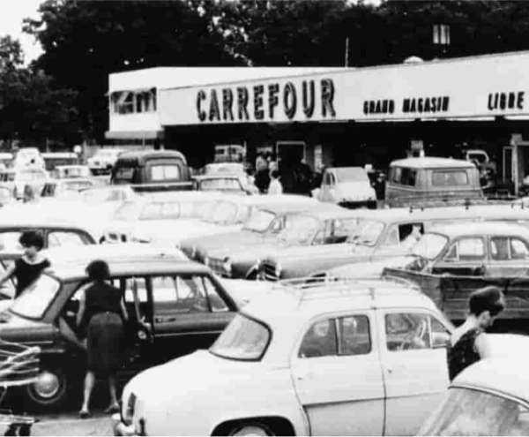
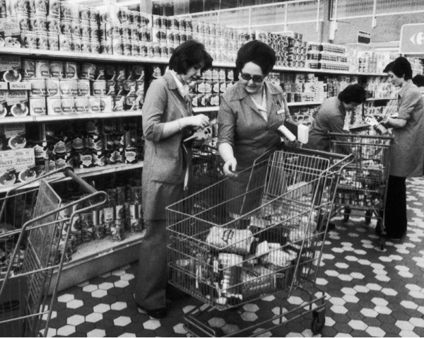
Carrefour was born from an aspiration in the early 60s…
… find all products “under the same roof”
Notes:
Your responsibility in the simplest terms is to make the best of our data gold mine, a totally unique asset of Carrefour, and guide your teams in getting all of the value out of the gold mine. But what is exactly Carrefour’s gold mine? (next page)

Slide 4
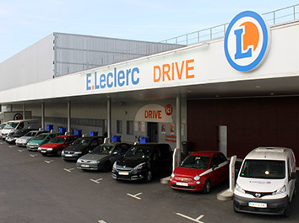
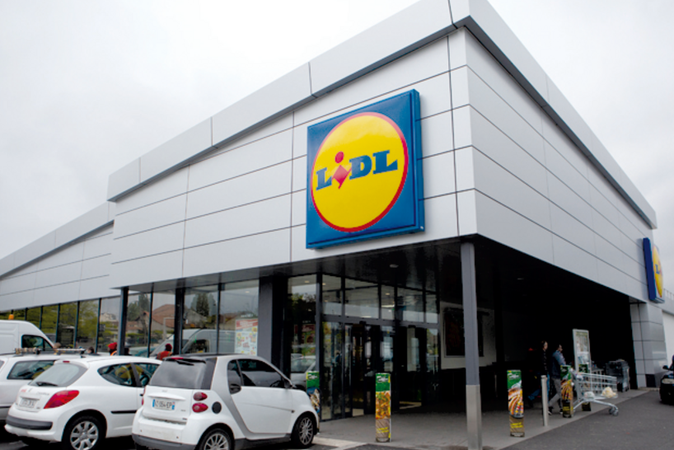
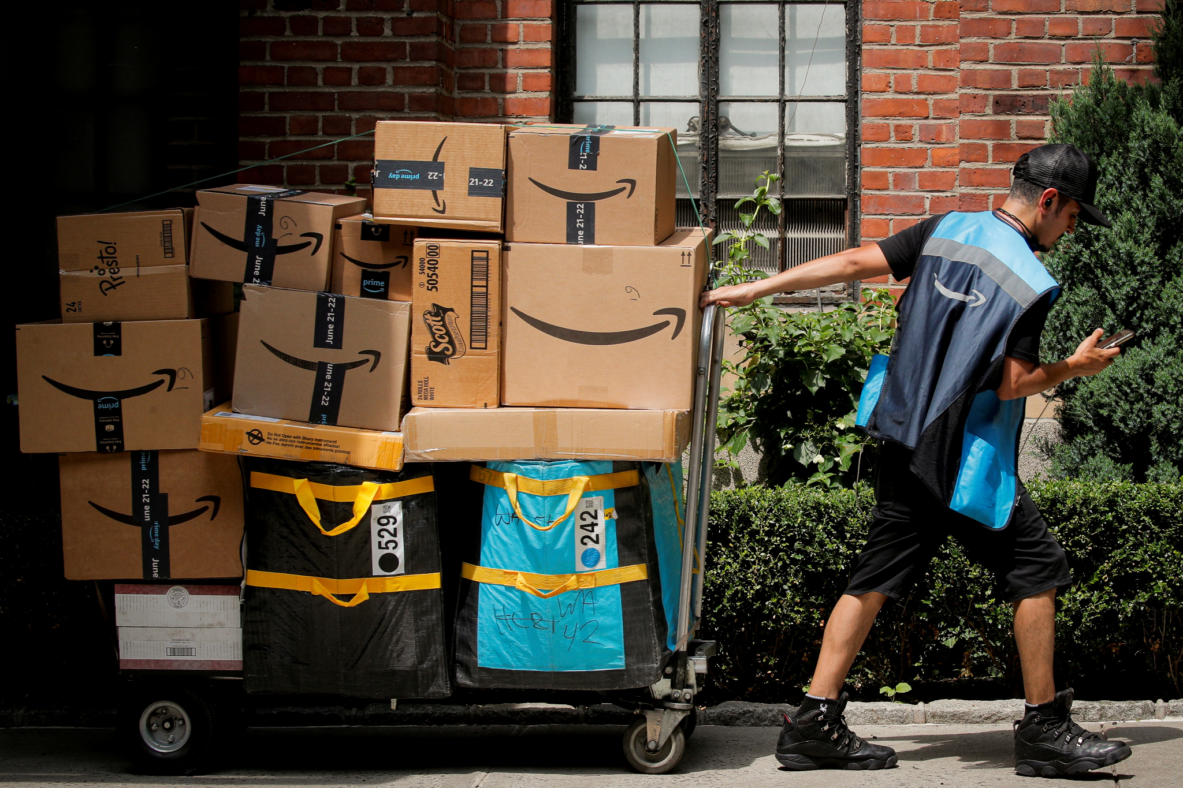
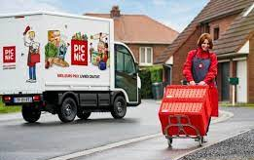
However, grocery retail has evolved a lot since then…
… which pushed us to reinvent ourselves
Notes:
Your responsibility in the simplest terms is to make the best of our data gold mine, a totally unique asset of Carrefour, and guide your teams in getting all of the value out of the gold mine. But what is exactly Carrefour’s gold mine? (next page)

Slide 5
Result : we are becoming a ”Digital Retail Company”
We are not the enterprise we used to be.
In 2026, Carrefour will be a “Digital Retail Company”
Alexandre Bompard
Digital Day, novembre 2021
Notes:
Your responsibility in the simplest terms is to make the best of our data gold mine, a totally unique asset of Carrefour, and guide your teams in getting all of the value out of the gold mine. But what is exactly Carrefour’s gold mine? (next page)

Slide 6
We are pursuing two opportunities to maximize the impact of data & AI
FOCUS TODAY
Data analytics Data for business
Leverage data to improve customer experience, operational processes and decision making
Data monetization Data as a business
Leverage data to better collaborate with brands & other retailers, developing a profitable business
Quick zoom

Slide 7
We tested the waters and created a full-blown “Data as a Business”... ramping up our AI capabilities beyond pure ‘data’
Mid-2023
Late 2022
Early 2022
Retail Media
- Unlimitail -
(Media monetization)
Category Management
(Operations)
Solutions
Data Shopper
(Negotiations)
Retail media digital and instore. Dissemination of targeted advertising to Carrefour customers
Data collaboration: assortment construction, category management, supply chain data exchange
Access to granular business dynamics data
Product

Slide 8
AI enables us to reinvent our business, at the service of our clients and internal staff
1
2
Personalize customer experience with AI
Simplify & improve our processes with AI
3
Reinvent our business with Gen AI

Slide 9
Personalize client experience with AI
Personalize client experience with AI
Simplify & improve our processes with AI
Reinvent our business with Gen AI

Slide 10
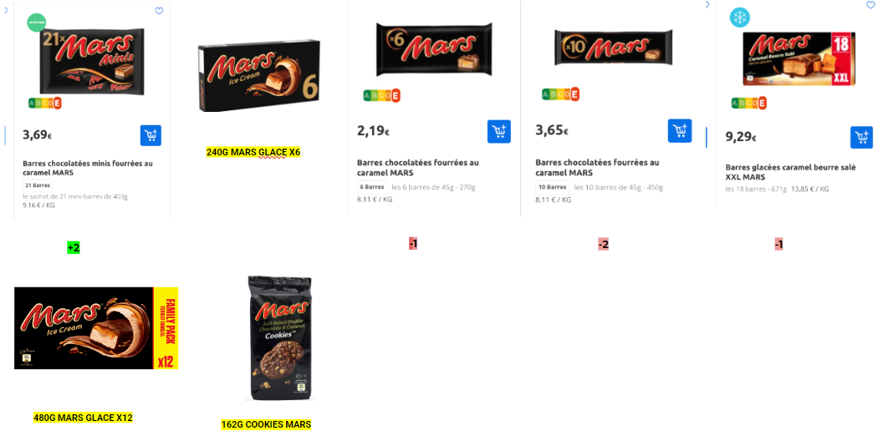
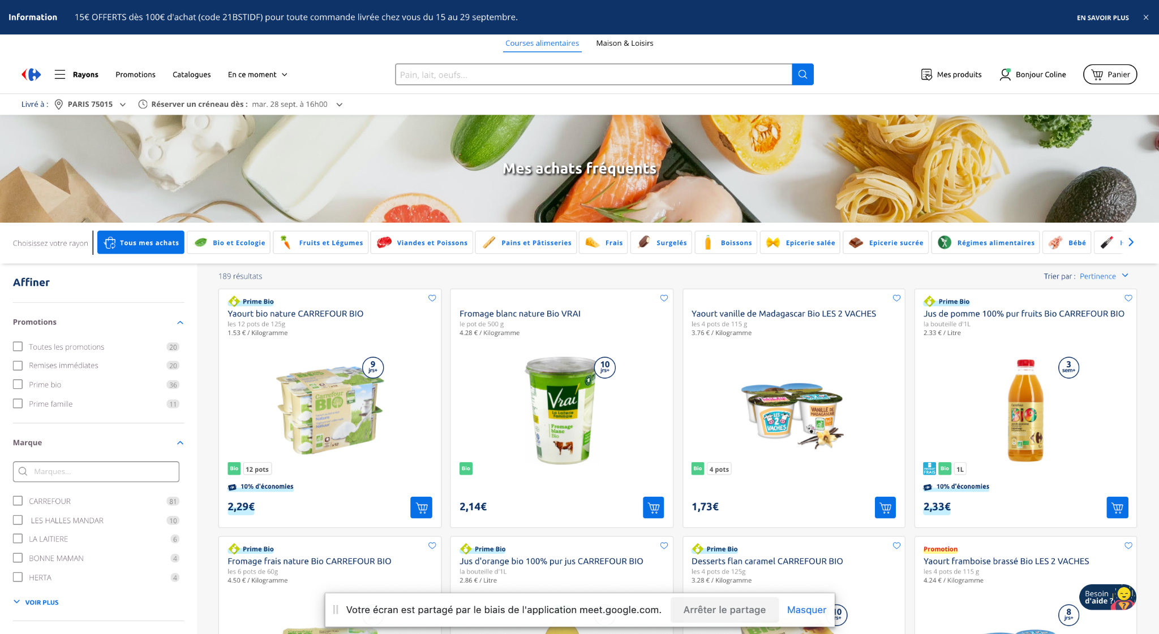
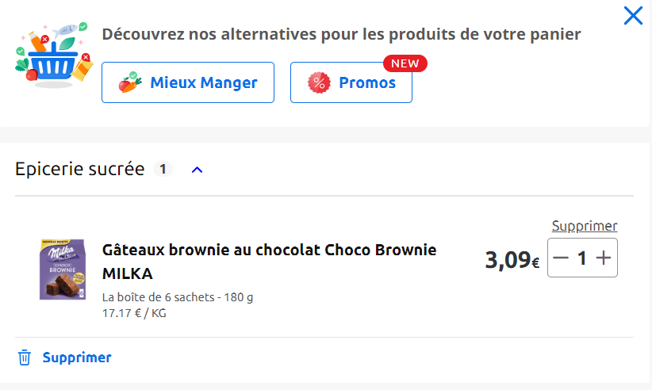
AI to improve our customers’ experience…
1
Customer experience
A
B
C
D
Personalize promotions
Personalize merchandising
Personalize product recommendations
Offer anti-inflation alternatives / eat better / promotions
Individualized promotions
(mechanics, discount rate, threshold) for 100% of drive and home delivery customers, according to their profile
Intelligent ranking of products on search pages based on their popularity with customers
15 product recommendation algorithms on the app and site
“Anti-inflation” or “Eat Better” button with less expensive alternatives or a better health score
32,7% on incremental sales
5,7 return on investment
+1,4 % basket size…
… meaning +1,65€ on each basket
~30M dproduct recos generated every day
2/3 of orders with at least one recommended product
35% of customers using the “anti-inflation” button purchase a product offered
32% of customers using the “Eat Better” button choose the alternative

Slide 11
Zoom - Personalized promo
1
A
Customer experience - Personalized promotion
A more effective & profitable promotional system
Impact
Activation on Danette yogurt for 15 days in July 2023
CRF Drive Desktop Visibility
Ultra customization of mechanics (immediate discount and gamified promotion)
Offer to 100% of drive and home delivery customers individualized promotions (mechanics, discount rate, threshold) according to the profile of each customer
Analysis of purchasing data
1 shopper = 1 persona
32,7% incremental sales
14% of clients captured
5,7 return on investment*
A reduced generosity rate (16% vs 33% on 2+1)
80+ criteria used in prediction algorithms
Individualization
promotions
*Incremental turnover/generosity

Slide 12
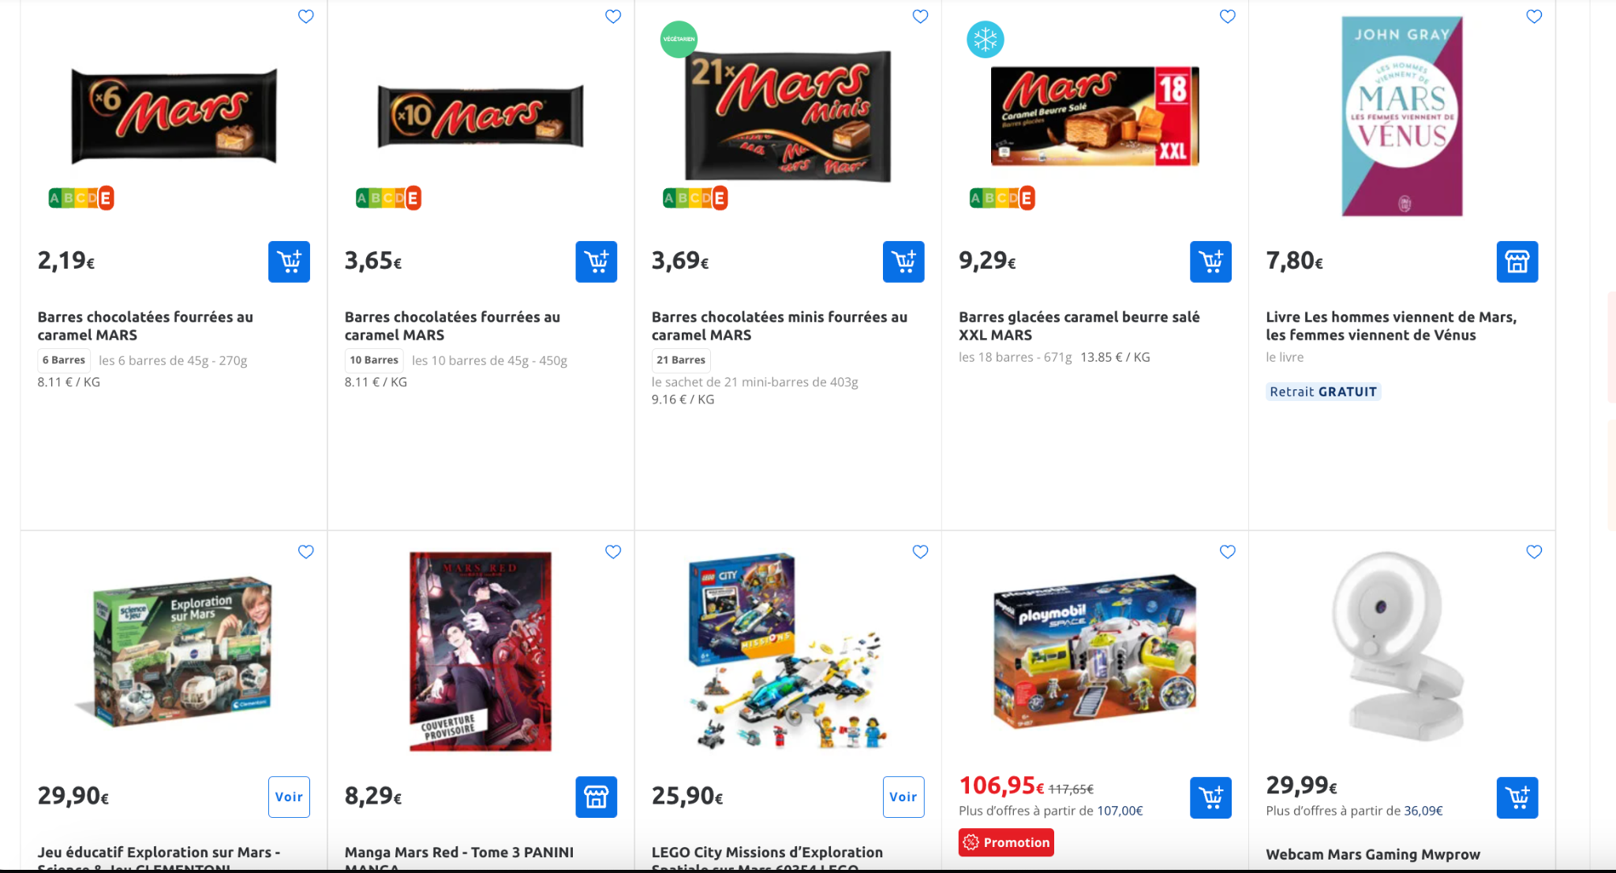
Zoom - Data-Driven Merchandising
1
B
Customer experience - Personalized merchandising
New display of products on the search page
Impact
Intelligent ranking of products on search pages based on their popularity with customers.
Optimization of the average basket with an improvement in the average position of products added to the basket without making navigation cumbersome (the user carries out the same number of searches to find their product)
To come: optimization of ranking on the shelves, taking into account the margin
+1,4% increase in the average basket, an increase of…
+1,65€ per basket
*CA incrémental/générosité

Slide 13
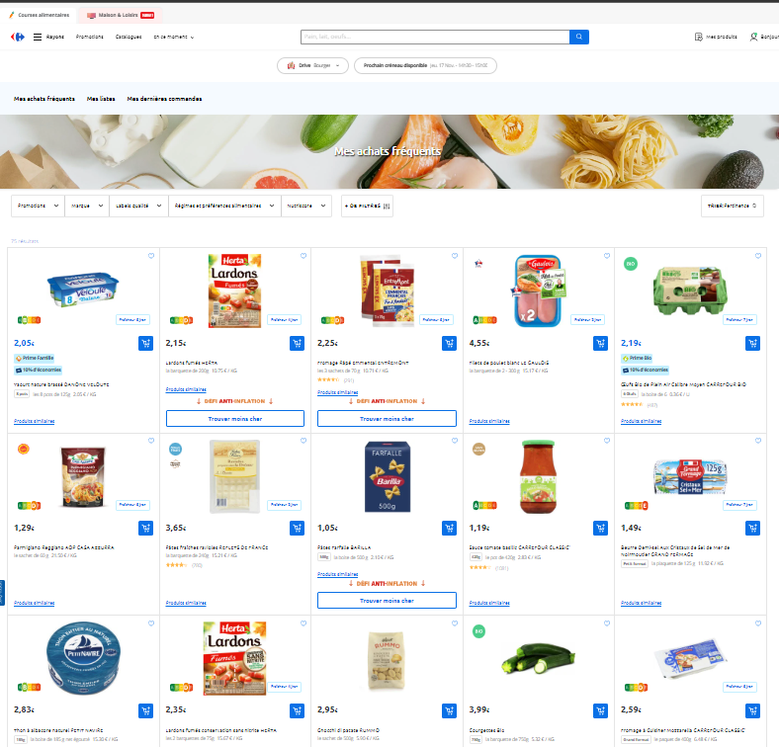
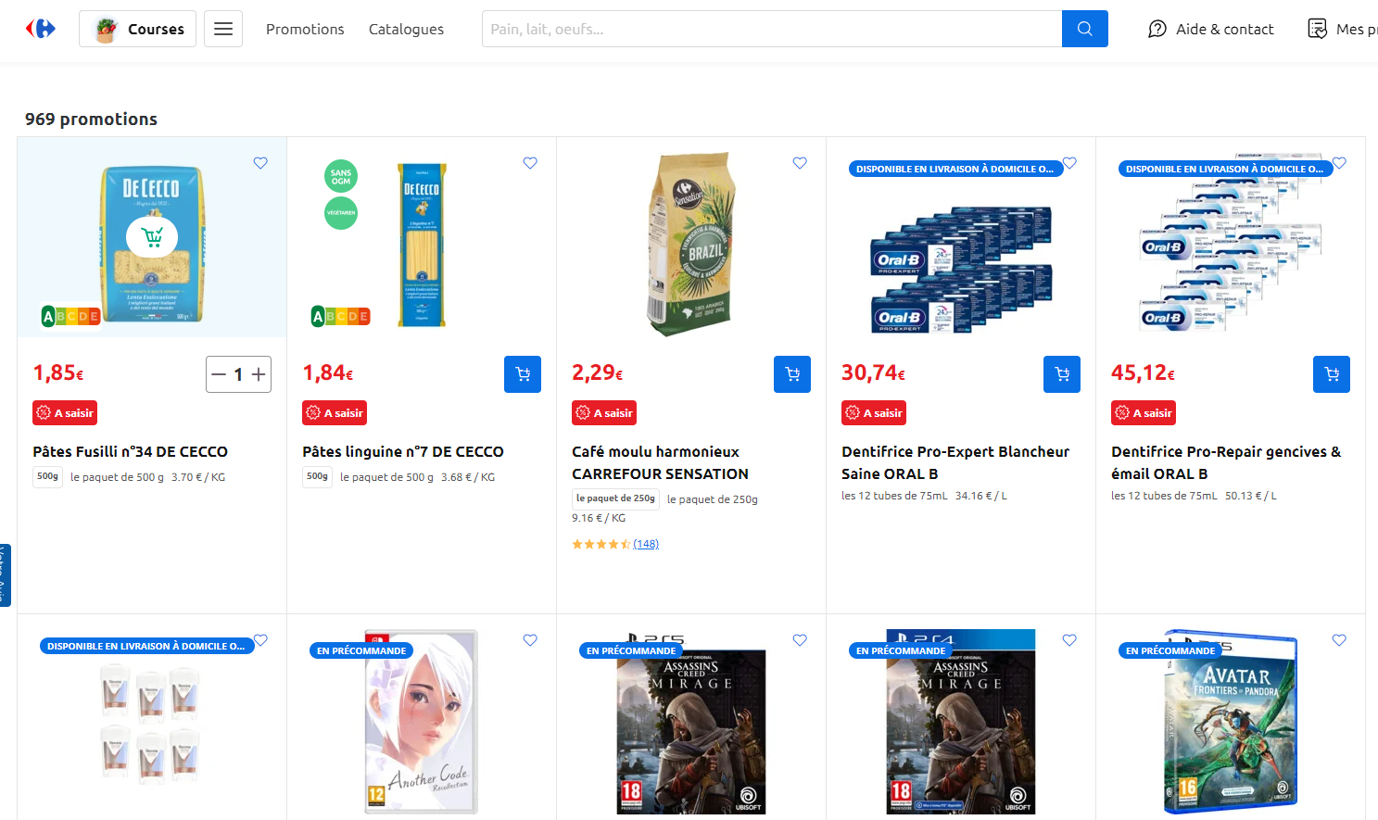
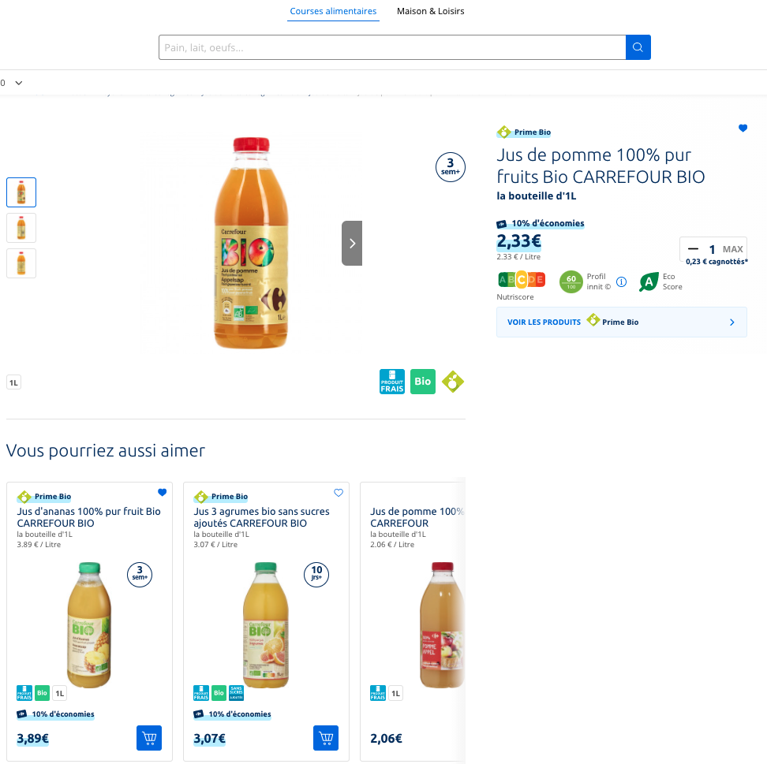
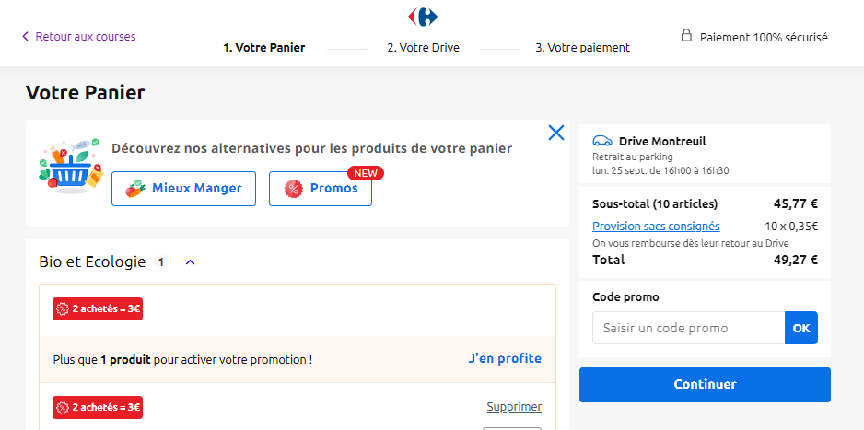
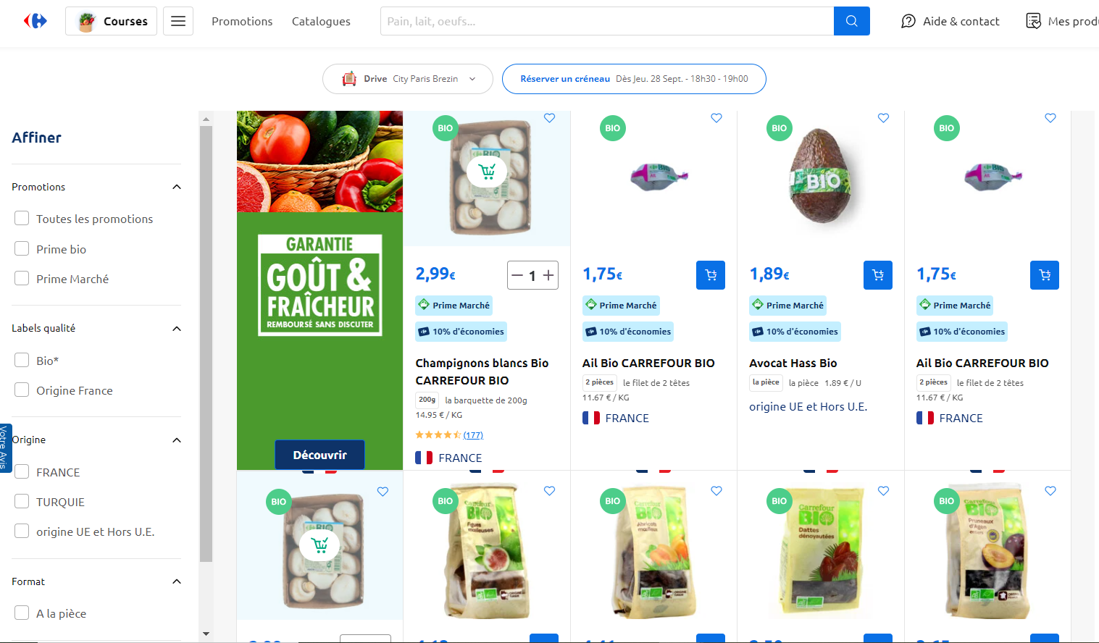
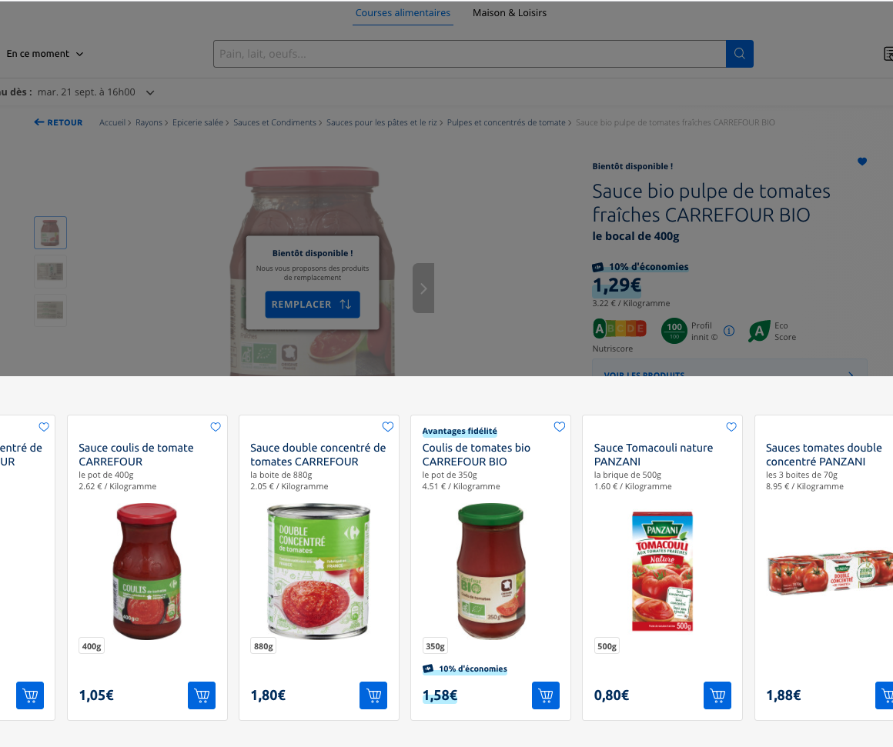
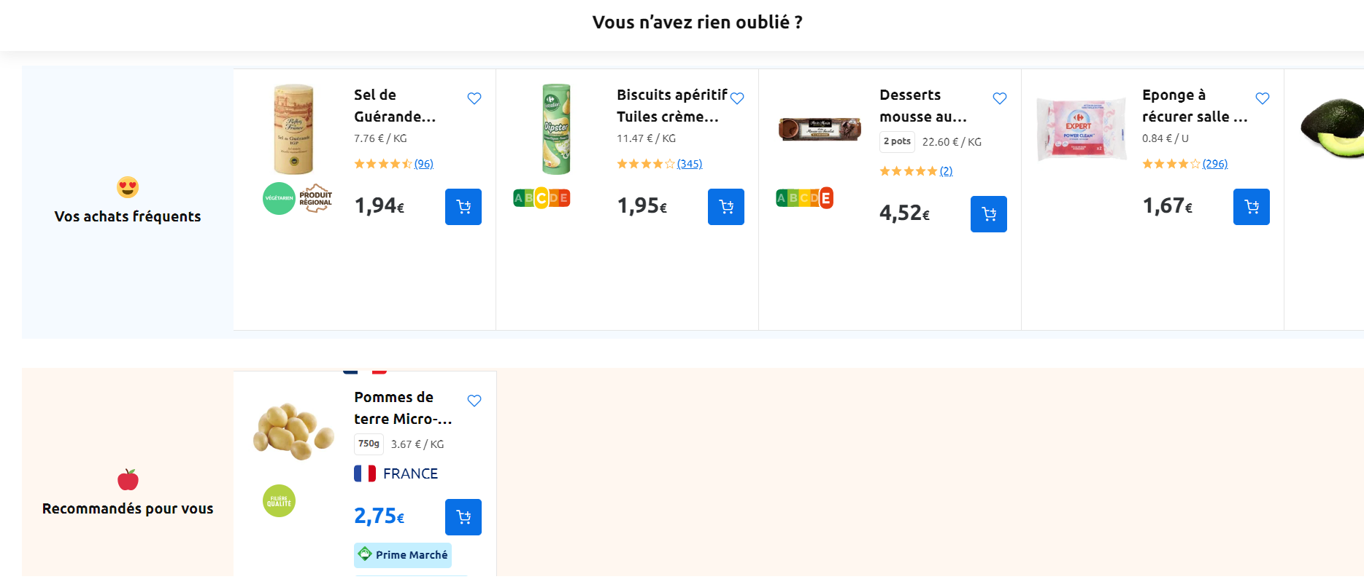
Nous positionnons nos recommandations tout au long du parcours client en ligne
We position our recommendations throughout the online customer journey
1
C
Customer Experience – Personalized Product Recommendations
Home page
Connexion
Product list page
Promo & availability
Product details page
Basket
My favorite products
My frequent purchases
Suggestion Search
Personal promotions
You might also like
Alternative basket: eat better
Our customers also purchased
Promos
Product substitution
Forgotten products
Bouton anti-inflation

Slide 14
Zoom - The “anti-inflation”, “eat better” and “promotions” buttons
1
D
Customer experience - anti-inflation alternatives / eat better / promotions
The “anti-inflation”, “eat better” and “promotions” buttons
Impact
The anti-inflation button allows us to suggest cheaper product alternatives to our consumers
35% of customers using the button purchase a product offered
The “Eat Better” alternative allows you to choose a product with a better nutri-score (health core in Europe)
32% of customers using this feature choose the alternative
The “Promo” choice allows you to find the equivalent product on sale
*CA incrémental/générosité

Slide 15
Simplify & improve our processes with AI
Personalize client experience with AI
Simplify & improve our processes with AI
Reinvent our business with Gen AI

Slide 16
AI to simplify and improve our internal processes
2
Internal processes
A
B
C
D
Automate and optimize our assortment
Automate fresh produce orders
Forecast the LTV of our customers
Forecast demand in our bakery departments
he assortment suite with 3 distinct AI solutions:
Assortment builder to optimize 60-70% of assortments
“Netflix of Assortment” to add/remove products to the assortment
Assortment localizer to reduce store assortments
Reduce manual PFT (traditional fresh product) orders and assist the manager in ordering:
Calculation of needs based on product characteristics and customer appetites
Assistance with purchasing decisions (e.g., deals with daily suppliers in 1 dashboard)
Improve/serve customer value from the first order:
Guide customer strategy
Identify the most relevant customer segments
Increase turnover/GMV
Reduce customer churn
Reduce waste in bakery equipping our staff with a powerful prediction engine:
Leverage Machine learning and years of experience stranded in data
Get positive impact on store P&L … and on the planet !
+19 pts reduction in churn on the Carrefour model
Equivalent of 5M croissants saved in 2023
~17 M PFT manual orders/year

Slide 17
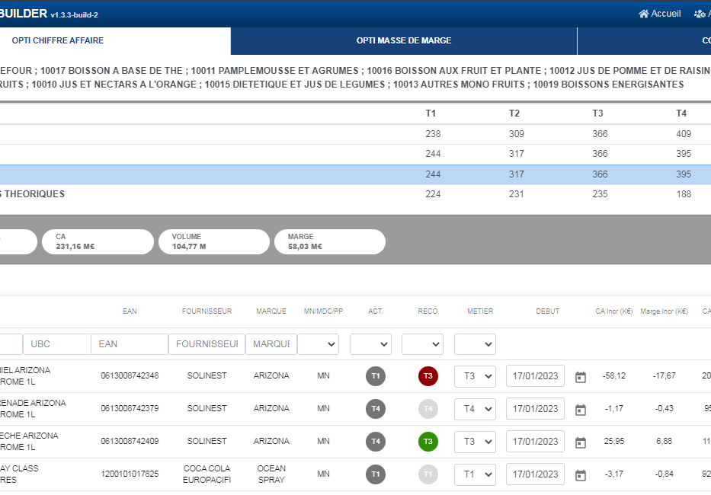
Zoom - Assortment Suite summary
2
A
Internal processes - Automate and optimize our assortment
Visual
Solutions
Impact
Assortment builder
Automatic optimization of 60-70% national FMCG assortments
-11% reduction in the HM/SM assortment in 2023 (-20% by 2026)
-50% reduction in headcount in the management category (enabler)
2,415 proxy stores equipped
+€58M in incremental turnover vs. 2022 (+1.4%)
83% of recommendations adopted
“Netflix of assortment”
Product recommendations to add/remove from the assortment for proxies and markets
Assortment localizer
Reduction of store assortments and reallocation of aisles by category

Slide 18
Reinvent our business with Gen AI
Personalize client experience with AI
Simplify & improve our processes with AI
Reinvent our business with Gen AI

Slide 19
How we got started on Gen AI: a pragmatic approach
3
GenAI - Methodology
Jan 2023
Identification & prioritization of high impact use cases with 25 execs
Rapid tests with partners: PoC / MVP en 6-7 semaines
Scaling of use cases with proven value

Slide 20
Critical to rapidly triage use cases, anchoring on a clear Gen AI strategy
3
GenAI - Methodology
GenAI everywhere
Competitive advantage with Gen AI
Reinvented functions end-to-end
Integration of GenAI into all internal company processes to increase productivity
e.g., smart workspace, meeting summary, email production
Improving the customer experience to create a sector competitive advantage
e.g., chatbot, personalized customer experience
Radical transformation of key functions thanks to GenAI
e.g., marketing, customer service, software development, network animation and HR
5% of effort
because it is commoditized in workspace tools (G-suite, Office365)
15% of effort
around a few chosen use cases
80% of effort
to gain efficiency

Slide 21
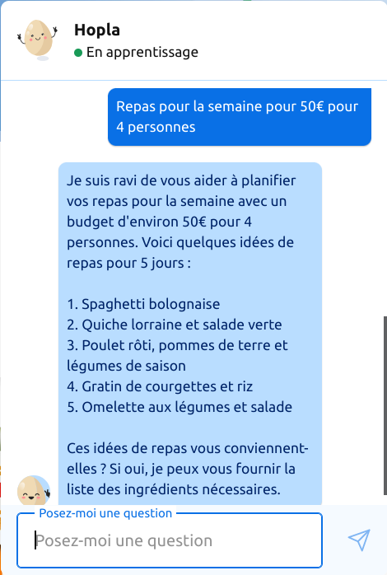
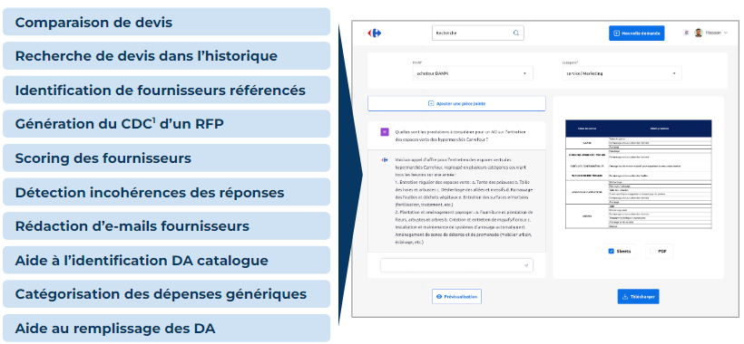
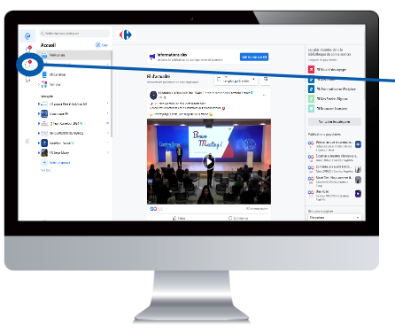
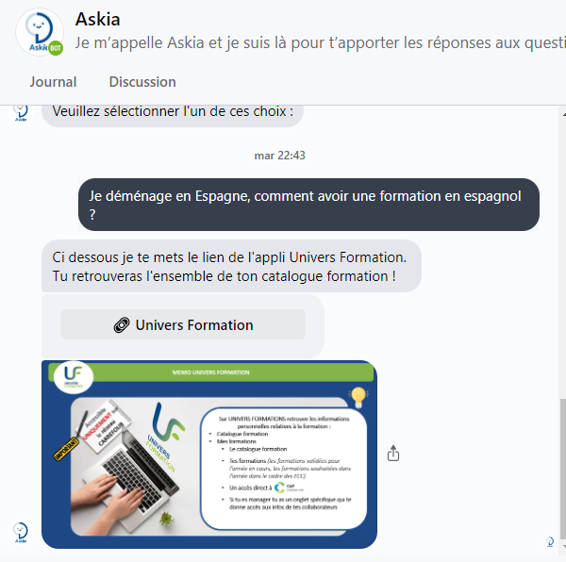
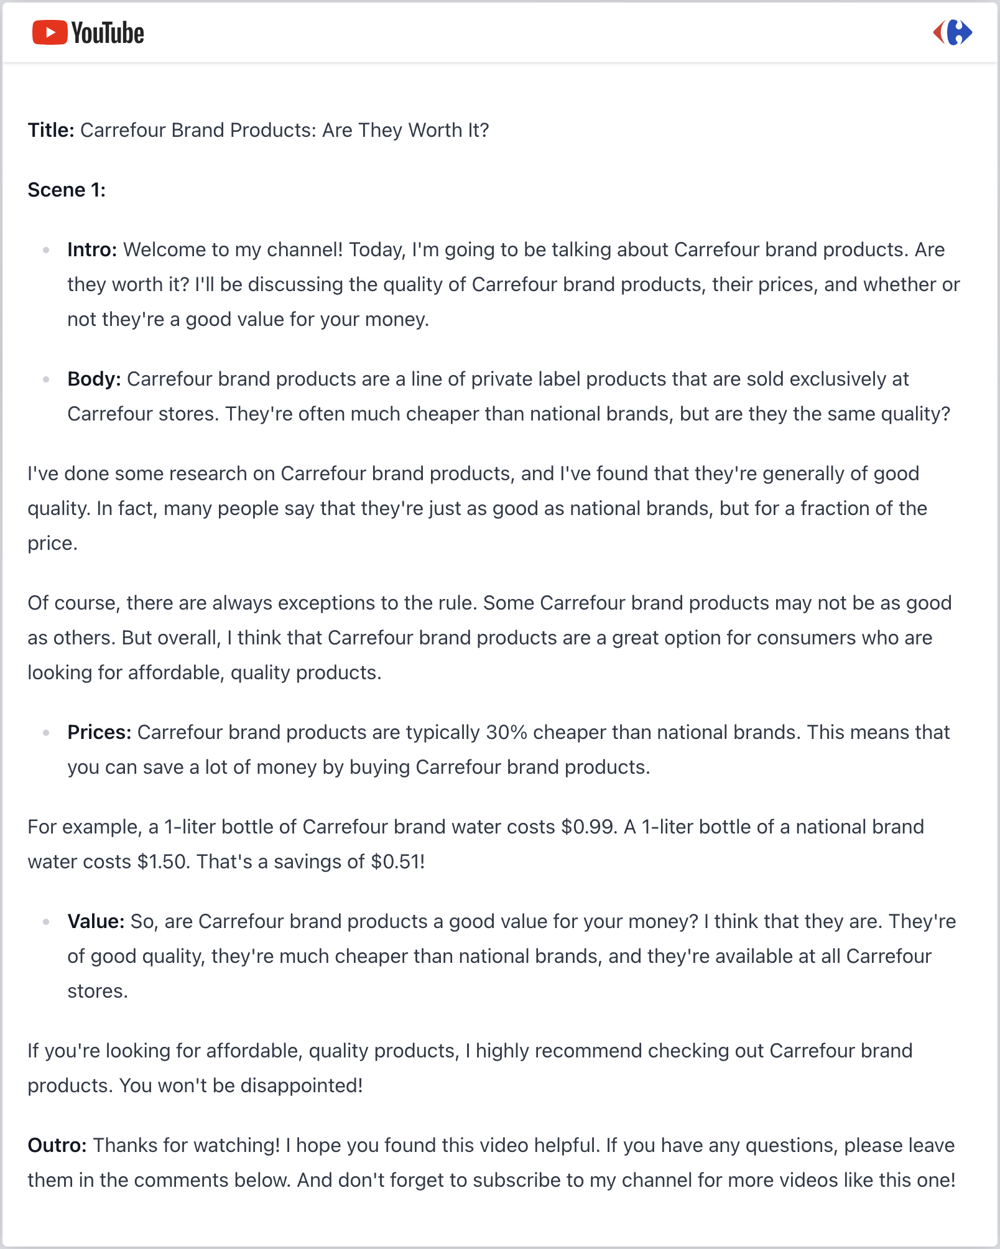
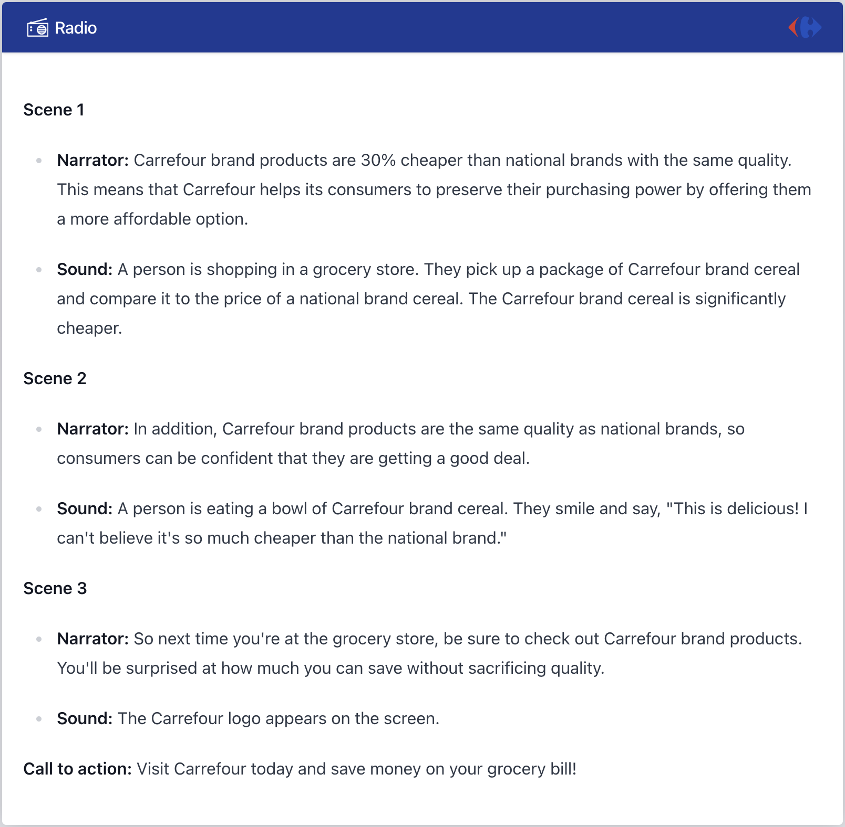
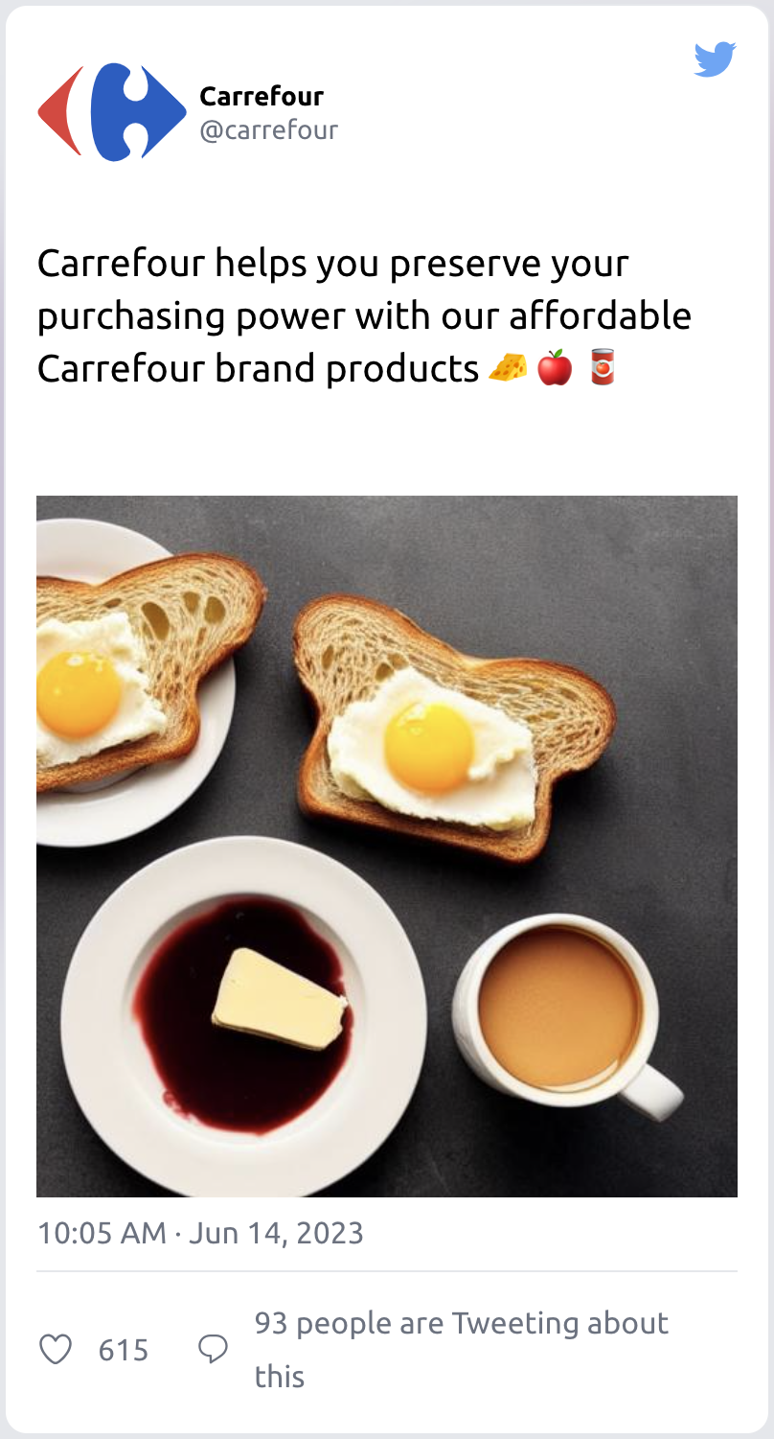
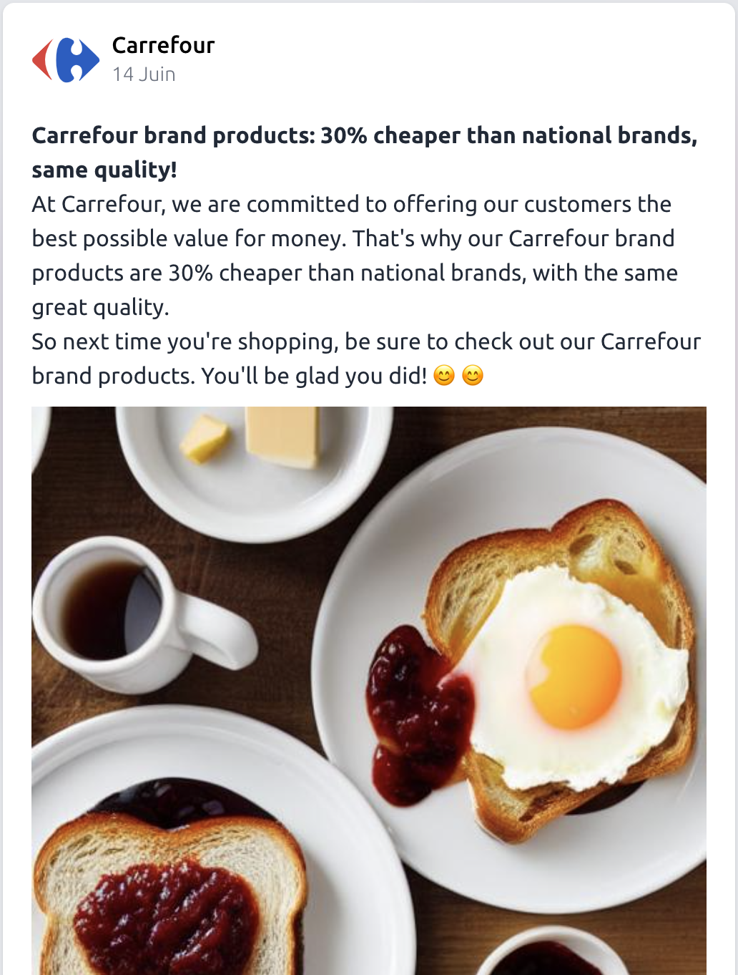
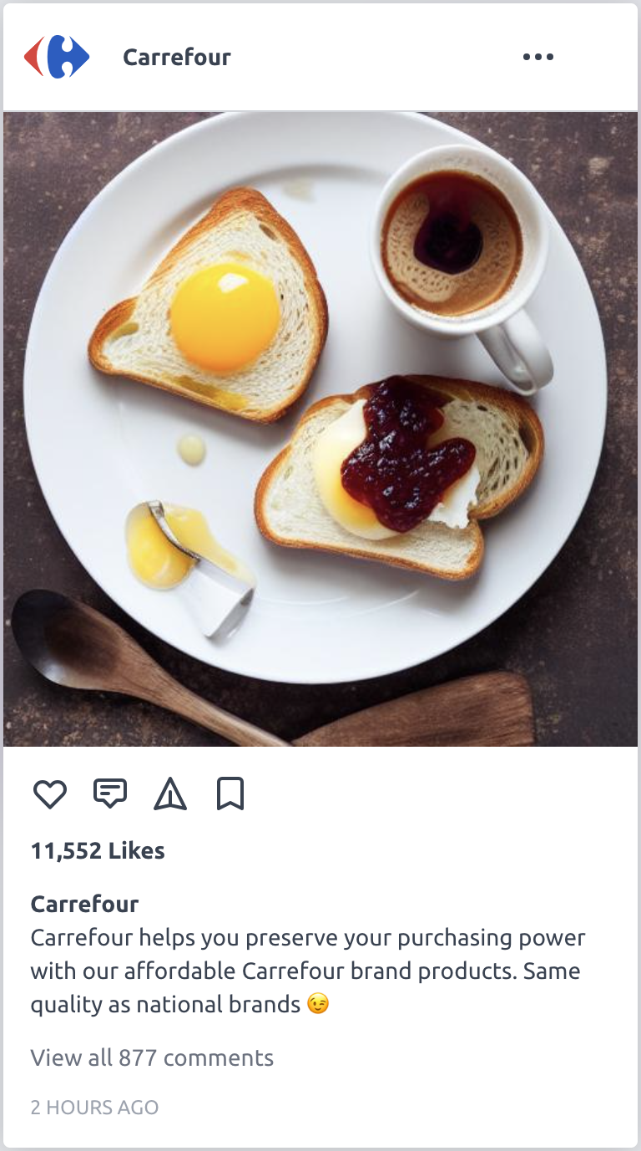
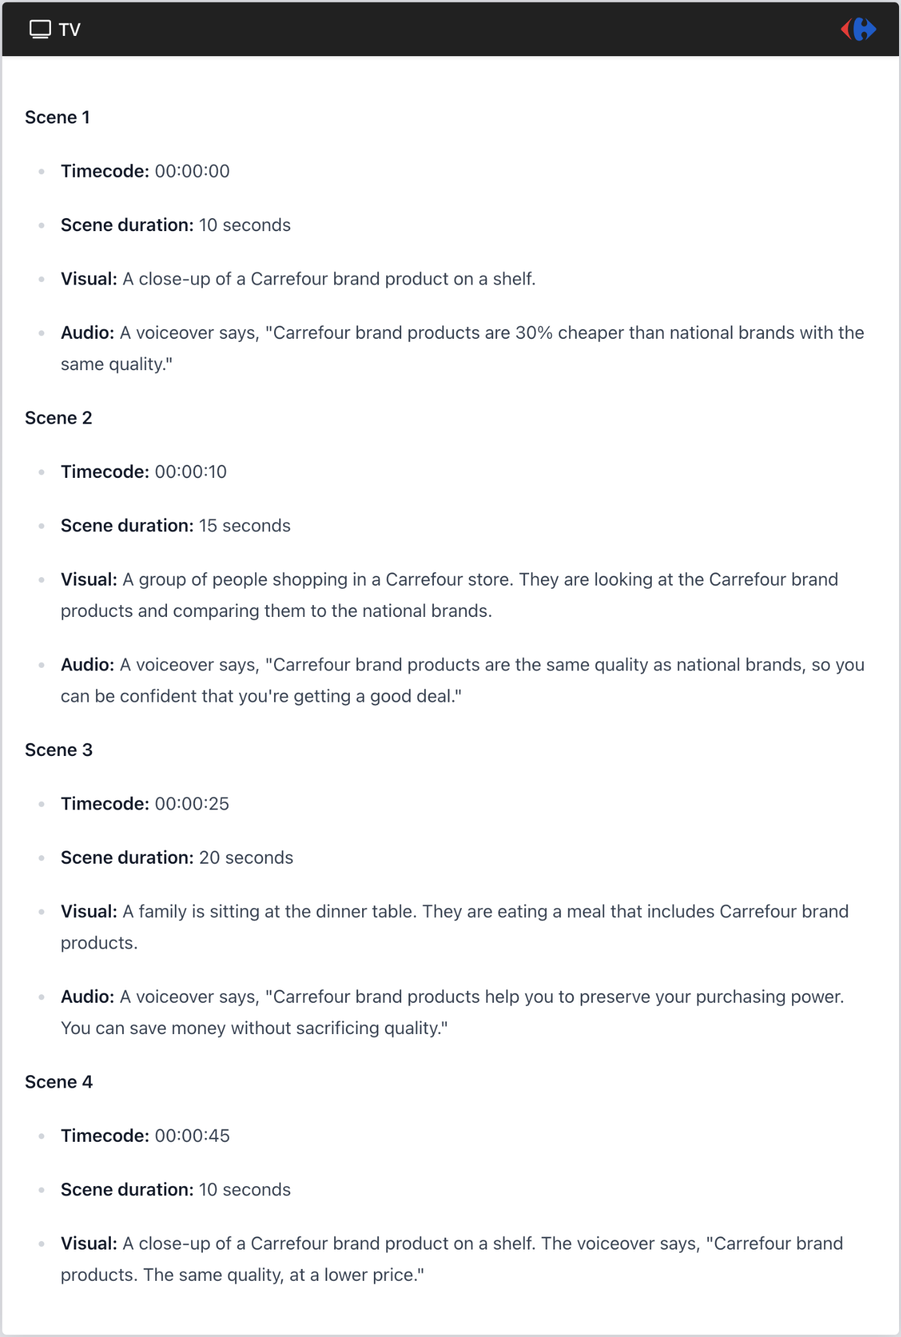
50+ GenAI use cases have been identified with Carrefour BUs
3
GenAI - Use cases
A
B
C
D
E
Offer personalized recommendations
Enrich our product sheets
Automate buyer tasks
Simplify marketing development
Answer employees' questions
Hoplà : GenAI chatbot which assists our Carrefour.fr customers with their daily shopping
A solution to optimize our product sheets
A solution to automate our buyers’ tasks
A solution to automate the production of marketing content for media campaigns
Askia : GenAI chatbot assisting our employees with HR questions
~2 500 daily sessions
42% of customers move from shopping list to adding cart
+85K product sheets
5’ creation time per file versus 3 days
10 use cases identified
15-20M€ annual earnings (ambition)
~80K marketing assets per year
5’ creation time versus 4-6 days
-80% local HR workload dedicated to employee requests

Slide 22
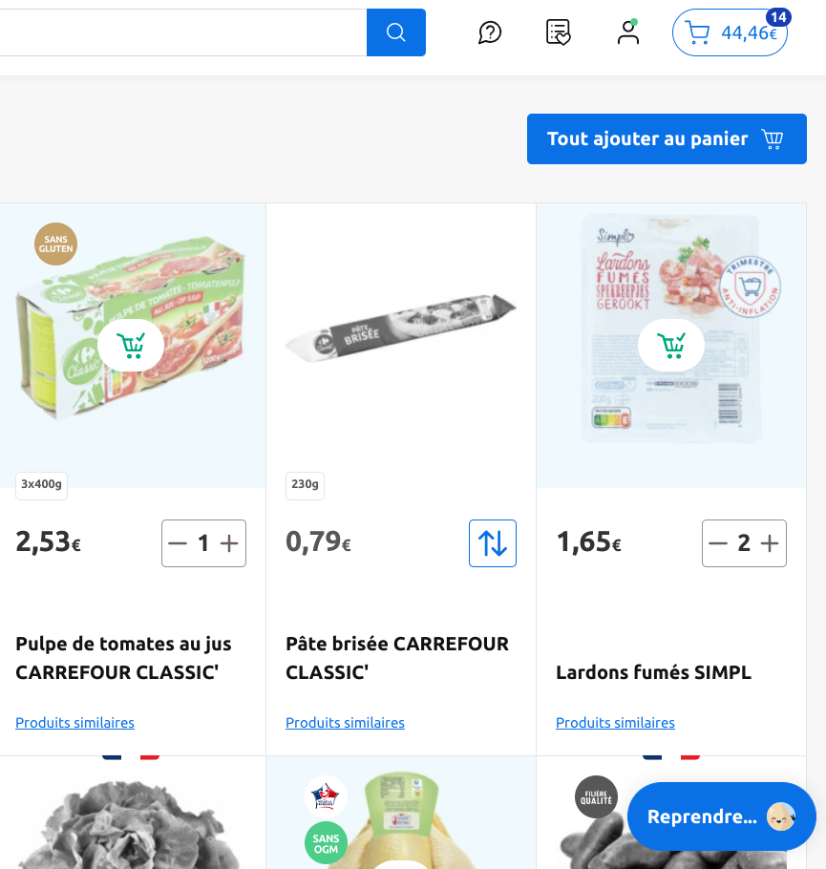
Zoom - Revolutionize the grocery shopping experience by addressing the #1 pain point of customers: the time to complete a basket
3
A
GenAI - Propose personalized recommendations
GenAI chatbot which assists our Carrefour.fr customers with their daily shopping
Impact
~2 500 daily sessions
42% of customers move from shopping list to adding cart
Launched in collaboration with:

Slide 23
Zoom - Enrich our product sheets : an easy win
3
B
GenAI - Enrich product sheets
Richer and more attractive product description, starting with Carrefour branded products
Impact
+85 K product sheets¹ per year
5’ creation time going from 3 days to 5 minutes / sheet
Launched in collaboration with:
1 - 87 000 fiches MN & MDC/an dont 5 500 fiches MDC enrichies (20€/fiche MDC)

Slide 24
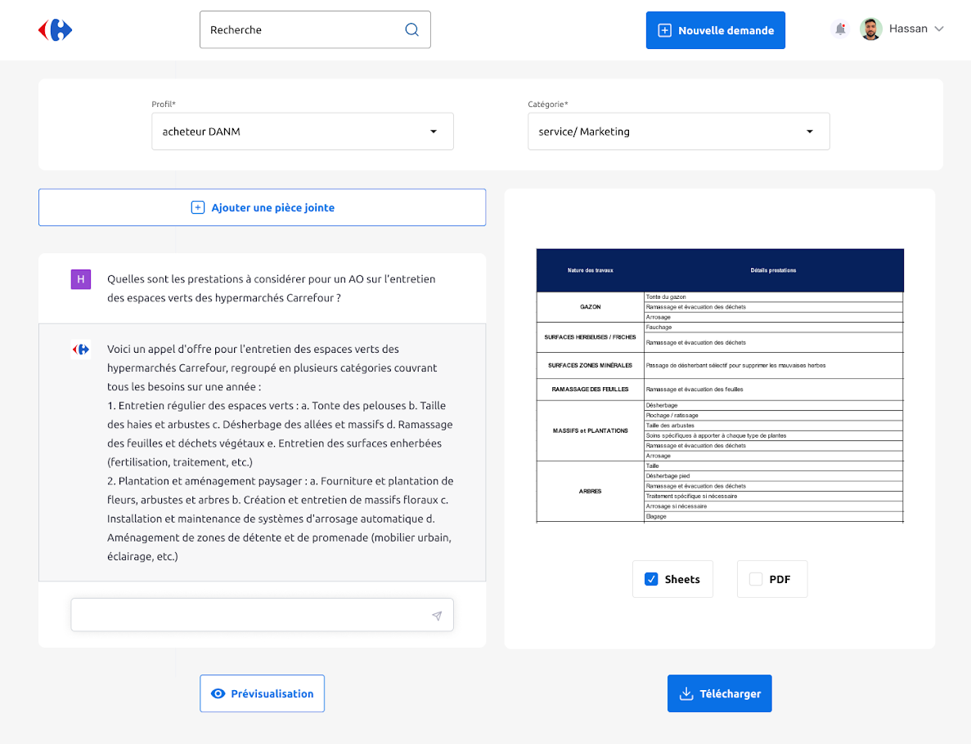
Zoom - Automate our Non-Merchant Purchasing (GNFR)
3
C
GenAI - Automate GNFR buyers tasks
A solution powered by ChatGPT to automate tasks for our buyers
Impact
10 Sub use cases identified
15-20M€ annual earnings (ambition)
With:
Quote comparison
Search for quotes in history
Identification of referenced suppliers
Generation of inputs to an RFP
Supplier scoring
Detection of inconsistencies in responses
Writing supplier emails
PO catalog identification assistance
Categorization of generic expenses
Help with filling out POs
Aide au remplissage des DA

Slide 25
Zoom - Générer des campagnes média grâce au Marketing Studio
3
D
GenAI - Simplify marketing development
How to generate media campaigns using AI?
Impact
~80k marketing assets created each year
5’ creation time going from 4-6 weeks / campaign
Launched in collaboration with:
Notes:
Le Marketing Studio, une plateforme générée par GenAI et intégrée à la Content Factory pour réduire les coûts de production et de post-production des actifs marketing
Sur étagère
Création d'une plateforme générant des campagnes marketing pour le G8 (ex. supports de communication, campagnes personnalisées)
Solution basée sur (i) l'outil GenAI de Google - Vertex AI - (ii) et d'autres solutions ad hoc GenAI
Enjeux et impacts
Les coûts de production marketing du G8 seront optimisés
Gains de productivité
Timeline 2024
Q1: V2: nouvelles fonctionnalités (e.g., radio + context. simple products)
Q2: Pilot V2 / transition to G8 scale selection
Q3: V3: new fctés. (e.g., context. complex products and KV)
Q4: Pilot V3 / transition to G8 scale selection

Slide 26
Zoom - Supporting our employees with the Askia HR chatbot
3
E
GenAI - Answering employees' questions
To answer all of our employees' HR questions: explanation of pay, leave, etc.
Impact
80% of local HR workload is devoted to employee requests
Solution based on both the GenAI PaLM tool and an internal knowledge management solution

Slide 27
Sébastien ROZANES
Global Chief Data & Analytics Officer
Let’s connect on LinkedIN

