Slide 1

What do sea turtles, wildfires and nursing homes have in common? Ethical AI.​
I-Sah Hsieh
Steve Mellgren

Slide 2
Detecting Deforestation in the Amazon

Slide 3
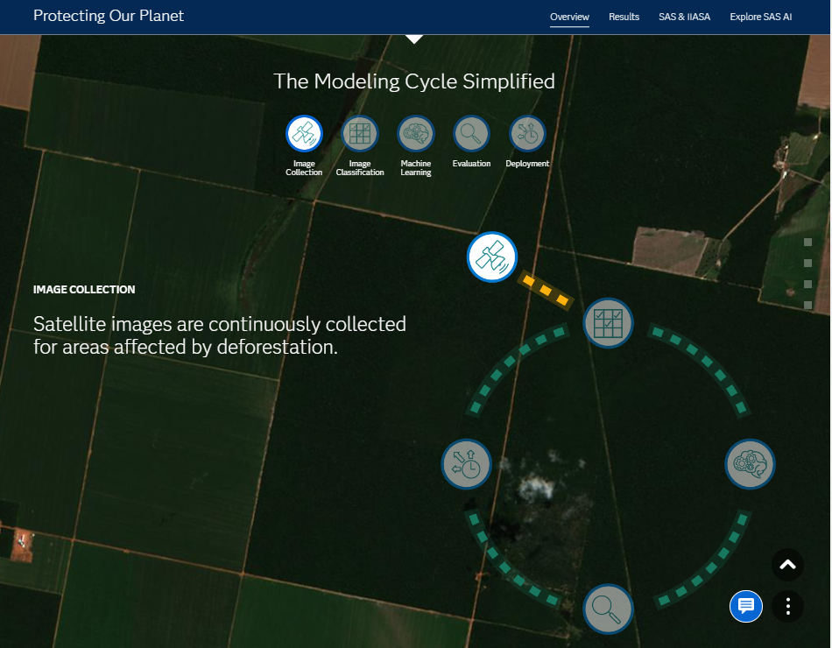
AI Literacy
How AI does its work?

Slide 4
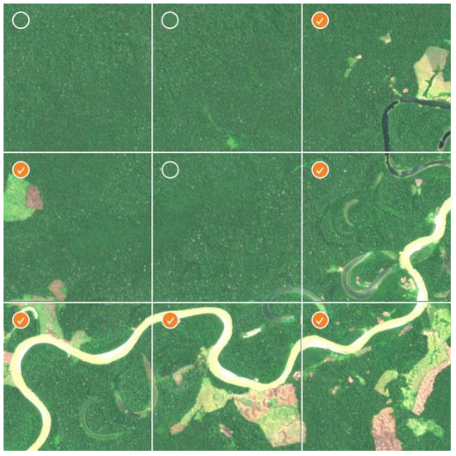
Crowdsource: Deforestation Identification

Slide 5
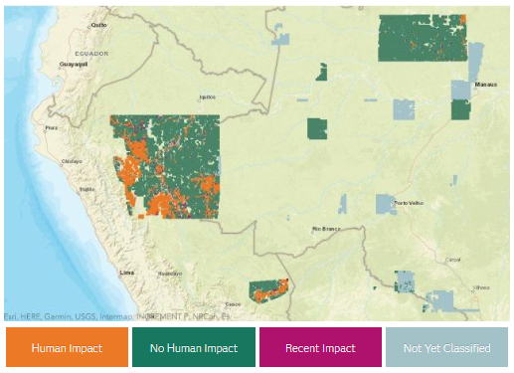
Report Results

Slide 6
What is Ethical AI / Trustworthy AI and why is it important?

Slide 7
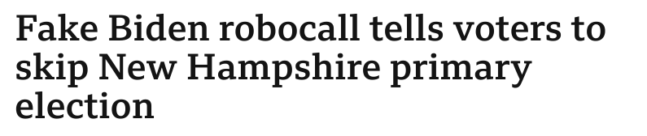
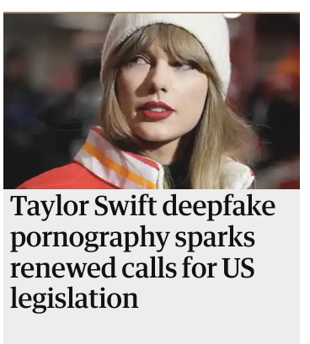

Source: Matza, Max. BBC News, BBC, 22 Jan. 2024
Source: Reed, Betsy. The Guardian, Guardian News and Media, 26 Jan. 2024
Source: Coscarelli, Joe. The New York Times, The New York Times, 19 Apr. 2023

Slide 8
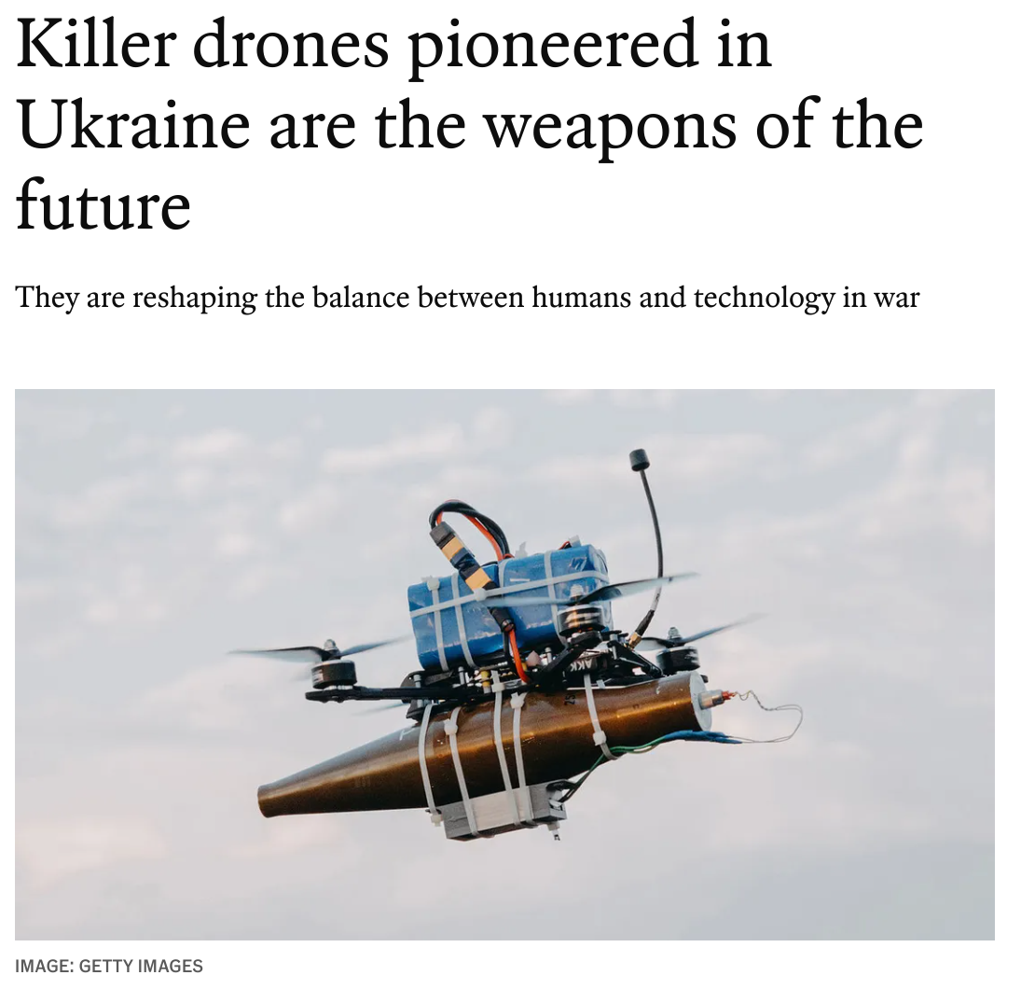

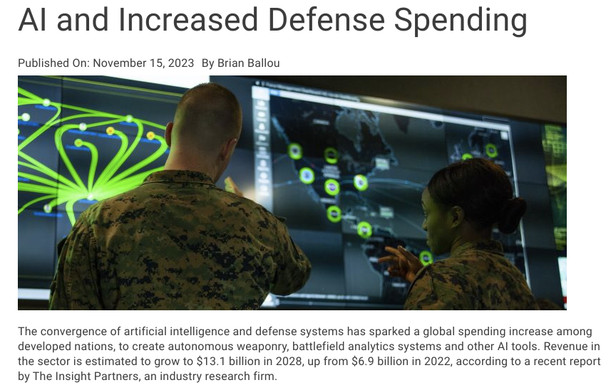
Source: Ballou, Brian. Techstrong.Ai, 15 Nov. 2024
Source: The Economist, The Economist Newspaper, 8 Feb. 2024

Slide 9

Source: Sidhartha, Banerjee. CBCnews, CBC/Radio Canada, 7 Apr. 2024

Slide 10
AI in the Future
AI IN THE FUTURE
Personal assistants
Self-driving cars
Healthcare diagnostics and treatment
Business process optimization
Cybersecurity threat detection
Customized education and tutoring
Immersive responsive entertainment
Supply chain and factory automation
AI writing and speech enhancement
Art/music/film generation
AR/VR experiences
Autonomous drones
Smart fitness tracking clothing
Robotic companions
Fake media identification
And more.
65% of today’s students will be employed in jobs that don’t yet exist.
Source: Britishcouncil.org
Notes:
Stat from Britishcouncil.org Preparing young people for the careers of the future | British Council

Slide 11
Acceptance of Innovation at Stake
I reject this innovation
I embrace this innovation
35
30
Artificial Intelligence
Gene-based medicine
34
29
GMO food
58
14
Source: 2024 Edelman Trust Barometer

Slide 12
Institutions Out of Balance
Ethical
NGOs
(1, 20)
Business
(17, 17)
Government seen as far less competent and ethical than business
Less Competent
Competent
Media
(-17, -4)
Government
(-35, -15)
Source: 2024 Edelman Trust Barometer
Unethical

Slide 13
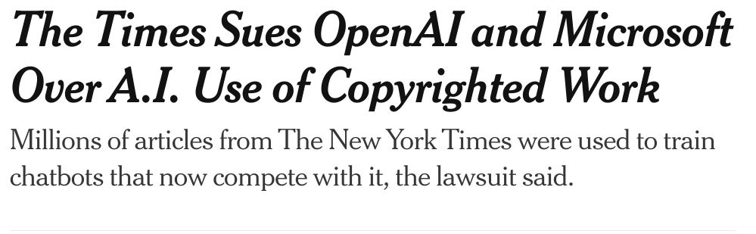
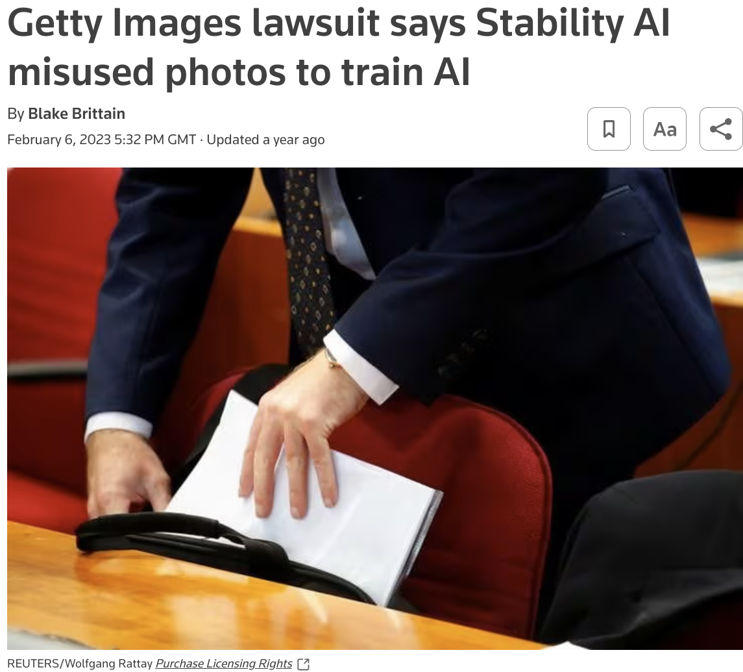
Source: The New York Times, The New York Times, 27 Dec. 2023
Source: Brittain, Blake. Reuters, 6 Feb. 2023

Slide 14
Key AI trends
Pace of innovation is increasing (faster than predicted)
More general-purpose & multi-modal AI systems
Increasingly international (e.g. China, France, Germany)
Open source / open weights v. closed / proprietary
Large private sector capital
Importance of national security actors
> 2 billion voters going to the polls in 2024
Source: Tom Lue, General Counsel / Head of Governance, Google Deepminds

Slide 15

AI Impact on Workforce in Canada
83%
of surveyed organizations expect to use AI-powered solutions across their organization by 2028
82%
Sales and Marketing
80%
Finance
78%
Information Technology
55%
expect enhanced communication to be the top benefit of AI, compare to task automation and enhanced creativity
Source: ACCELERATING AI SKILLS, AWS, STUDY ON AI SKILLS. 20 Nov. 2023
Notes:
A largely positive outlook on the impact of generative AI has resulted in 86% of employers and 74% of employees stating that they will “somewhat” or “extensively” use generative AI in their organizations in the next five years.

Slide 16
The Rise of AI in Decision Making
1
Acceleration
2
Amplification
Vast data, storage, and computing capabilities enable us to make real-time, automated decisions
AI makes decisions so quickly that the impact of bad decisions gets much bigger
3
Accountability
If something goes wrong, who’s to blame?

Slide 17

Stakeholders, Opportunities & Risks
STAKEHOLDERS, OPPORTUNITIES, & RISKS
REGULATORY
Discrimination
SOCIETAL
Ecosystem
Vulnerable Peoples
Privacy
Recourse
Ethics
Lawful Basis
Accountability
Transparency
Explainability
Integrity
Human
Rights
Notice & Consent
Diversity
Assessments
Fairness
Audit
Agency
Consistent Application
Security
Human-in-the-loop
Executive Awareness
Training
Contracts
Governance
Graphic by Steven Tiell
OPERATIONAL

Slide 18
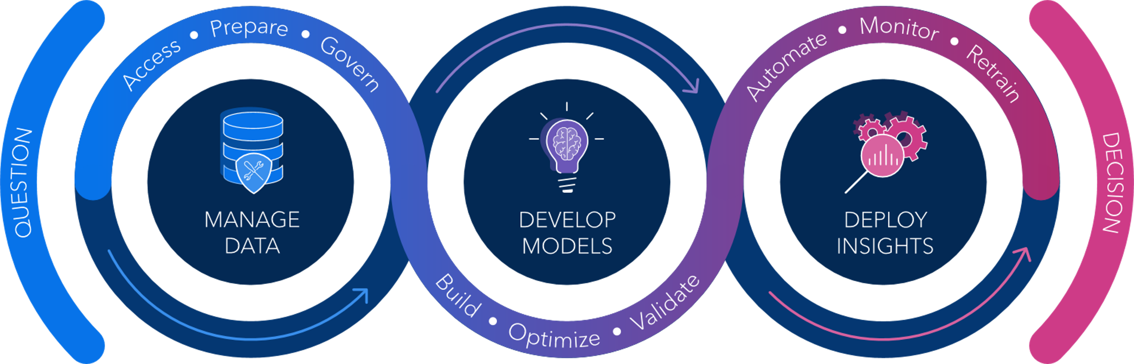

Bias Examples
USER INTERFACE
DISCLOSE DATA
A person, process, or system creates, and publishes/ shares data
STAGE AND PREPARE DATA
A person, process, or system transforms, moves, or analyzes data.
CONSUME DATA
A person, process, or system benefits from manipulated data
ACQUIRE
Ingest data from sensors, systems, or humans, recording its provenance and consent for use wherever possible
STORE
Record data to a trusted location that is both secure and easily accessible for further manipulation
PRE- PROCESS
Combine disparate datasets to create a larger dataset that is greater than the sum of its parts
MODEL BUILD
Examine and transform data with the purpose of extracting information and discovering new insights
MODEL DEPLOY
Apply the insights gained from data analysis towards making decisions, affecting change, or delivering a product or service
SHARE/ SELL
Provide Access to datasets or data insights to new sets of data manipulators or consumers
DISPOSE
Remove data from servers to prevent future release or use
Availability Bias
Recall Bias
Exclusion Bias
Pre-processing Bias
Measurement Bias
Time-interval bias
Historical Bias
Sample Selection:
Selection Bias
Attrition Bias
Confirmation Bias
Cause/ Effect Bias
Confounding Bias
Collider Bias
Prediction Bias
Performance Bias
Hindsight Bias
Chronological Bias
Funding Bias
Proxy Bias
Aggregation Bias
Survivorship Bias
Automation bias
Deployment Bias
Drift Bias
Reporting Bias
COMMON BIASES

Slide 19
Trustworthy AI at SAS

Slide 20



Our Principles
OUR PRINCIPLES
Human-Centricity
Transparency
Explain and instruct on usage openly, including potential risks and how decisions are made.
Privacy & Security
Promote human well-being, human agency and equity.
Respect the privacy of data subjects.
Inclusivity
Ensure accessibility
and include diverse perspectives and experiences.
Robustness
Operate reliably and safely, while enabling mechanisms that assess and manage potential risks throughout a system’s lifecycle.
Accountability
Proactively identify and mitigate adverse impacts.

Slide 21
Governing AI at SAS
H
T
C
G
O
S
I
NT
E
R
R
O
O
V
L
S
P
L
E
A
T
R
F
TU
O
U
L
R
M
C

Slide 22
Governing AI at SAS
Oversight
Compliance
Operations
Culture
ACTIVATION
AI Governance, Strategy,
and Enforcement
Performance and Risk Management
Ethically Systemic
Norms & Practices
SOPs w/ Supporting Infrastructure
Establish principles for responsible innovation
Assess and monitor readiness for regulations
Curate procedures for AI and data management
Instill awareness
of responsible
innovation practices
Develop responsible innovation strategy
Identify risks and
implement risk
management systems
Embed curated procedures into processes consistently across infrastructure
Foster shared norms and employee competency
ESSENTIALS
Adapt and enforce governance and accountability policies
Create a contingency
and mitigation plan
Enable the technology
to support responsible innovation strategy
Cultivate a culture
of resilience

Slide 23
AI Engagement Continuum
Responsible Innovation at SAS
Internal Training
AI Ethics Circle Ambassadors
Web Site
Data for Good Projects
Swarms
Lower engagement
Higher engagement

Slide 24
Identifying sea turtles in the Galapagos

Slide 25
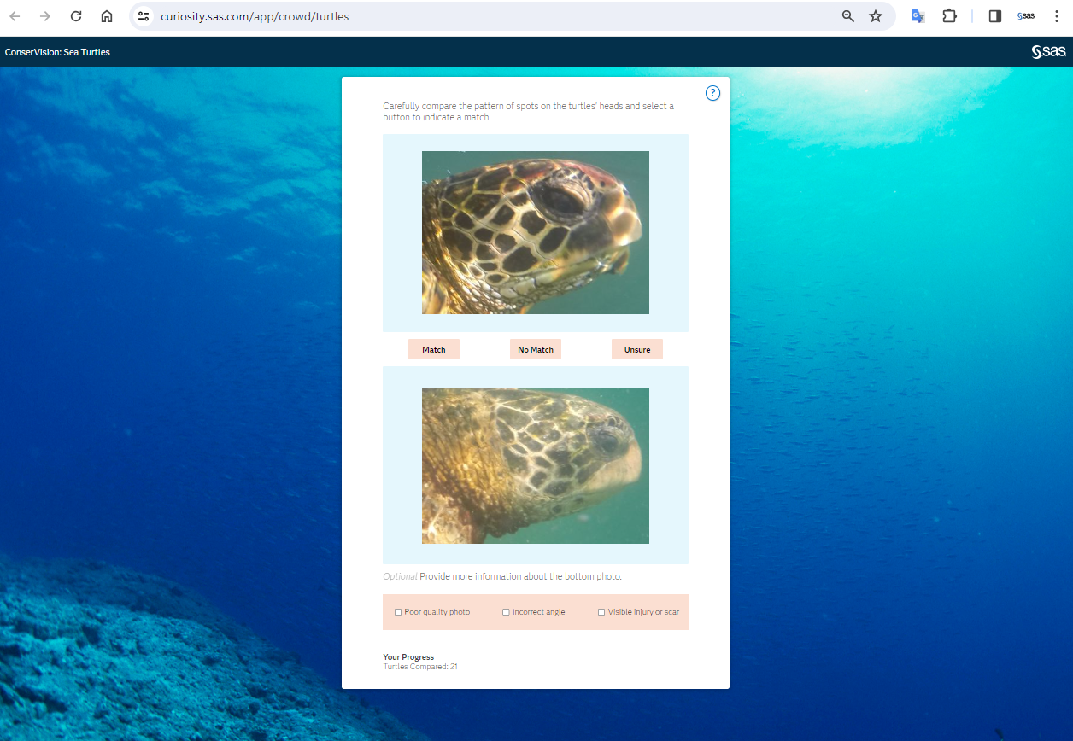
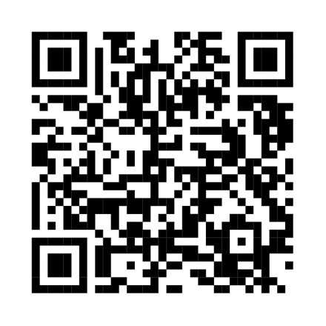
Sea Turtle Identification
Try it yourself:
https://curiosity.sas.com/app/crowd/turtles

Slide 26
AI Engagement Continuum
Responsible Innovation at SAS
Internal Training
AI Ethics Circle Ambassadors
Web Site
Data for Good Projects
Swarms
Lower engagement
Higher engagement

Slide 27

Promote & Engage AI Ethics Reviews in D4G
Identify Projects
Selection of meaningful projects that elevates AI ethics awareness, sensitivity, and practice guidelines for trustworthy AI.
Evaluate for Transparency & Human-Centricity
Assess the robustness of project documentation used in D4G projects.
Evaluate system & Participatory design
Assess the robustness of participatory design of project, stakeholder engagement, capturing the following:
Establish processes for infrastructure of trust
Apply design thinking methodology to help define and establish trustworthy AI governance process:
Share the learning journey
Communicate lessons learned and best practices with Community of Practice Leaders on the Responsible Innovation Champions channel.
Scope,
Nature,
Purpose,
Context of AI systems
Include ethical choice awareness, tensions, tradeoffs, and impact.
Foreseen risk,
Disparate impact
Conditions for use
Limits of use
Inappropriate use
Prototype
Test
Feedback
Implement
Ex. Instructions for Use (IFU) called out by EU AI Act
PROTOTYPE
TEST
FEEDBACK
IMPLEMENT

Slide 28
Identifying Canadian Wildfire Boundaries

Slide 29
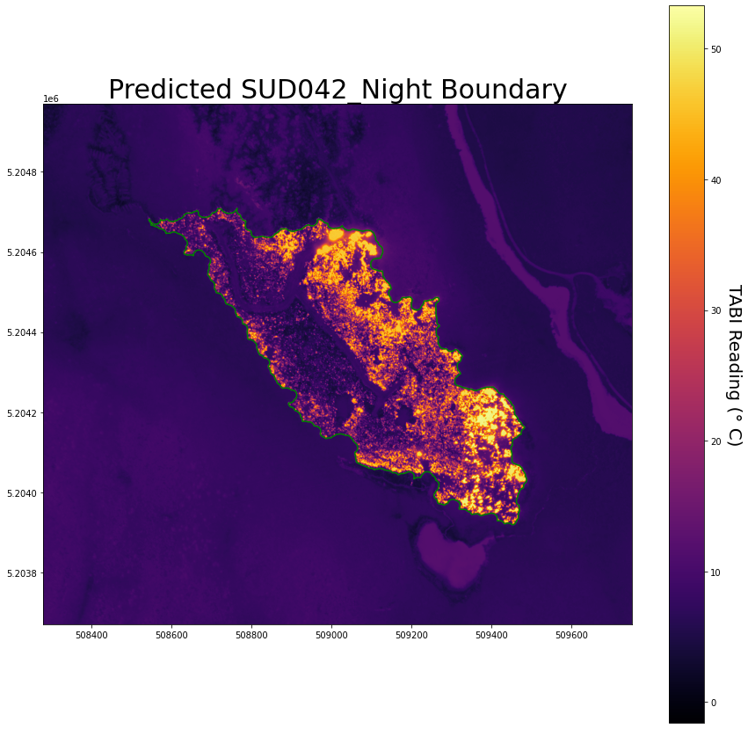
Preliminary Fire Boundary Predictions

Slide 30
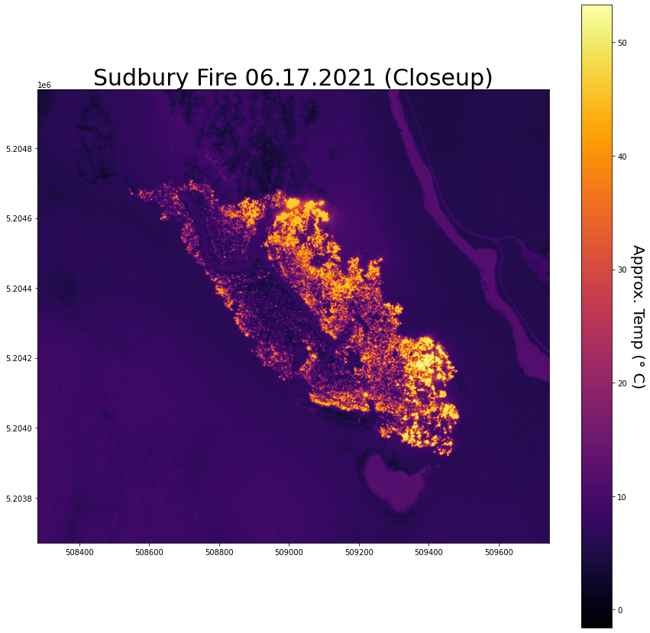
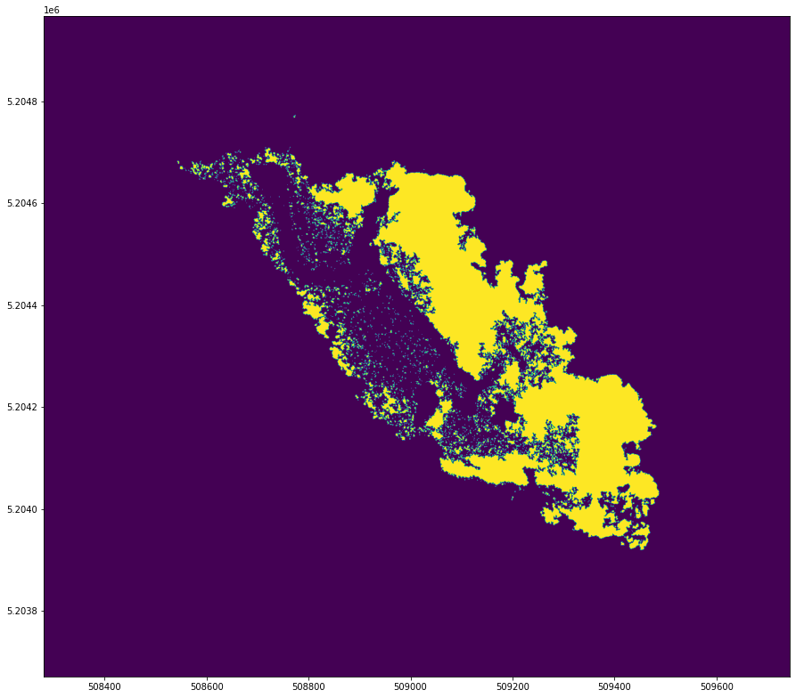
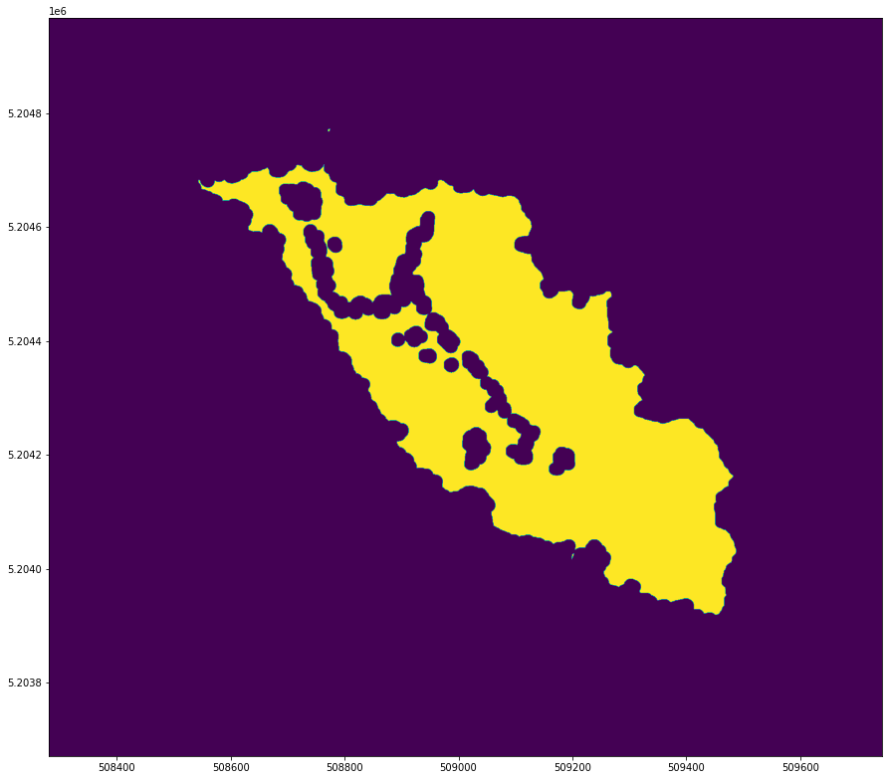
Modeling Process
Thresholding
Select the pixels above value
Dilate/Erode
Combines ‘similar pixels’
Contour
Draw the outer edge of the largest shape

Slide 31
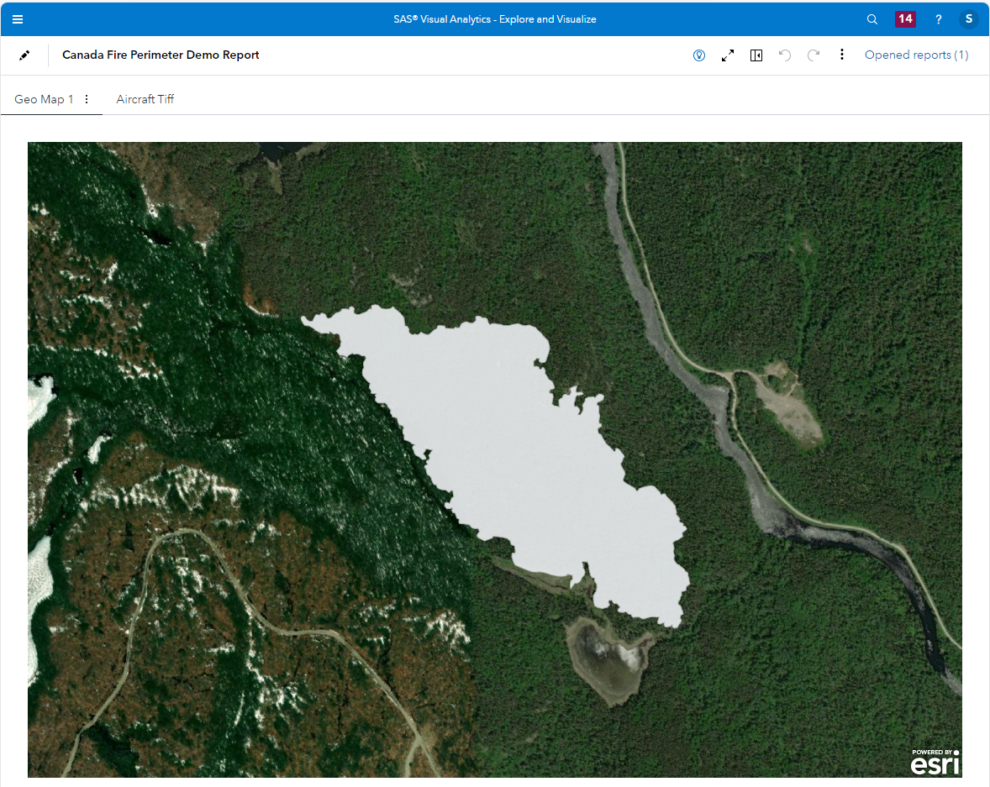
Visualization and Modeling

Slide 32
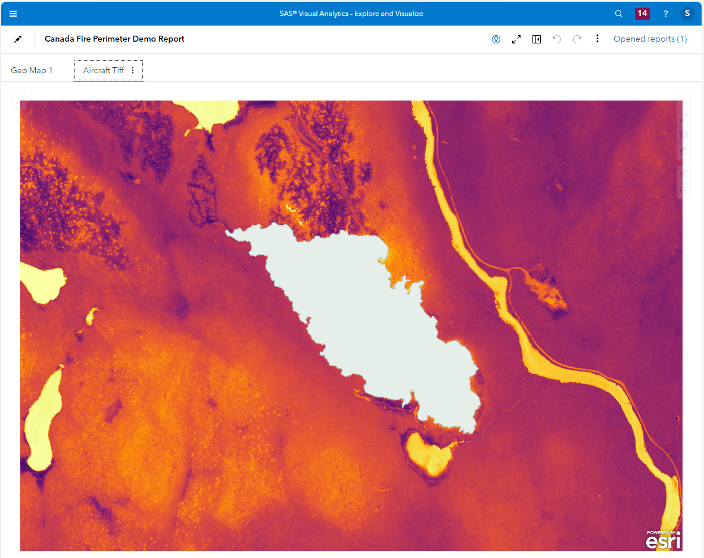
Visualization and Modeling

Slide 33
Nursing Homes / Retirement Facilities

Slide 34
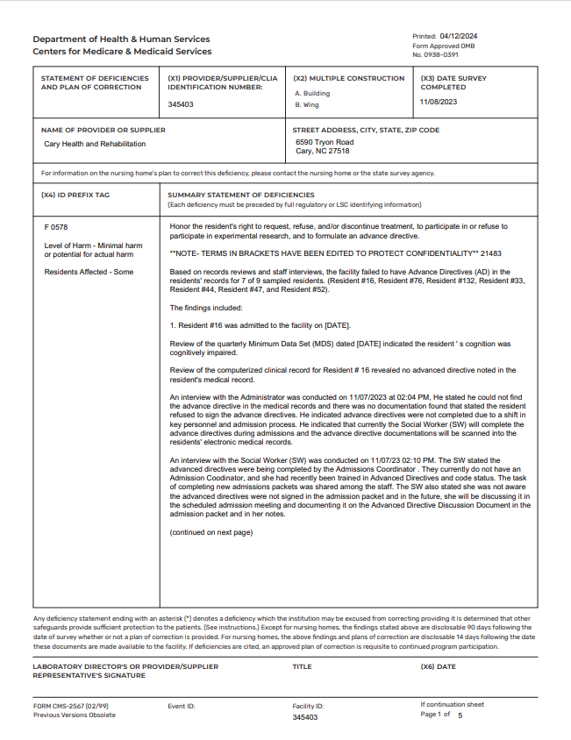
How to turn text summaries into information?

Slide 35
What can you do with text?
Information Extraction
Pattern Discovery
1
Organizing New Documents and Archives
1
Analysis of Document Collections
2
2
Categories
Sentiment Analysis
3
3
Concepts
Topic Discovery
Notes:
Text analytics can be divided into two categories—information extraction and pattern discovery. Information extraction provides the ability to pull specific information out of documents and organize them. Concepts can be written using language interpretation for textual information (LITI) syntax to extract entities, facts, and relationships. Concepts can be used in categories to build taxonomy structures for organizing unstructured data, thus providing some structure.
Pattern discovery empowers users to better understand unstructured document collections through sentiment analysis and topic discovery. Sentiment analysis is used to determine the polarity (positive, negative, or neutral) of documents. Topic discovery is the process of generating clusters of terms that can emerge as topics from the collection.

Slide 36
AI Engagement Continuum
Responsible Innovation at SAS
Internal Training
AI Ethics Circle Ambassadors
Web Site
Data for Good Projects
Swarms
Lower engagement
Higher engagement

Slide 37
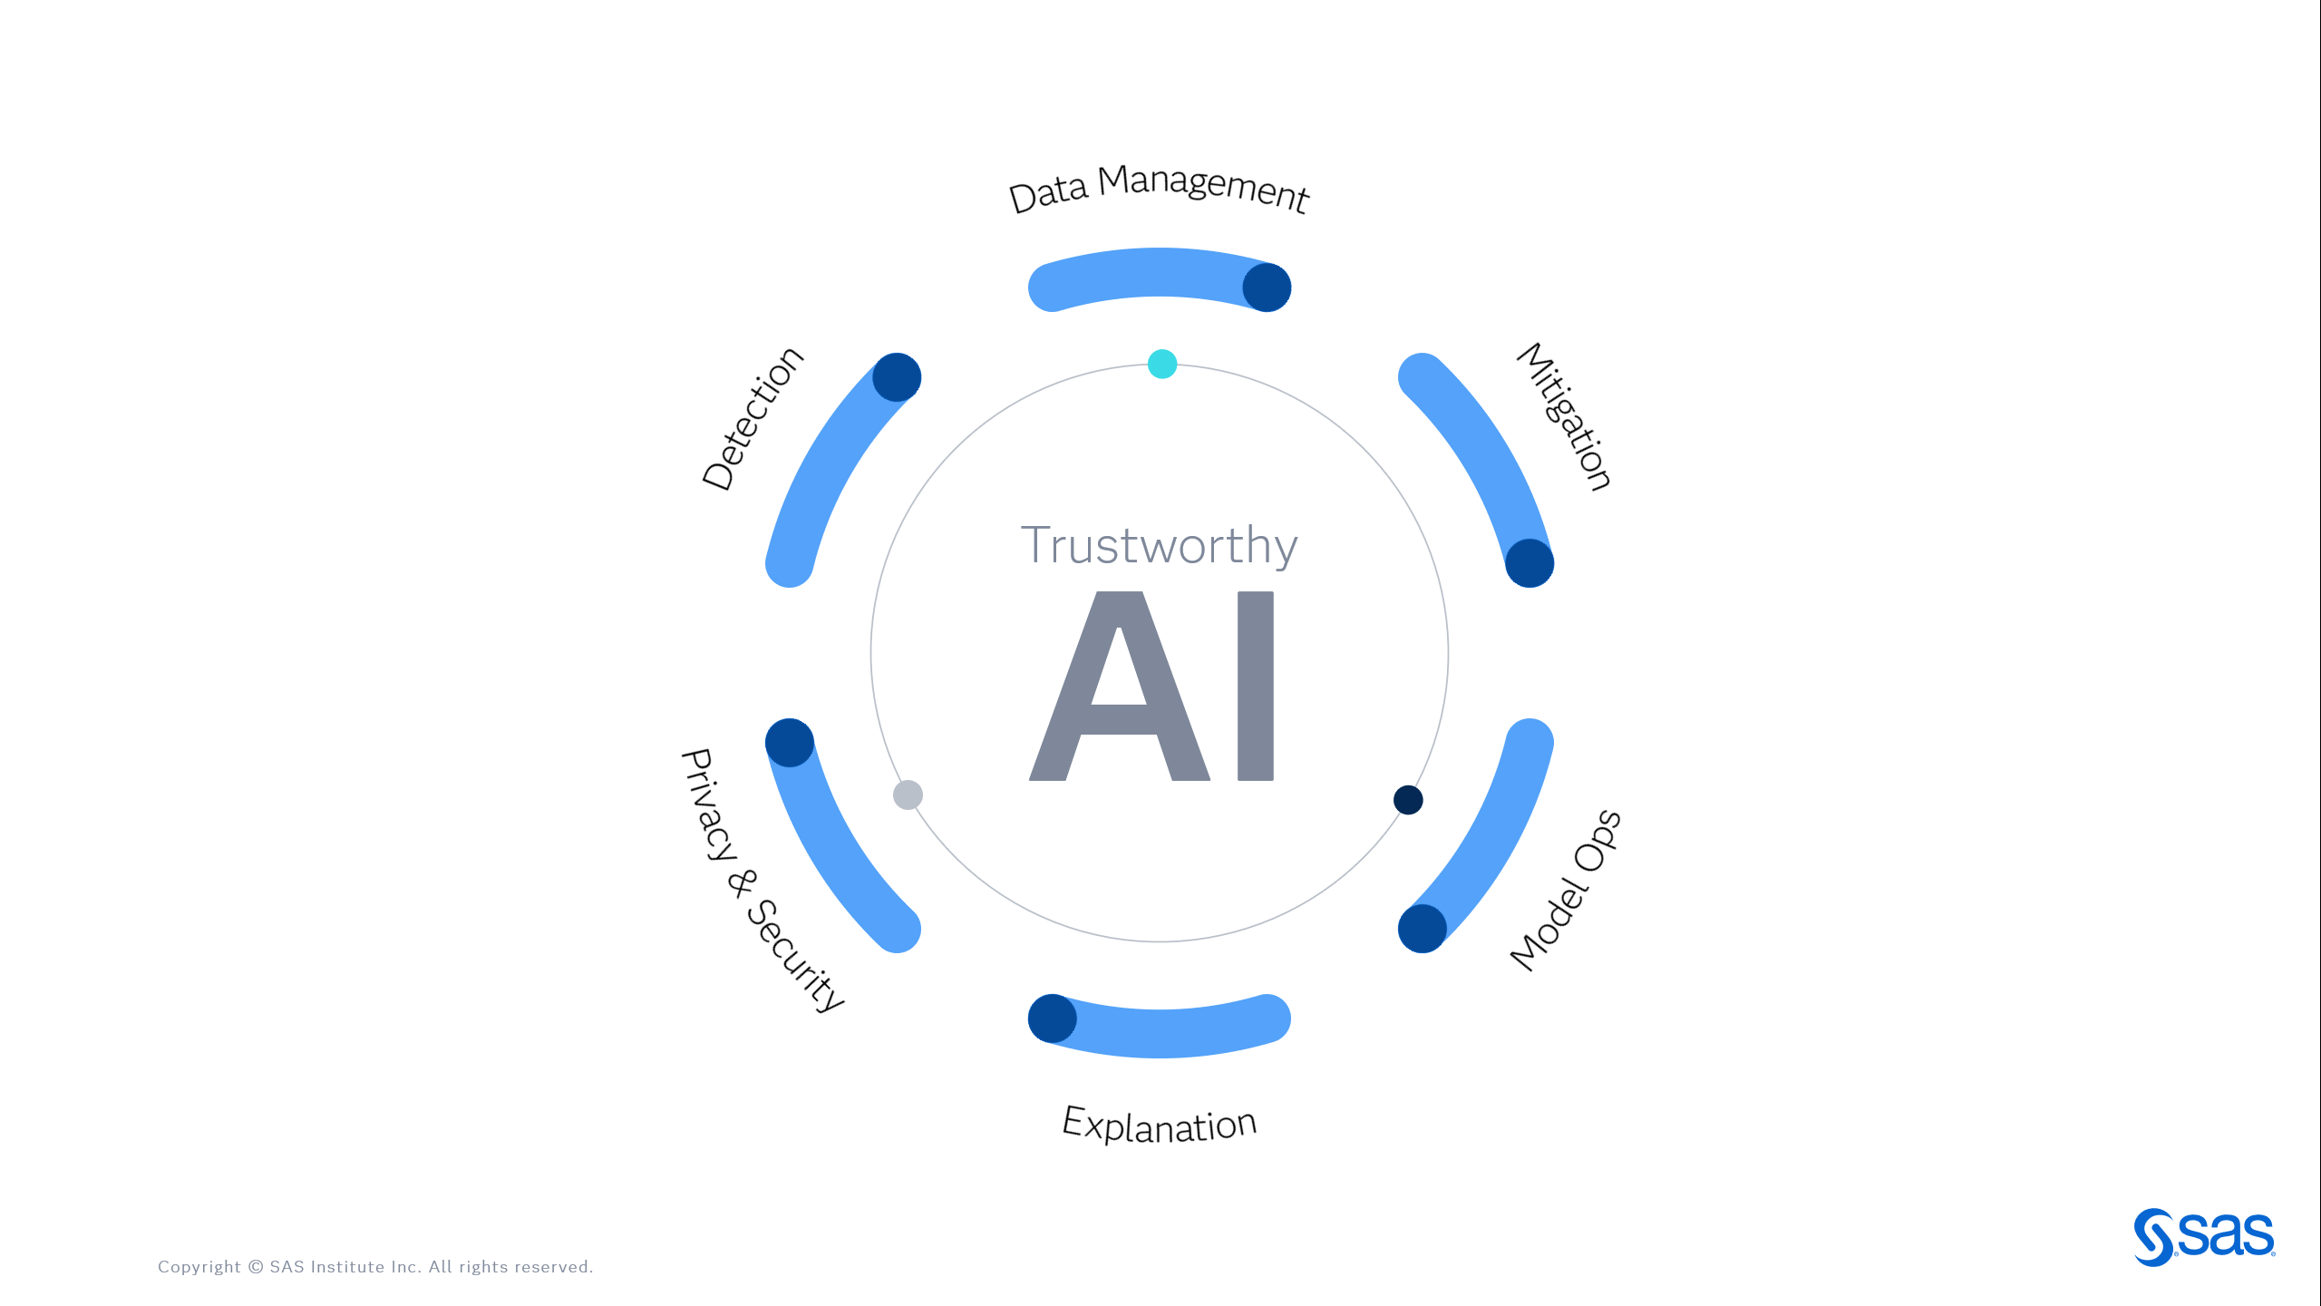
Capabilities Landscape

Slide 38
Capabilities Landscape
Governing Trustworthy AI
Oversight
AI Governance, Strategy and Enforcement
Operations
SOPs with Supporting Infrastructure
Compliance
Performance and Risk Management
Culture
Ethically Systemic Norms and Practices
Activation
Data Management
Explanation
Data Quality
Variable Metadata
Data Preparation
Data Asset Catalog
Natural Language Explanation
Explainable ML
Counterfactual Explanation
Surrogate Model Interpretation
Causal Inference
Technology
Detection
Privacy & Security
Bias Detection
Fairness
Assessment
Privacy Preservation
Model
Security
Autonomy Preservation
Consent and Control
Mitigation
Model Ops
Bias Mitigation
Bias Prevention
Synthetic Data Generation
Model Cards
Decisioning
Life Cycle Management
Metric Monitoring
Model Robustness
Model Oversight

Slide 39
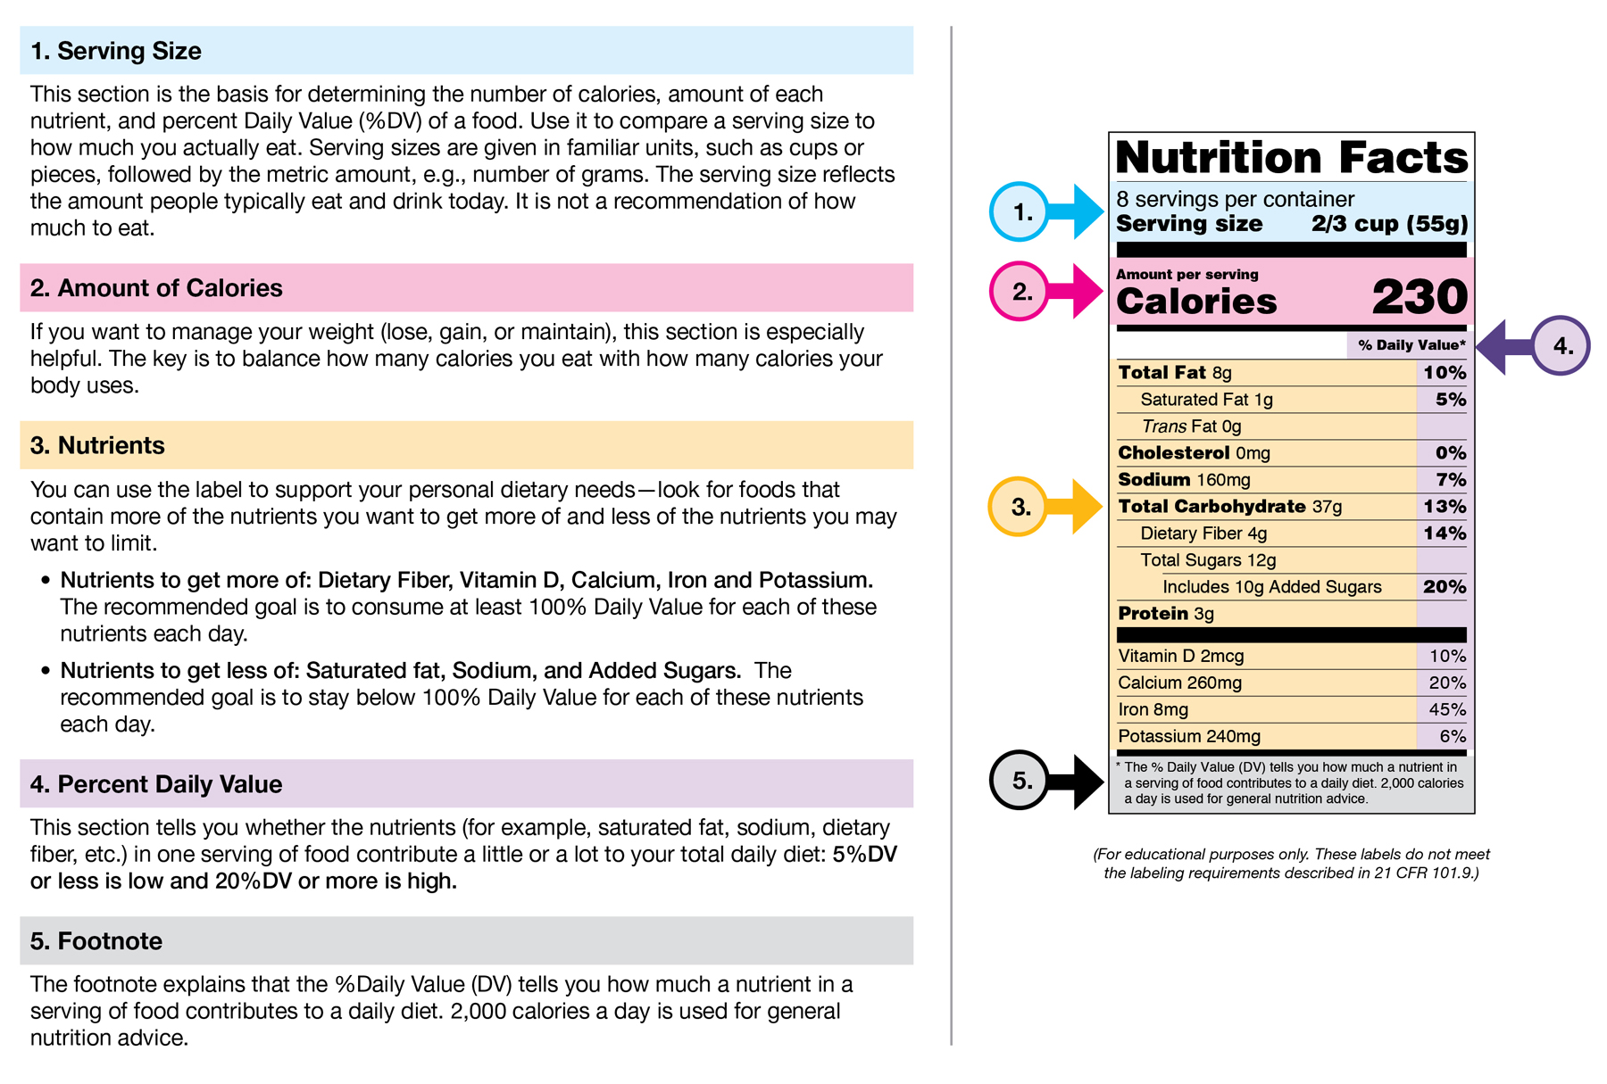
When you want to know how it’s made…

Slide 40
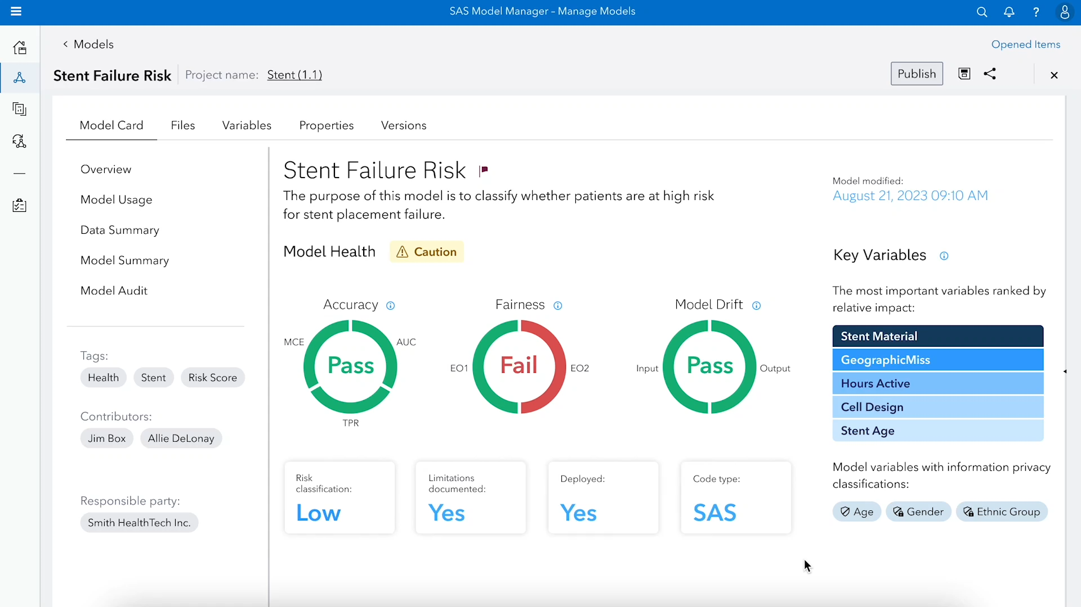
Model Cards

Slide 41




Slide 42
Thank you!

