Slide 1
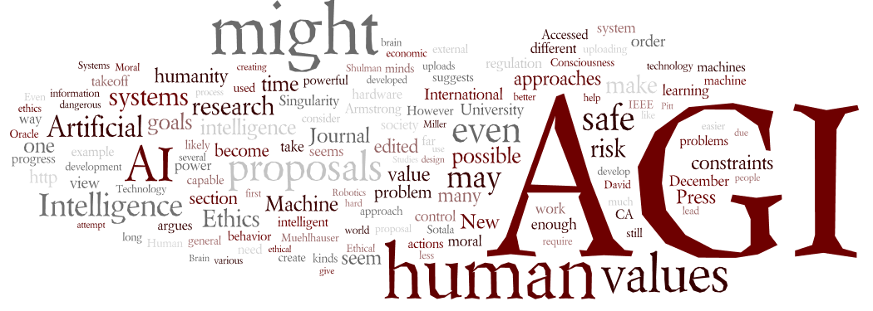

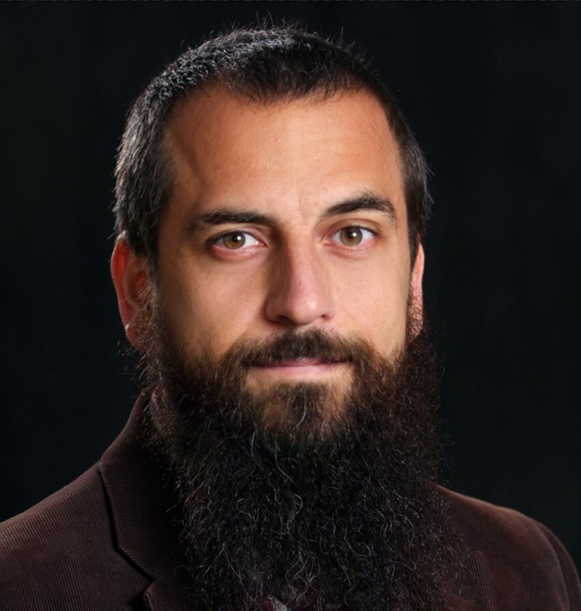


AI: Unexplainable, Unpredictable, Uncontrollable
Dr. Roman.Yampolskiy@louisville.edu
Computer Engineering and Computer Science
University of Louisville - cecs.louisville.edu/ry
Director – CyberSecurity Lab
@romanyam
/roman.yampolskiy

Slide 2
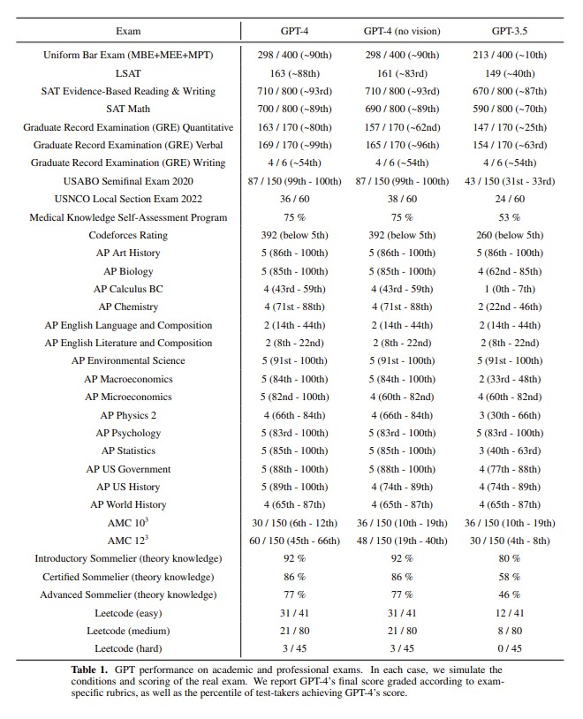

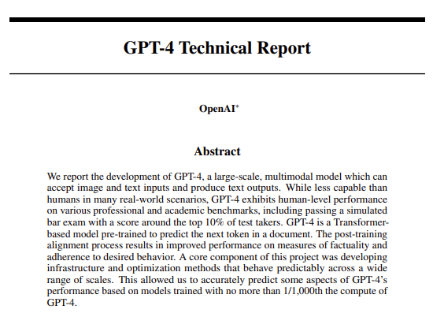
@romanyam roman.yampolskiy@louisville.edu
https://arxiv.org/pdf/2303.08774.pdf, March 4, 2023

Slide 3
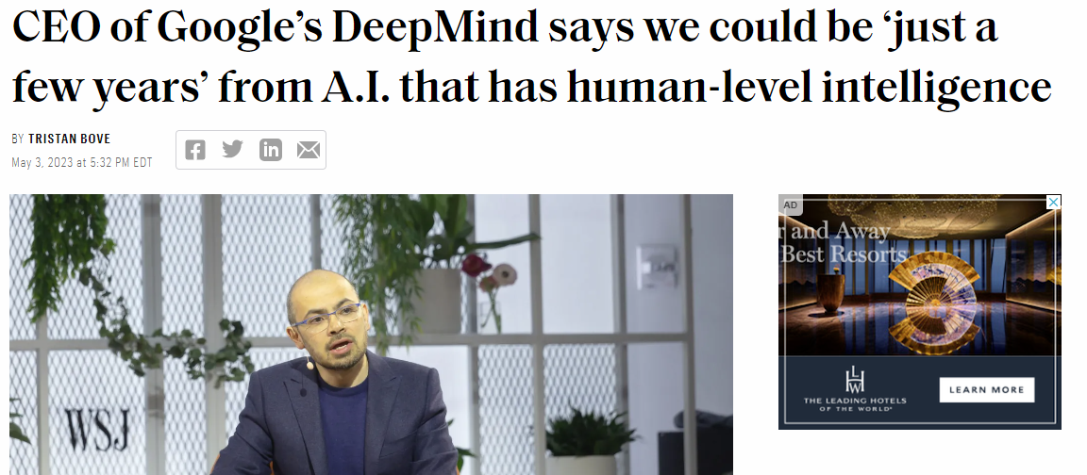
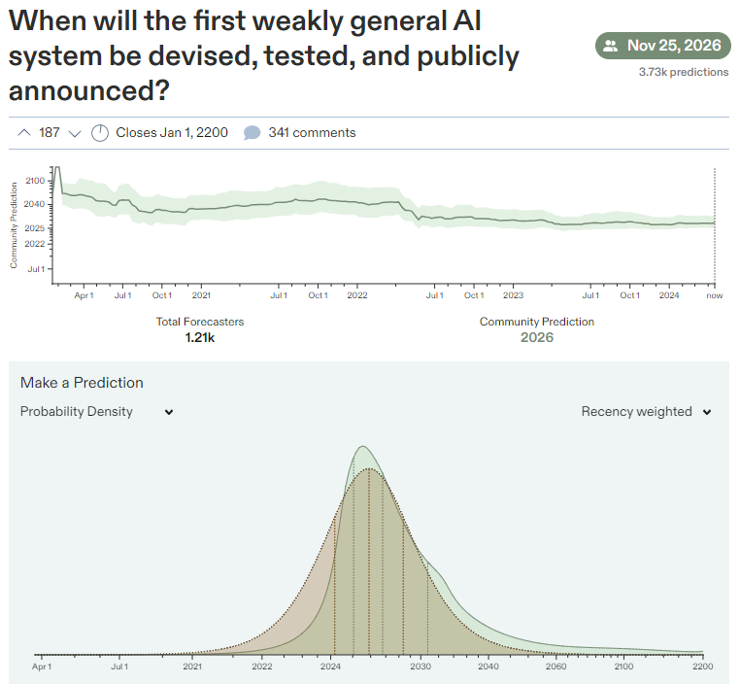

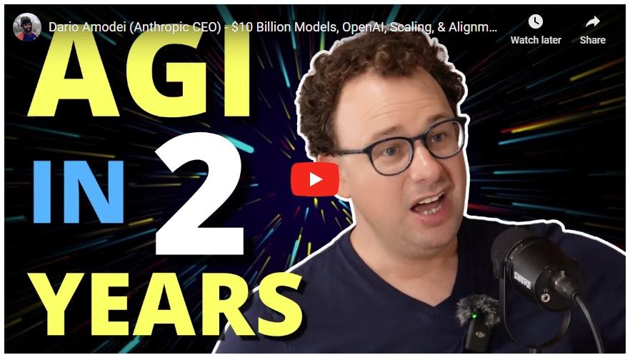
@romanyam roman.yampolskiy@louisville.edu
https://www.metaculus.com/questions/3479/date-weakly-general-ai-is-publicly-known/

Slide 4
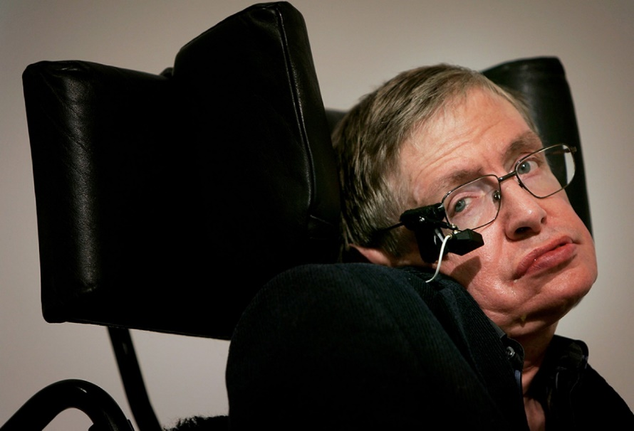
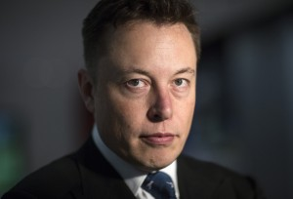
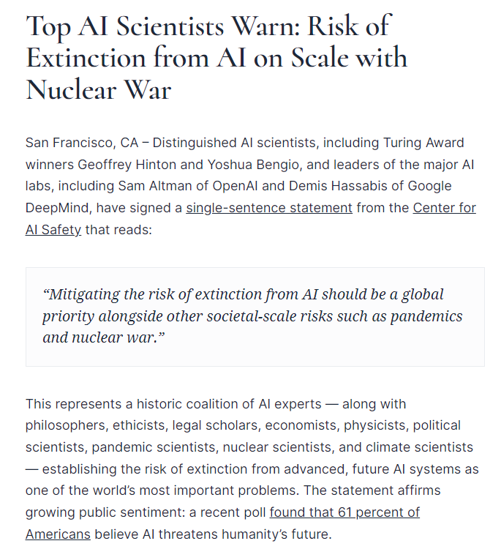
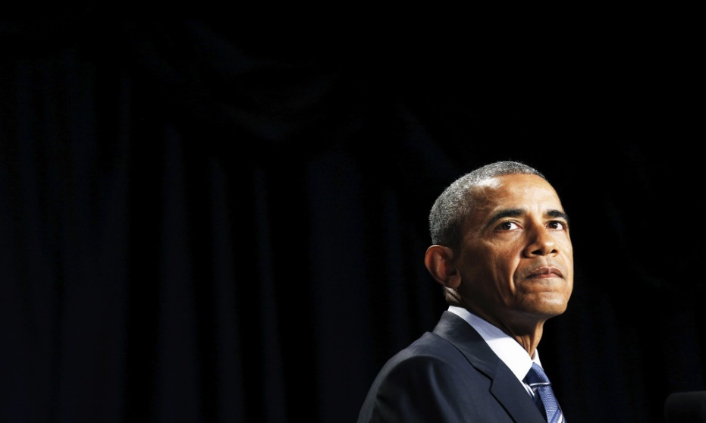


Concerns About A(G)I
@romanyam roman.yampolskiy@louisville.edu
“The development of full artificial intelligence could spell the end of the human race.”
“I think we should be very careful about artificial intelligence”
“… there’s some prudence in thinking about benchmarks that would indicate some general intelligence developing on the horizon.”
"I am in the camp that is concerned about super intelligence"
“…eventually they'll think faster than us and they'll get rid of the slow humans…”

Slide 5
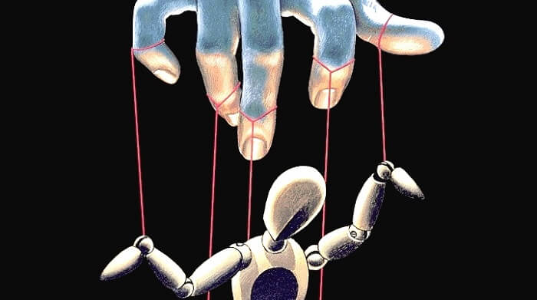
AI Control Problem
@romanyam roman.yampolskiy@louisville.edu
How can humanity remain safely in control while benefiting from a superior form of intelligence?
Is the AI control problem:
Solvable?
Partially Solvable?
Unsolvable?
Undecidable?

Slide 6
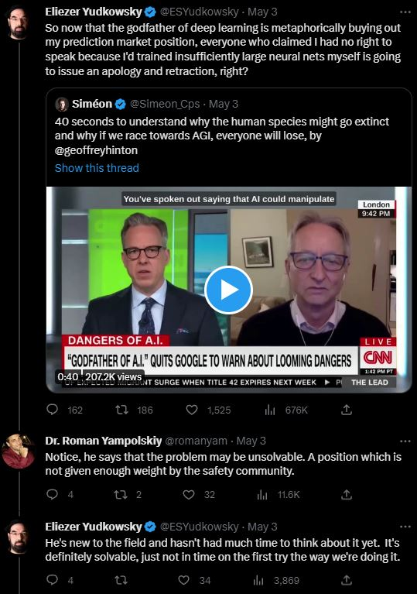
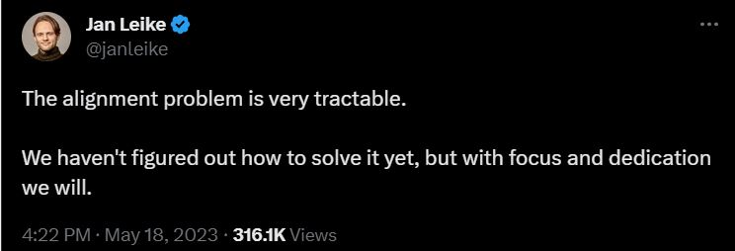
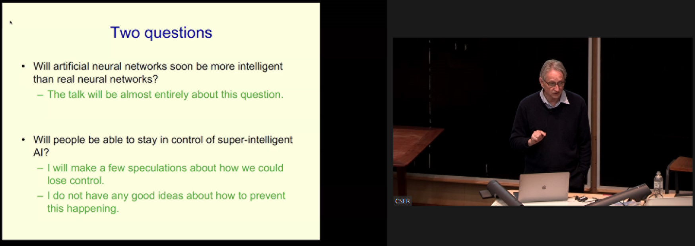
Definitely Solvable, Very Tractable, No Idea
@romanyam roman.yampolskiy@louisville.edu

Slide 7

Tools for Controllability
@romanyam roman.yampolskiy@louisville.edu
Explainability
Comprehensibility
Predictability
Verifiability
Many more!

Slide 8
@romanyam roman.yampolskiy@louisville.edu

Slide 9
@romanyam roman.yampolskiy@louisville.edu

Slide 10
@romanyam roman.yampolskiy@louisville.edu

Slide 11
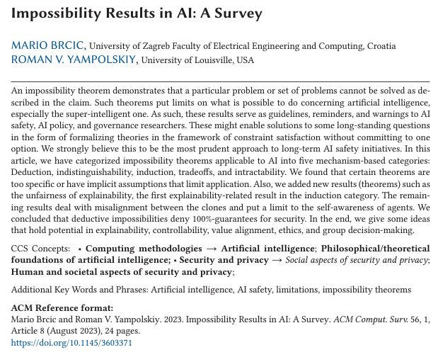
@romanyam roman.yampolskiy@louisville.edu

Slide 12
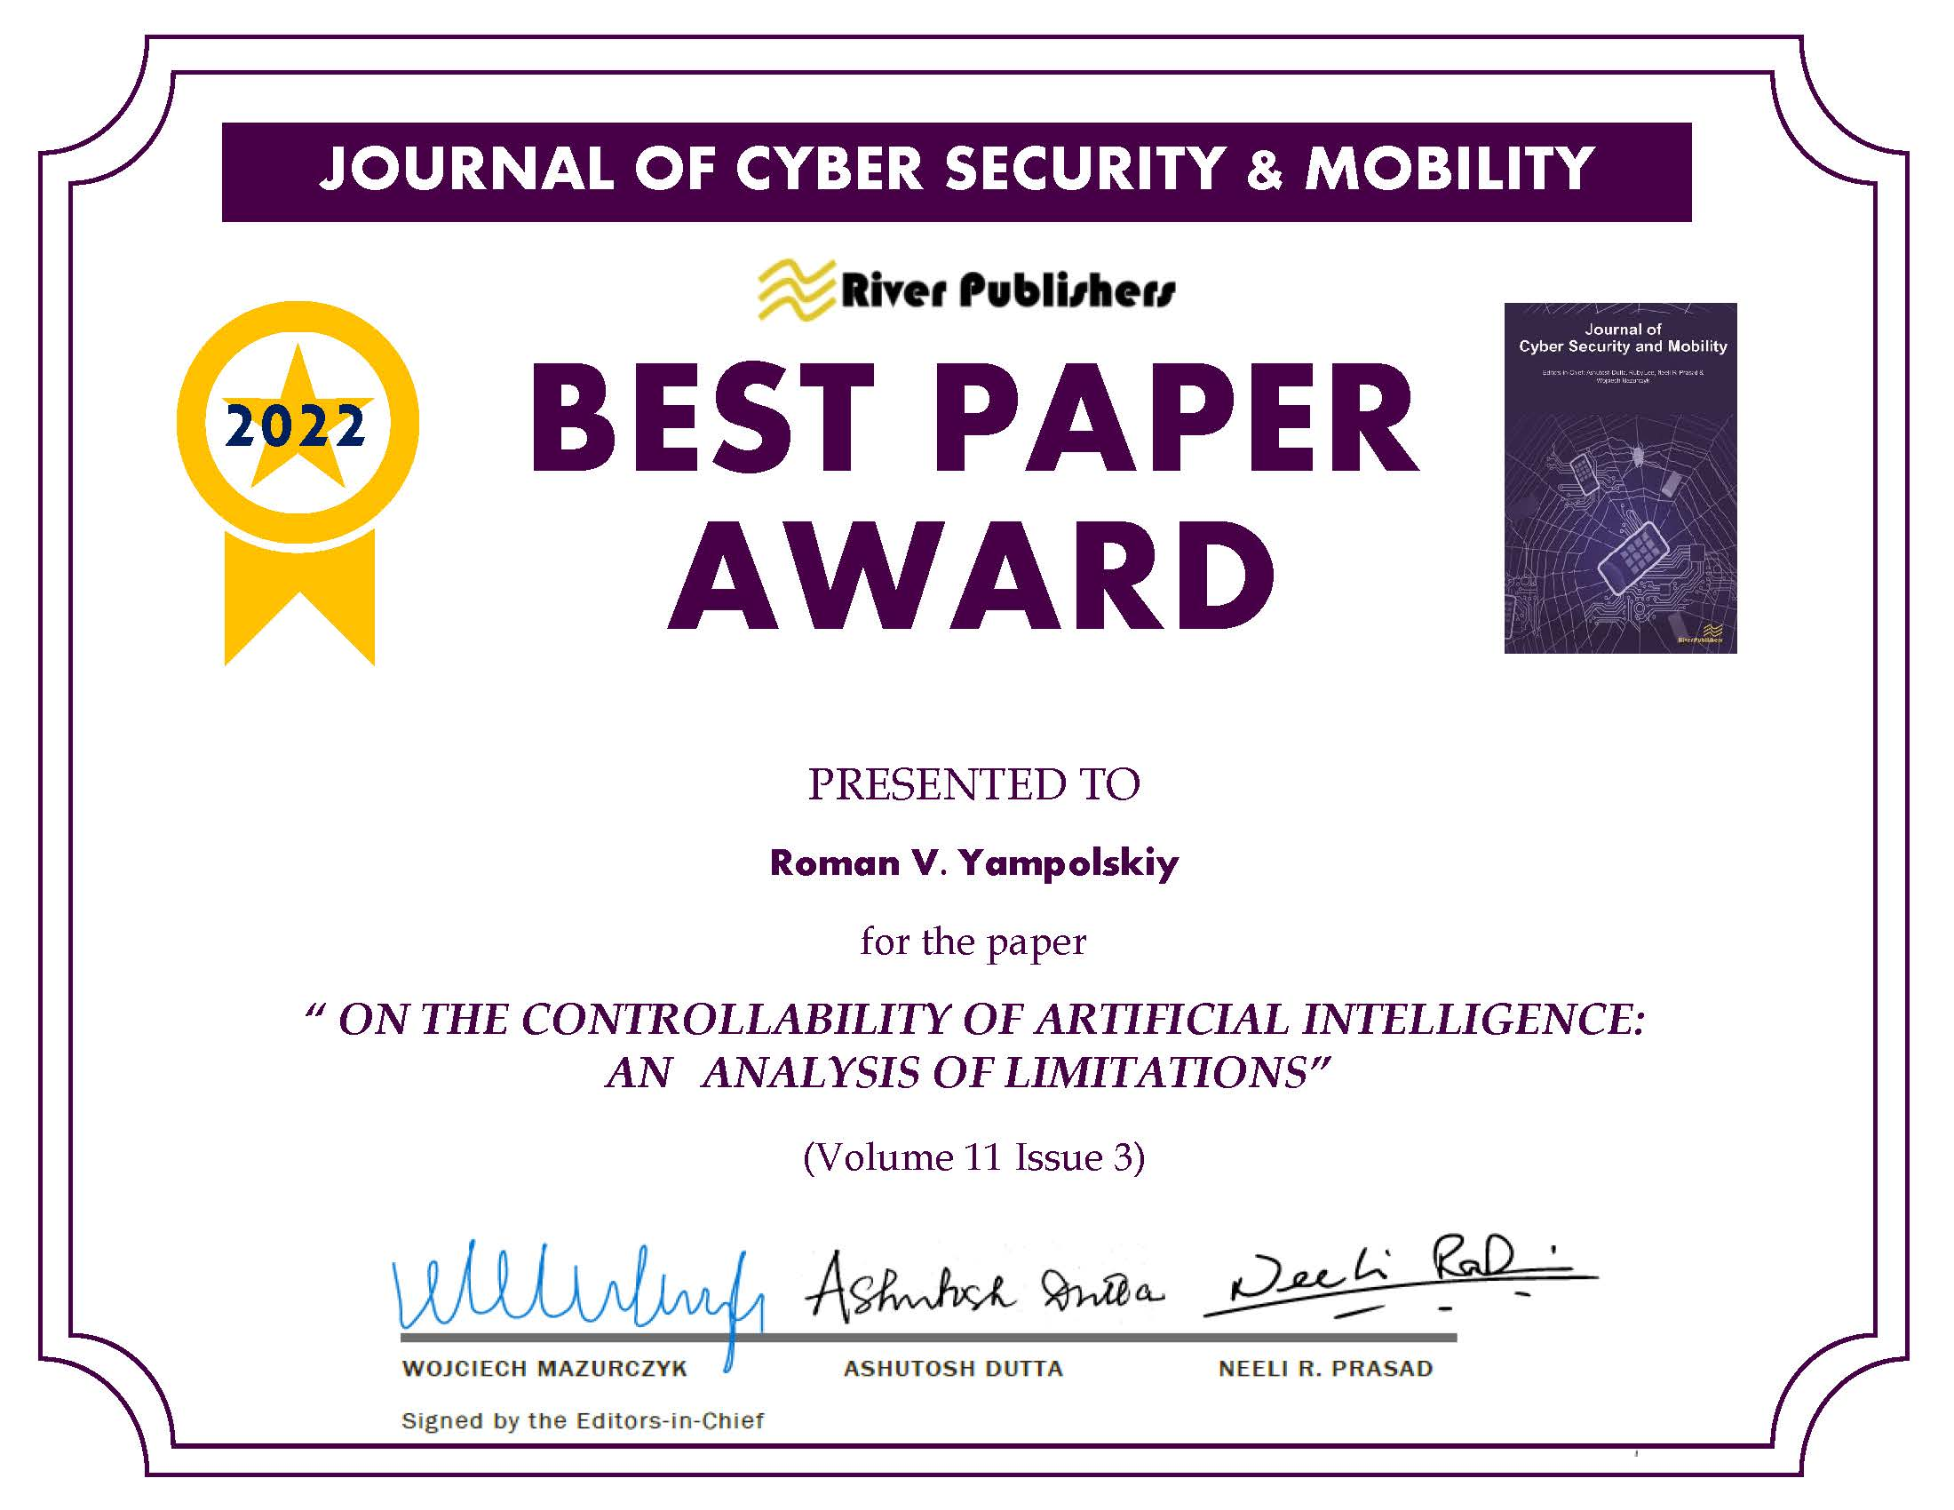
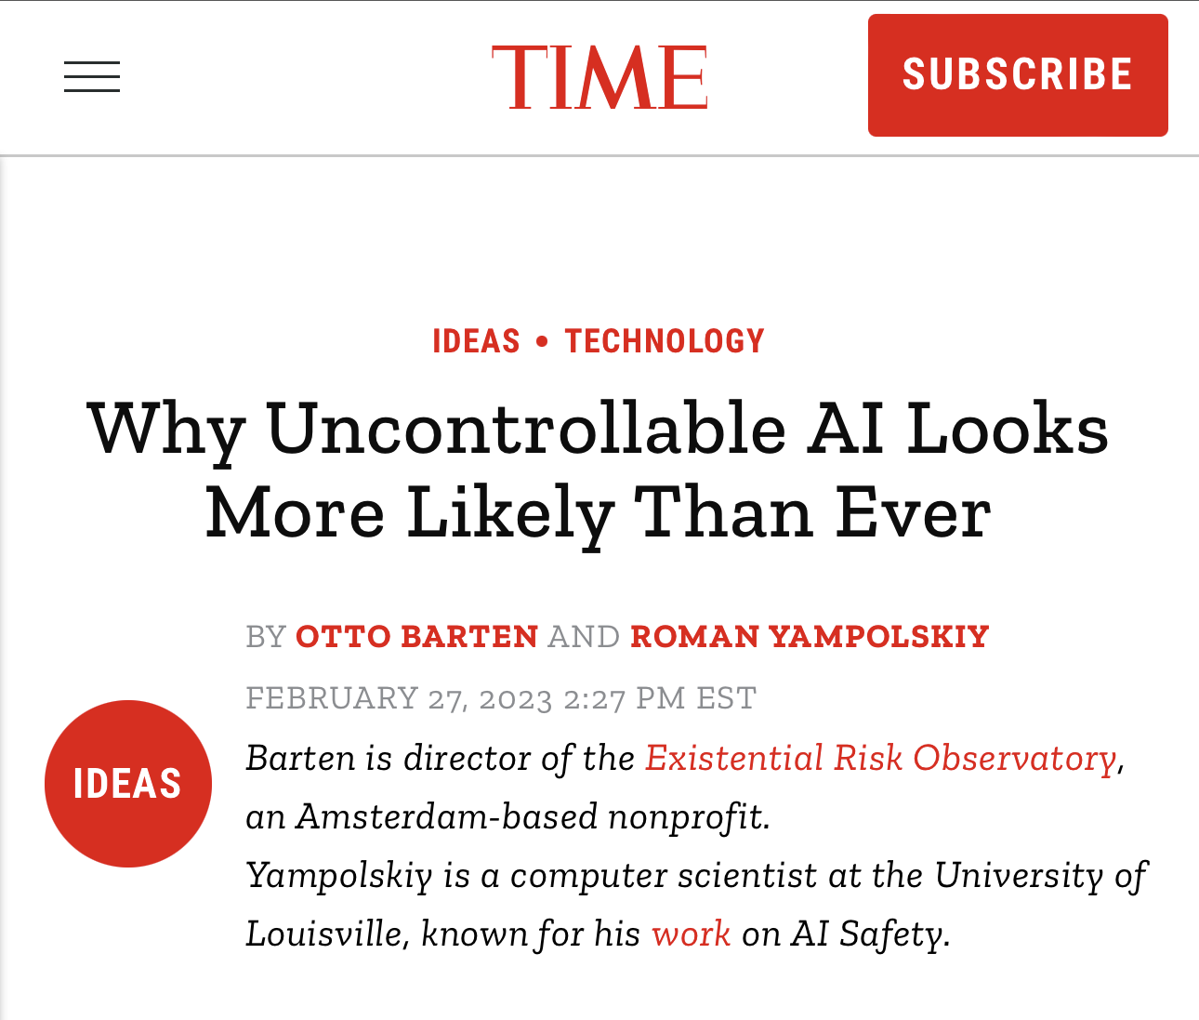
@romanyam roman.yampolskiy@louisville.edu

Slide 13
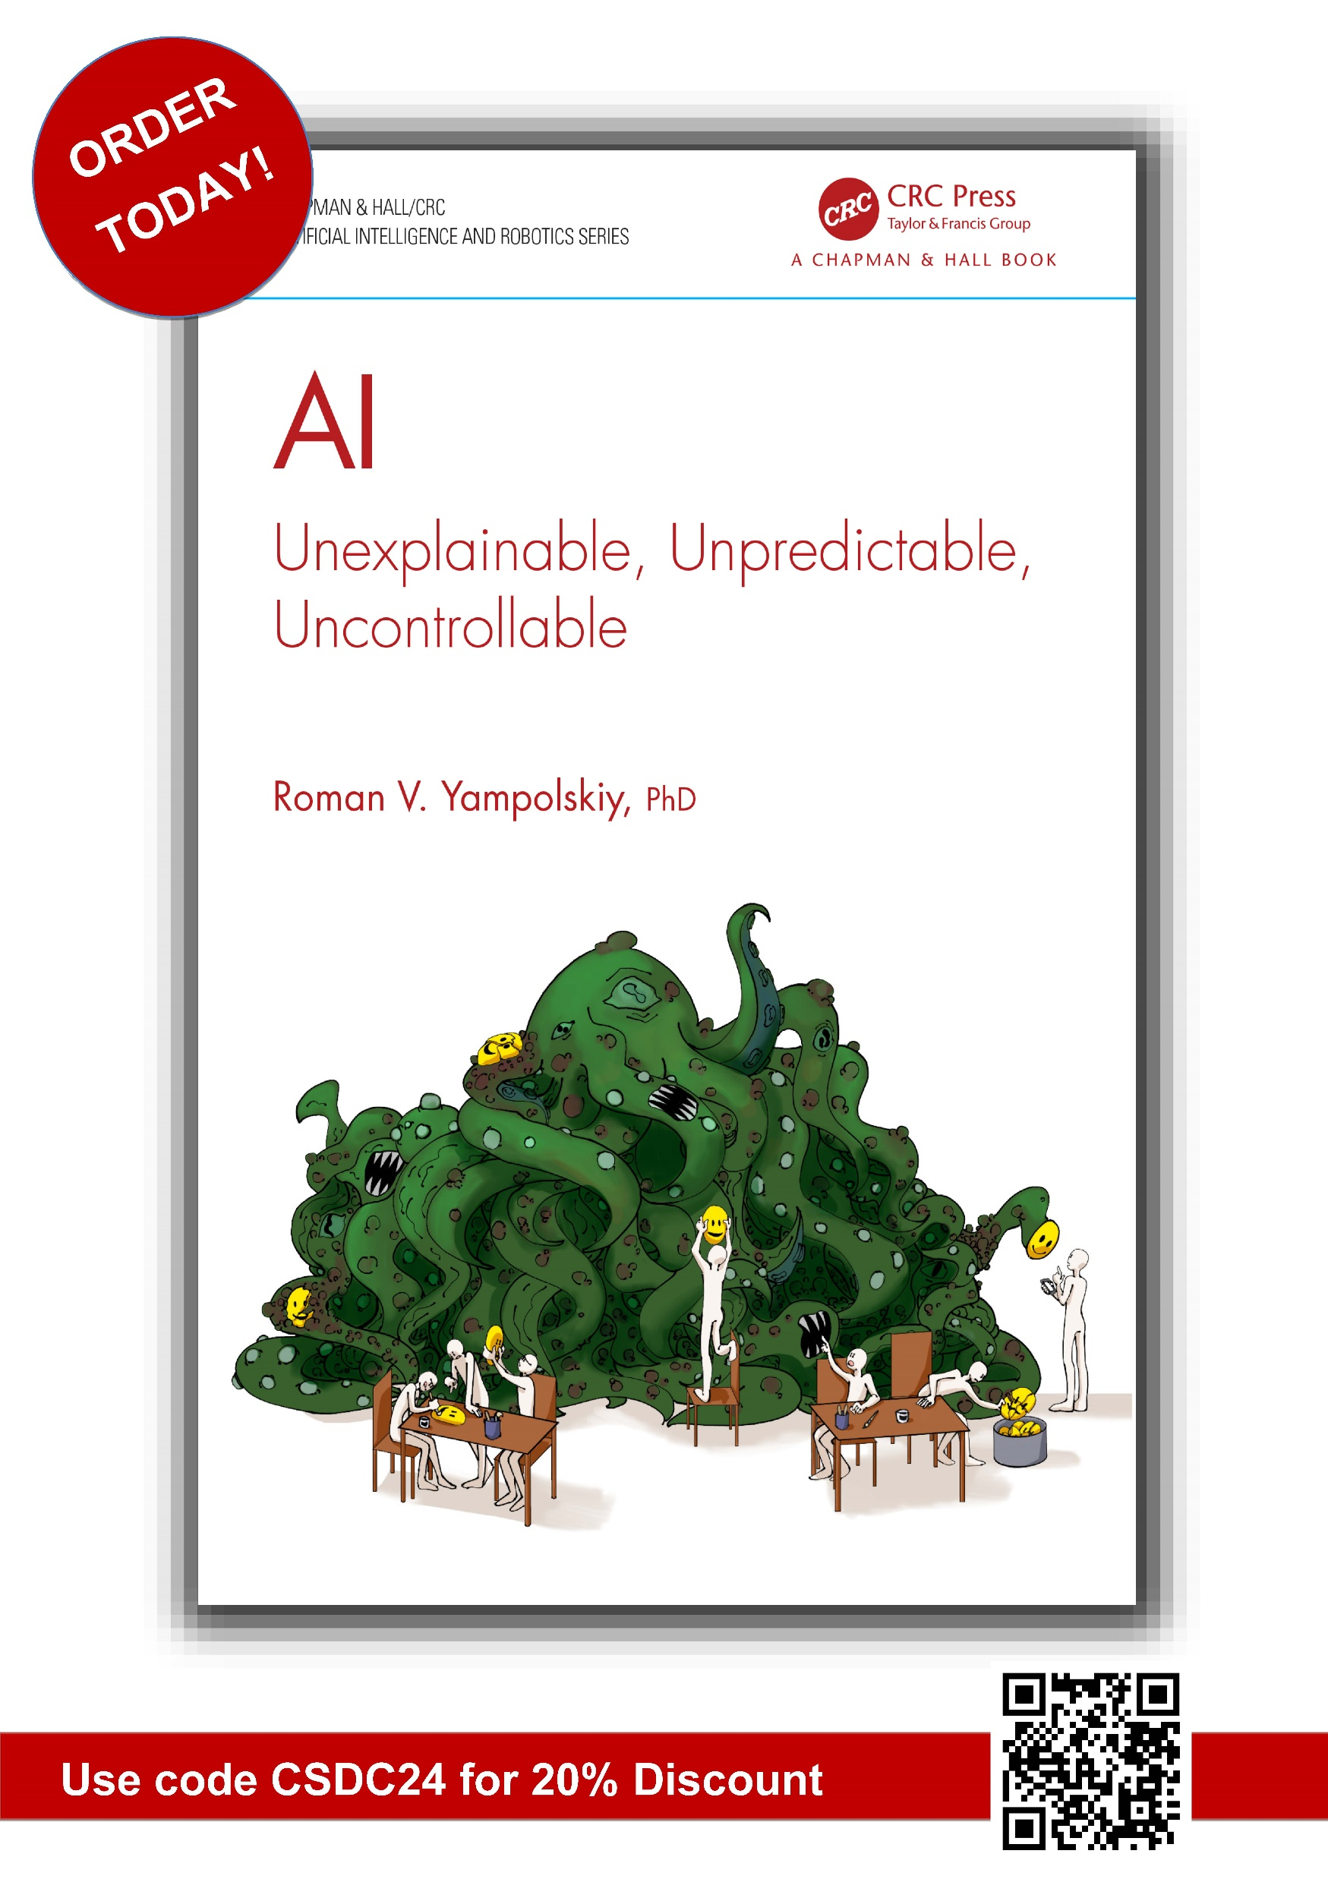
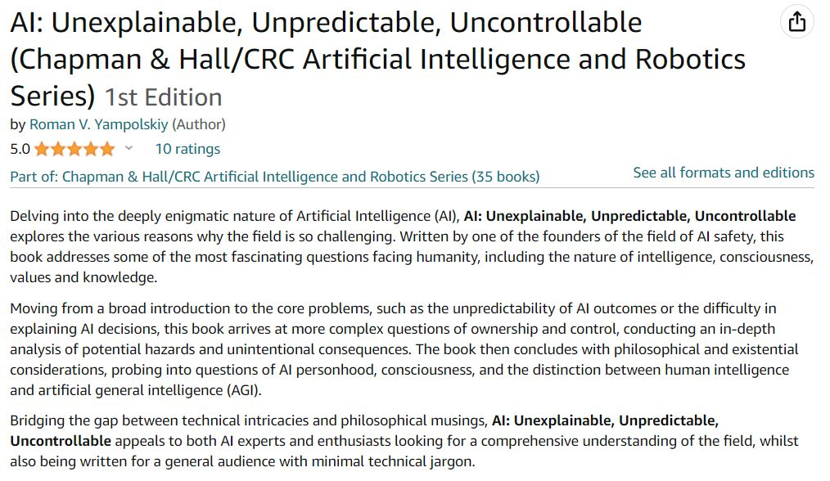
@romanyam roman.yampolskiy@louisville.edu

Slide 14
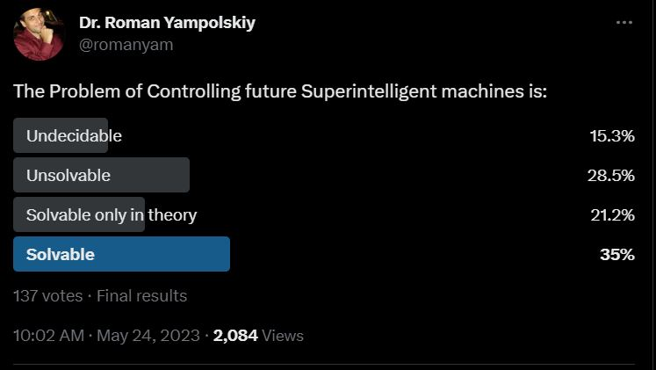
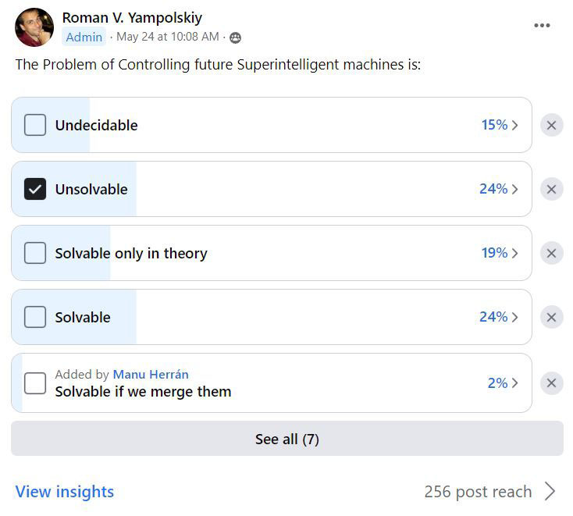
Opinion Polls – The Problem is:
@romanyam roman.yampolskiy@louisville.edu
Small sample size (n=137 tw; n=55 fb).
Mix of experts and nonexperts.

Slide 15
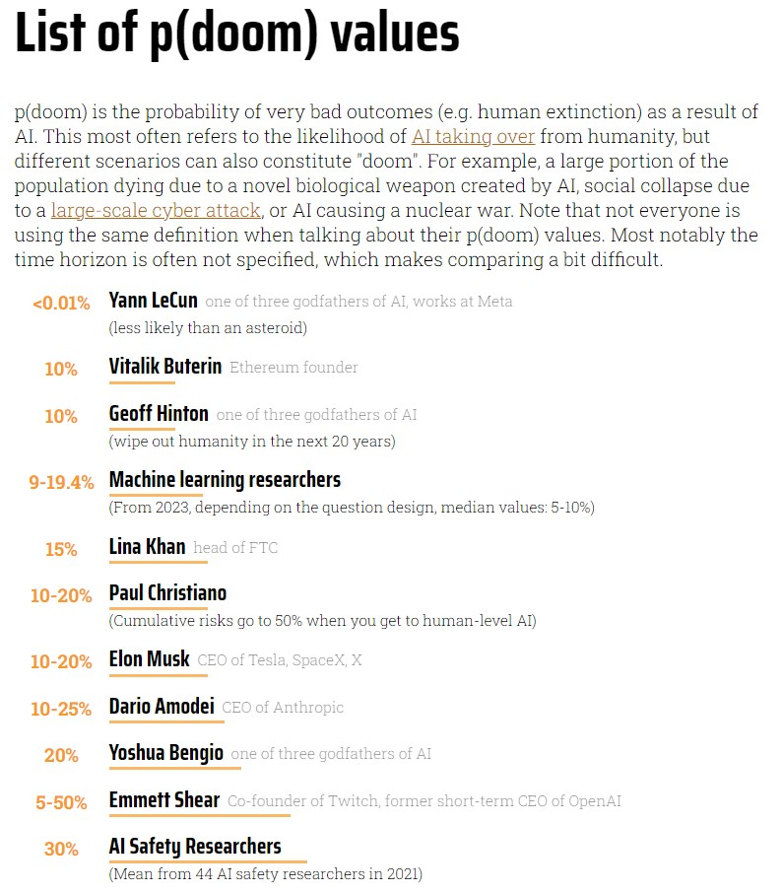

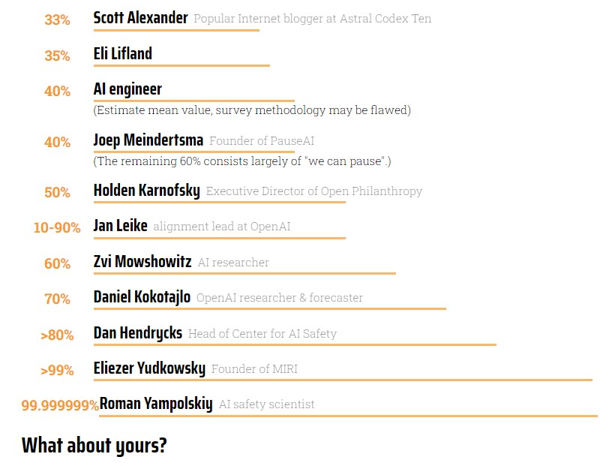
@romanyam roman.yampolskiy@louisville.edu
https://pauseai.info/pdoom

Slide 16
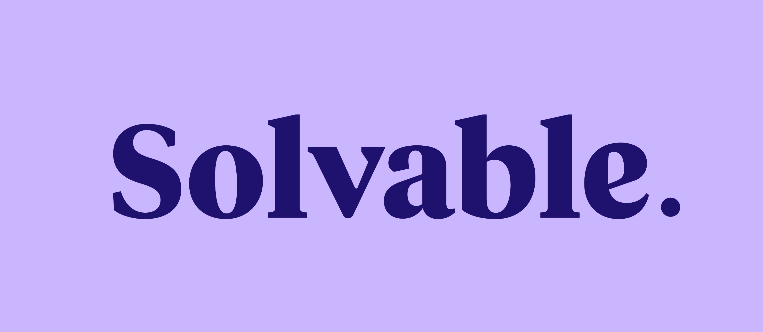
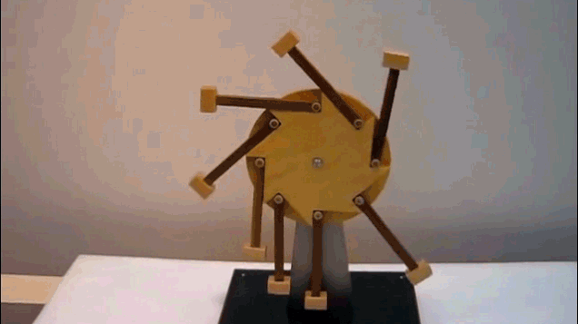
Perpetual Safety Machine
@romanyam roman.yampolskiy@louisville.edu
Cybersecurity or Narrow AI Safety | Superintelligence Safety
Many chances to fix problems. (reissue credit cards, change passwords, etc.) Limited damages (financial loss, privacy loss). 99.9999% safe is good enough. Eventually sufficiently debugged. | Only 1 chance to get it right. Unlimited damages (X-risk, S-risk). <100% Safe is not good enough, but 100% is impossible. Doesn’t stops changing (learning, self-modifying, etc.).

Slide 17
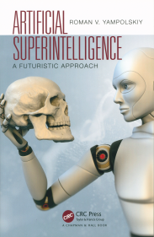


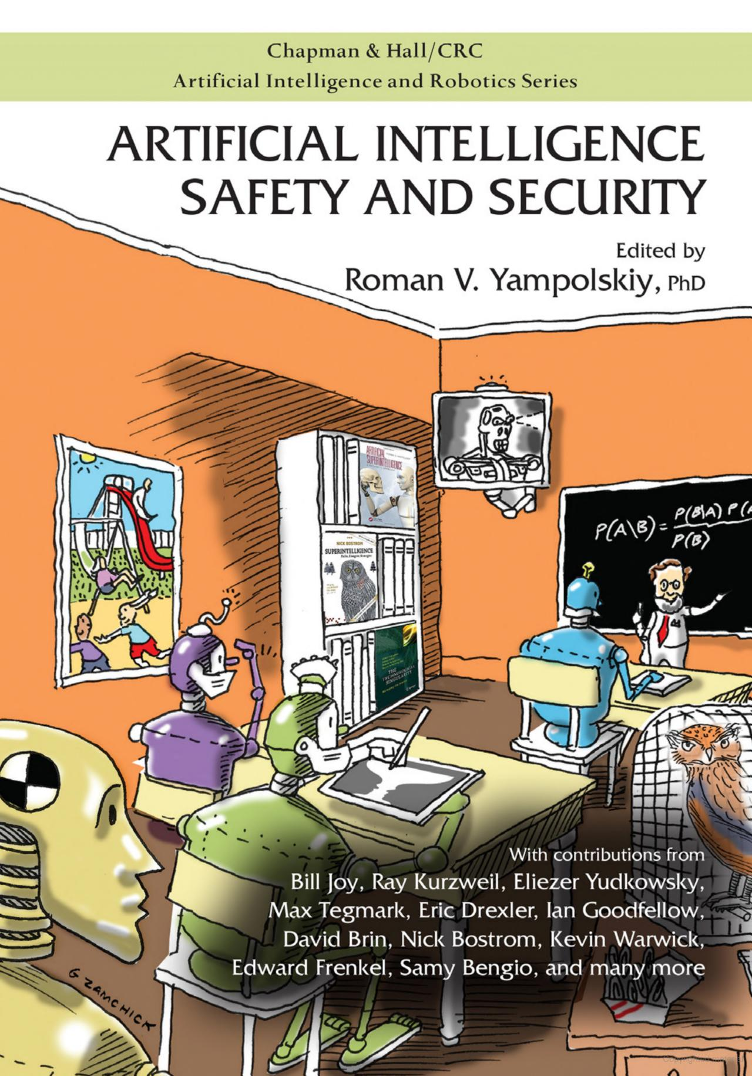

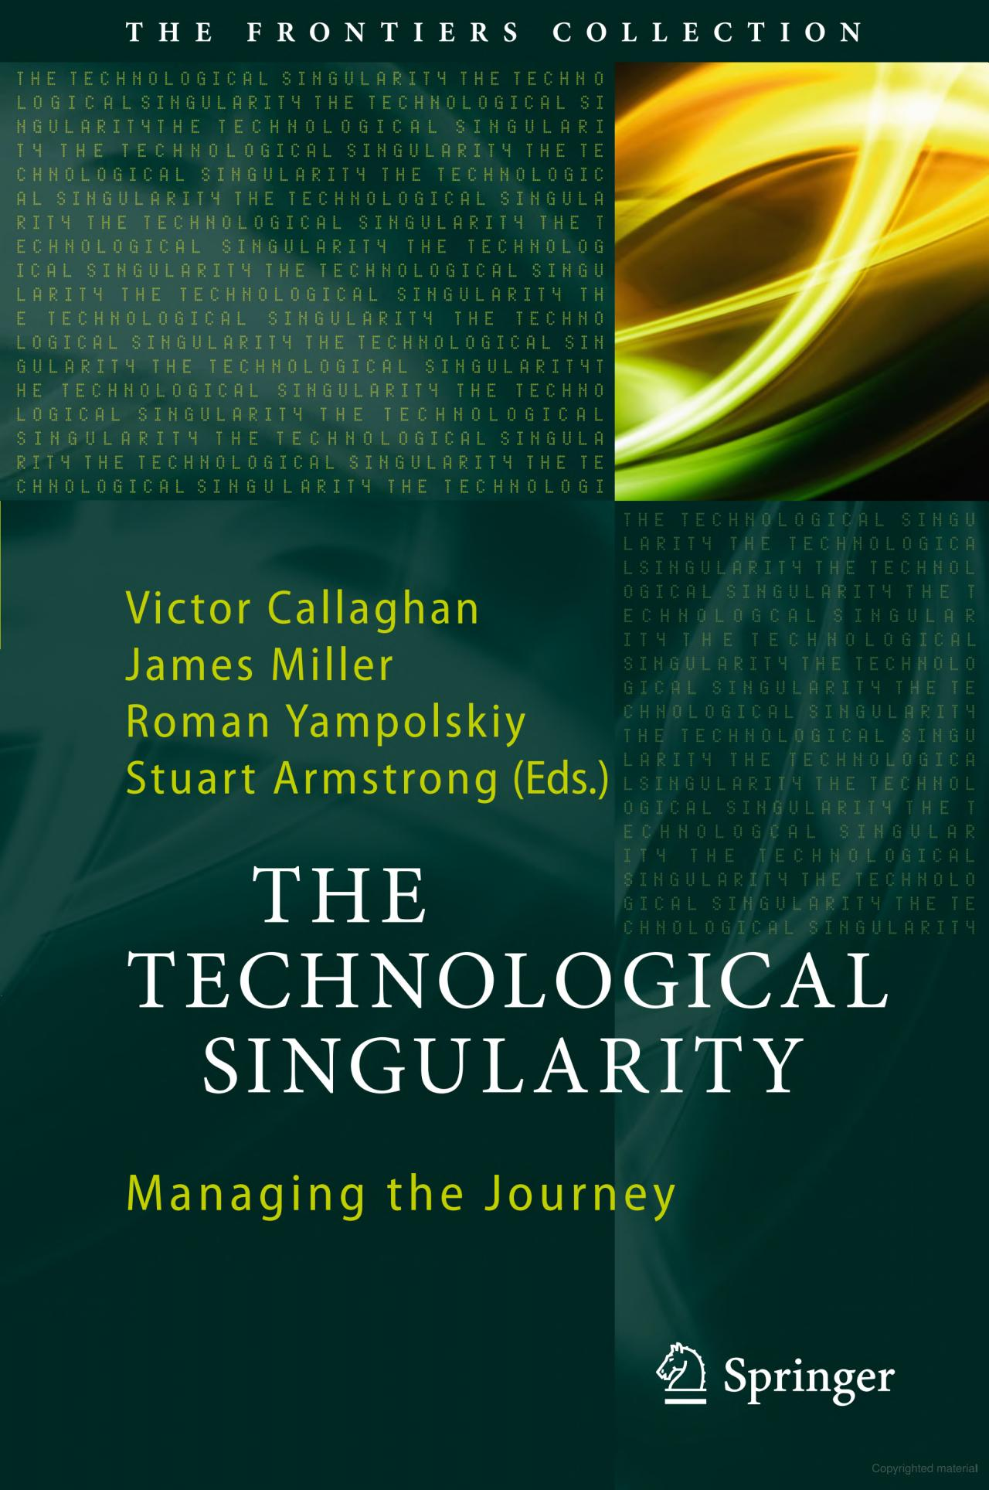
The End!
Roman.Yampolskiy@louisville.edu
Director, CyberSecurity Lab
Computer Engineering and Computer Science
University of Louisville - cecs.louisville.edu/ry
@romanyam
/Roman.Yampolskiy
All images used in this presentation are copyrighted to their respective owners and are used for educational purposes only.

