Slide 1
Crisis or Cure:
The divisive debate on AI’s role in modern healing
Rohan Goswami, MD Director – Heart Transplant Innovation and Research Transplant Cardiologist Division of Transplantation and Heart Failure Mayo Clinic Florida
April 24th, 2024 – World AI Summit Americas

Slide 2
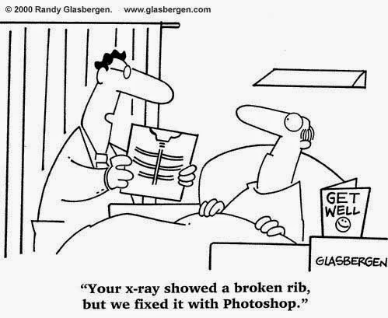
Why am I talking about ai?
Technology
Equity
Access
Notes:
The goal of equity is to reduce and eventually eliminate health disparities among different population groups. The goal of access is to ensure that everyone has the same opportunity to use healthcare services when needed.

Slide 3
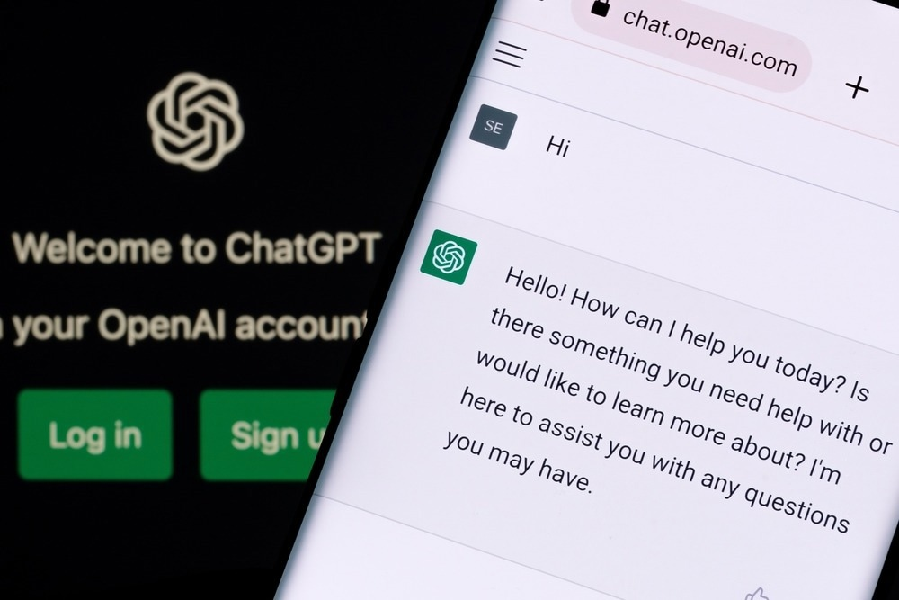
Your “doctor” will see you now

Slide 4
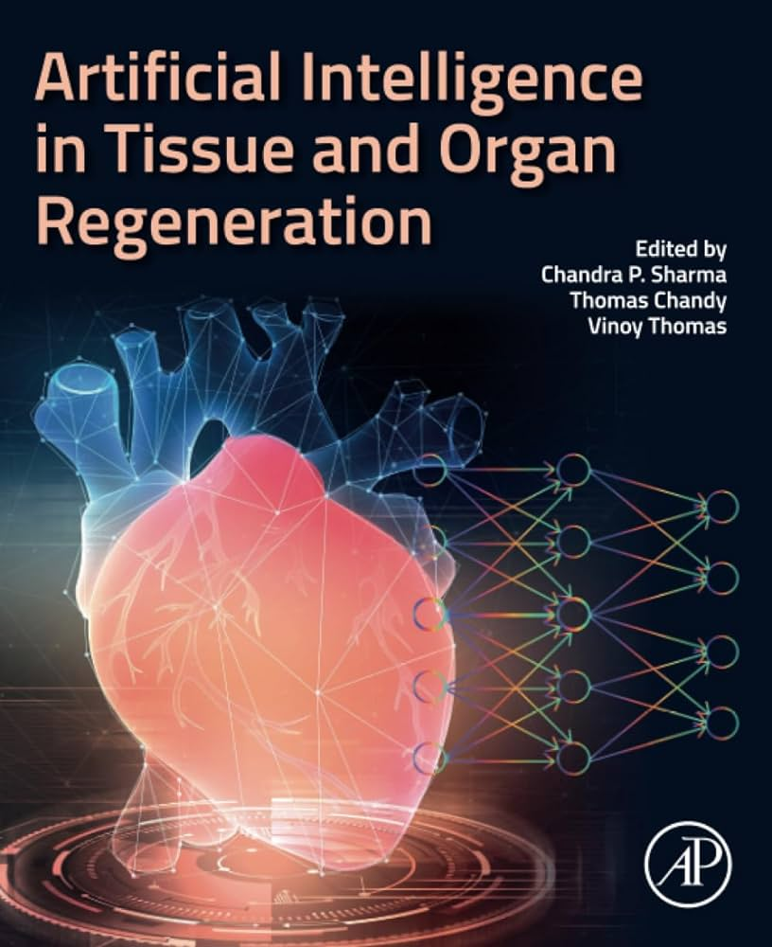
Mayo clinic Florida
#1
Hospital system
#1 in Florida for heart failure and transplantation
#2 in the US for post-transplant survival
# 5 in the US by volume, 80 heart transplants in 2023

Slide 5
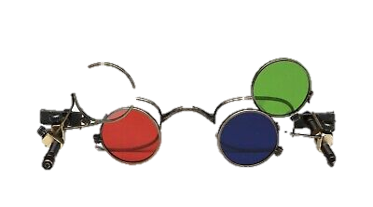
Crisis or cure
Approaching healthcare with a different lens
Understanding data
Population
Interaction
Outcome focused
How do we define benefit?

Slide 6
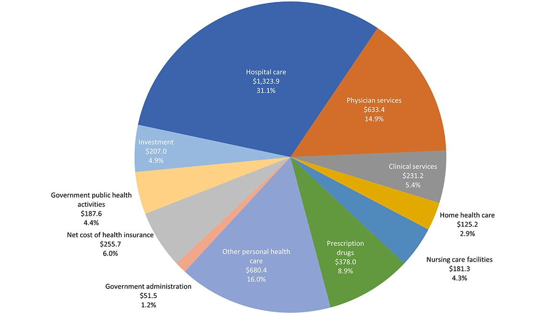
Burden of healthcare in America
https://www.ama-assn.org/about/research/trends-health-care-spending

Slide 7
Burden of healthcare in America
46%
https://www.ama-assn.org/about/research/trends-health-care-spending

Slide 8
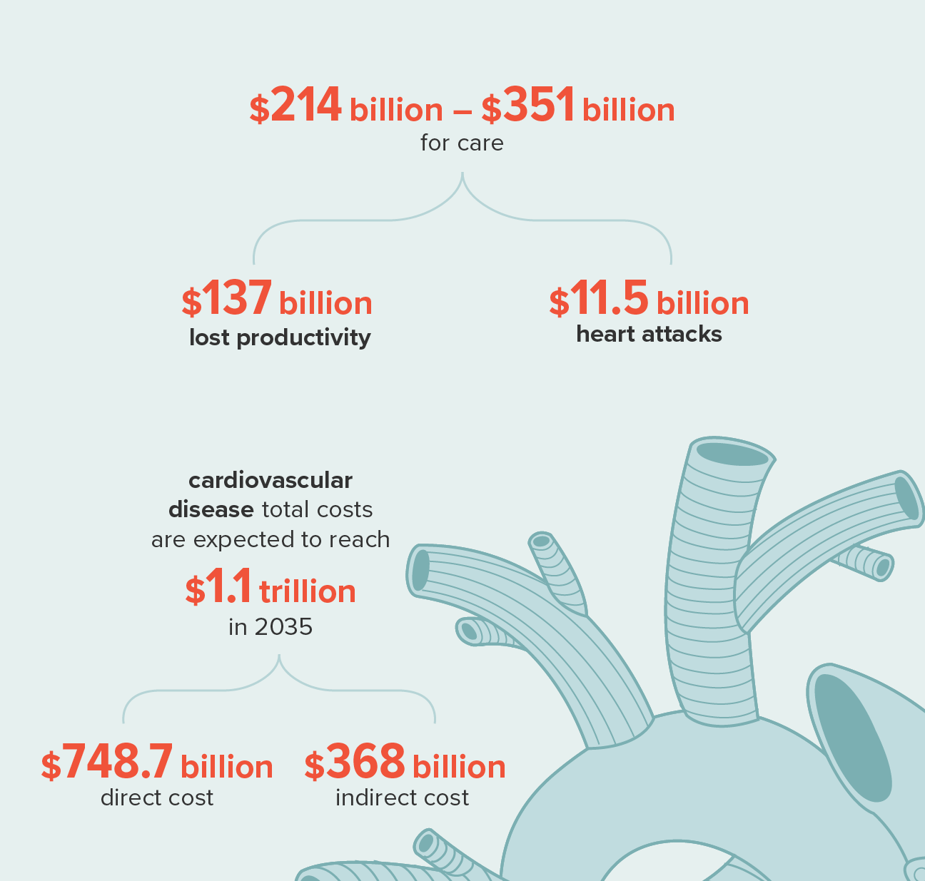
Burden of heart failure
US Costs on the rise
Highest cause of readmission
https://www.ahajournals.org/doi/full/10.1161/CIR.0000000000000659
Notes:
17 million patients die of cardiovascular disease worldwide
6.2 million patients have complications due to heart failure-associated conditions in the US Alone each year
600,000+ have end-stage heart failure needing advanced therapies
3,500 are added to the transplant list yearly (avg)

Slide 9
The good

Slide 10
Traditional use of AI in Healthcare
Traditional Paradigm
BIG
DATA
& A LOT OF IT!!!
New Prediction
Learning from the outcome
Refining the algorithm
Analyzing new data
Goswami R. The current state of artificial intelligence in cardiac transplantation. Curr Opin Organ Transplant. 2021 Jun 1;26(3):296-301. PMID: 33938466.

Slide 11
Patient EXAMPLE
LV
RV
LA
RA
50 year old female
10 years of heart disease
2x heart attack
Open heart surgery
Heart function ~ 10% (NL >50%)
Denied care at 6 centers
End of life options
“nothing we can do”

Slide 12
Reverse engineering AI for healthcare
Clinical Problem (organ failure)
Transplant
Machine Learning Process
A
Output
LVAD
Hospice
B
C
D
Smoker
HTN
Female gender
Cardiac index
Traditional Paradigm
Clinically Relevant Paradigm
DATA
BIG
& A LOT OF IT!!!
New Prediction
Goswami R. The current state of artificial intelligence in cardiac transplantation. Curr Opin Organ Transplant. 2021 Jun 1;26(3):296-301. PMID: 33938466.

Slide 13
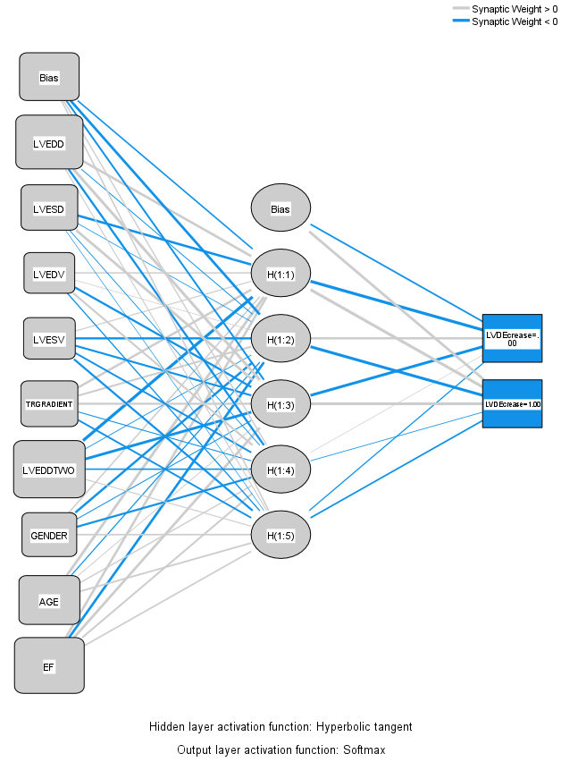
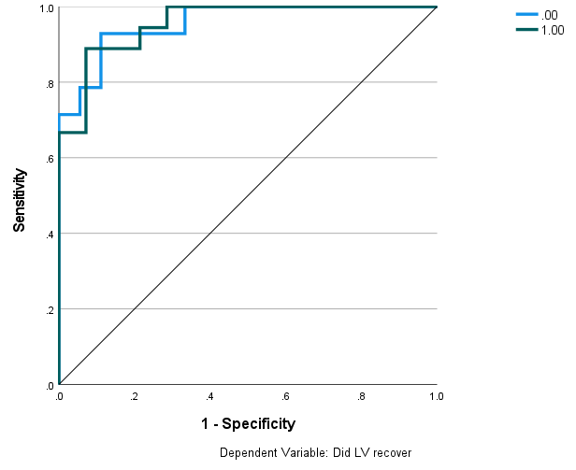
Ai in practice
v1
Utilization of convolutional neural network
Feature characterization to limit bias
Traditional and AI-weighted factors
AUC .956
v2
v3
v4
=0
v5
+1
v6
v7
v8
v9
Pre-publication data, do not share without written permission.

Slide 14
Crisis or cure – paradigm shift
50-year-old female
Long-standing heart disease with a multiple comorbid conditions
Backup options for care
Historical factors
Patient support with artificial heart
Patient survival
AI-Based assessment
Pre-publication data, do not share without written permission.

Slide 15
The BAD

Slide 16
Crisis or cure – Real world case
Can doctors and patients trust AI?

Slide 17
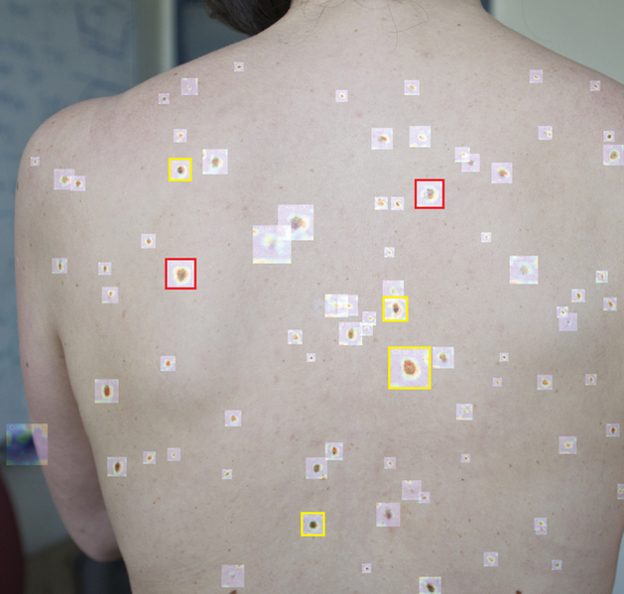
Crisis or cure?
Computer vision based skin cancer screening
Pathology associated training

Slide 18
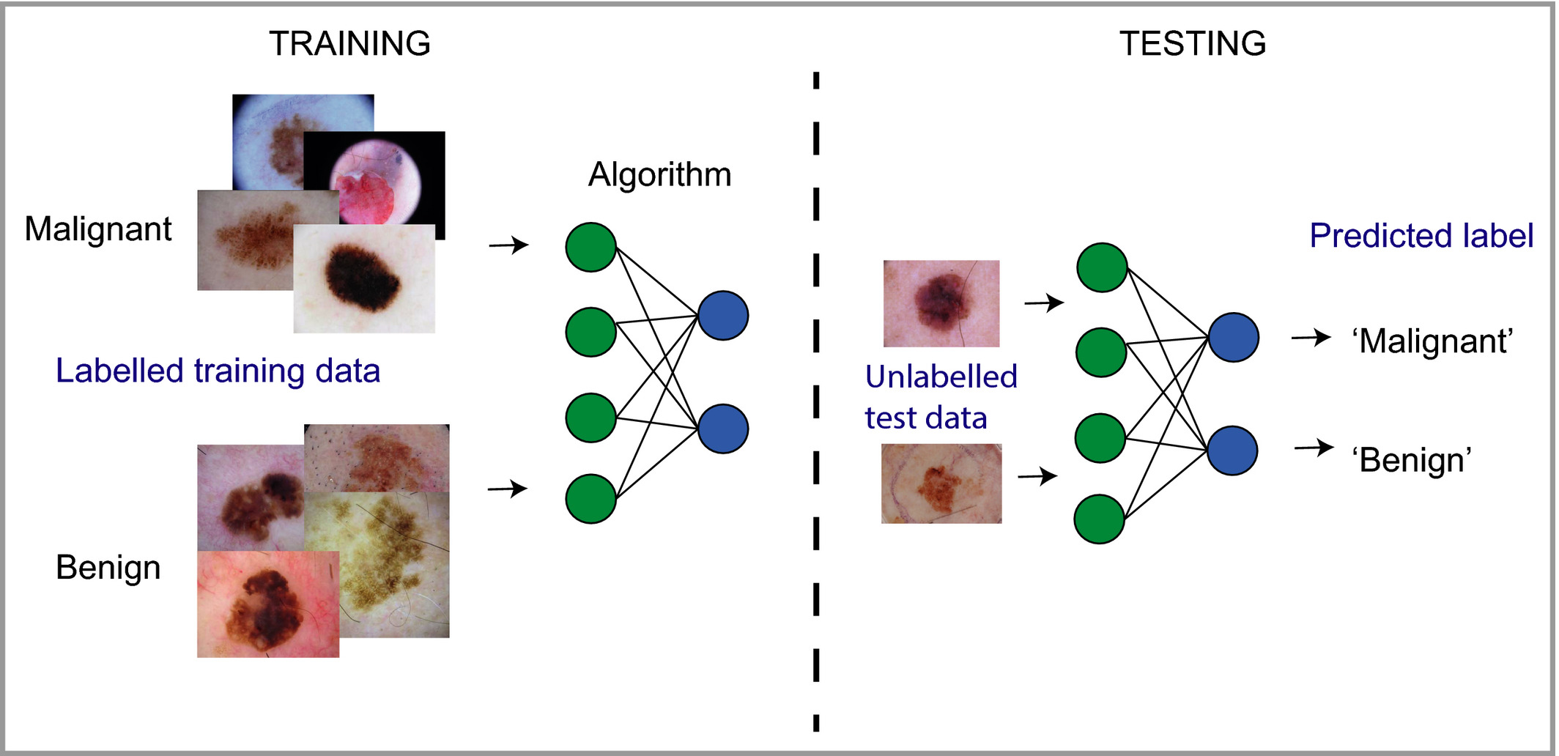
Crisis or cure – real world pitfalls

Slide 19
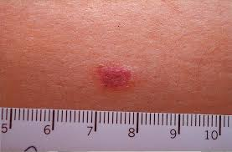
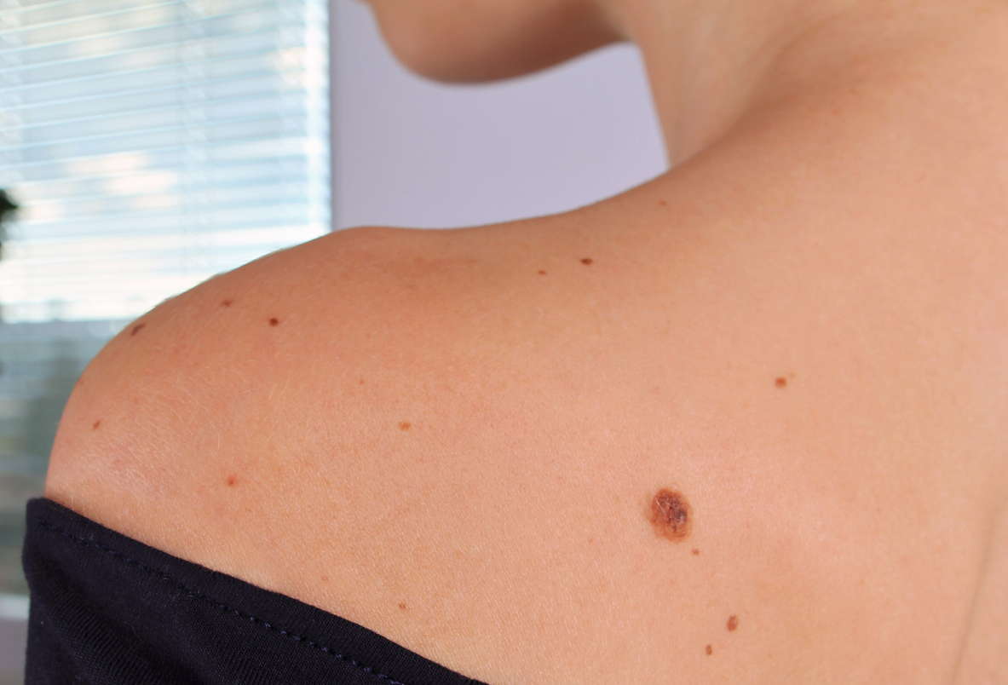
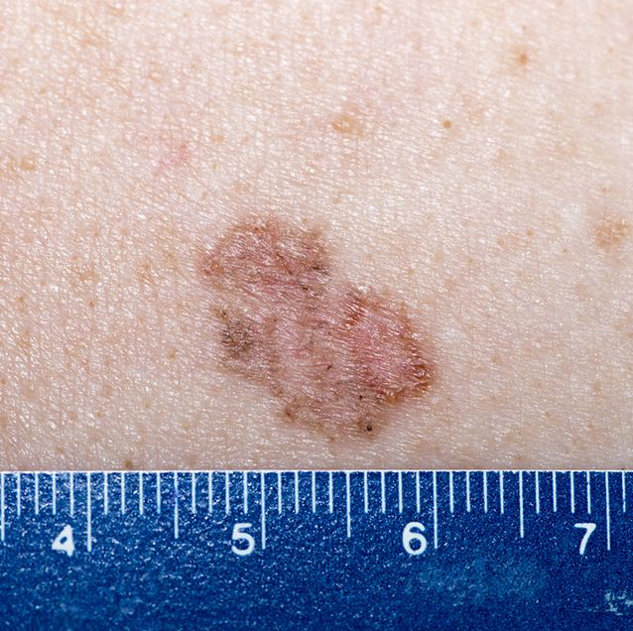
Cancer? “Regular” Mole? Bruise?

Slide 20
The UGLY

Slide 21
Crisis or cure – high stakes
Understanding data in medicine is not the same as other areas of ML
Skin cancer “positive” diagnosis …. Found to be inaccurate
Missed cancer
Unwanted surgery
Affected patient lifespan
1 incorrect analysis
=
1 patient death

Slide 22
Future directions
Equitable modeling
Centralized, independent, validation
Improving access

Slide 23
Thank you
Goswami.rohan@mayo.edu

