Slide 1
Unlocking Value Through Responsible Use of Data
Rebecca Evans, Product Marketing – Responsible AI
April 24, 2024
Notes:
Hello and welcome to our session
My name is Rebecca Evans, I am a Senior Product Marketing Manager at OneTrust
For those of you who don’t know OneTrust, we’re about 8 years old, founded in the wake of GDPR as privacy management solution provider. Today, we help over 14K customers world-wide rsponsibly collect and unlock the value of data, meet and exceed compliance requirements, find and respond to risk, and support initiatives spanning across privacy, security, ethics and ESG to help our customers build and demonstrate trust.
Today I am here to talk about how maturing privacy programs to ensure responsible use of data is the key to unlocking new value for your organization with AI.

Slide 2
Why does privacy matter in the context of AI?
Notes:
Now many of you may be wondering, why are we talking about privacy at an AI conference right?
While it's true privacy isn’t the only key principle for trustworthy AI – there's safety, security, explainability, fairness, accountability, accuracy and transparency – you still need to get privacy right to get responsible AI right. It’s likely why a recent poll conducted by Gartner indicated that 42% of IT leaders cite data privacy as the generative AI related risk they worry about most
Thanks to the rapid pace of AI regulation, many Privacy professionals are now tasked with ensuring legal compliance of their organizations AI systems and mitigate the risk of harms to people.
Second, there’s no carveout for AI technology within existing privacy regulations – so for many of our customers, AI isn’t new, but it is getting a whole lot more challenging to carry out across many organizations

Slide 3
Despite fears, consumers WANT AI
70%
No trust in companies how they use AI in Products.
81%
Believe information will be used in ways they are not comfortable with.
80%
Believe information will be used in ways that were not originally intended.
62%
Believe information could be used in ways that could make people’s lives easier.
Notes:
70% say they have little to no trust in companies to make responsible decisions about how they use AI in their products.
81% say the information companies collect will be used in ways that people are not comfortable with
80% say it will be used in ways that were not originally intended.
Still, 62% of those who have heard of AI say companies using it to analyze personal details could make life easier.

Slide 4
Privacy Pitfalls for AI Adoption
Purpose limitation
Proportionality
Continuity
AI may use data in ways not originally agreed upon by consumers
AI is data hungry and may conflict with data minimization practices
AI is a one-way street for data, misuse can lead to street closures
Notes:
Purpose limitation
AI incentivizes secondary uses of data, which means using data for a different purpose than it was originally intended for. \
The example we commonly use to illustrate this is collecting a birthdate for identity verification and then later using it for a birthday promotion. Unless the individual explicitly agreed to the use of their birth date for marketing purposes, you do not have consent to use the birthday for this use case.
LLMs are challenging because its difficult to truly provide enough detailed information for how the data collected will be used to collect informed consent. A general rule of thumb here is that information should be given to consumers at the point of collection and should be delivered in plain-english
Data minimization vs. Robustness
AI requires robust datasets to ensure accuracy, fairness, and quality which may conflict with data minimization practices
The example we commonly use to illustrate this is using a resume scanning tool to accelerate hiring practices. You’d want to train the tool on a dataset of resumes for qualified candidates. One might think race and gender are not required inputs and remove them to avoid bias. But bias is inevitable regardless of whether you remove those datapoints, without capturing those datapoints there is no way to understand if the training dataset is representative of the impacted population. You actually need those data points to to proactively monitor the fairness of the tool.
So it’s important to consider the purpose and outcomes of the system to determine proportionality of the data and the security controls that are needed
In many ways, PETs (privacy enhancing technology) like differential privacy, synthethic data, homomorphic encryption, multi-party computation, can help protect the sensitive inputs and privacy of individuals who’s data is used in training, while allowing the data to be used for the analysis that’s needed
Business continuity
Data comes in but it doesn’t go out – if you don’t put the right data in then someday that system won’t be available for you. What happens if the data you put into a system is subject to consumer privacy laws, and by extension the right of deletion that consumers under these laws enjoy? AI is like a brain, and just like you can’t unsee something once you’ve seen it, AI can’t unlearn it (yet) – the only thing to do is roll back to a previous version before that data was input into the model and re-train without it.
This can pose a significant threat to business continuity if your processes rely on AI systems that are being trained on data subject to individual consent

Slide 5
Privacy has evolved from a regulatory compliance initiative to a customer trust imperative to ensure responsible use across the data lifecycle
Notes:
All of this combined requires a shift in how we perceive privacy.
Privacy has evolved from a regulatory compliance initiative to a customer trust imperative to ensure responsible use across the data lifecycle

Slide 6
Responsible use touches every stage of the data lifecycle
Delivering the data and privacy promise:
What actually happens
Making the data and privacy promise:
What should happen
How do you delete or modify data when retention periods expire, or consumers exercise their rights?
Do you have consent from the consumer, based on clear purpose, that complies with local regulation?
Dispose
Collect
Data lifecycle within your business
Which activities and AI models will use sensitive data and what are the corresponding risks?
Can you locate and control sensitive data and drift across your data estate?
Store
Process
Use
Share
Do your downstream systems respect signals for privacy and confidentiality?
How are you sharing data with third parties and what AI models are being trained?
Notes:
The concept or responsible use touches every stage of the data lifecycle
And has massive implications for activating data within AI projects
This is the NIST information lifecycle – most organizations use this or something like this in their data management programs
-----------CLICK------------
It starts with collection
- are you transparent about how you collect and use sensitive data?
- when you get information from a customer or consumer do you have their consent to use it?
- do they know what you are going to use it for?
- Does that comply with local regulation, which varies jurisdiction to jurisdiction?
You need to do this for mobile apps, connected devices and so forth
-----------CLICK------------
Once you have that information, what do you do with it?
- what are the activities in your organization that consume, process or manage that data?
- Do you know what the purpose of each is?
- Do you know which is the highest risk?
This is all about risk assessment, you probably have many processes that utilize personal data, which is the highest risk?
Now in this age of embedded AI systems, most of those activities will leverage AI or behavioral models, so it becomes increasingly important to add that to your risk assessment and understand what data, especially personal data is going into those
-----------CLICK------------
No business is an island, you can’t just do this for your company – you need to do this for all the third parties you work with.
- How are they managing that data?
- Are they using that data to train AI models?
- How are you controlling what countries that data goes to?
So, the right hand of this chart is collecting data responsibly and doing the appropriate assessments to ensure you can make risk-informed decisions – both within the organization and across third parties.
Now you have a program in place, let’s make sure the data is being used the right way.
-----------CLICK------------
The consent signal that you collected, and the concept of purpose have to be respected by all downstream systems and must be passed to the right place.
That’s important to make this notion of responsible use work, it’s not good enough to collect the information and say you are going to do something – you must do it as well
-----------CLICK------------
The data also needs to be visible
Where did the data go? It needs to be protected, it needs to have the right access rights.
Most of the time data will expand, so understanding where that data is, taking risk-mitigating actions, understanding if its being used to train AI models, and resolving drift become fundamental.
Drift is the delta between what is happening to the data and where it is and what you thought was happening to the data and where you thought it was – those should be the same thing
-----------CLICK------------
Finally, every piece of data ultimately hits an end of life
So, what do you do when retention periods expire, or when a consumer says you can no longer use their data?
How do you get rid of it?
What is your process for doing that?
What happens to AI models that might have been trained off that data?
-----------CLICK------------
So, this entire lifecycle is important for every piece of personal and sensitive data in the organization
The right hand side is the promise that you are making
and the left hand side is how you deliver that promise

Slide 7
Goals of the ​
Data Privacy Maturity Model​
​
Tie data privacy to value and support overall business strategy​
Reinforce importance of multi-disciplinary approach​
Establish common internal language​
Support program planning
Notes:
The goals of the data privacy maturity are One - to tie data privacy to business value
Two & Three, I’ll combine – are to establish a common language across teams you need to deliver privacy
and Four, supporting the overall program planning and roadmap development that you have in your organization
This model enabled a company to set its business strategy for data privacy, and the approach we will go through is a complement to traditional maturity models that support execution of individual components in that strategy
So why do we need a maturity model? Don’t we have enough?
Data privacy is evolving, it has historically been focused on regulatory compliance
Now its increasingly focused on customer trust, so this evolution from regulatory compliance to customer trust imperative means that the business value is changing from mitiating risk by ensuring compliance to thinking about privacy as a strategic driver for the business
There is a virtuous cycle of data underneath all of this when an indivudal trusts that a company is using their data responsibly, they are willing to share more data, that’s going to enable the business to increase its engagement, loyalty, and lifetime value
This notion of reinforcing customer trust to unlock the value of data is the strategic goal for a privacy program.
We have three catalysts for privacy in 2024

Slide 8
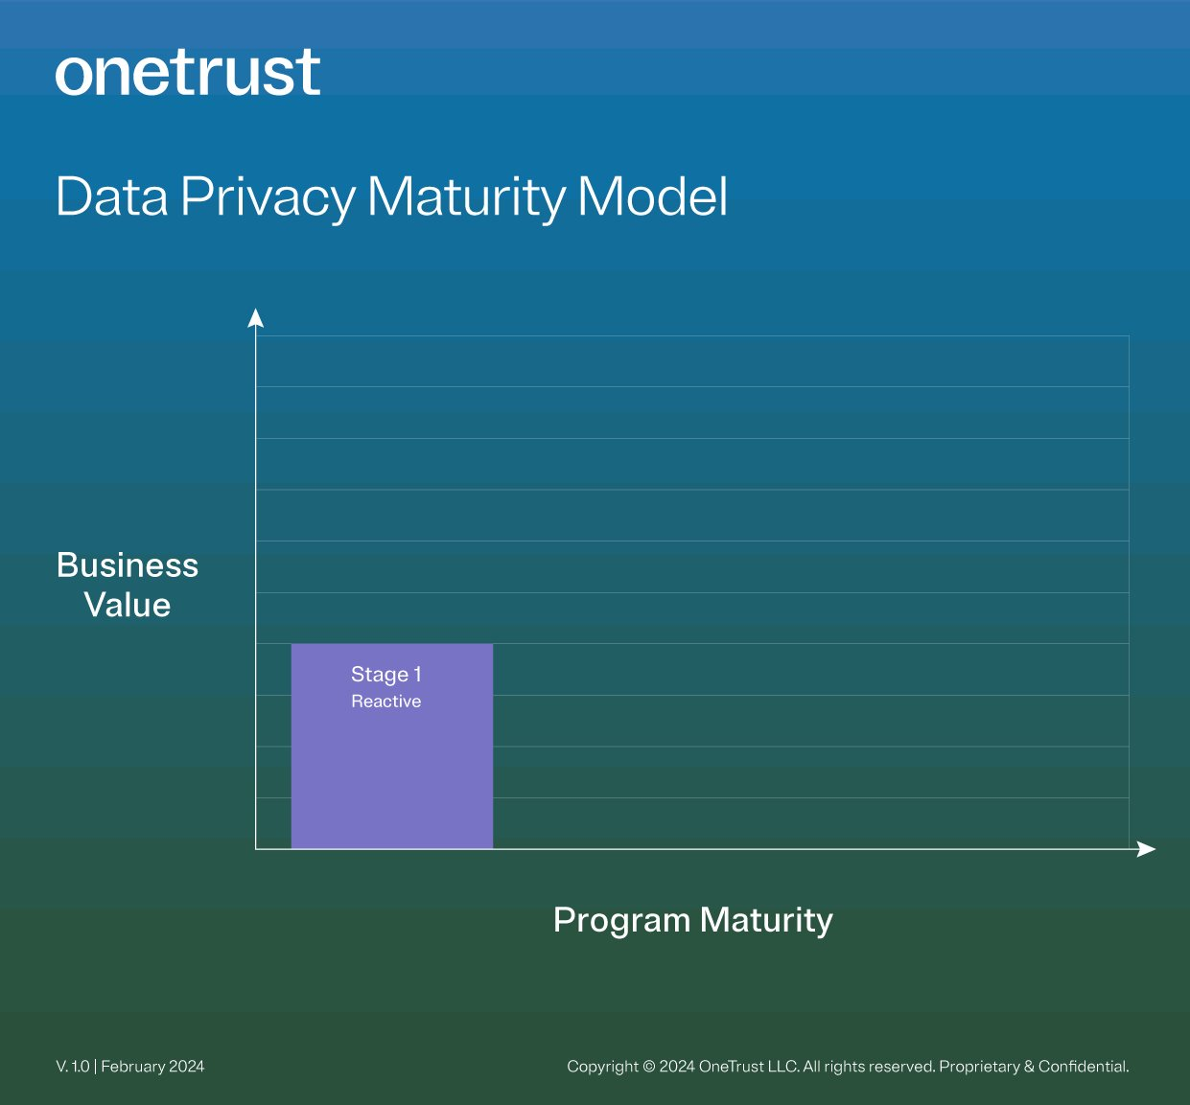
STAGE 1: REACTIVE
Value to business
Reactive compliance
Reactive, tactical, request-driven workflows
Ad-hoc program, policy, and record-keeping
Minimal funding – perceived as low risk
Process
Spreadsheet-based manual processes
Ad-hoc, triggered by request or enforcement
Organizational alignment
Siloed with time-shared privacy owner
Minimal cross-functional collaboration
Consumer experience
Basic website cookie compliance
Email-based DSAR process
Static privacy notice
Data and activity
Static, manual data and activity map
Limited visibility to cross-border data transfers
Ad-hoc risk assessment
Minimal visibility into data storage and usage
AI governance
Minimal visibility into AI usage
Ad-hoc risk assessment
Notes:
No let’s looks at each stage.
Stage 1 is reactive
Companies often don’t have established privacy programs at this stage – they tend to address new regulations reactively as they emerge
The data privacy efforts are primarily tracked via spreadsheets – - we’ve all been there- which are not scalable
And, generally data privacy is not yet prioritized – programs are addressing baseline requirements such as cookie compliance
Privacy in this stage is someone’s part-time job, and this ad-hod and reactive approach can be inefficient and often and ineffective for keeping up with regulatory and business requirements
In this stage, there’s limited, arguably no insight into the level of AI usage in the organization
So reactive, generally where a lot of companies started when regulation first hit

Slide 9
STAGE 2: PROACTIVE
Value to business
Proactive compliance
Proactive planning for new regulations
Structured data-centric program
Valued by leadership – partial accountability
Process
Software-based processes
Change management for new regulations
Organizational alignment
Dedicated leader (e.g., Chief Privacy Officer)
Access to IT resources and budget
Consumer experience
Multi-channel consent
Preference center for direct marketing
Web intake and automated workflow for DSAR
Data and activity
Evergreen map – source of truth for purpose
Structured, collaborative risk assessment
… including third-parties and ecosystem
Visibility and inventory of sensitive data assets
AI governance
Project, model, and dataset inventory
Structured, collaborative risk assessment
Visibility into training datasets
Notes:
Stage 2 is proactive
So here, companies begin using software extensively to establish more of a structured data privacy program to comply proactively with regulations. They have an understanding, framework for how regulations are evolving and what they need to do. They start to think of some of the commonalities of those regulations and frameworks.
Here now is when we see privacy become a key duty for someone senior in the legal or compliance function, and they generally oversee small teams.
Companies will gain visibility in their data, something they did not have in stage 1 – some understanding of where sensitive data lives in the organization. They become more astute at addressing third party risk, which is becoming increasingly important, and they start to integrate basic AI oversight.
This intersection between AI, data privacy and governance programs is absolutely essential – these are directly linked. One of the things Gartner says is that AI amplifies any existing issues you have in your privacy and data governance programs – that is a pretty accurate statement, right? Now the risks have ratcheted up, and if there is something that I have wrong, incomplete or something I am delaying, then it comes back to potentially haunt me because now the implications of those gaps are that my AI models get training on inappropriate data, biased data, and potentially drive decision making that is inappropriate or disadvantages certain groups
So in this stage, usually, companies aren’t all the way to figuring those pieces out but they are starting to get some understanding of what their basic AI inventory is – what are the AI projects they have that are AI based, what are the models in use, maybe around the datasets used as well.
But still in stage 2, the primary goal of the data privacy program is compliance

Slide 10
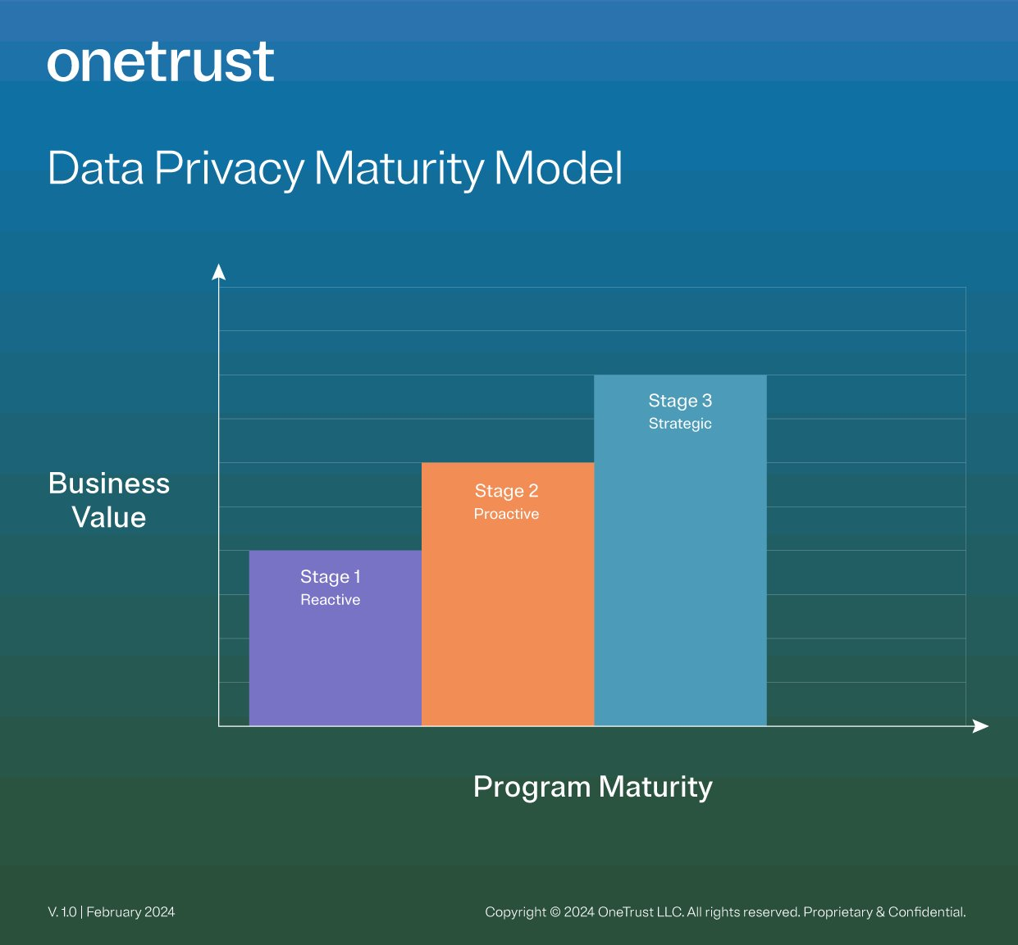
STAGE 3: STRATEGIC
Value to business
Assured compliance
Strategic framework anticipating regulations
Visibility tied to action for program violations
Clear accountability in the business
Customer preferences (enabled by trust)
First-party data acquisition core to business
Process
Repeatable, automated workflows
Standards to anticipate future regulation
Organizational alignment
Privacy DRIs added to IT & marketing teams
Strong IT partnership to deploy and operate
Consumer experience
Post-cookie consent, incremental opt-out
Preference center: product / service choices
DSAR: Fully automated fulfillment & redaction
Data and activity
Data controls enforcement and validation
Identification and remediation of data drift
Mitigation of risk from sensitive data
Enforcement of data retention / minimization
AI governance
Governance linked with project development
Risk assessment of third-party use of AI
Risk mitigation for training datasets
Notes:
Stage 3 represents a major shift in the data privacy program, at this level of maturity we start to see privacy teams with much more optimized automated processes and very importantly, accountability is not just on the shoulders of the legal and compliance function but also shared responsibility with technology and marketing stakeholders.
Many times in stage 1 and 2, many of the challenges with privacy, is that it’s a data problem – its not a regulatory issue. Regulation is there to make sure the right things happen with data, its about the data. So whomever the owner is, they need to have the engagement of the technology team and go-to-market teams to support deployment of the program and get long term value from it.
In this stage we see the accountability get spread, and directly responsible individuals on technology and marketing. Privacy becomes the link, the unifying force between these two functions.
Companies in this stage, start to view privacy as an enabler of customer engagement. This is where the move to first-party data starts, so how do I start to collect consented data – not just making sure I support do not sell/do not track, but making sure I collect consented data that will feed my first party data strategies. One of the many challenges organizations have, is that they are data hungry, but they have not put in place what the impact of that first-party data is going to be. They see it as essential to getting and maintaining consumer trust, but exactly how that is going to manifest within the experience they provide is still being worked on but more and more fundamental – there’s a link now that there’s value from those kinds of investments.
The company now also actively monitors and addresses data privacy violations – what happens with the data, what should be done with it. Establishes the right data controls and now starts looking at AI not just from the perspective of an inventory, but looking at the datasets being used for model training, identifying is there’s sensitive data being used in those datasets, and mitigating that risk.
Majority of the Global 2000 are on the boundary of 1 and 2 – over 50%.
There’s about 25% who’s started to move into stage three, because they’ve connected the value of privacy with customer trust strategies.
Things are on the left for most companies, and they’re looking for guidance to get to the right

Slide 11
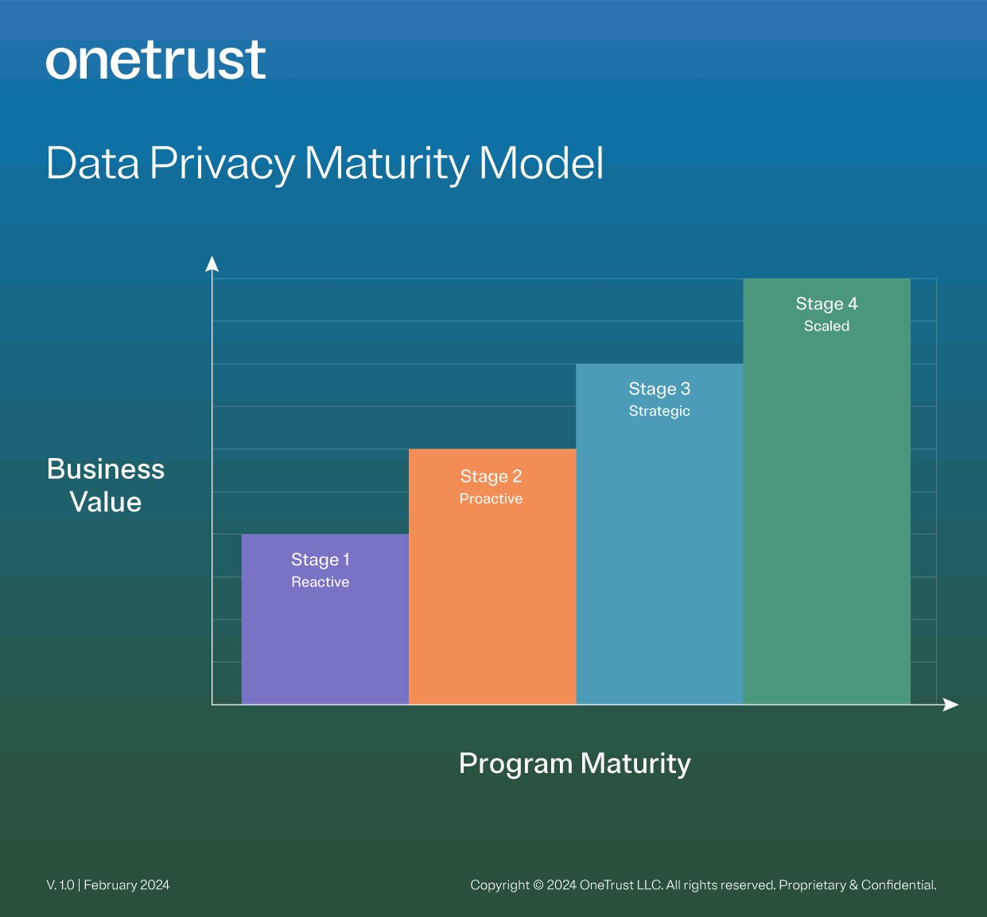
STAGE 4: SCALED
Value to business
Unlocking and activating data
Data privacy as enabler for innovation
Shift-left governance to address issues early
C-level accountability in the business
Customer engagement (centered on trust)
Customer loyalty and lifetime value outcomes
Process
Optimized processes, regularly reviewed
Higher standards than required by regulation
Organizational alignment
C-level accountability in every functional group
Hub-and-spoke with decentralized execution
Consumer experience
User consent synchronized across channels
First-party data drives marketing/product strategy
Trust center: Integrated consumer right UX
Data and activity
Unlocking and activating data
Behavioral analytics and AI model training
Enforcement of responsible use policies
Data sharing and future-proofing
AI governance
Shift-left governance to surface issues early
Faster innovation and time-to-market
Responsible practices and defensibility
Notes:
Stage 4 is scaled, and it’s the final stage, and the reality is there’s no final stage this is an ongoing journey but here is where you want to be
Privacy is an integral part of the decision-making process, integral part of product development and overall organization strategy.
Why is that? Because its seen as a mechanism to activate customer data for business use, and increase in customer lifetime value
So many organizations are making large investments in data warehouses, data lakes. How do I expose data for use by the business? And privacy is one of the key, think of it as core hygiene for these data sources, to unlock them and leverage them for business innovation organizations wants.
So if I want to apply AI or behavioral analytics to my datasets, I need to be able to do that responsibly. My datasets need to be future-proofed which means I need to think about where I need consent, where is it relevant. And for things like model training, what is the role of consent? Is it better for me to say I am going to use de-identified datasets even if they may not be the ideal dataset for that model, knowing that I may not have access to that data in the long-run and its not my data, its my customers data. It actually drives a new set of decision points when I think about the datasets that are being ingested, and not just the AI models but overall behavioural analytics.
This is also relevant for companies in datasharing environments. So stepping back, in stage 4 I now have a tight link between my customer engagement, loyality and lifetime value strategies, with privacy, and I’ve thought very carefully of what the long-term impact is with the datasets I have and how I am sharing those internally and externally. My processes are more optimized, policies are defined centrally, many organizations move to a hub and spoke model in this part of their journey and I generally have to be able to have reliable, de-centralized execution.
Coming back to AI, at this point, AI governance programs are embedded much earlier into the development cycle for my internal projects and my procurement cycle for 3rd party solutions, embedded solutuons that I am buying to support my ability to innovate and move to market fast.
A lot of this tied to the general notion of shifting left in the process, so I have the governance earlier in the process rather than later. So the data privacy program becomes central to unlocking the business value of my data.

Slide 12
VIRTUOUS CYCLE OF CUSTOMER TRUST
​
EARN
RETAIN
EXPAND
Notes:
Bringing it all together
As the program matures, it evolved from a regulatory compliance initiative – which is the curve you see flattening out over time – to a customer trust imperative that unlocks the power of data
Transparency drives trust, and as I mentioned earlier, the more a customer trusts an organization, in a way that benefits the customer, the more data they’ll share, the more that organization will be able to unlock
so compliance is the foundation but this is why these two value curves are key – you need that as a basis, and as that gets embedded in your organization’s mindset, I can now start driving trust value – the value from the data that I unlock and I realize value from both these
So maturing a program along this journey, certainly takes time, commitment and clear direction. And each organization will inevitably follow a different pace and trajectory – I would like to leave you with three principles I believe are impactful for companies of any stage of maturity:
The first is fostering a privacy-centric culture – absolutely, not an afterthought values by leadership
The second is thinking through practically, how collaboration will work across Privacy, IT and the line of business teams – how do I embed privacy early? This is one of the failure points of many programs, its not the technology, its not the intent, its not leadership – a lot of times its just very hard to drive collaboration across teams with different internal langauges
And third, thinking about agility at the beginning of the program design, because the regulations are everychanging and even more importantly, technology innovation like we’re seeing with AI now will only become more rapid

Slide 13
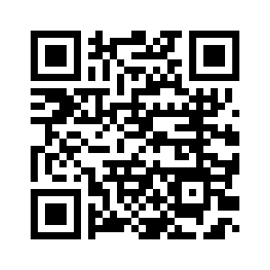
Thank you!
Connect with me on LinkedIn

