Slide 1
Supercomputing for AI
Today, tomorrow, and how to do it in a sustainable way
Nicolas Dubé, Ph.D.
HPE Senior Fellow and Chief Architect
HPC and AI Business Unit
World Summit AI - Montreal
April 24th, 2024

Slide 2
Exascale and how we got there

Slide 3
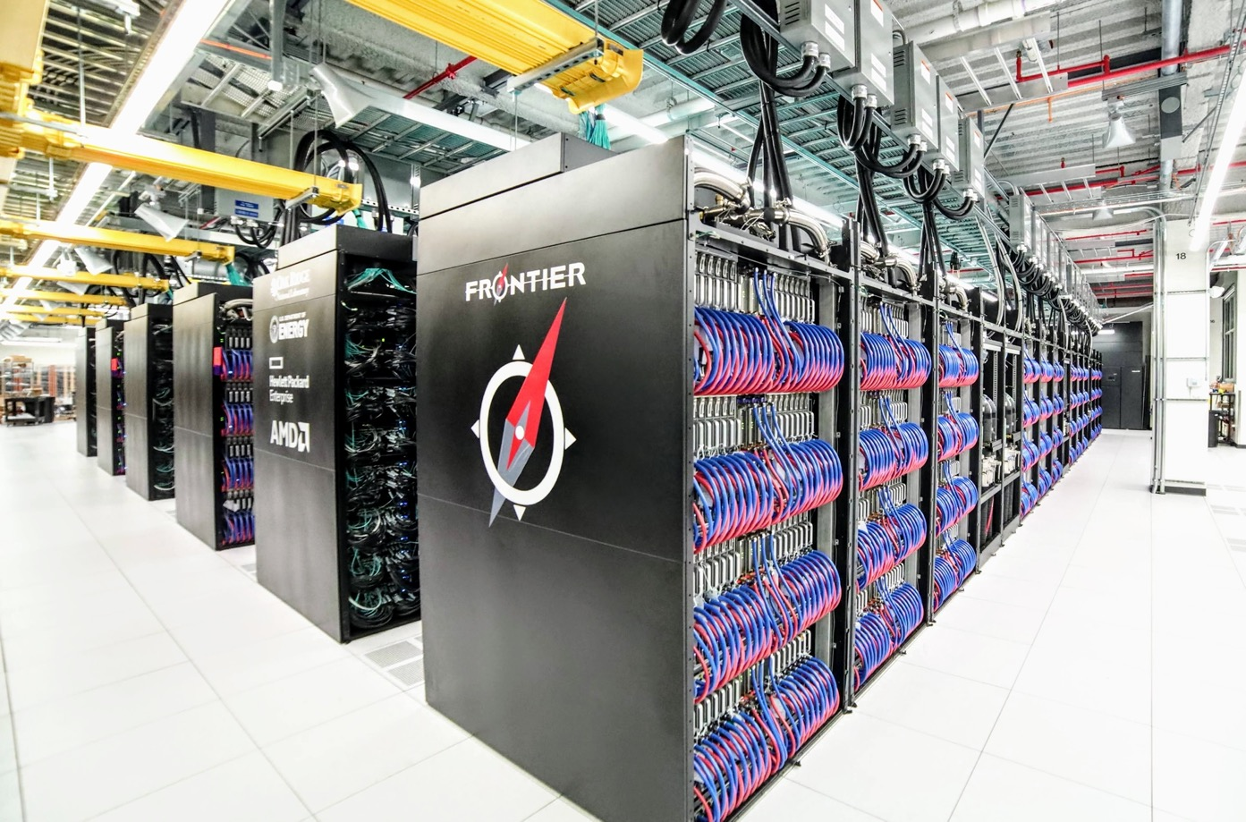
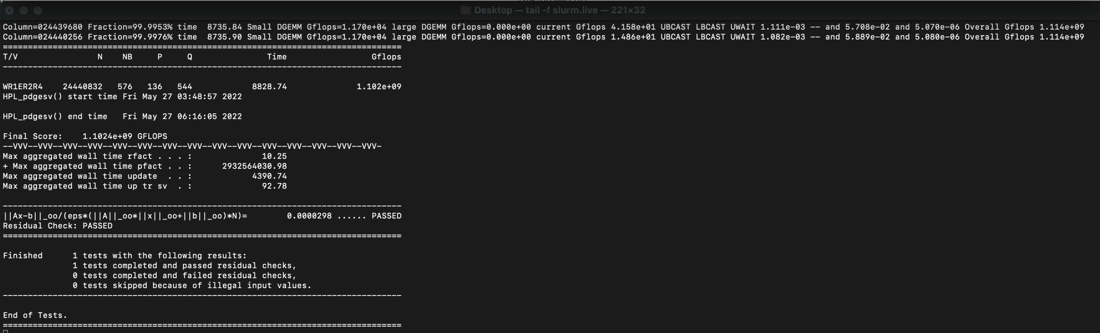
We achieved exascale on May 27th, 2022, at 6:16 am
Frontier in numbers:
  37,888 AMD MI-250 GPUs
  9,472 AMD Trento CPUs
  2,424,832 HBM chips
  75,776 DIMMs
  23,680 cooling connectors
  2368 switches
  37,888 High-Speed NICs
  150 km of interconnect cables
  21-29 MW of power
Performance
  1.19 Exaflops
  19.2 Pflops per rack
  4.85 PB HBM + 4.85 PB DDR
  7.5 PB/s injection bandwidth

Slide 4









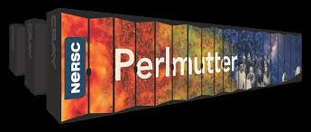
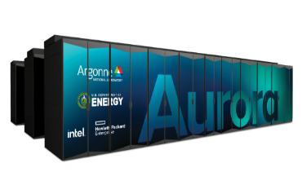
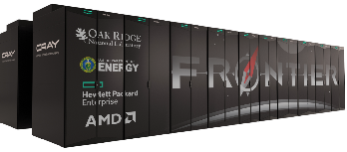
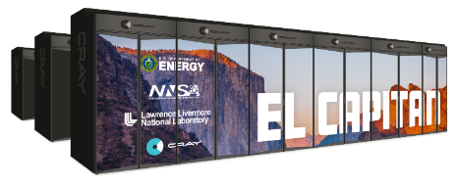
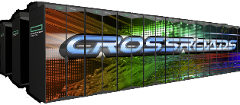
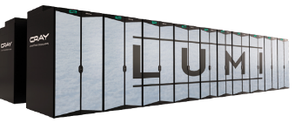
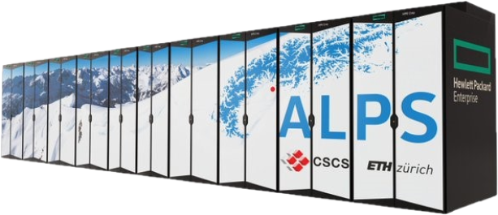
Delivering the fastest systems on the Planet
WORLD’S FASTEST
EU’S FASTEST
Lawrence Livermore National Laboratory
CSCS
L U M I
EXASCALE
EXASCALE
EXASCALE
DELIVERED
DELIVERED
DELIVERED
IN FACTORY
DELIVERED
DELIVERED
IN FACTORY
AMD Milan EPYC CPU & NVIDIA GPU with Slingshot interconnect
Future Intel Xeon CPU & Intel Xe architecture with Slingshot interconnect
AMD EPYC CPU & AMD Instinct GPU with Slingshot interconnect
AMD Instinct MI300a APU with Slingshot Interconnect
Intel Xeon Sapphire Rapids HBM/CPU with Slingshot interconnect
AMD EPYC CPU & AMD Instinct GPU with Slingshot interconnect
NVIDIA Grace Hopper ARM + GPU with Slingshot interconnect
STORAGE
STORAGE
STORAGE
STORAGE
STORAGE
STORAGE
STORAGE
35 PB All Flash
Cray ClusterStor
E1000
200 PB
Cray ClusterStor
E1000
700 PB
Cray ClusterStor
E1000
400 PB
Cray ClusterStor
E1000
Not Publicly
disclosed
87 PB
Cray ClusterStor
E1000
10 PB**
Cray ClusterStor
E1000

Slide 5
Has AI become a supercomputing problem?

Slide 6
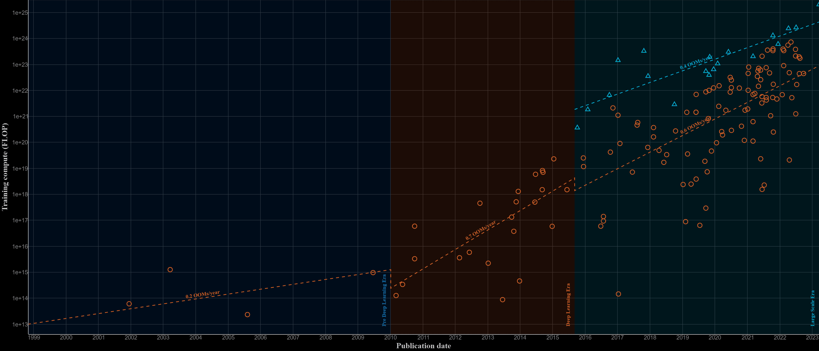
Factors and megatrends: AI is now a supercomputing problem
One week of ORNL Frontier supercomputer
(8 AI EXAFLOP/s, 40k GPUs)
One week of accelerated server
(6 AI PFLOP/s, 8 GPUs)
One week of iPhone 14
(2 AI TFLOP/s, 1 GPU)
Pre-deep learning (1960–2009)
Deep learning (’10–’16)
Foundation models (’16–)
Source: https://epochai.org.org
Notes:
Double click on the AI mega-trend: Today, AI is a supercomputing problem.
Backdrop of 3 Eras and compute trends…
X: Model publication data; 3 eras
Y: Compute load (Flops) for training
Summary: We have collected a dataset and analysed key trends in the training compute of Machine Learning models since 1950. We identify three major eras of training compute - the pre-Deep Learning Era, the Deep Learning Era, and the Large-Scale Era. Furthermore, we find that the training compute has grown by a factor of 10 billion since 2010, with a doubling rate of around 5-6 months. See our recent paper, Compute Trends Across Three Eras of Machine Learning, for more details.
Pre-deep learning: 1.5x/yr - Growth rate in the training compute of milestone systems from 1956 to 2010
Deep Learning: 4.2x/yr - Growth rate in the training compute of milestone systems since 2010.
Foundation Models: 100x - Gap between the compute used by large-scale models and other notable models in the same year.
Ten years ago, the first successful neural networks for run on a single GPU. Today, a model like GPT-3 that is behind ChatGPT requires thousands of GPUs. It costs tens of millions of dollars to train one model to a desired accuracy and the workload itself runs for several months (6 months of AI model training is not uncommon)
The availability of supercomputers to train AI models has enabled new innovations for AI - From training computer vision models or simple natural language processing tasks , we now are able to train foundational models and generative AI models to create legal documents, code, images, video etc. using natural language prompts. Supercomputers enable training large models with trillions of parameters. AI models trained on large amounts of data and on supercomputers get more accurate, customizable and valuable.
=================
Compute Trends Across Three Eras of Machine Learning
Model size has grown 5x/year in the last 4 years
Vision and language training datasets from 1990 to 2022 have grown by 5 and 9 orders of magnitude
The cost of the single final training run of a milestone ML model has passed $1M in 2022
1 week = 604,800s = 6 * 10^5 s
Frontier: 1.2 EF64/s, approx. 5 EF16/s = 5 * 10^18 F16/s
1 week of Frontier = 5 * 6 * 10^ 23 F16 = 3 * 10^24 F16
Iphone 14: 2 TF16/s = 2 * 10^12 F16/s
1 week of iphone 14 = 5 * 2 * 10 ^ 17 F16 = 10^18 F16
H100: 750 TF16/s = 7.5 * 10^14 F16/s
8xH100 = 6 * 10^15 F16/s
1 week of 8-GPU server = 6 * 6 *10^20 = 4 * 10 ^21 F16

Slide 7
Can supercomputing fix large-scale AI issues?

Slide 8
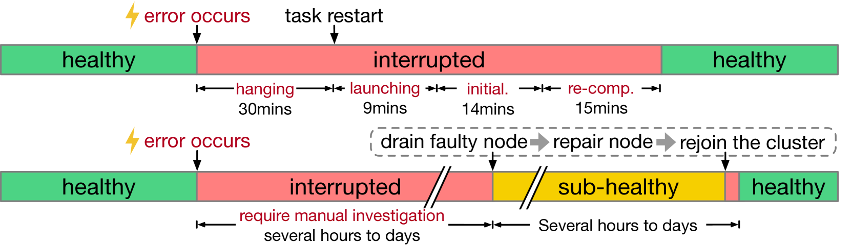
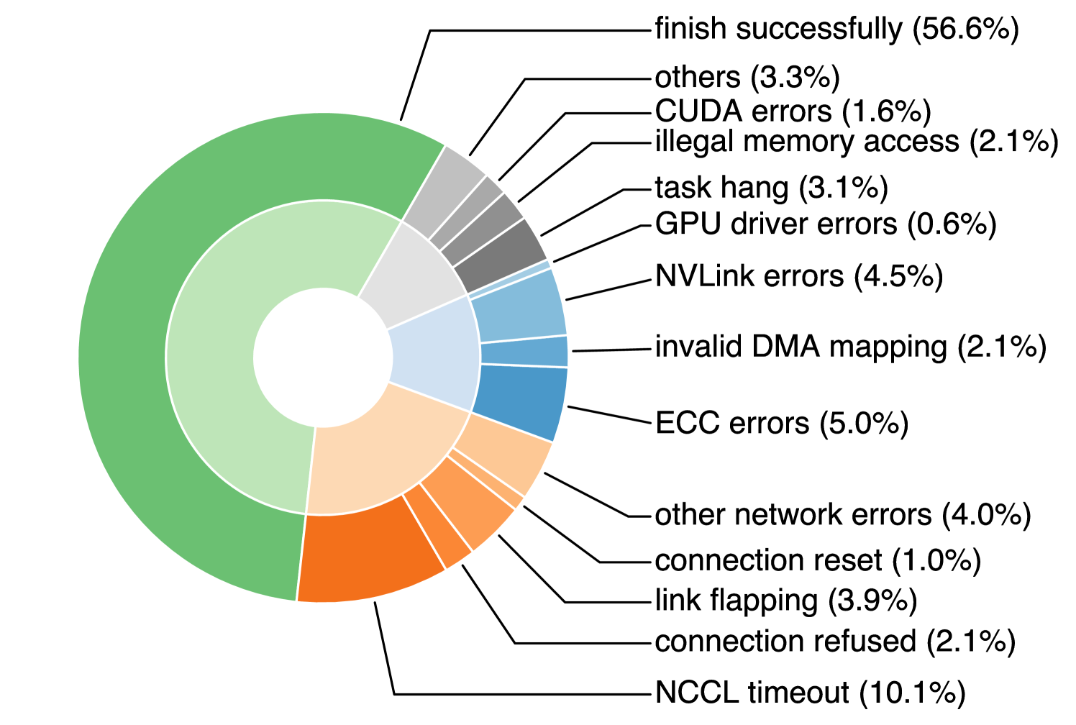
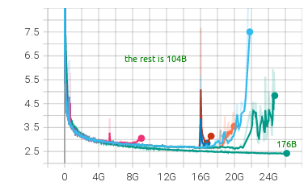
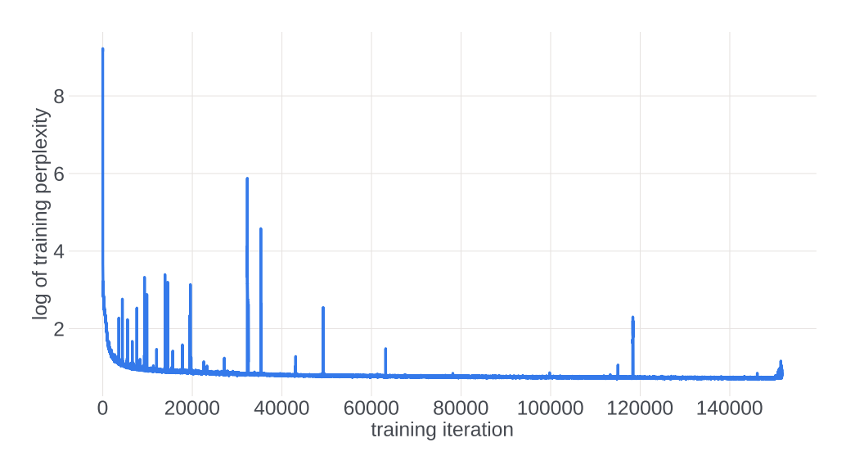
Many are reporting high failure rates for cloud GPUs
(100+ jobs using >100 GPUs)
Troubleshooting
Error types
Reference: Unicron: Economizing Self-Healing LLM Training at Scale
Training instability (Algorithm and Model architecture)
https://arxiv.org/pdf/2304.09871.pdf
https://github.com/bigscience-workshop/bigscience/

Slide 9
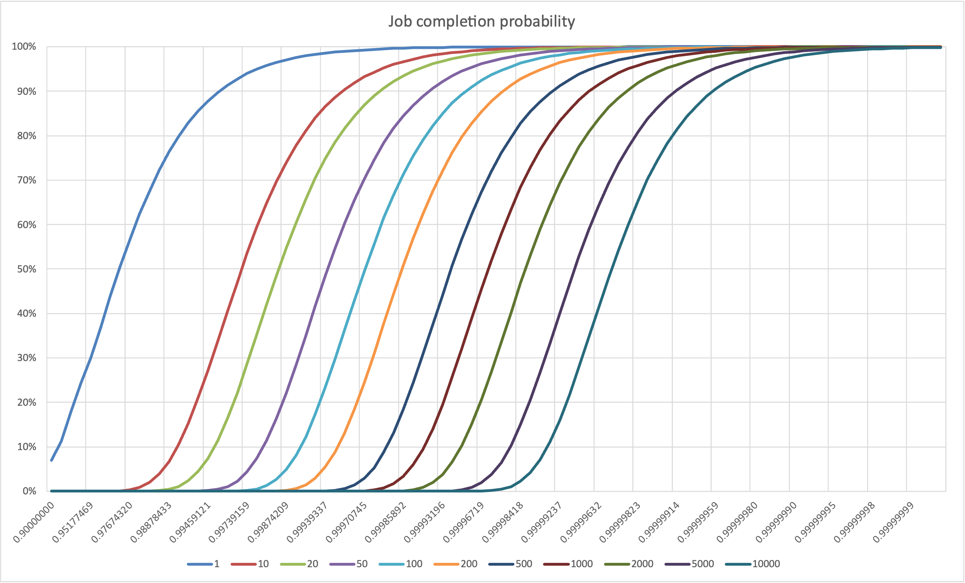


Strong-scaling workloads call for something different than today’s cloud
99.5% Uptime
99.9%
7 “9s” required for 10k GPUs !
Assumptions
Failure recovery time : 1h
Job duration : 24h
Failure probability at time t
where

Slide 10
Supercomputing technology also allows us to train trillion parameter (GPT4-sized) models as one single monolithic model
Time to Train Model vs. System Size
Time to Train Model vs. System Size
With supercomputing technology, we’re able to train a GPT-4 size model in a monolithic approach in 49 days (at a cost of $150M), compared to 91 days without supercomputing (at a cost of $272M)
This contrasts with an MOE approach where a model can be trained in 12 days without supercomputing, and 7 days with supercomputing
95%
~100%
90%
~100%
80%
91 Days
10%
53%
27%
Time to Train Model (Days)
99%
49 Days
99%
97%
12 days
7 Days
94%
512 NVDA reference pod
Frontier: ~40K GPUs
1
2
5
10
20
50
100
200
1.8T Parameters (~GPT-4) - Base
System Size (K GPUs)
1.8T Parameters (~GPT-4) - Optimized
1.8T Parameters (~GPT-4) - MOE = 8 - Base
1.8T Parameters (~GPT-4) - MOE = 8 - Optimized
Note: Efficiency is shown as a % on each plot, defined as: Productive model training time / Total Time

Slide 11
Next Steps and Innovations Required
Design AI systems like supercomputers
  Liquid Cooling
  High-Speed networking with adequate bandwidth
  Parallel file system
Implement more granular and distributed checkpointing
  Per GPU, ideally asynchronous
Rethink runtime and frameworks from bulk-synchronous to asynchronous
  Neural networks don’t run like physics simulations

Slide 12
The path to sustainable supercomputing

Slide 13
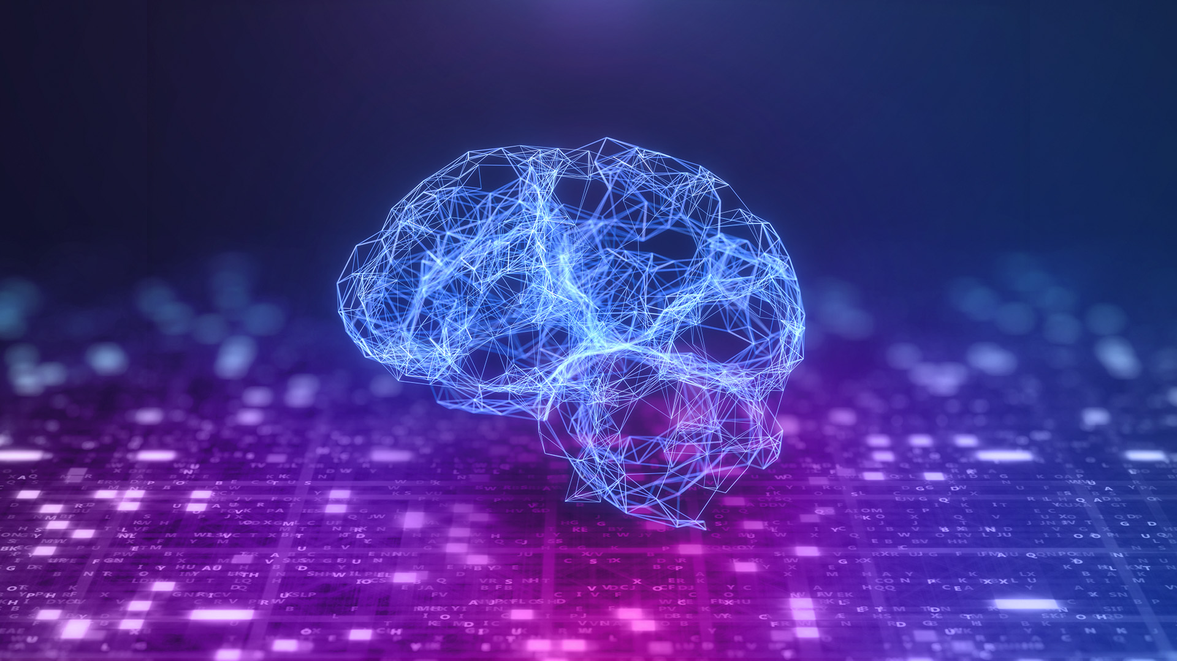
Let’s find another image for Large language models. I liked this one on google (see cut/paste below) but it’s obviously not our photo. Can we find something more like this though? Chat GPT is a well known LLM so something that represents that.
“Training GPT-3, for example, which has 175 billion parameters, consumed 1,287 megawatt hours of electricity and generated 552 tons of carbon dioxide”
Patterson & al., Carbon Emissions and Large Neural Network Training
https://arxiv.org/ftp/arxiv/papers/2104/2104.10350.pdf

Slide 14
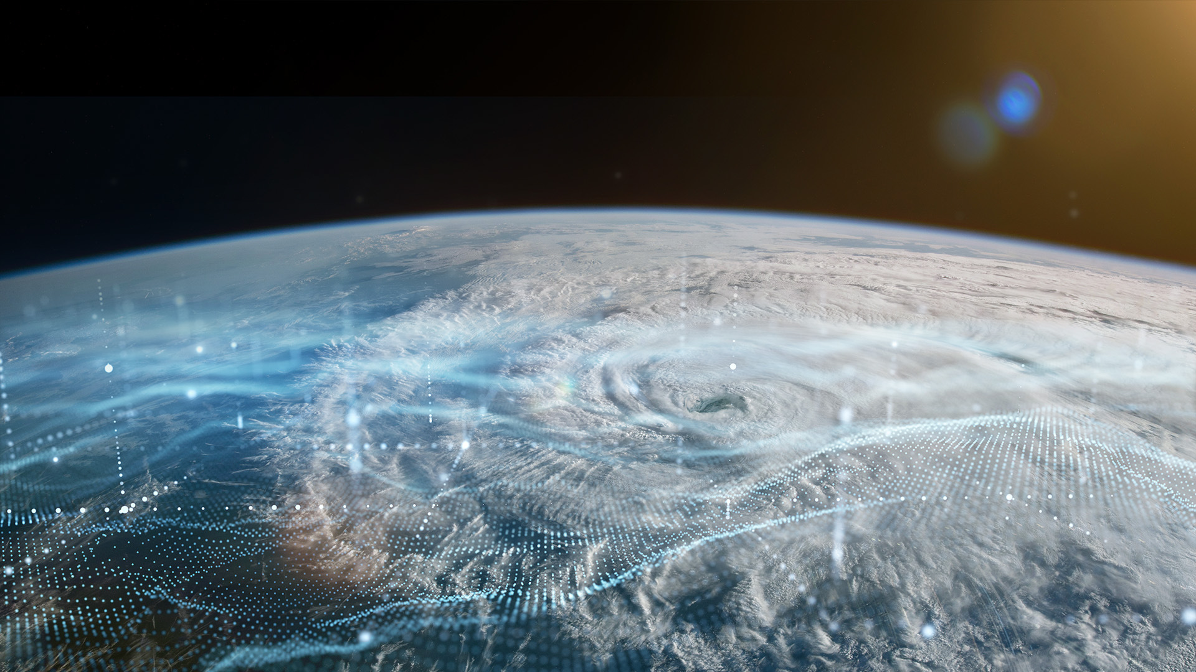
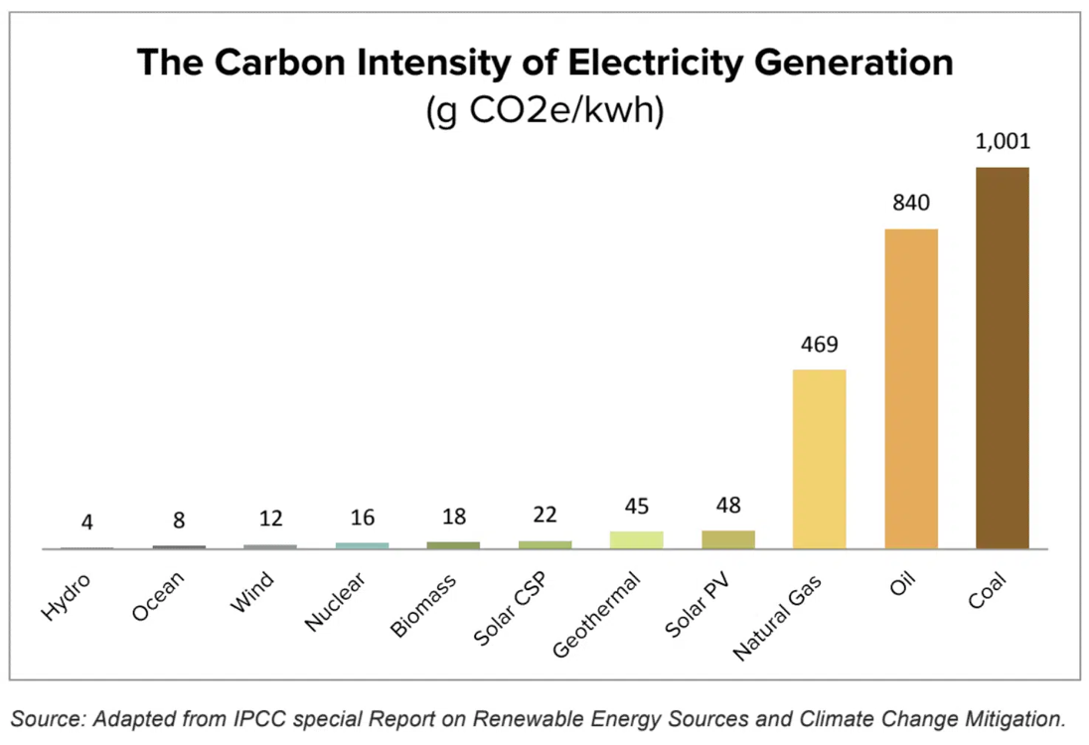
CO₂ Emissions per kWh of electricity production
Notes:
USE CASE 2
Digital Twin
Climate Modeling

Slide 15
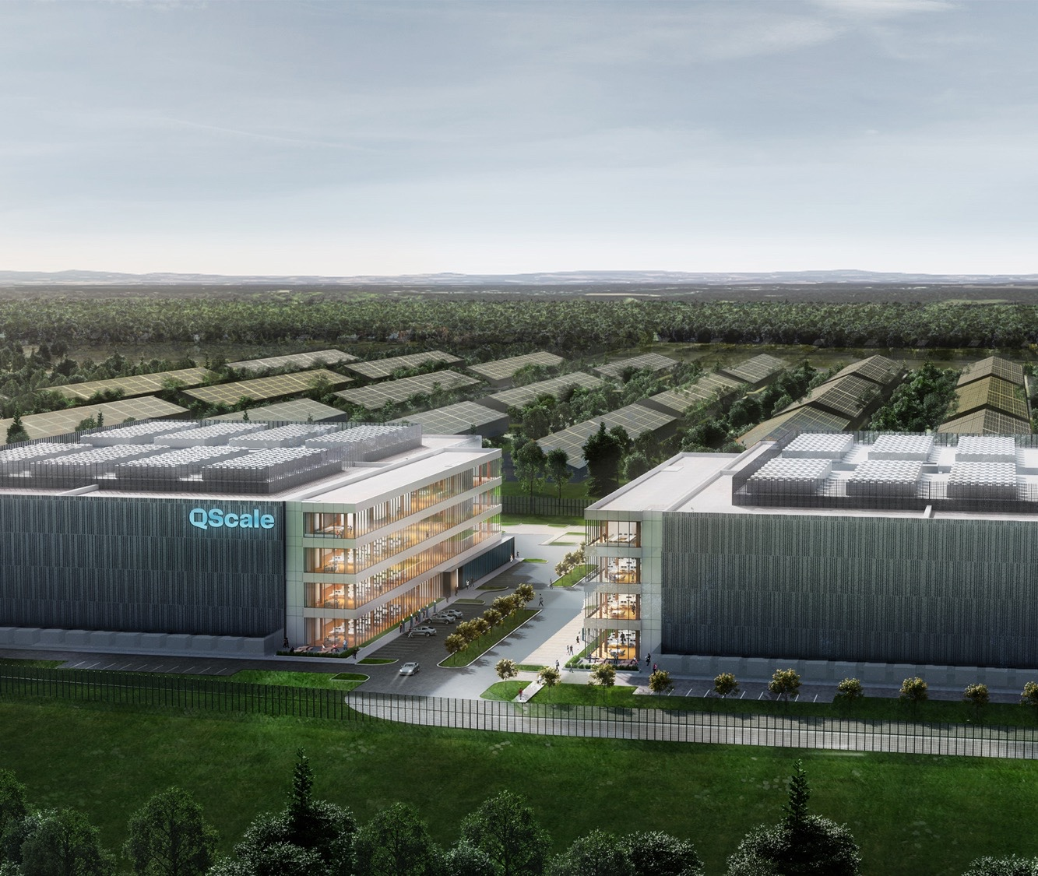
The Path to Sustainable Supercomputing
> 100 MW site in Canada
100% renewable grid
Free cooling year round
“waste heat” re-capture

Slide 16
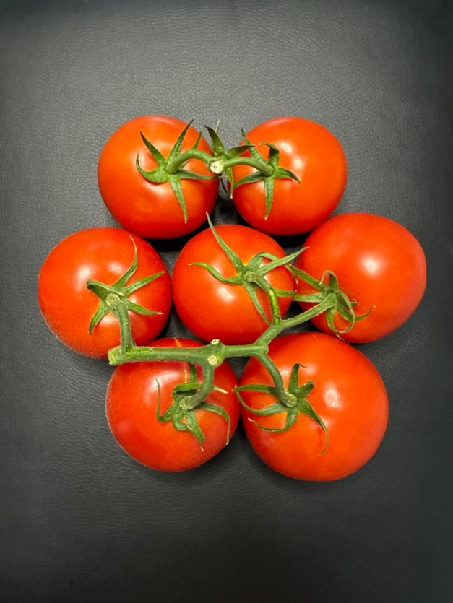
How many tomatoes can ChatGPT grow?
Typical 500 m² Greenhouse in Quebec, Canada
  5549 climate hours below 10ºC
  ~1000 Gigajoules per heating season
ChatGPT training of 1,287 MWh
  = 4,633 Gigajoules or 4.6 Greenhouses (for 1 year)
Natural gas combustion carbon offset (in addition to the 552 tons!)
  0.0372 GJ/m³ => 38,402 m³ needed per greenhouse (70% combustion)
  2.2kg of CO₂eq / m³ => 85 Tons of CO₂eq per greenhouse
  4.6 Greenhouses => 391 tons of CO₂ (or 85 cars annual carbon footprint)
Tomatoes production math
  75 kg per m², per year ( !!! )
  85% greenhouse area for production
  4.6 Greenhouses * 500m² * 85% = 1,969 production m²
  1,969 * 75 kg = 147,677 kg per year
  => 1,033,738 tomatoes !!!
Natural Gas | Electricity
Volume required: 0.0372 GJ/m³ => 26 881 m³ | 0.0036 GJ/kwh => 277 778 kWh
Combustion efficiency: 80% => 33 602 m³ | Efficiency: 100% => 277 778 kWh
Cost: $0.38/m³ => $12,768 | $0.05/kWh => $13,888
2 kg of CO₂ / m³ => 67 tons of CO2 / year
 | 277 778 kWh / 5549 h = 50kW
10 MW datacenter @ 50% heat re-cycle efficiency = 100 Greenhouses and 6,720 tons of CO₂ offset | 10 MW datacenter @ 50% heat re-cycle efficiency = 100 Greenhouse and 2500 tons of CO_{2 offset!}

Slide 17
Thank you
nicdube@hpe.com

Slide 18
Today’s agenda
Exascale: how we got here
Next generation system architecture options
How AI can help
Limiting the carbon footprint
Discussion

Slide 19
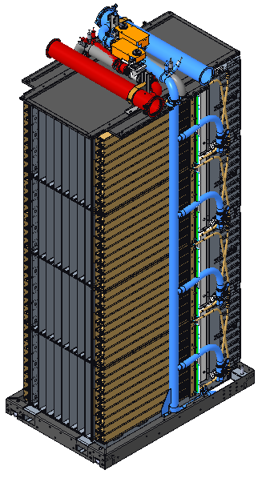
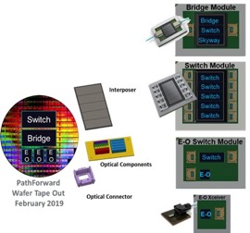
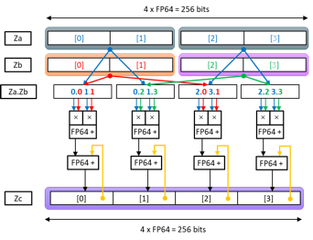
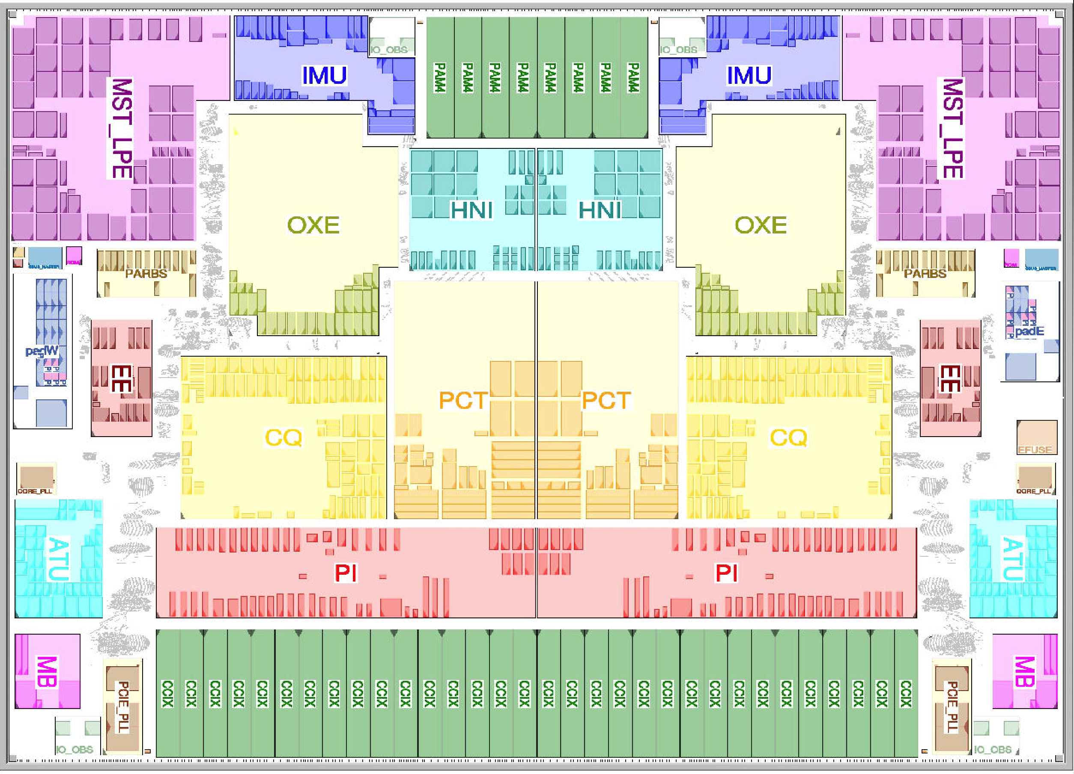
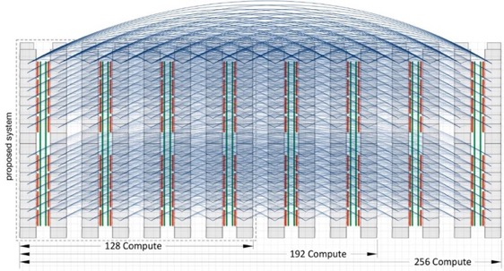

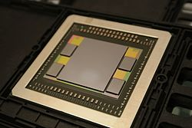
The long and windy road to exascale
A decade+ long journey, from inception to delivery
PathForward R&D program : US Dept. of Energy 300 $M investment to accelerate exascale (2016)
HPE’s largest R&D program, ever
New infrastructure, new software, new interconnect
SiPh, VCSEL, new topologies, driving value chain
Slingshot-2 architecture
Cassini-NIC development
Advanced processor technologies
Research in SoC memory architectures
Notes:
Literally hundreds or people at HPE, SGI and Cray have worked on the US exascale program since 2010
Recognize the team that has worked on PathForward
But also everybody in engineering and product management that had to make the design real and build it
Dealing through a global pandemic and unprecedented supply chain crisis, that was no easy task

Slide 20
Carbon footprint of Generative AI
“Training GPT-3, for example, which has 175 billion parameters, consumed 1,287 megawatt hours of electricity and generated 552 tons of carbon dioxide”
Patterson & al., Carbon Emissions and Large Neural Network Training
https://arxiv.org/ftp/arxiv/papers/2104/2104.10350.pdf

Slide 21
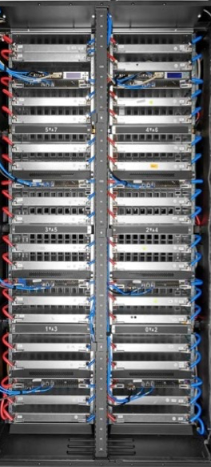
Option 1 - Build a very large supercomputer
Notional system design
256 Compute Racks
65,536 GPUs
3D hyper-X, 16x16x16, 16 GPUs per router
Built with Nvidia H100:
  FP64 SIMD: 2.2 Exaflops (peak)
  FP64 Tensor Cores: 4.4 Exaflops (peak)
  BF16 Tensor Cores: 130 Exaflops (peak)
  HBM3 memory: 5.24 PB
  Power: ~ 60-80 MW
  Floor space: ~ 1000 sq. meters
  Cost: “Few” B$
    excluding the datacenter

Slide 22
Option 1 XL – Build a very very large supercomputer
x8
Notional system design
2048 Compute Racks
524,288 GPUs
8 rails 3D hyper-X, 16x16x16, 16 GPUs per router
Built with Nvidia H100:
  FP64 SIMD: 17.7 Exaflops (peak)
  FP64 Tensor Cores: 35.4 Exaflops (peak)
  BF16 Tensor Cores: 1.04 Zettaflops (peak)
  HBM3 memory: 42 PB
  Power: ~ 500-700 MW
  Floor space: ~ 8000 sq. meters
  Cost: “Few” 10s of B$
    excluding the datacenter

Slide 23








Option 2 – Federate a constellation of systems
~10x Exascale
Productivity and agility for HPC and AI applications
Today
Exascale supercomputer
Federated diverse systems
Integrate, automate, and optimize workflows that span multiple organizations, locations, and vendors
Multi-faceted, complex workflows
For modeling, simulation, data analytics, and artificial intelligence
World’s fastest
Supercomputer
World’s fastest
Workflows
Notes:
Transition to how we are thinking about the solution space (What we are doing), projects in flight…
Two threads
Evolution of "capability" systems; keep and build momentum; 10x and beyond; progress towards Z
Apply learnings from design and deployment
Applications (ECP)
SW and tools investments
Workflows: Coupling of AI and Science (Mega Trend)
Ack (feedback from many customers) complex workflows will span from Edge to extreme scale
Ack growing importance of AI and analytics in these workflows
In the future we’re talking about autonomous experiments, AI embedded everywhere in the decision process, AI-assisted design of experiments, AI-assisted data cleaning and pattern recognition, analysis and pattern recognition.
Federated Systems
Edge, compute system, memory system, training, analytics, data science
(system most conducive to running a given part of the job)
System of systems for each workflow
Systems designed to run the workflows; different SW components
Deeper integration, sophisticated orchestration

Slide 24
Workflows: enable end-to-end workflows across boundaries
Instruments
Other data centers
API layer
/workflow
/co-schedule
/data
/metadata
/fleet
/auth
Experiment steering
Simulation steering
Experiment
AI data reconstruction and analysis
Simulation
AI surrogate model
inference
Monitoring
Training data selection
AI model training and retraining
AI model validation
Edge
HPC
AI
Notes:
Parallel/Distributed/Federated Programming environments
Data management
at-rest
event-triggered
in-motion
Federated orchestration
Analytics and AI Enablement
Persistent
Serverless
Batch
Delivering performance for end-to-end workflows comes with its own challenges.
In the post-exascale future, workflows (that can be defined as a semi-automated complex sequence of workloads) will touch a spectrum of resources across the whole computing landscape, from the edge to supercomputers to the cloud. (This is an example fwd looking workflow)
For these workflows, data can emerge from an edge device, from a simulation/digital twin or from a massive data store.
Data will have to be managed in all its forms – at rest, triggered by events, and in motion.
Workloads will need to be orchestrated across mediums, and analytics will need to be managed to serve persistent, serverless and batch processing scenarios.
In the post-exascale era, users need to be able to orchestrate workloads that connect edge instruments of interest for any industry – be it telecom, retail, manufacturing or cameras installed for security/safety purposes.
HPE systems in the post-exascale era will provide different knobs of performance (capacity, capability, latency, and scalability) to these emerging workflows.
That is, given any workflow, a customer can build a supercomputer that will run that specific workflow the fastest.
(Dashed rectangles represent opportunities for AI)

Slide 26
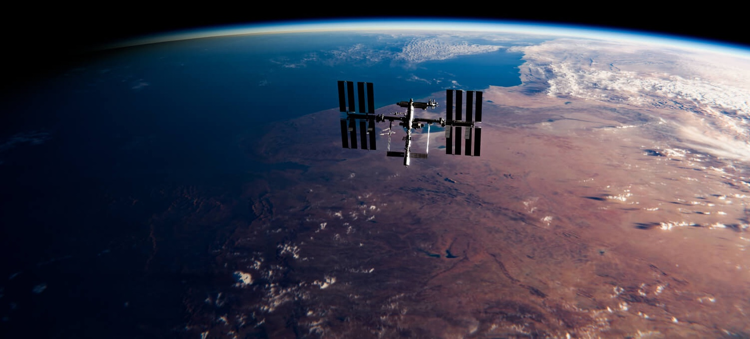
What comes after Exascale?
From Edge to Exascale
Democratization
of Parallel Runtime Environments
Performance Portability
Enabling Silicon Innovation
Secure Networking Foundation
Worldwide Data Web with Metadata Indexing
Hybrid Execution Pipelines
Open - You’re in Control
The Internet of Workflows
An open internet of supercomputers that will accelerate innovation even faster in the 2nd half of the decade
N. Dube, D. Roweth, P. Faraboschi and D. Milojicic, "Future of HPC: The Internet of Workflows," in IEEE Internet Computing, vol. 25, no. 5, pp. 26-34, 1 Sept.-Oct. 2021
²⁶
Notes:
Intent of slide: Close with the unique long-term vision that we are working on for the post-Exascale era.
But we do not stop here. We already are already working on what come after Exascale. Our long term vision is the “Internet of Workflows” where workloads and their data freely flow between supercomputing sites around the globe and are execute wherever it makes the most sense from a scientific or business perspective. This open and distributed supercomputing vision will create much more value than the vision of others (Comment Uli: Intel) who just want to get to “Zettascale” as fast a possible by building even larger, highly centralized machines.
We must ensure that supercomputing is a widely accessible resource. Accelerating innovation at scale can’t happen if leadership supercomputing capabilities remain confined to a small number of global supercomputing leadership sites —especially with supercomputing priorities such as developing AI that’s inclusive and responsible. Making supercomputing accessible to many more organizations independent of geographic locations also will increase the chances for creative sparks to jump between public and private poles.

Slide 27
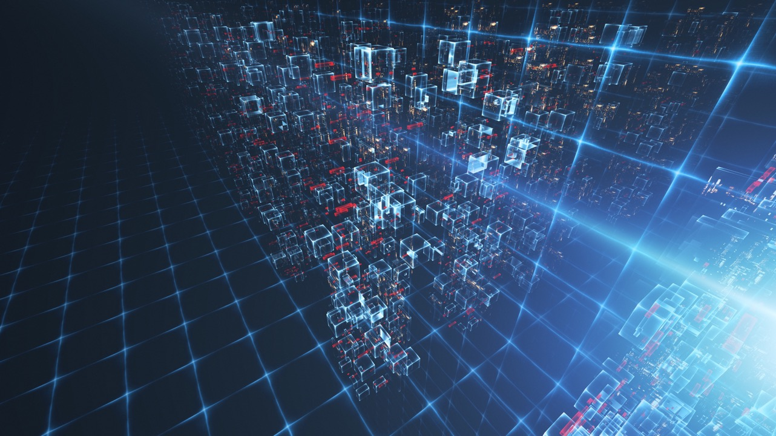
R&D required, for both options
Option 1 – Go Big
Option 2 – Go Broad
Reliability and resilience at scale
Data movement to a single repository
Large scale application scheduling
Advanced optical networking
Asynchronous runtime (for resilience)
Resilience between sites
Data movement across sites
Multi-site co-scheduling
WAN networking between sites
Asynchronous runtime (core)
Multi-institution identity management / security

Slide 28
Will AI come to the rescue?

Slide 29
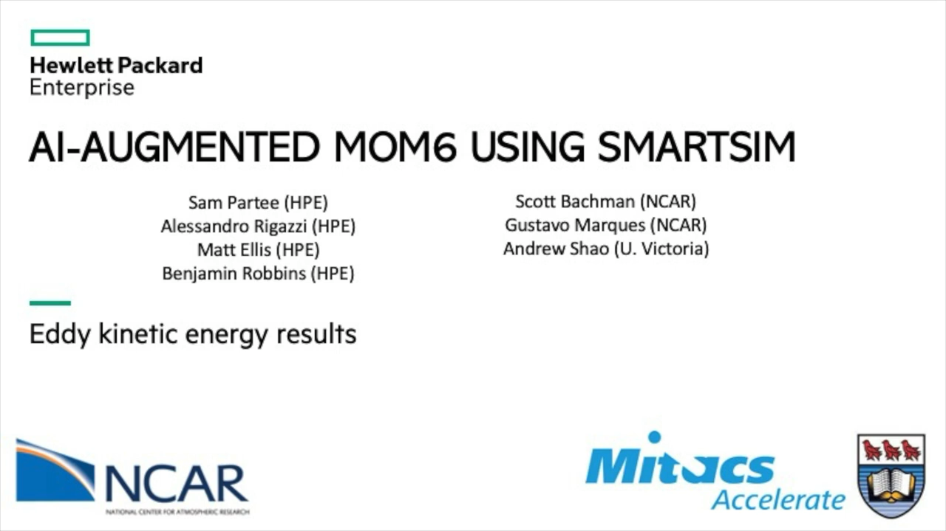
Simulation driven by AI

Slide 30
Backup

Slide 31
The Evolution of AI workloads
Training compute (FLOPs) of milestone machine learning systems over time¹
Extrapolation
1 week of ORNL Frontier Supercomputer
(~8 AI EXAFLOP/s, 37,888 GPUs)
1 week of an accelerated server
(~6 AI PFLOP/s peak, 8 GPUs)
1 week of an iPhone 14
(~2 AI TFLOP/s peak, 1 GPU)
4.2x/year growth
Deep Learning (‘10-’16)
Foundation Models (‘16-22)
Future Projection

Slide 32
The HPE Vision: A federation of systems for integrated workflows
Automate orchestration of apps, distributed data flow, applied AI
Workflows
AI/ML Integration
Distributed Data Flow
Edge Device Integration
Workflow Framework
Application and Data Orchestration
Host on-demand HPC and AI apps for broad consumption
Applications
Optimized Applications
Ai/ML Workloads
Interactive Visualization
Apps Marketplace
AI
Earth Sciences
Life Sciences
Manufacturing
Enable simple access to supercomputing resources
Platform
Compile/Debug/Performance Tools
OS Support
BYO Apps and Licenses
Multi-tenancy
Security / Monitoring
Data Movement
Consumption Analytics
Multi-site Support
DevCloud
ProdCloud
CPU
Storage
High-Perf Interconnect

Slide 33

The HPE Opportunity: Enable ACCESS to supercomputing on demand to advance transformation and improve decisions
Scaling simulation and AI workloads for large-scale production is difficult for enterprises today
Increasing need for on-demand capability computing
Desired State
Capability to run massive mod/sim and parallel computing
Software and platform that accelerates delivery of business value, broadly or domain-specific
Faster, less expensive access to true supercomputing technologies
No in-house expertise required
A trusted, proven technology partner
Resources – human, financial and technical – are scarce
Multi-tenancy and security need to be addressed differently
Traditional public clouds are not optimized for strong scaling jobs
Notes:
Skills shortage
Most enterprises face challenges to scale
successful simulation & AI proof-of-concepts into production due to a lack of skills to
build /operate / run the required systems.
Multi-gen on prem infra
Most enterprises struggle to achieve maximum acceleration of their new product/AI initiatives without the latest in processing power.
Data Privacy
Many enterprises are reluctant to put their “crown jewels” (R&D data, differentiated AI model) into anonymous public clouds
Public clouds not optimized
Public clouds have built HPC instances, but control, governance and costs concerns are prohibitive for most enterprises for large-scale jobs that run 24x7.

Slide 34
Introducing HPE Project Breckenridge, the best of both worlds
A better way to manage and deliver large-scale AI and ad hoc business-critical simulation workloads
Invest Purchase one’s own supercomputer | Best option: HPE Project Breckenridge | Use Public Cloud Purchase HPC & AI instances from hyperscalers
Built for single, large-scale SC and AI jobs that run 24x365 on 100s or 1000s of CPUs or GPUs | A new class of supercomputing cloud from the global leader in supercomputing. | Not designed for single, large-scale SC and AI jobs that run 24x365 on 100s or 1000s of CPUs or GPUs
Strong governance and control of sensitive models and data |  | Limited control of sensitive models and data – limited governance
No data egress fees that impose unnecessary cost and complexity |  | Unnecessary data egress fees to retrieve one’s own data
Requires specialized data center infrastructure and skills | Combines the power of traditional supercomputers with the agility and ease of use of the cloud. | No specialized data center or infrastructure skill requirements
Typically requiring a large upfront capital investment |  | Cloud-based consumption model (Only pay for what you use)
Typically, many months from decision to production |  | Readily accessible for on-demand production
Confidential | Authorized
34
Notes:
Intent of the slide: describe the benefits of Proj Breckenridge
Extremely efficient for large-scale jobs that run 24x7
Unbeatable price/performance
No data egress fees that impose unnecessary cost and complexity
Easy to access with cloud-native tools from anywhere
As-a-service model shields user from skills, liquid-cooling, data center infrastructure and power complexities
Cloud-based consumption model (only pay for what you use)
Short time lag from decision to production
- Complements the current HPE GreenLake for HPE, on-premises

Slide 35


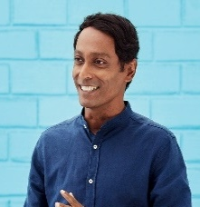

ACCELERATE Simulation and Generative AI workloads in the Global 2000
Familiar with supercomputing
Getting access to supercomputing for the first time
HPC users
Use HPC today on-prem for
business-critical modeling & simulation
R&D innovators
Have started strategic HPC initiatives
to enable their company to leap ahead
AI innovators
Have started strategic AI initiatives
to enable their company to leap ahead
“Born-in-the cloud”
AI companies
Are driving innovation around the next generation of AI foundation models
Head of R&D or HPC
Head of R&D, VP Engineering
Chief AI Officer
CEO, Founder
Can now boost on-prem capability
to the new supercomputing cloud to
avoid missed deadlines
Can now tap into supercomputing power to bring new products to market more efficiently
Can now fine-tune and serve licensed foundation models faster and with higher accuracy
Can now develop next-gen
foundation models faster and
in a more efficient way
Preloaded tooling •
Get up and running in minutes
Browser-based, cloud-native ease • Preloaded with role-specific tooling
• No supercomputing expertise required
Confidential | Authorized
35
Notes:
Target Markets
i. First – enterprises, government and academic organizations that know HPE well can now get supercomputing on demand for crash simulations, molecular docking, etc.
Ii. Second, traditional modeling and simulation organizations, that had been running on-premises for decades, are now asking for a more flexible high-performance computing (HPC) consumption model, allowing them to ramp from idle to PetaFlops in a matter of minutes. Additionally, there is an opportunity to serve a new market, where a new generation of technical computing customers - who cannot afford an on-premises HPC system - could afford a consumption-based model.
Iii. R&D organizations within enterprises are seeking to leverage AI and supercomputing capabilities to increase productivity and accelerate TTM.
Iv. , the fast-growing AI segment - with startups that had all began in the cloud on single GPUs - is now scaling to large language models (LLMs) and GPT-3 sized workloads requiring dozens, hundreds and even thousands of GPUs, all running in concert. It is estimated that it took $2-$3bn in compute cost to train GPT-3 [] [2] (per WSJ) over the past few years and the compute requirements for large-scale AI experiments have increased >300,000x in the last decade (per State of AI 2022 Report).
Target Use cases
- Mod/sim: unplanned, business- and time-critical , large scale (instances with 100s or 1000s of CPUS)
- AI: unplanned, business-and time-critical, large scale (instances with 100s or 1000s of GPUs)

Slide 36
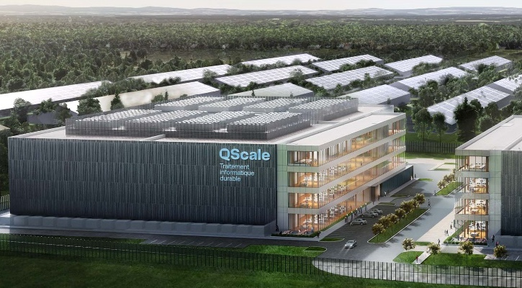
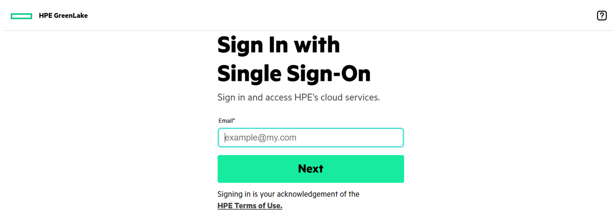
ACCELERATE Time to Insight, sustainably
First site: QScale, Quebec, Canada
Compress time exponentially
Complex simulations and massive AI training workloads that take weeks on normal resources finish in days, even hours, on an HPE Cray supercomputer.
Log-in and
get to work
Preloaded essential HPC libraries and built-in environments for data science and AI training enable workloads to be up and running in minutes.
Renewable energy
percentage
99.5%
Free cooling days
during a year
290
Waste heat
capture & re-use
Yes
(Heating greenhouses)
Confidential | Authorized
36

Slide 37
ACCELERATE Simulation and AI initiatives – with the best of HPE and partner software
HPE
NVIDIA
Aleph Alpha
LLM aaS
Enterprise-ready large language model Luminous for explainable and trustworthy AI
Advisory
services
Performance
Engineering
Services
Financial
services
Support
services
Security
Compliance
Governance
AI tools &
frameworks
TensorFlow
PyTorch
RAPIDS
NeMO
AI platform
features
Bring your own platform
HPE Machine Learning Development Environment
AI data
management
Bring your own environment
HPE Machine Learning Data Management Software |
HPE Ezmeral Data Fabric
AI infrastructure
optimization
Magnum IO
CUDA-X AI
Cray Programming Environment
AI system
infrastructure
x8 H100 GPU
2P AMD CPU
High Perf, Low Latency Interconnect
Notes:
Intent of the slide: demonstrate we have the software partnerships and hardware partnerships to enable large scale AI workloads
Key message: best of enterprise software from strong partner NVIDIA plus the choice to “bring your own software and platforms” while leveraging HPE superior infrastructure, tools, support and services.
- Infra - Proj Breck will feature Cray XD products, initially. We also plan on providing other options in addition to NVIDIA GPUs from our other partners such as AMD, offering our potential customers a variety of hardware to scale up their workloads.
- Slingshot – available at launch for large scale HPC workloads. For large scale AI, Slingshot is expected to be available soon after GA
- DLC - We are working with our vendor partners to accelerate the DLC versions of their solutions and will be rolling them out at the earliest availability. We are initially using rear door heat exchangers and ARCS Units as an interim cooling strategy.
- MLDE is expected to be supported in CYQ4’23.
- MLDMS - tbd

Slide 38

Thank you

Slide 39
Where should (?) we go next?

