Slide 1
Training the Next Generation of Pilots with AI-Based Adaptive Learning Applications
Mike Jones, PhD Systems Technology, Inc. (STI) | Annik Carson, PhD AI Redefined (AIR)

Slide 2
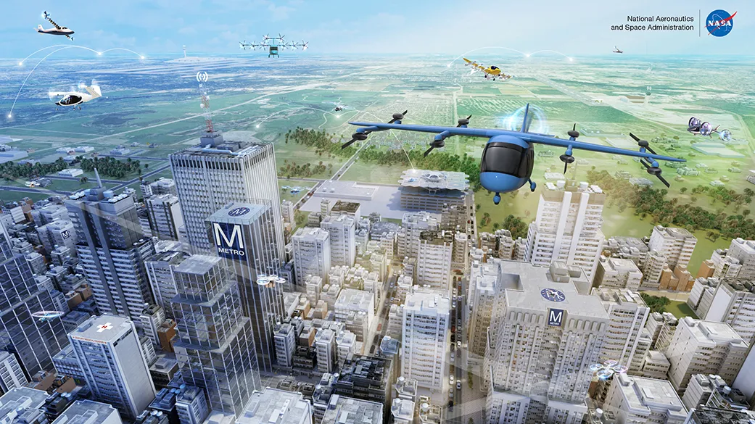
Transforming the Way We Travel
Future methods of transportation are currently in development under the umbrella terms ‘Urban Air Mobility’, ‘Flying Cars’, and ‘electric Vertical Take-off and Land’ (eVTOL)
Operations similar to modern helicopters, but vehicles are lighter, quieter, and electric
Full-scale vehicle testing and certification activities are in full swing, production aircraft expected in 2025+

Slide 3
The Need to Scale Training to Meet Demand
“
The eVTOL industry is emerging at a time of unprecedented pilot shortage. More efficient methods of training are required to improve efficiency and lower cost.
— Aviation Training Consultant, former Airline Director of Flight Training
80%
Estimated pilot dropout rate in traditional training¹
60K
Number of pilots to train by 2028²
35%
Excess training time in-flight to become
proficient in traditional aviation³
Our goal is provide a data-driven approach to eVTOL training to reduce training time, increase efficiency, and maintain safety standards
1 Aviation advocacy research, 2023 2 McKinsey, 2020 3 Helicopter training school data

Slide 4
Combined Expertise to Offer Best-in-Class AI-Powered Training Simulation Tools
Systems Technology Inc. (STI) founded in 1957, is a technology company specializing in assessment-based solutions for human-machine interaction. With a mission to advance safety and efficiency in aviation, STI develops cutting-edge technologies to meet the evolving needs of the aerospace industry.
AI Redefined (AIR) is a leading applied AI research firm dedicated to enabling human-AI alignment via their Cogment orchestration platform. Cogment enables RLHF solutions for various industries, including aviation, renewable energy, healthcare, and autonomous (human-machine teaming) systems.

Slide 5
Scalable eVTOL Pilot Training
Powered By Cogment Adaptive Learning
On-demand training, any time, anywhere
AI-recommended content tailored to each learner
AI feedback & reporting frees up instructors
INTEGRATES WITH ANY TRAINING SIMULATOR
SCALES TO ANY CLASS SIZE
VALIDATED BY HUMAN INSTRUCTORS
Notes:
SimAssist delivers a scalable pilot training and assessment platform
with cutting-edge AI technologies and best-in-class training curriculum and evaluation criteria
Unique agent-driven feedback architecture providing critical performance insights to improve learning and targeted scenarios for focused skills development

Slide 6
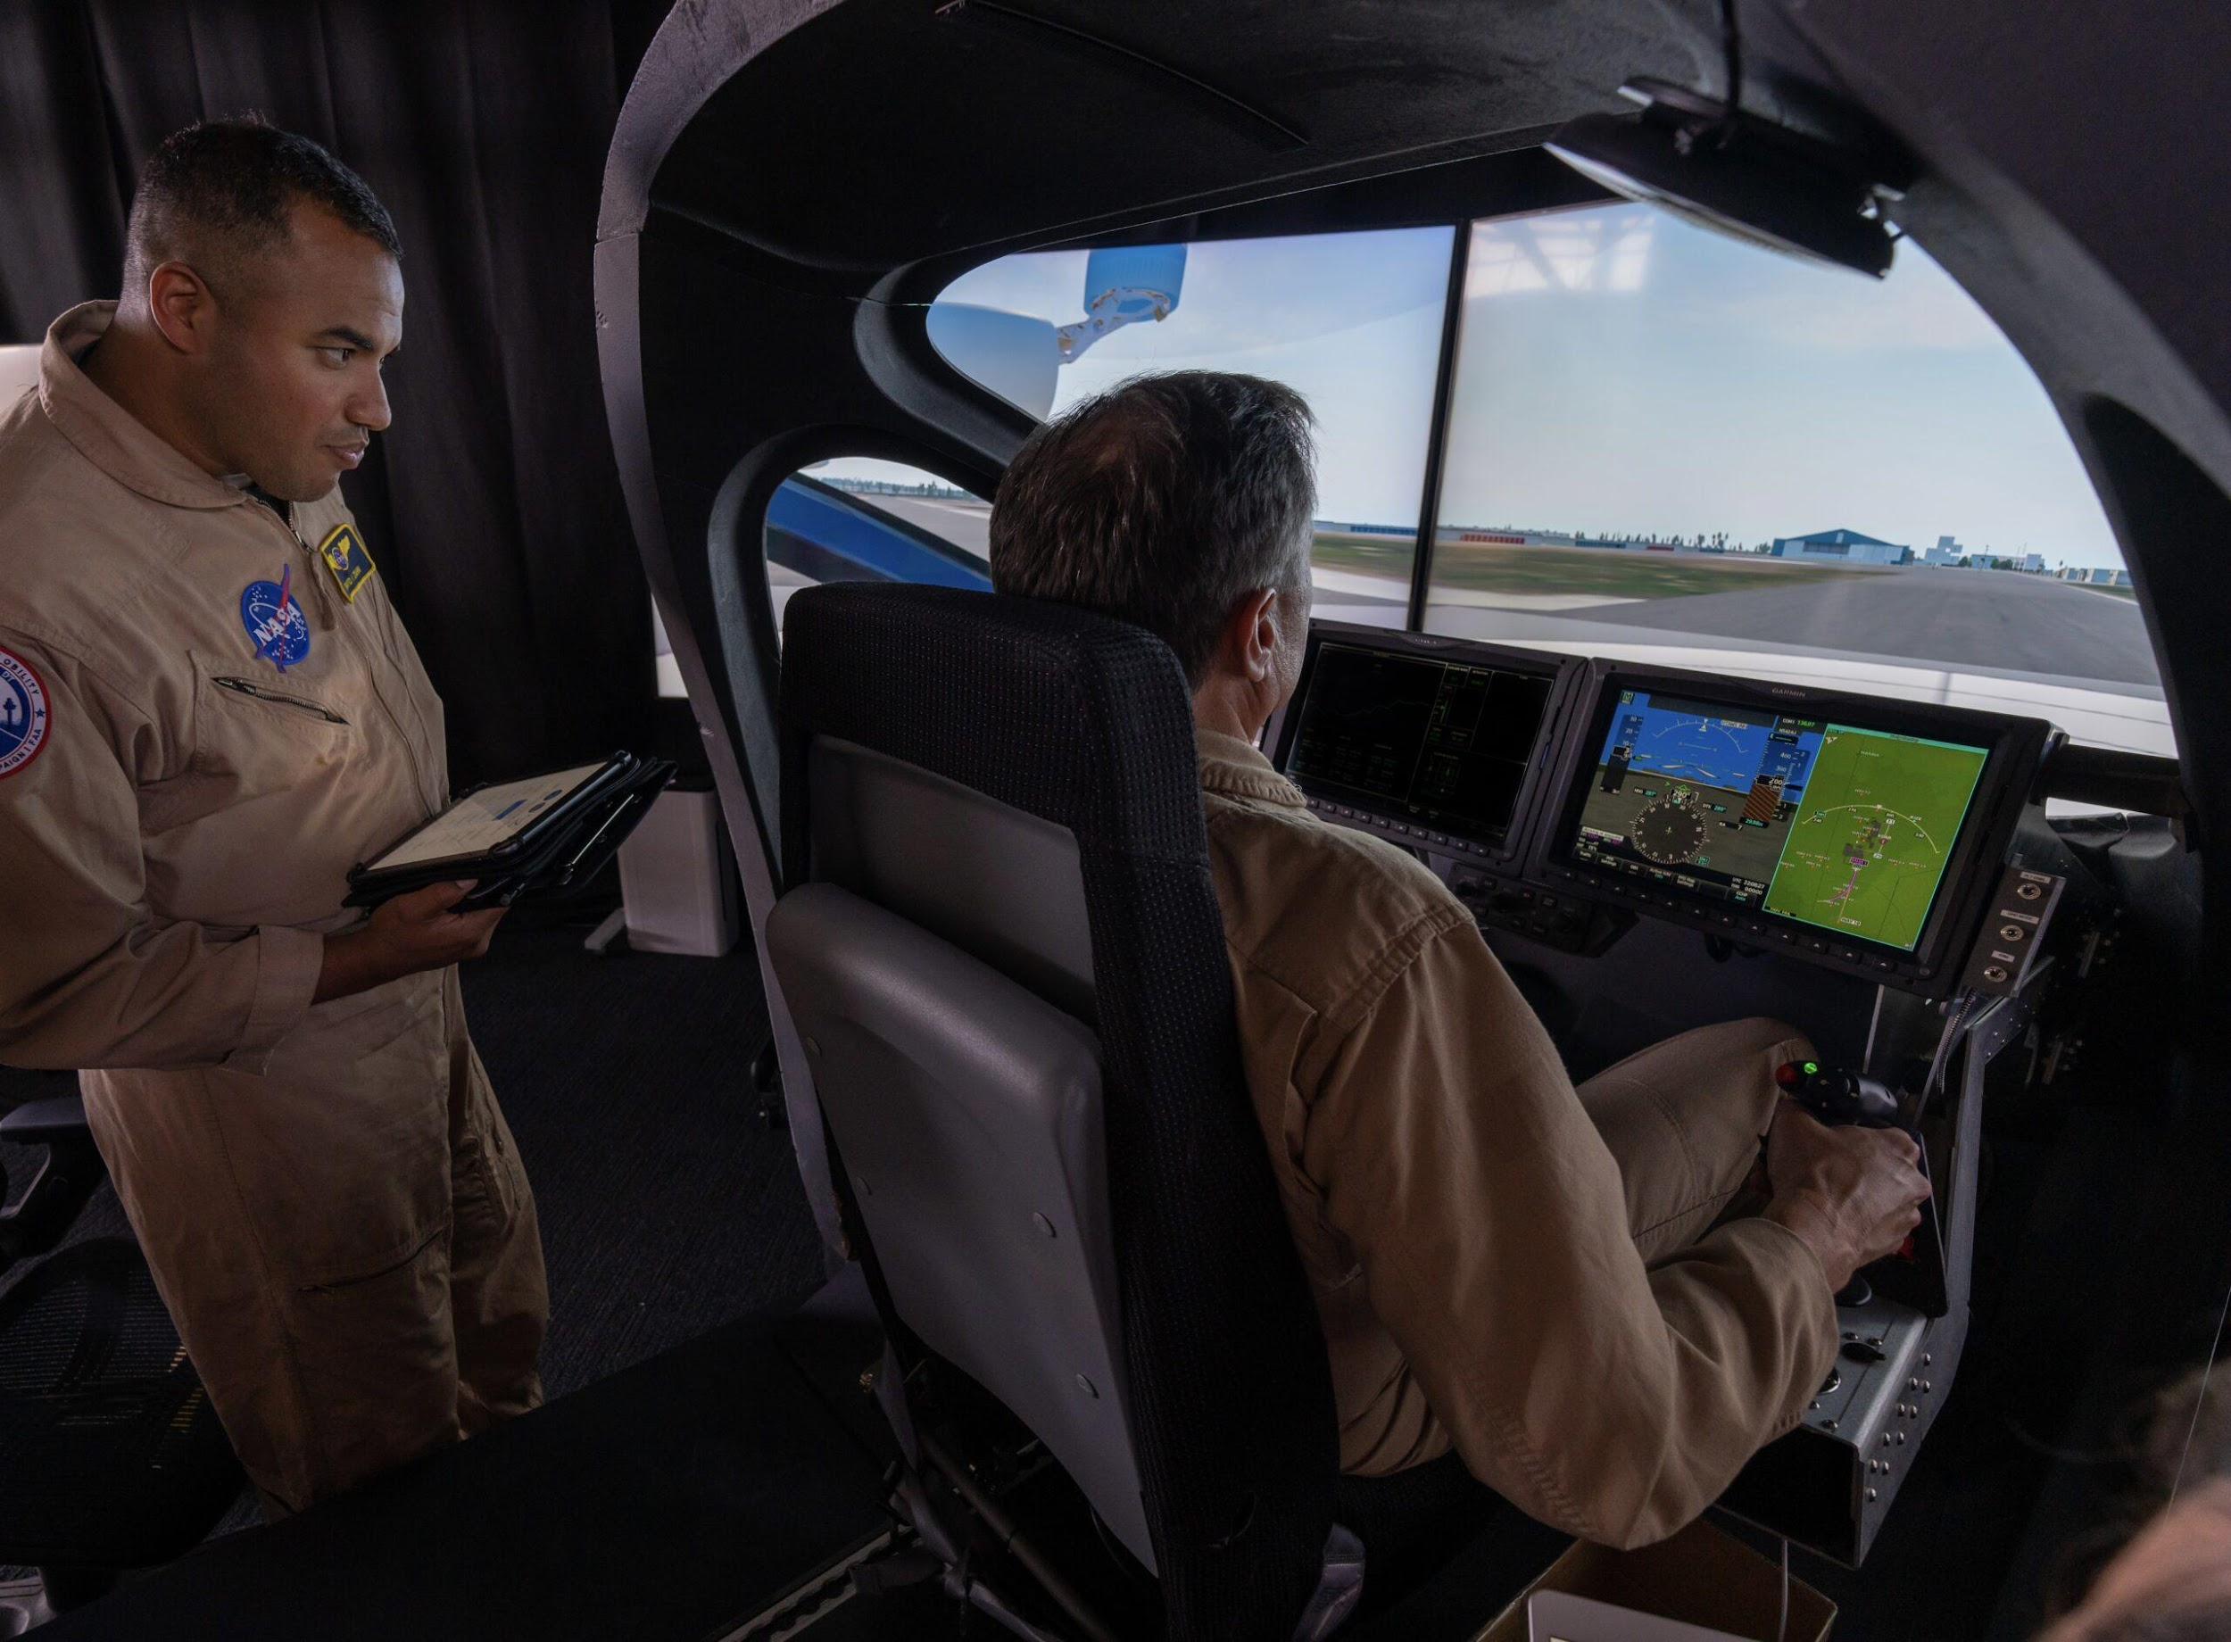
CONTINUOUS TEACHING AND LEARNING
training simulation
Train on learners’ performance
Contribute learning profiles
and abilities
Evaluator
Director
learners
AI agents
Provide feedback, and tailor the best next exercise
Notes:
Q: Where do we start

Slide 7
TWO CUSTOM AI AGENTS
ENABLING INSTRUCTOR SCALE-UP AND STUDENT PERSONALIZATION
Evaluator Supervises student progress and provides continuous feedback and evaluation
Compares student against AI-based reference agent
Director Generates objective-driven personalized training sessions within expert-defined curriculum structure
Trained to target specific student performance needs by identifying areas of strength and weakness

Slide 8
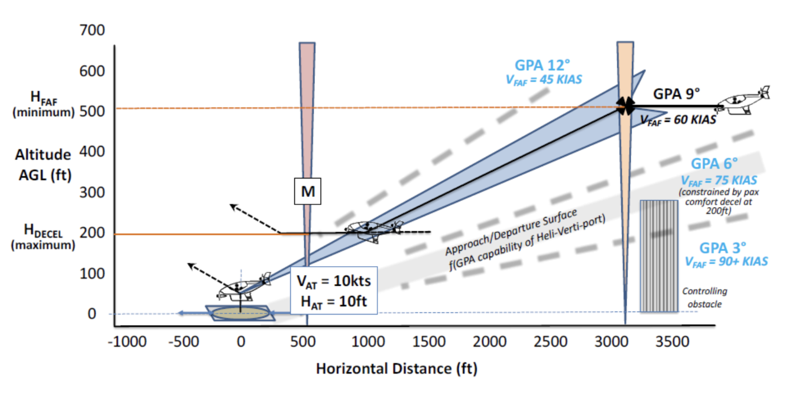
HOVER TO LAND MANEUVER TRAINING
Mission segments:
Capture Glideslope
Follow Glideslope, Constant Velocity
Follow Glideslope, Deceleration to hover
Landing
SIMULATED ENVIRONMENT
D
C
B
A
DYNAMIC CONTENT DIRECTOR
AI eVTOL PILOT
AGENT
COGMENT
ORCHESTRATOR
PERFORMANCE ANALYSIS EVALUATOR
STUDENT eVTOL PILOT

Slide 9
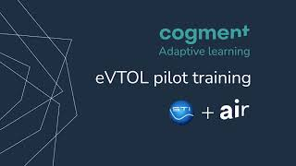
HOVER TO LAND MANEUVER TRAINING
SIMULATED ENVIRONMENT
DYNAMIC CONTENT DIRECTOR
AI eVTOL PILOT
AGENT
COGMENT
ORCHESTRATOR
PERFORMANCE ANALYSIS EVALUATOR
STUDENT eVTOL PILOT
Notes:
Long video : https://youtu.be/QOnvGZipwJE

Slide 10
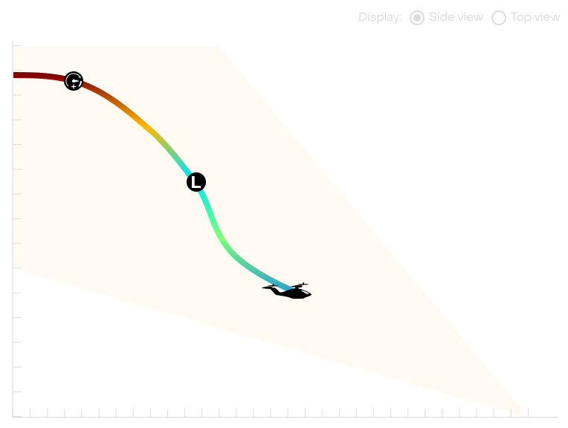
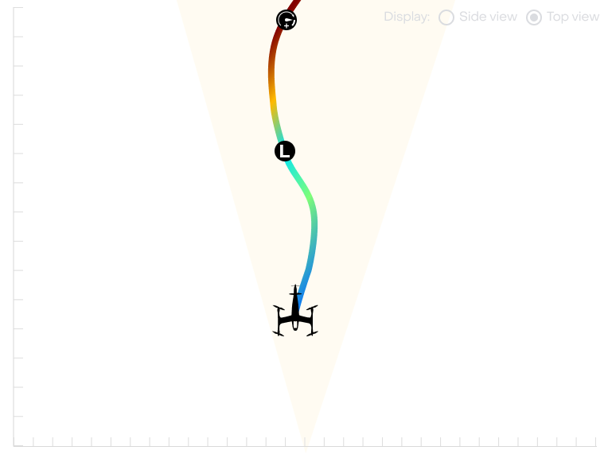
EVALUATING HOVER TO LAND MANEUVER
eVTOL Pilot Adaptive Learning Application Evaluation Method Examples
Technique to Evaluate | Threshold
Aircraft tilt (pitch / roll) | < 30-45 deg (flight) <15 deg (landing)
Position offset from target trajectory | < 5 deg (lateral) <0.5 deg (on glideslope)
Speed offset | < 5 kts
Acceleration / deceleration | < 50 ft/sec²
Vertical touchdown sink rate | <50 ft/min
Landing within target zone | < 10 ft
Energy consumption | *variable for task
Reference Agent
Trajectory

Slide 11
TRAINING A REFERENCE AGENT TO FLY OPTIMALLY USING EXPERT-DEFINED TASK CRITERIA
Trained to fly task using Reinforcement Learning (RL)
RL learns through trial-and-error, optimizing performance within constraints and goals defined by expert pilot instructional designers
RL advantageous in situations with multiple ways to complete task correctly
Trained reference agent used by Evaluator to assess how student performance could be improved
Notes:
Reference trajectory generated for each training run, faster than real-time computation can allow for real-time feedback and situational analysis
Comparison between reference agent and human pilot using the AI Evaluator can recognize safety concerns and common mistakes

Slide 12
TRAINING AN OPTIMAL REFERENCE AGENT
Agent trained with proximal policy optimization (PPO) to fly to variable target location within bounding box*
Agent is given a new randomly sampled goal location for each trial (eg. not one single correct trajectory to learn to optimize)
After training, Agent has learned to maximize reward regardless of goal position (here shown only variance of goal height)
* Bounding box defines positions which can be reached safely with respect to speed/orientation constraints

Slide 13
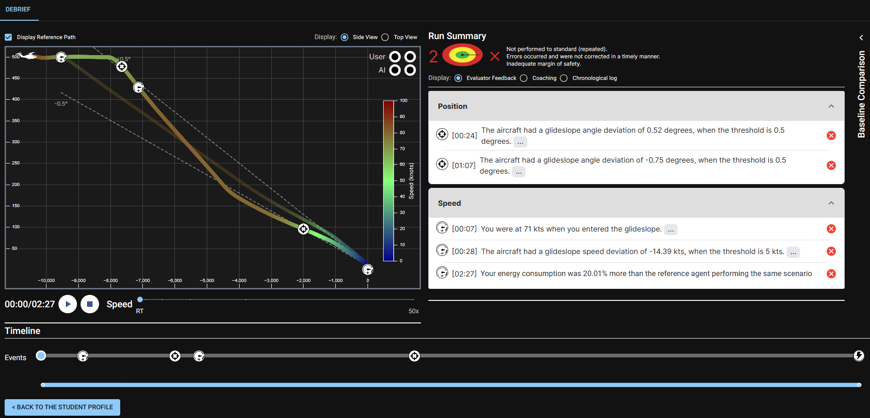
PROVIDING PERSONALIZED SESSION FEEDBACK
Notes:
This is using AI operator as a reference agent for the feedback
Replay to review and learn from performance
Qualitative and quantitative feedback on student’s performance using AI operator as a reference agent

Slide 14
PROVIDING PERSONALIZED SESSION FEEDBACK
Notes:
This is using AI operator as a reference agent for the feedback
Replay to review and learn from performance
Qualitative and quantitative feedback on student’s performance using AI operator as a reference agent

Slide 15
USING PERFORMANCE ASSESSMENT TO ADAPT TRAINING DIRECTOR GENERATED EXERCISE CONTENT
Historical data fully accessible for review
Performance statistics and visualized evolution
Personalized training content AI recommendations
Notes:
This is using AI ATC as a reference agent for the feedback

Slide 16
THE HUMAN IN THE LOOP VALUE
Retrieve environment dynamics, using it for continuous training of the AI agents, accounting for both human input and logic
software
Interact with the software, influencing the shared environment with expertise, context, and other human strengths
CONTINUOUS COLLABORATION LOOP
With every iteration of the loop, the human users and the AI agents further align together. Trust and
understanding grows.
The relationship between AI agents and human users is the core of our both our approach and our technologies at all stages, from design to implementation to product use
users
AI agents
Support the users, learn from them and strengthen their trust

Slide 17
Pilot Training using Adaptive Learning
Platform-agnostic, data-driven tool to support pilot trainees at all stages of learning
From
first principles…
…To
expert systems training
Procedural
training
Classroom-based
learning
Low-cost VR/AR
Simulation
Full-Flight Simulator (FFS)
AI-based performance assessment, feedback, and content direction
Helping scale training with a safe, regulation-compliant tool built with human experts in the loop
Notes:
provide a data-driven approach to eVTOL training to reduce training time, increase efficiency, and maintain safety standards using Adaptive Training
AIR & STI are collaborating to build a tool which addresses some of the complexities of training eVTOL pilots
Using AI for pilot training is a transformative approach that not only improves the quality of training but also addresses safety concerns and cost-efficiency. It allows pilots to develop and refine their skills in a dynamic and evolving manner, ensuring that they are well-prepared to handle the challenges of modern aviation such as eVTOL aircrafts.

Slide 18
Come see us at booth A22 for more information or visit ai-r.com
See our white paper
See our blog post

Slide 19
Creating an AI-powered Adaptive Training System
An On-Demand Training Tool Leveraging Expert Wisdom for AI-Assisted Personalized Learning
Trainees can train anywhere, anytime, on exercises tailored-made to target their needs
Learning Progress Summary
Flight Simulation
Performance Debrief
Director Agent Determines scenario elements to practice in next exercise
Trained to adjust training curriculum to target specific student performance needs
Evaluator Agent
Measures student performance and compares against reference pilot
Reference Pilot
Trained with RLHF for optimal flight
Instructors inform and validate ideal AI performance, trainee evaluation criteria, and exercise recommendations
Notes:
SimAssist delivers a scalable pilot training and assessment platform
with cutting-edge AI technologies and best-in-class training curriculum and evaluation criteria
Unique agent-driven feedback architecture provides trainee pilots with critical insights to improve learning and targeted scenarios for focused skills development.

