Slide 1
Sparsify Open-Source LLMs for Accelerated Inference
Boost performance and reduce costs of LLM deployments
Mark Kurtz
CTO
Neural Magic
Notes:
Talk Track:
Hello everyone, I'm Mark Kurtz, CTO at Neural Magic, where we obsess over making AI, specifically deployments, more efficient and accessible.
Today, that focus is on compressing large language models through quantization, sparsity, and more.
LLMs are transforming industries, but their intense compute needs make real-world deployments challenging and very costly.
We'll explore how to boost your LLM performance, cut costs, and unlock the full potential of this groundbreaking research and technology.

Slide 2
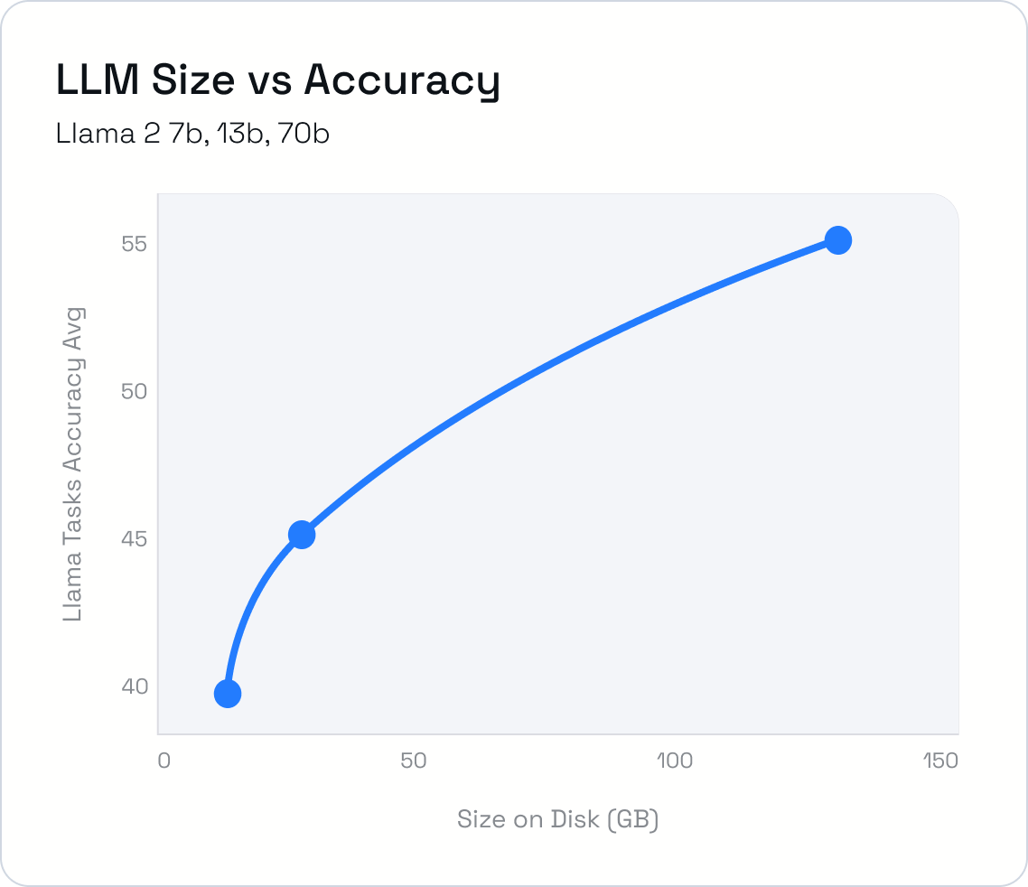
The Impact and Cost of LLMs
LLM adoption continues to grow
Boost productivity
Unlock new revenue streams
Specializing LLMs to your data is key
Align to your company brand and values
Build on top of your specific terminology and expertise
"Large" translates to a lot of headaches
Costly and complex to train
Issues further compounds in deployment
Notes:
The adoption of LLMs is exploding, and with good reason.
They've boosted productivity across a number of industries and use cases. For example, studies are starting to show a 10x improvement in software development with LLM based code generation tools.
Created exciting new revenue opportunities such as personalized product recommendations.
And enhanced existing processes such as chatbots to streamline customer support and reduce call center volume.
To truly harness that power, though, LLMs need to be specialized for your unique needs
This means they can better understand your domain and your specific terminology
Align with your company values and brand
And reflect your internal processes
But the large in LLMs isn't just about potential, it's also about headaches
Training and experimentation now take an immense amount of resources and time
And this only further compounds as we move into deployment.
The costs and complexity explode as we start serving users in production, where size directly impacts our speed, accuracy, and costs.
Expected Time:
1 - 1.5 minutes
Notes:
The graph is to reinforce that simple model growth doesn't equal limitless gains and cost is where things get out of hand – ideally want to highlight this graph as soon as we get into the headaches talk point

Slide 3
Transformative but Costly Customer Support
Chat LLMs are revolutionizing customer service
Enterprises actively field support requests through LLMs
LLMs handle common queries so humans are free to address complex issues
Notes:
Diving into an active use case, companies such as Delta are utilizing chat LLMs to transform their customer support pipelines
They are able to automate common queries and, in the process, free agents to focus on where they are truly needed – the more complicated or timely support needs.
But, for an LLM chatbot to actually help and not hinder this process, it needs to be accurate and fast.
The minimum guidelines that our research and the community in general have shown is
[show accuracy vs model size graph] a minimum size of 7b for the model
and strict speed targets to enable fluid responses.
[show usage vs costs] Translating these requirements to a scalable deployment, results in
## dollars on average per chat
and ## dollars per month for a medium sized support use case.
Expected Time:
1 - 1.5 minutes
Notes:

Slide 4
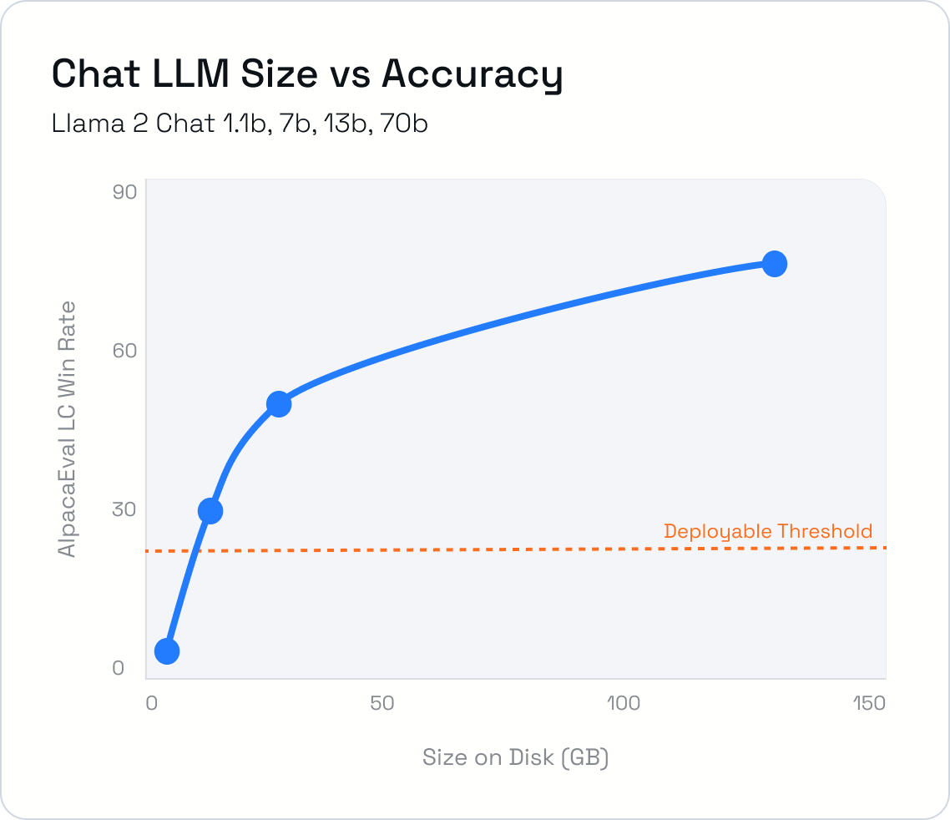
Transformative but Costly Customer Support
Chat LLMs are revolutionizing customer service
Enterprises actively field support requests through LLMs
LLMs handle common queries so humans are free to address complex issues
Accuracy and performance are key
Minimum 7B parameters for reliable accuracy
<1 sec to first token and 20 tokens/sec for fluid responses and positive customer experience
Notes:
Diving into an active use case, companies such as Delta are utilizing chat LLMs to transform their customer support pipelines
They are able to automate common queries and, in the process, free agents to focus on where they are truly needed – the more complicated or timely support needs.
But, for an LLM chatbot to actually help and not hinder this process, it needs to be accurate and fast.
The minimum guidelines that our research and the community in general have shown is
[show accuracy vs model size graph] a minimum size of 7b for the model
and strict speed targets to enable fluid responses.
[show usage vs costs] Translating these requirements to a scalable deployment, results in
## dollars on average per chat
and ## dollars per month for a medium sized support use case.
Expected Time:
1 - 1.5 minutes
Notes:

Slide 5
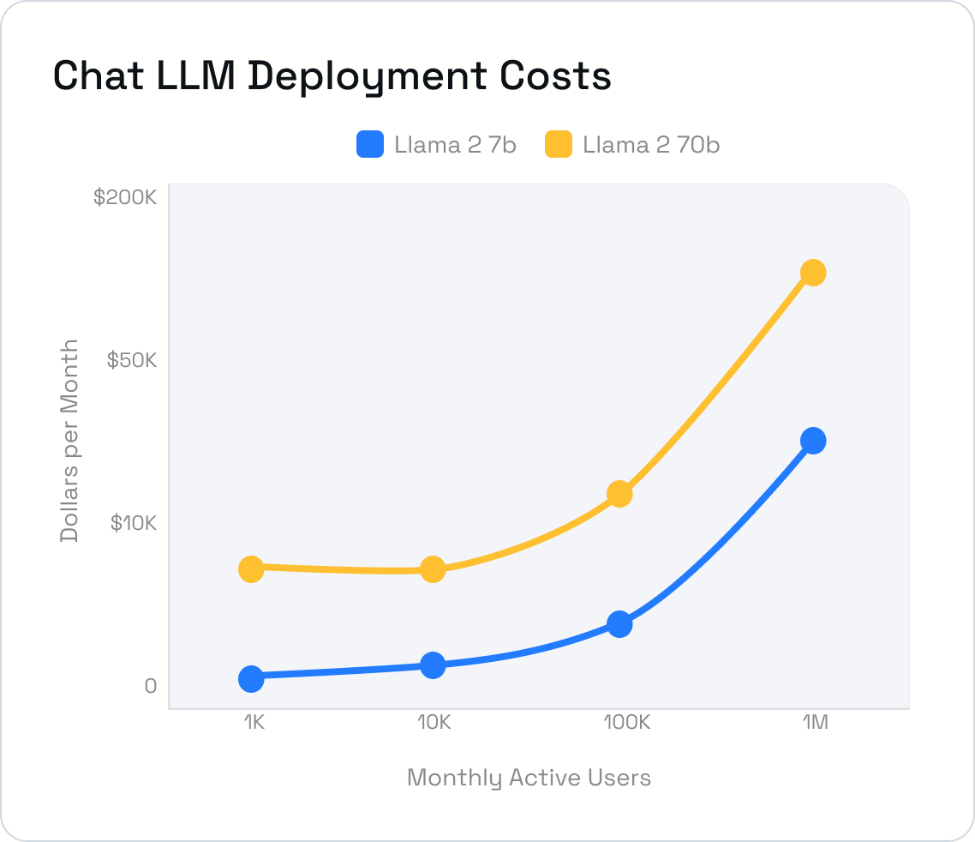
Transformative but Costly Customer Support
Chat LLMs are revolutionizing customer service
Enterprises actively field support requests through LLMs
LLMs handle common queries so humans are free to address complex issues
Accuracy and performance are key
Minimum 7B parameters for reliable accuracy
<1 sec to first token and 20 tokens/sec for fluid responses and positive customer experience
Results in costly deployments
A small deployment of 1K MAUs requires $7.5K per month in spending for 70B model
Notes:
Diving into an active use case, companies such as Delta are utilizing chat LLMs to transform their customer support pipelines
They are able to automate common queries and, in the process, free agents to focus on where they are truly needed – the more complicated or timely support needs.
But, for an LLM chatbot to actually help and not hinder this process, it needs to be accurate and fast.
The minimum guidelines that our research and the community in general have shown is
[show accuracy vs model size graph] a minimum size of 7b for the model
and strict speed targets to enable fluid responses.
[show usage vs costs] Translating these requirements to a scalable deployment, results in
## dollars on average per chat
and ## dollars per month for a medium sized support use case.
Expected Time:
1 - 1.5 minutes
Notes:

Slide 6
Expensive Empowerment for E-Commerce Customers
LLMs empower shoppers through new pathways
Large e-commerce sites actively deploy product review summarizers
Distills long reviews into key insights for better customer experiences
Notes:
Product summarization is another revolutionary area, especially for e-commerce sites.
By distilling long reviews into key sights, it enables more informed decisions for shoppers and easier comparisons leading to fewer returns and customer retention.
This is why Wayfair, Amazon, and many others have actively deployed these already.
But, all of this only works if the summaries are reliable and up to date.
So the minimum guidelines that our research and the community in general have shown is
[show accuracy vs model size graph] a minimum size of 7b for the model.
Performance targets are trickier here, as they depend on how often reviews change and how many products you're tracking, but setting a strict refresh rate and the number of review tokens per product
enables cost estimates based on the number of products to summarize.
[show usage vs costs] So, translating these requirements to a scalable deployment, results in
## dollars on average per product summarization
and ## dollars per month for a medium sized ecommerce site.
Expected Time:
TODO
Notes:
TODO

Slide 7
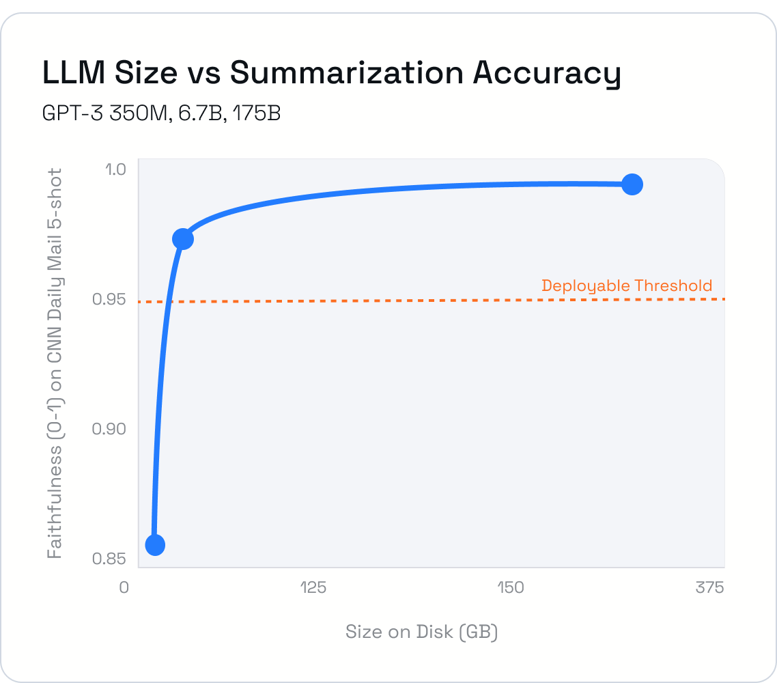
Expensive Empowerment for E-Commerce Customers
LLMs empower shoppers through new pathways
Large e-commerce sites actively deploy product review summarizers
Distills long reviews into key insights for better customer experiences
Accuracy and performance is still key
Minimum 7b parameters for reliable accuracy
1 hour refresh time, 5K tokens per product
Notes:
Product summarization is another revolutionary area, especially for e-commerce sites.
By distilling long reviews into key sights, it enables more informed decisions for shoppers and easier comparisons leading to fewer returns and customer retention.
This is why Wayfair, Amazon, and many others have actively deployed these already.
But, all of this only works if the summaries are reliable and up to date.
So the minimum guidelines that our research and the community in general have shown is
[show accuracy vs model size graph] a minimum size of 7b for the model.
Performance targets are trickier here, as they depend on how often reviews change and how many products you're tracking, but setting a strict refresh rate and the number of review tokens per product
enables cost estimates based on the number of products to summarize.
[show usage vs costs] So, translating these requirements to a scalable deployment, results in
## dollars on average per product summarization
and ## dollars per month for a medium sized ecommerce site.
Expected Time:
TODO
Notes:
TODO

Slide 8
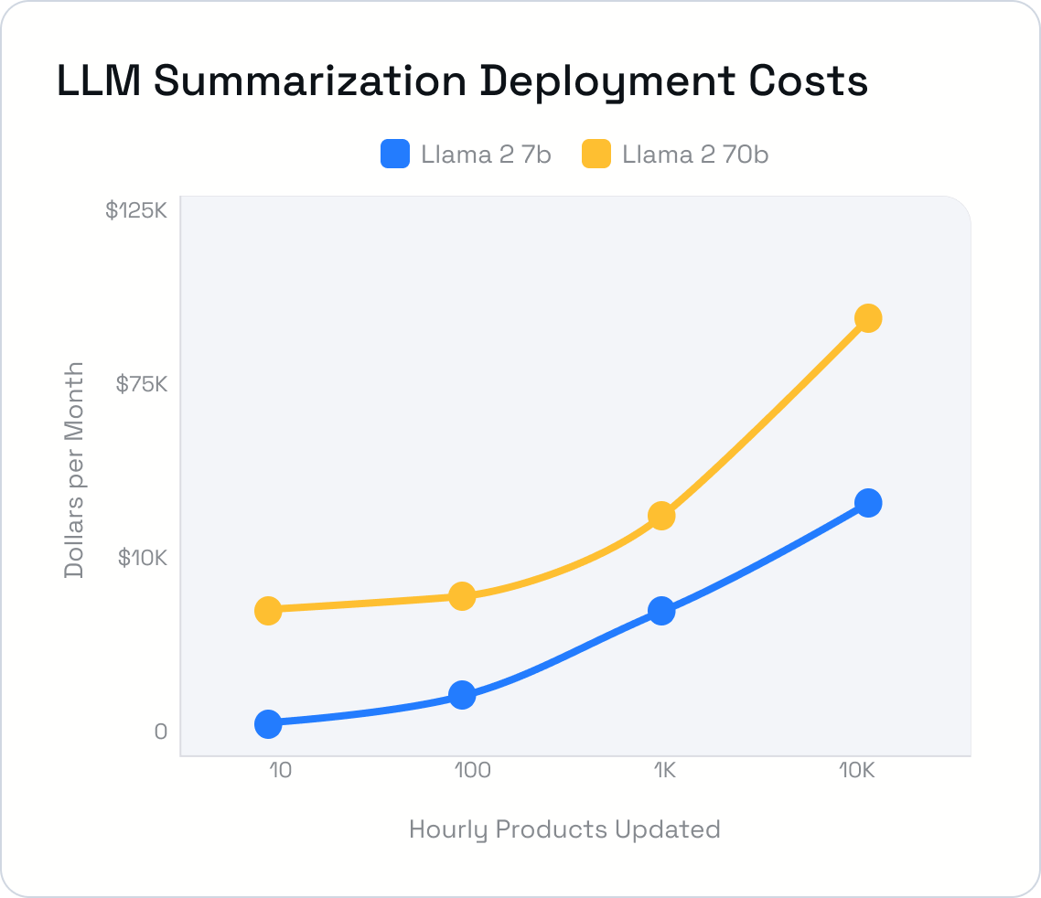
Expensive Empowerment for E-Commerce Customers
LLMs empower shoppers through new pathways
Large e-commerce sites actively deploy product review summarizers
Distills long reviews into key insights for better customer experiences
Accuracy and performance is still key
Minimum 7b parameters for reliable accuracy
1 hour refresh time, 5K tokens per product
Results in costly deployments
A medium deployment handling 100 products per hour requires $7.5k per month in spending for 70B model
Notes:
Product summarization is another revolutionary area, especially for e-commerce sites.
By distilling long reviews into key sights, it enables more informed decisions for shoppers and easier comparisons leading to fewer returns and customer retention.
This is why Wayfair, Amazon, and many others have actively deployed these already.
But, all of this only works if the summaries are reliable and up to date.
So the minimum guidelines that our research and the community in general have shown is
[show accuracy vs model size graph] a minimum size of 7b for the model.
Performance targets are trickier here, as they depend on how often reviews change and how many products you're tracking, but setting a strict refresh rate and the number of review tokens per product
enables cost estimates based on the number of products to summarize.
[show usage vs costs] So, translating these requirements to a scalable deployment, results in
## dollars on average per product summarization
and ## dollars per month for a medium sized ecommerce site.
A small deployment of 1K MAUs requires $7.5K per month in spending for 70B model
Expected Time:
TODO
Notes:
TODO

Slide 9
No Free Lunch: Deployment Tradeoffs
+
Large Model
+
Large Model
+
Small Model
Scaled Infrastructure
Limited Infrastructure
Limited Infrastructure
Performant
but Costly
Affordable
but Unusable
Affordable
but Inaccurate
Notes:
LLMs are powerful, but the headaches force painful compromises as we move into production.
[Slow perf icon and vertex] Let's say we prioritize accuracy, keeping the most powerful model. To make it affordable, we limit our infrastructure, but now our LLM is sluggish. Users don't utilize it and we never realized our advantages from adding LLMs.
[High cost icon and vertex] Maybe we focus on performance instead. We need the LLM to be as fast as possible, but now we're paying for a massive server setup, and the budget simply isn't there to scale it across our use cases.
[Low accuracy icon and vertex] Or, we bite the bullet and shrink our model to fit existing resources. But, the compromised accuracy translates to limited usefulness, so is it actually useful?
Expected Time:
1 - 1.5 minutes
Notes:
The triangle comparison is the central point with accuracy, cost, and performance as the edges that are shown at the beginning
As I talk through each point in the talk track above, we would show the circle vertices that correspond to it
Ideally we should find some eye catching images to represent the issues at the vertices and animate them in as I talk through the downside for each of the vertices

Slide 10
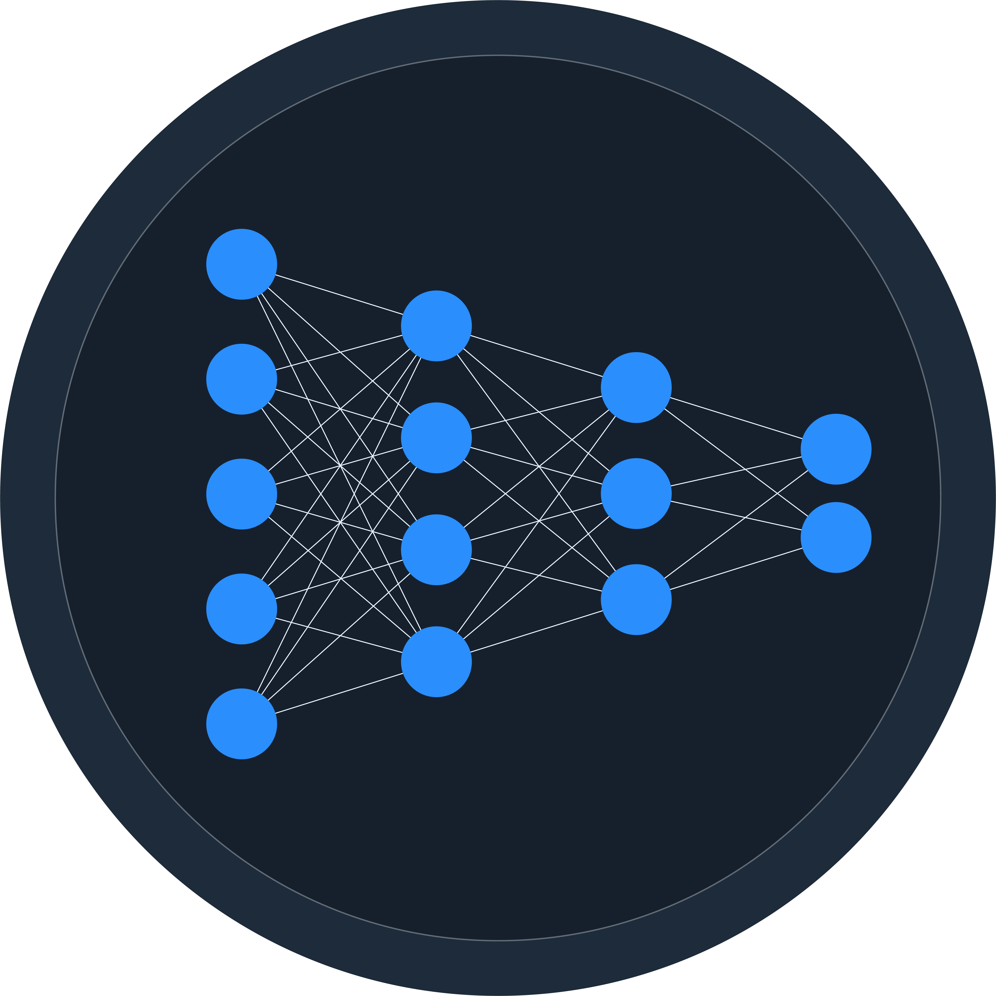
Reduce, Reuse, Sparsify
Neural Networks are large and over-parameterized with redundant compute
Pruning reuses connections
Quantization reduces precision
Large Model
Large Model
+
Small Model
+
+
Limited Infrastructure
Limited Infrastructure
Scaled Infrastructure
Affordable
but Inaccurate
Affordable
but Unusable
Performant
but Costly
Notes:
Talk Track:
Expected Time:
1 - 1.5 minutes
Notes:
The graph is to reinforce that simple model growth doesn't equal limitless gains and cost is where things get out of hand – ideally want to highlight this graph as soon as we get into the headaches talk point

Slide 11
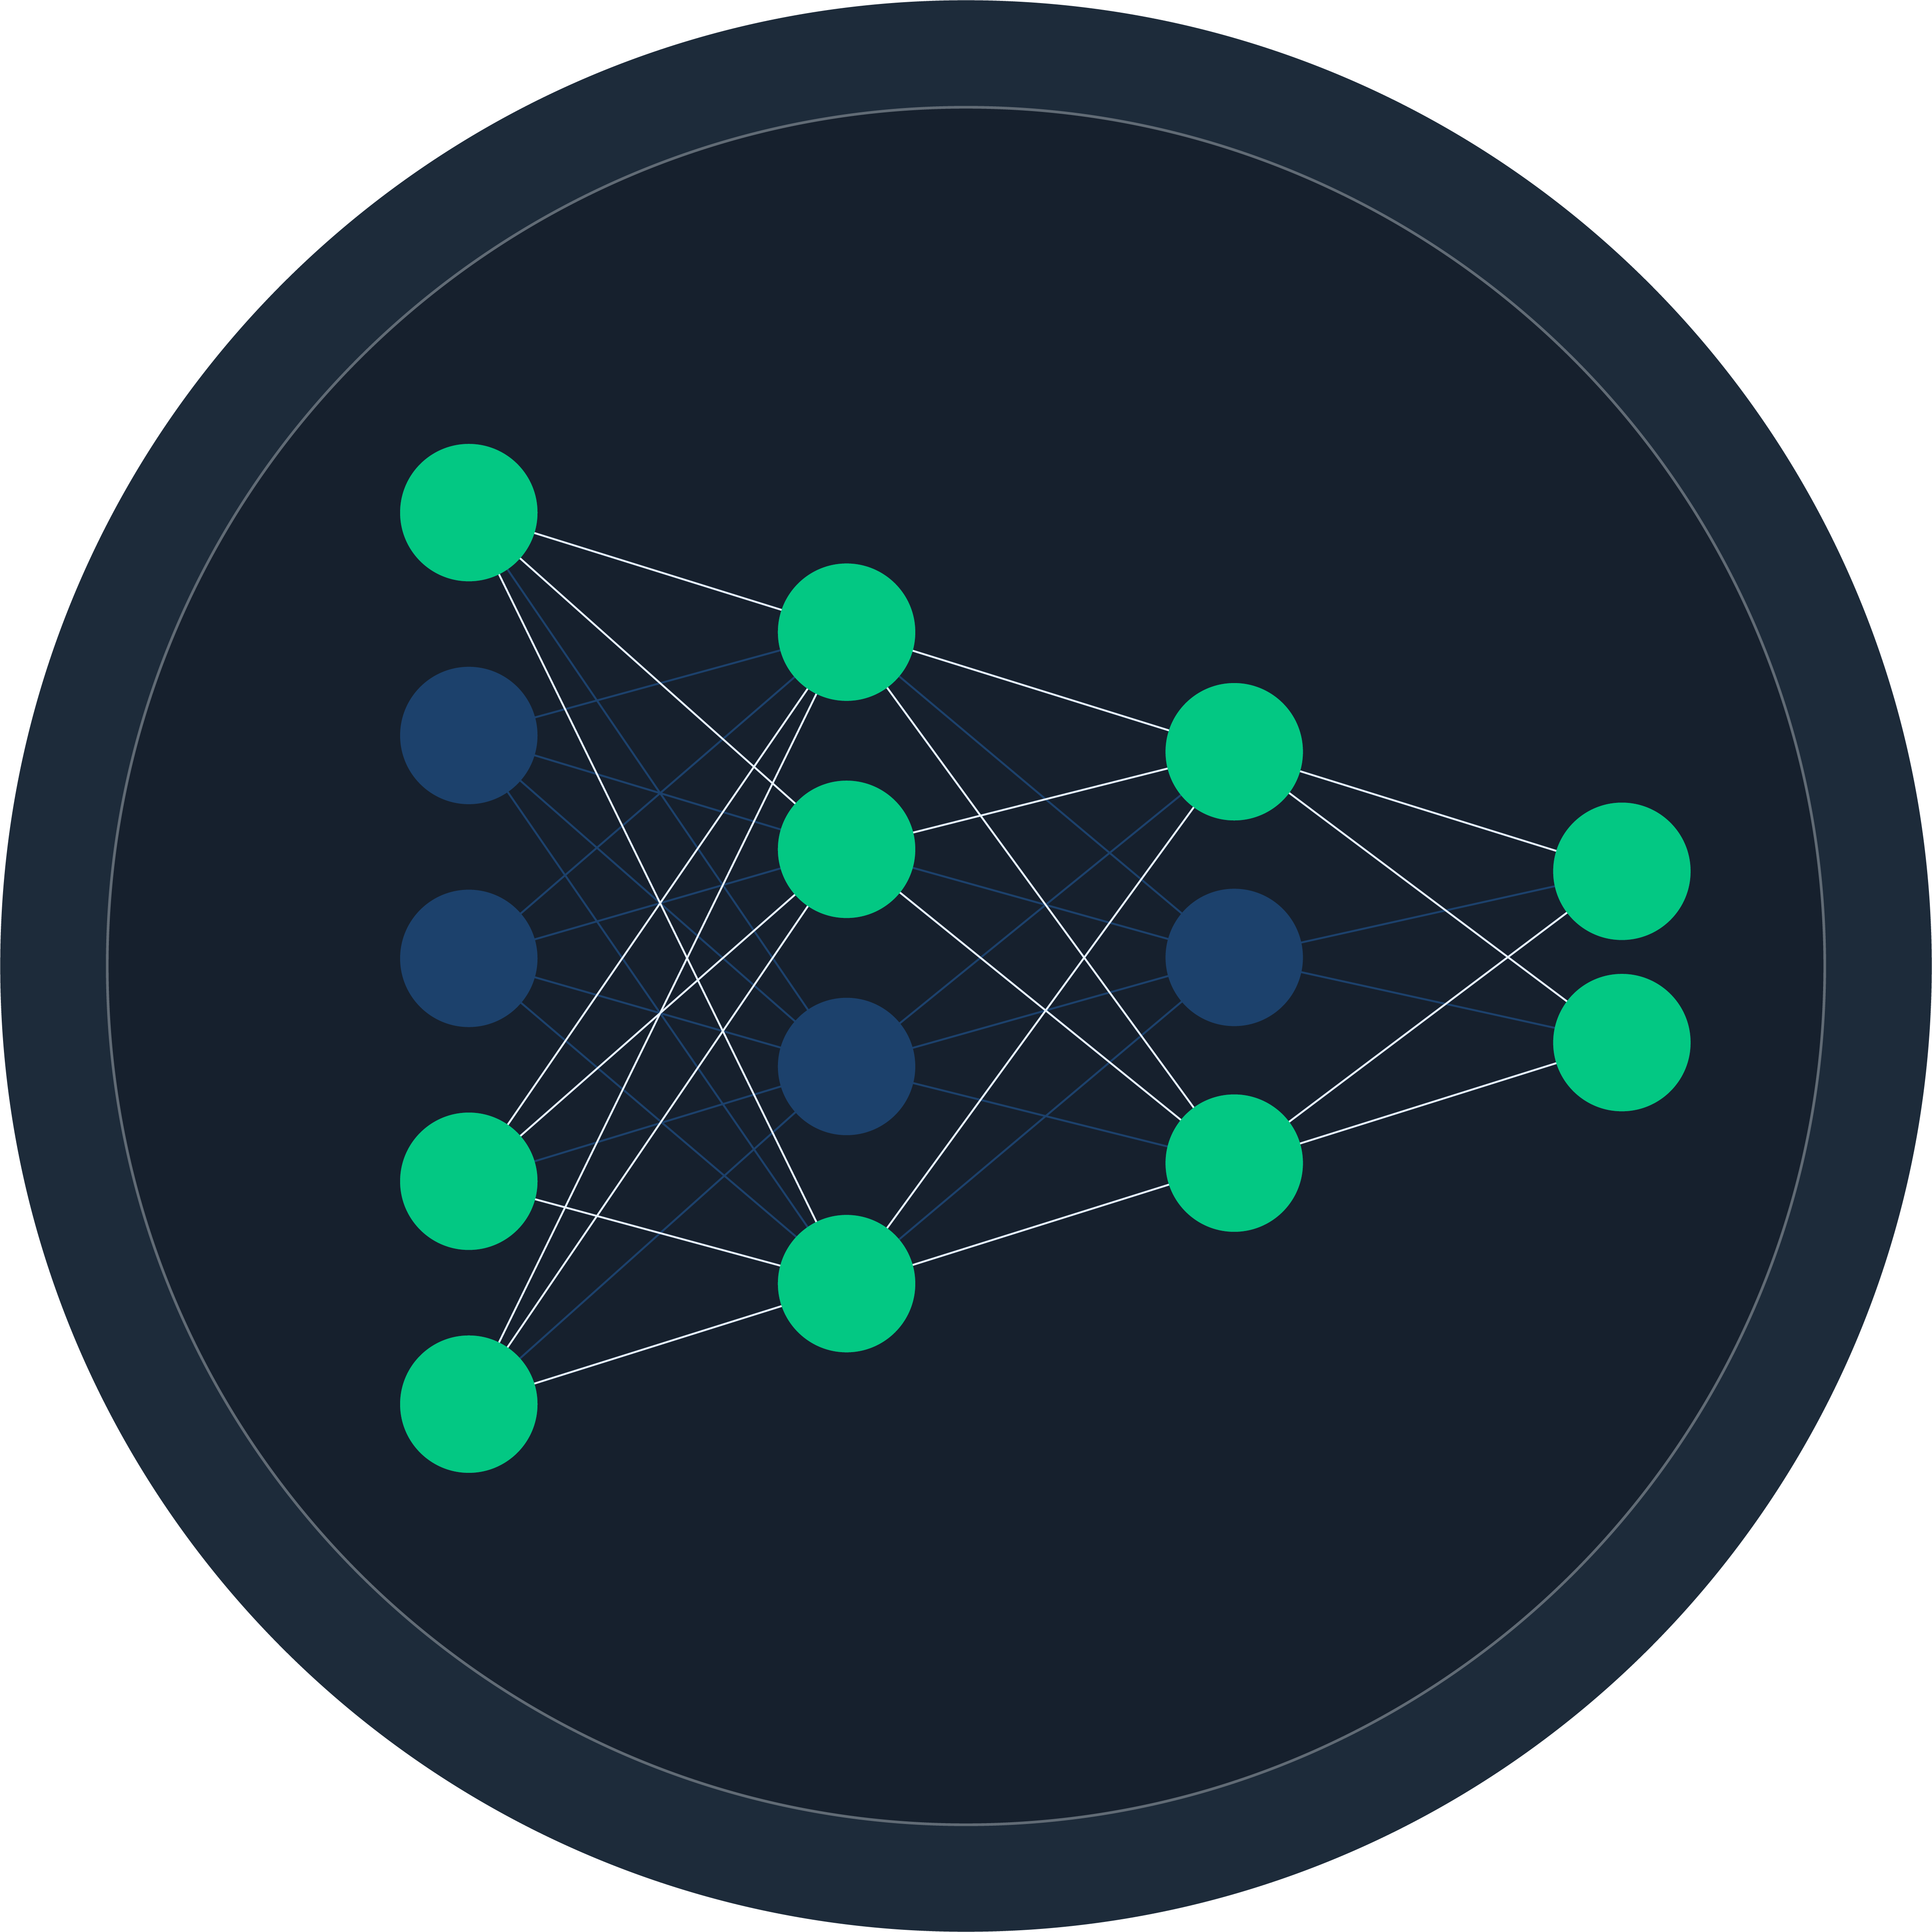
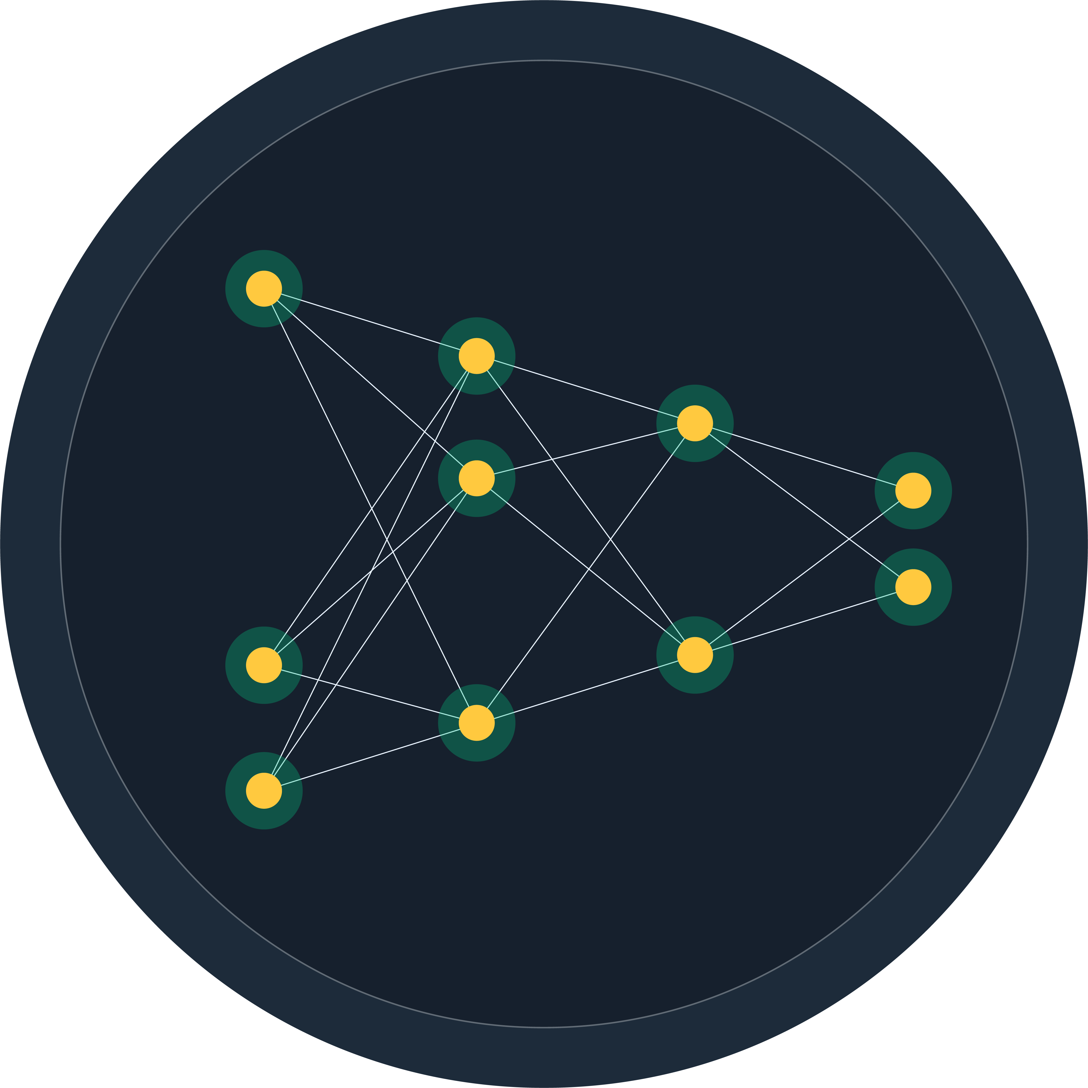
Reduce, Reuse, Sparsify
Neural Networks are large and over-parameterized with redundant compute
Pruning reuses connections
Quantization reduces precision
Large Model
Large Model
+
Small Model
+
+
Limited Infrastructure
Limited Infrastructure
Scaled Infrastructure
Affordable
but Inaccurate
Affordable
but Unusable
Performant
but Costly
Notes:
Talk Track:
Expected Time:
1 - 1.5 minutes
Notes:
The graph is to reinforce that simple model growth doesn't equal limitless gains and cost is where things get out of hand – ideally want to highlight this graph as soon as we get into the headaches talk point

Slide 12
Reduce, Reuse, Sparsify
Neural Networks are large and over-parameterized with redundant compute
Quantization reduces precision
Pruning reuses connections
Neural Magic has led the way in model optimization without sacrifices
Computer Vision → 27x compression with 99% recovery (ResNet-50)
NLP → 23x compression with 99% recovery (BERT)
LLMs – not just large but massive
Still over-parameterized
Limited compression research
Neural Magic is fully focused on LLM compression
Notes:
Talk Track:
Expected Time:
1 - 1.5 minutes
Notes:
The graph is to reinforce that simple model growth doesn't equal limitless gains and cost is where things get out of hand – ideally want to highlight this graph as soon as we get into the headaches talk point

Slide 13
LLM Weight Quantization
1
2
3
Weights are a big issue for LLMs
LLM Quantization is actively done with GPT-Q
Results in smaller, faster models
Weight quantization lessens the issue by reducing precision for faster memory access
7B parameter model
16bit (before): 13GB weights, 1GB activations
4bit (after): 4GB weights, 1GB activations
Co-authored by Neural Magic
First algorithm to compress LLM weights to INT4 with accuracy recovery
3.5x reduction in disk size
3.8x faster TPOT (time per output token)
Notes:
Talk Track:
Expected Time:
1 - 1.5 minutes
Notes:
The graph is to reinforce that simple model growth doesn't equal limitless gains and cost is where things get out of hand – ideally want to highlight this graph as soon as we get into the headaches talk point

Slide 14
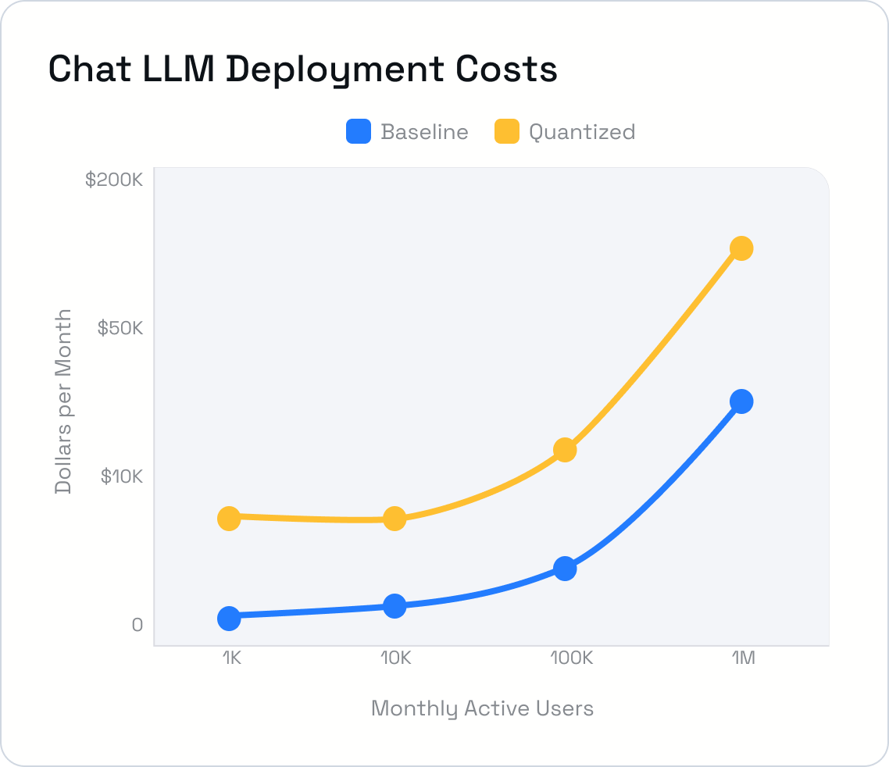
Improve Performance with LLM Weight Quantization
Notes:
Talk Track:
Expected Time:
1 - 1.5 minutes
Notes:
The graph is to reinforce that simple model growth doesn't equal limitless gains and cost is where things get out of hand – ideally want to highlight this graph as soon as we get into the headaches talk point

Slide 15
LLM Weight Quantization in Action
Notes:
Talk Track:
Expected Time:
1 - 1.5 minutes
Notes:
The graph is to reinforce that simple model growth doesn't equal limitless gains and cost is where things get out of hand – ideally want to highlight this graph as soon as we get into the headaches talk point

Slide 16
LLM Sparsification - A New State of the Art
1
2
3
There's still more redundancy. Start reusing, reduce further!
SparseGPT and Sparse Foundational Models
Resulting in smaller,
faster models
Reuse connections with pruning: >2x further compression
Reduce further with activation quantization – 2x reduction in cache storage
Compound everything together, enabling faster memory access and faster compute for inference
Neural Magic open sourced both
SparseGPT: The first algorithm to prune LLMs to 50% or more with one-shot
Sparse Llama-2 7B: SparseGPT + further pretraining = ready to use, compressed LLMs for your use case
8x reduction in memory usage
7x faster TPOT (time per output token)
Notes:
Talk Track:
Expected Time:
1 - 1.5 minutes
Notes:
The graph is to reinforce that simple model growth doesn't equal limitless gains and cost is where things get out of hand – ideally want to highlight this graph as soon as we get into the headaches talk point

Slide 17
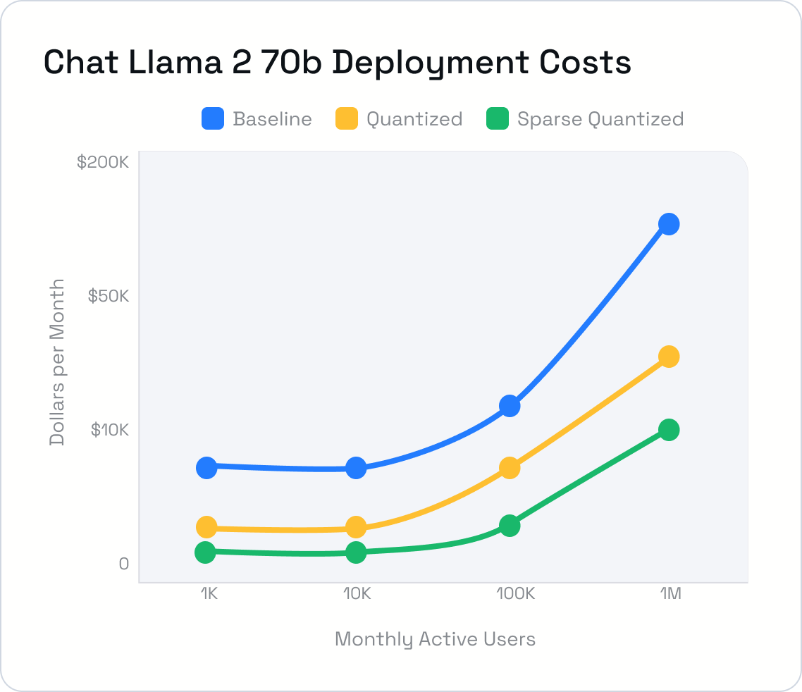
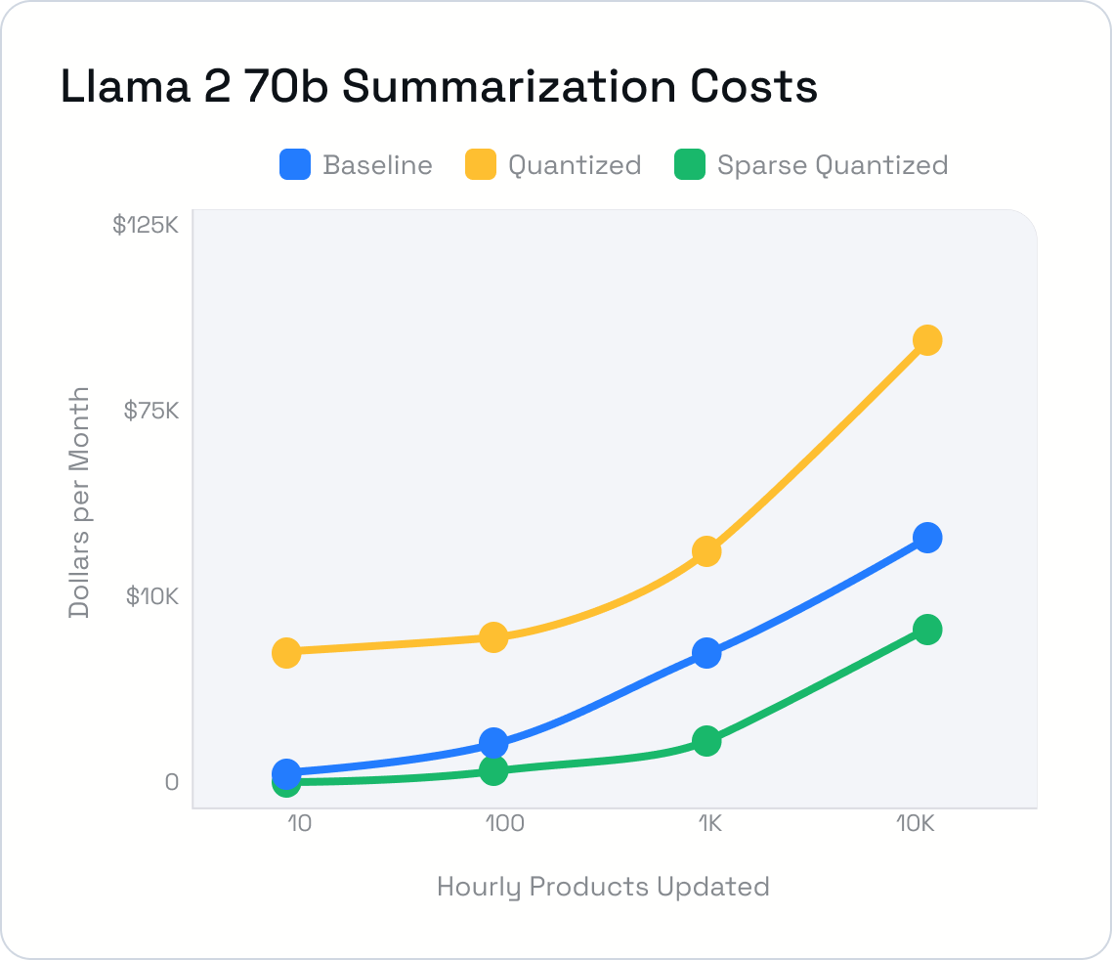
Revamped Performance with LLM Sparsification
Notes:
Talk Track:
Expected Time:
1 - 1.5 minutes
Notes:
The graph is to reinforce that simple model growth doesn't equal limitless gains and cost is where things get out of hand – ideally want to highlight this graph as soon as we get into the headaches talk point

Slide 18
LLM Sparsification in Action
Notes:
Talk Track:
Expected Time:
1 - 1.5 minutes
Notes:
The graph is to reinforce that simple model growth doesn't equal limitless gains and cost is where things get out of hand – ideally want to highlight this graph as soon as we get into the headaches talk point

Slide 19
Key Takeaways
8x
7x
600%
700%
Smaller LLMs while matching the baseline accuracy
Faster LLMs while matching the baseline accuracy
Cost savings for latency-based LLM use cases such as chat
Cost savings for throughput-based LLM use cases such as summarization
Notes:
Talk Track:
Expected Time:
1 - 1.5 minutes
Notes:
The graph is to reinforce that simple model growth doesn't equal limitless gains and cost is where things get out of hand – ideally want to highlight this graph as soon as we get into the headaches talk point

Slide 20
Next Steps
*While at the event, come by our booth to learn more about our research, products, or how we can help with your enterprise use case.
Deploy
pre-sparsified LLMs
Finetune
pre-sparsified LLMs
Sparsify
custom LLMs
Engage
with us on Slack
Optimize your LLM deployments with nm-vllm for GPUs and DeepSparse for CPUs.
Finetune our sparse foundational models on Hugging Face to your use cases.
Use our open-sourced algorithms in SparseML to sparsify your current LLMs.
Join our Slack community, engage with the team and ask questions.
Notes:
Talk Track:
Expected Time:
1 - 1.5 minutes
Notes:
The graph is to reinforce that simple model growth doesn't equal limitless gains and cost is where things get out of hand – ideally want to highlight this graph as soon as we get into the headaches talk point

Slide 21
A Look Ahead
Further releases of sparsified LLMs
Increased sparsification levels
We'll continue to sparsify larger models, the latest architectures, and new domains.
We're pushing research to enable higher sparsities, further quantization, and new pathways.
Expansion to efficient training
A commitment to open source
We're expanding research around PEFT methods to include compound sparsification.
We will continue to open source our results, models, and our research for the community's benefit
Notes:
Talk Track:
Expected Time:
1 - 1.5 minutes
Notes:
The graph is to reinforce that simple model growth doesn't equal limitless gains and cost is where things get out of hand – ideally want to highlight this graph as soon as we get into the headaches talk point

Slide 22
THANK YOU!
GitHub: github.com/neuralmagic X: @neuralmagic Slack: neuralmagic.com/community
neuralmagic.com
Q&A
Mark Kurtz
CTO
Neural Magic
Notes:
Hello everyone, I’m excited to share some insights and results from our research collaboration with Cerebras.

