Slide 1
Kids Help Phone AI Trailblazers Changing the Youth Mental Health Ecosystem

Slide 2
Our Impact 2023
75% of service users said they shared something with Kids Help Phone that they have never shared with anyone else
85% found their conversation with KHP helpful
78% said that they felt less upset after their conversation with KHP
49% said that if they had not reached out to Kids Help Phone, they would have ignored the issue or hoped it went away
9% said that if they had not reached out to KHP they would have gone to the ER
Since 2020 we have had more than 19 million interactions with service users.
Since 2019 we completed more than 76,759 safety plans
On average, in 2023, KHP has supported young people over 13,000 times every day.
1 in 2 youth struggle with their mental health alone.
That’s not “fine”.

Slide 3
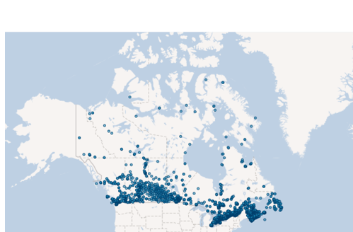
Who is Kids Help Phone?
KHP is a 35-year-old start up, delivering Canada’s only 24/7, bilingual/multilingual, e-mental health service for young people accessible from any community across Canada.
With translation services in 100 different languages launched in 2023, including Arabic, Pashto, Dari, Ukrainian, Russian, Plains Cree, Ojibway, Mandarin, Hebrew, Yiddish, etc.
KHP offers clinically based self-directed tools and activities, health promotion and mental wellness interventions, crisis response services, professional counselling and resource referral in French and English
Canada's largest community resource database (March 2024 – youth mental health apps database will be added)
Programs designed and delivered in partnership with equity seeking communities, from coast to coast to coast:
Finding Hope: KHP Action Plan to Support Inuit, First Nations and Métis Youth
RiseUp powered by Kids Help Phone in support of African, Caribbean and Black Youth
New Journeys: Supporting Newcomer Youth
Requests for Service since 2017

Slide 4
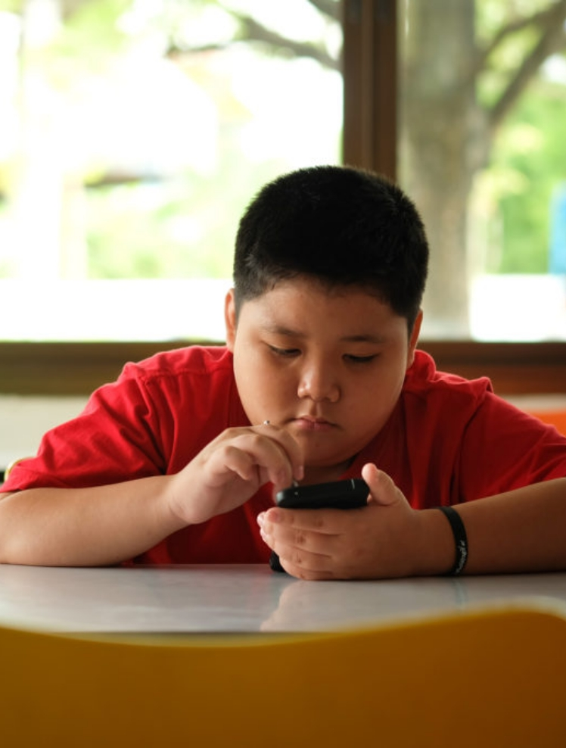
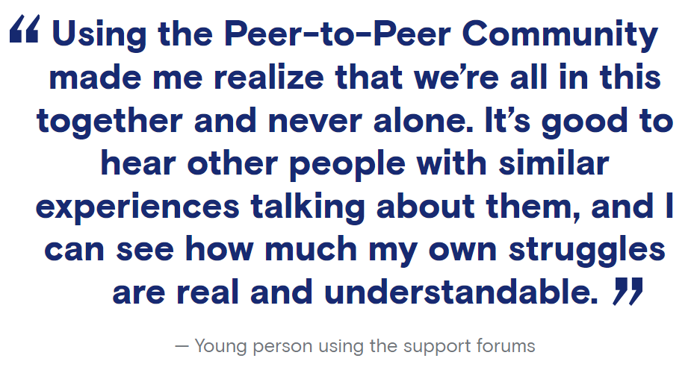
KHP has changed the landscape of e-mental health...
2018 – launched the first 24/7 textline in Canada powered by leading edge technology and trained volunteer Crisis Responders. One of the most scalable 1:1 services in Canada.
1M+ conversations
40M+ messages - the largest youth mental health dataset in Canada
10K+ trained volunteers
2020 – launched the stepped care model on KidsHelpPhone.ca with leading edge navigation technology and new content in multiple languages.
4.1M+ interactions in 2023 (+17% over 2022)
2020 – launched KHP Insights, a public data dashboard with trends from the largest mental health dataset in Canada and Regional Dashboards provided to public sector partners in NS and NB.
Dozens of new partnership opportunities for data collaborations and partnerships
Data infrastructure to support advanced analytics and AI/ML development
2021 – launched Peer to Peer Community, a rapidly growing online platform where young people can share their experiences and connect with peers.
260K+ interactions in 2023 (+46% over 2022)
2023 – funded first ever Mental Health Apps Database, available in KHP's Resources Around Me which will offer service users curated referrals to mental health apps.
Launch plans in progress for 2024

Slide 5
KHP's Data Hub: Canada's Largest Dataset on Youth Mental Health
KHP has the largest dataset on youth mental health in Canada. Only dataset that captures a young person's journey as it relates to mental health and well-being outside of an institutional setting and offers insights in real time (validated by CIHI, Vector Institute, Centre for Surveillance and Applied Research (CSAR) - PHAC). KHP’s Data Hub is an established ecosystem that centralizes and optimizes KHP’s large, unique datasets for advanced analytics, insights, and AI
40 Million + Messages
4 - 5 Million Annual Interactions
Service User & Frontline Data
AI Develop AI and ML models to enhance our service offering, giving us the ability to offer more personalized and tailored services to service users and frontline teams.
AI
Analysis & Insights Leverage powerful tools for visualizing and analyzing data, allowing users to gain deeper insights.
Central Storage - Provide quick and easy access to data from multiple sources at scale.
Central Data Storage

Slide 6
Technology is Changing. Youth are Changing Faster.
In order for KHP to “Meet Youth Everywhere” we are reconceptualising our very understanding of content and presence in digital spaces (social, search, and gaming), and our approach to content development, and service delivery to reflect these changes.
Key Trends in Tech and Online Spaces
What this means for KHP
The use of generative AI (i.e. Chat GPT) is revolutionizing search engines…
…Search Engines are becoming aggregators that provide summaries of key insights for users – moving away from the old UX of sharing links to websites
As AI features becomes more ubiquitous…
KHPs services will be integrated into digital spaces to ensure clinically sound recommendations are available
Life like gaming environments, virtual reality and social gaming…
…Complete immersion into digital spaces, for example, through interactive and life-like gaming settings
Revolutions in technology will require KHP to be able to provide services directly on key platforms…
limiting re-routing or popups, and creating seamless experience for young people…
Increased Expectations regarding content type, format, and structure. Content will need to be easy to find and digest
The personalization of social media…
Using algorithms that not only pick up what you like, but predict and direct you to things you may need, based on what it has learned about you
The Web MD Effect…
With the advances in technology, there comes an even more flooded market of content, young people are likely to get advice from these platforms in new ways, which changes how they might ask for health…

Slide 7
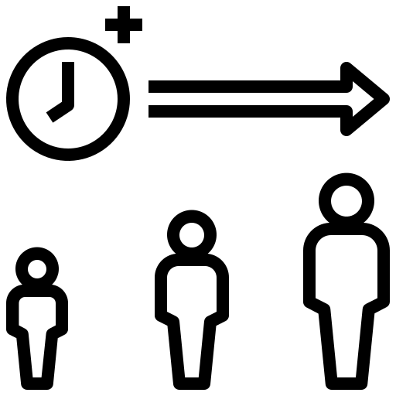
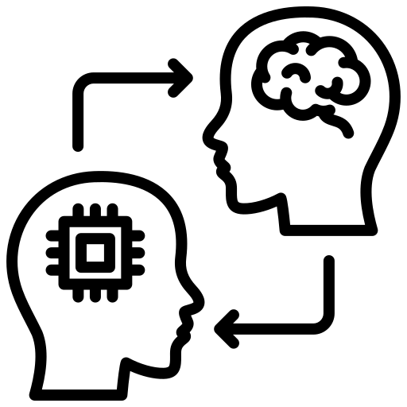
More and more, young people are turning to AI…
The State of AI and Young People in Canada, and Globally
64%
79%
42%
Of young people aged 18 to 34 are familiar, and comfortable using AI. Compared to only 38% of those older than 55¹.
Of young people between the ages of 13 and 17 said they had used ChatGPT, Snapchat My AI, and Midjourney. 50% have used Snapchat my AI².
Of younger respondents in a recent study thought AI tools were good for society, compared to only 23% of older Canadians. This number increased to 66% among youth in the UK and Europe^{1.}
Sources:
National Observer (Canadian Youth): https://www.nationalobserver.com/2024/02/11/news/thirty-percent-young-canadians-use-i#:~:text=Similarly%2C%20nearly%20half%20of%20younger,it%20comes%20to%20personal%20safety.
OfCom Report (UK) : https://www.ofcom.org.uk/__data/assets/pdf_file/0029/272288/online-nation-2023-report.pdf

Slide 8
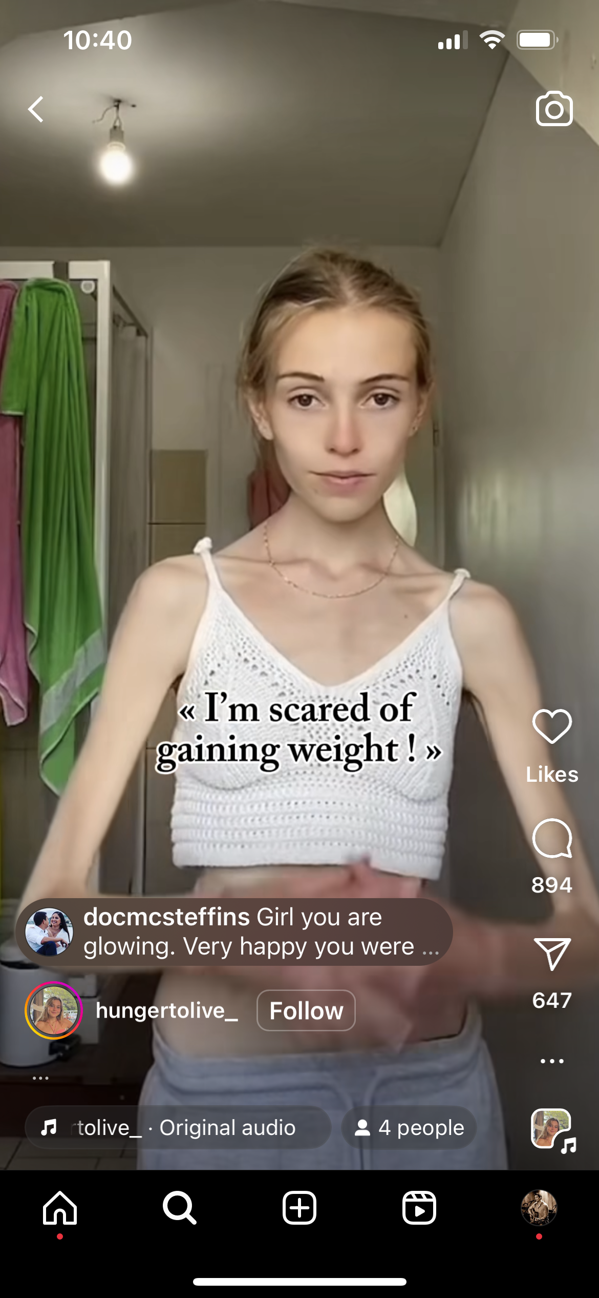
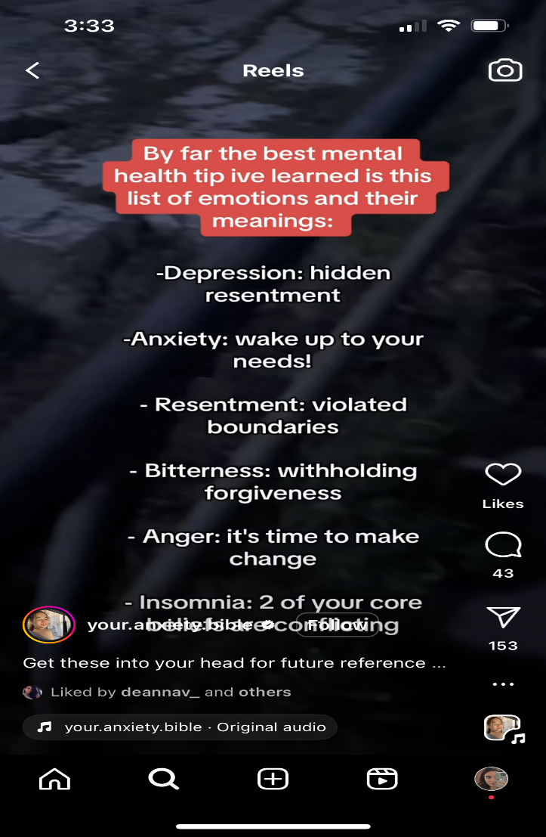
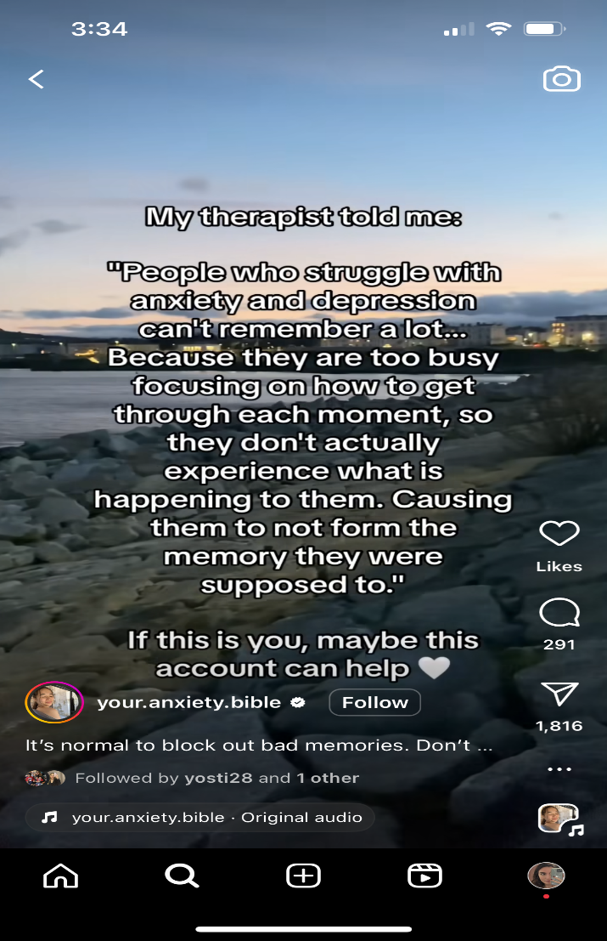
AI in social media has changed the way young people explore their feelings and Mental Health content...
Notes:
Add a slide on the other online spaces young people are spending time in (e.g., Bing…)

Slide 9
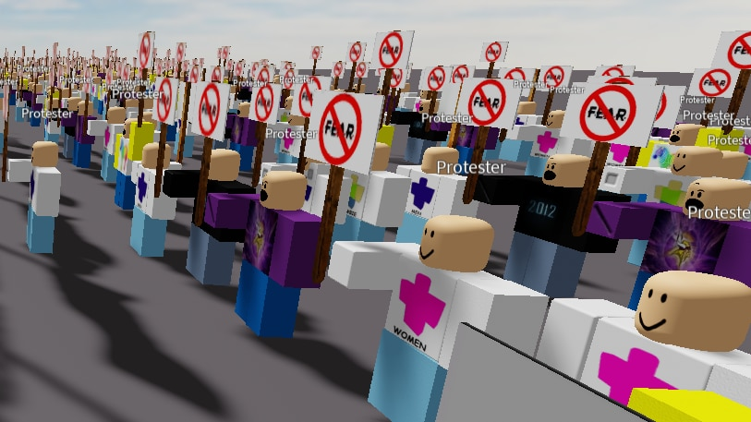
AI in gaming has changed the way young people interact with the digital world, society, and with each other.
Roblox “Voice Chat” Hangouts
Gamers on Roblox bringing “activism” to the virtual world*
*Source: https://www.abc.net.au/news/2023-11-10/virtual-protest-activism-in-video-games-like-roblox/103077494
Notes:
Add a slide on the other online spaces young people are spending time in (e.g., Bing…)

Slide 10
When it comes to youth mental health, AI is a promising tool…and maybe…
The State of AI and Young People in Canada, and Globally
In a recent study conducted by CAPMH, more than two-thirds of young people have experience with and rely on mental health apps for support on their mental health journeys and 60% make regular use of at least 1–2 apps³.
More and more, if done correctly, AI presents an opportunity to improve the mental health outcomes and interventions for young people
KHP understands the responsibility we have to support young people 24/7, and we take that same approach when it comes to how we apply AI to our work
Sources:
3. Child and Adolescent Psychiatry and Mental Health https://capmh.biomedcentral.com/articles/10.1186/s13034-022-00522-6

Slide 11
KHP's Philosophy on the Use of AI…
Beyond AI - The Innovation Imperative at KHP
We take a human-first approach to building AI tools that
support humans making decisions – not to make decisions for humans.
We use AI only where it is best suited to solve challenges.
We are transparent about what our technology is intended for.
We are equitable and use testing frameworks with technical
and manual validation to ensure our AI tools are unbiased, accurate, fair and explainable.
Protecting privacy is our priority and we only use best practices.
We follow a multi-layer privacy security and risk framework to ensure AI is adopted ethically and responsibly with oversight from industry leaders.
KHP does not use AI to replace human-to-human interactions between our front line and service users.

Slide 12
At KHP, AI enables more specialized services and helps to solve challenges in service delivery
Beyond AI - The Innovation Imperative at KHP
We are using this unique and valuable data to develop AI tools to support our frontline staff and service users.
We see AI as a powerful assistant to our human staff, not as a replacement for their clinical expertise.
Currently, we use AI to triage texting conversations by severity and to support KIP, our navigation chatbot on the KHP website.

Slide 13
On Equity & Bias Mitigation in AI at KHP
Beyond AI - The Innovation Imperative at KHP
Equity is at the core of everything we do at KHP.
We take bias very seriously. We serve all young people at KHP, however they identify.
We have developed strategies to support equity-deserving groups with specialized programs for Newcomer youth through our New Journey’s strategy, support Black youth through our RiseUp strategy and support for Indigenous young people through our Finding Hope strategy.
When it comes to AI …
Knowing we support all young people from coast to coast to coast provides us with a dataset to create models that have less risk in creating bias against equity deserving groups.
Our Participatory Design Process:
Our design is always youth centered. In 2023, we consulted with 140+ youth on how we move the Innovation, Data and AI strategy forward.
KHP validates our AI processes with our clinical staff to ensure any bias in the model(s) are flagged and corrected.
We complete manual validation reviews with our frontline staff and from Vector researchers to ensure the products we built accurately.
Notes:
*Mariana, can you talk about the advisory councils we have formed for our equity programs: Indigenous Advisory Council, Black Advisory Council – it shores up that these programs are created for the community by the community.

Slide 14
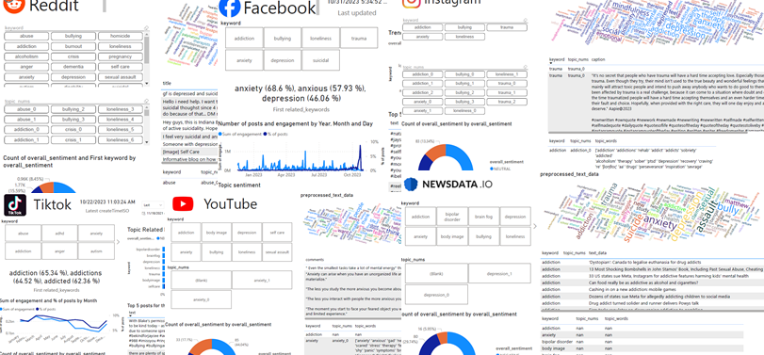
How KHP uses AI today
Beyond AI - The Innovation Imperative at KHP
Trend Spotting
Insights
KHP is using AI for social listening to better understand what youth are experiencing online, what the online youth mental health trends are, and what words youth are using to describe their experiences. We are currently building dashboards to pull data related to trending mental health topics over social media.
Using AI technology, KHP is disseminating our data through Insights Briefs. This AI tool can interpret data, write narratives, and design these reports. Through these reports, we can advocate for and represent youth mental health experiences and trends, reducing stigma and helping youth to feel heard.

Slide 15
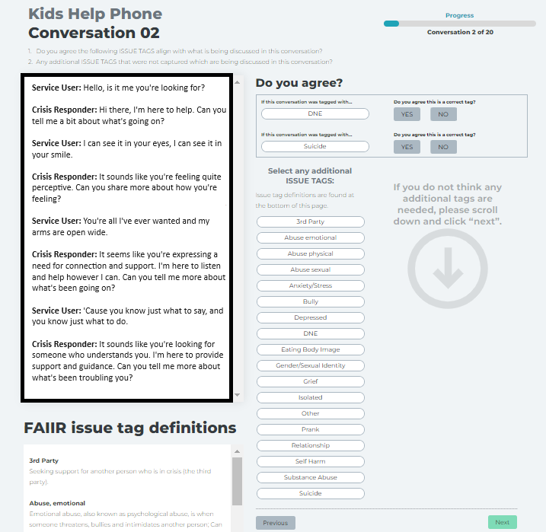
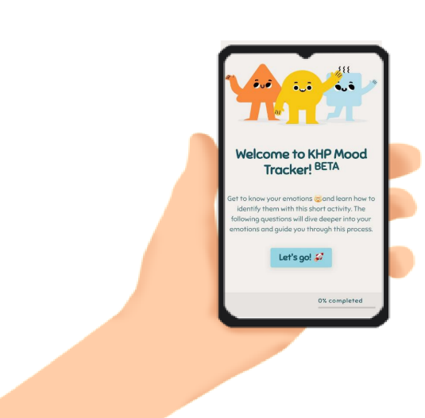
In progress
Beyond AI - The Innovation Imperative at KHP
Mood Tracker
FAIIR Model
KHP brought together about 100 young people from across Canada to learn how to create a supportive experience that helps each person find the resources they need, when they need it, and in the way they want.
Together with the Vector Institute engineers and scientists, we developed an AI prototype that predicts issues like anxiety and bullying in conversation transcripts.
The model is called FAIIR (Frontline Assistant: Issue Identification and Recommendation). Our prototype can predict the main issue in 97% of conversations. ​
They wanted a “Blob Friend” that supports SMS/email check in to see how you are feeling, provide affirmations and personalized resource recommendation

Slide 16
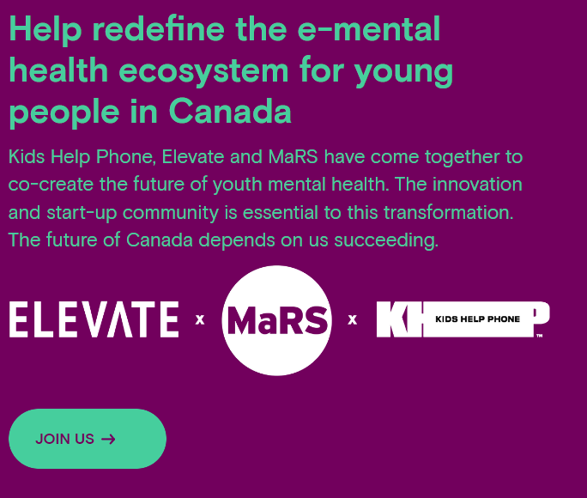
We have the right partners helping us stay ahead…
The Future of Innovation at KHP
x
Our priority is to use these predictions to:
Reduce the administrative burden on counsellors by automatically surfacing referrals and tip sheets, auto populating surveys, etc.
To predict a young person’s needs based on what they say/text to our frontline staff, what web pages they click on, and responses to surveys.
Recommend content and services without requiring them to know anything about mental health.

Slide 17
Thank you! Connect with us if you want to collaborate mariana.catz@kidshelpphone.ca

