Slide 1
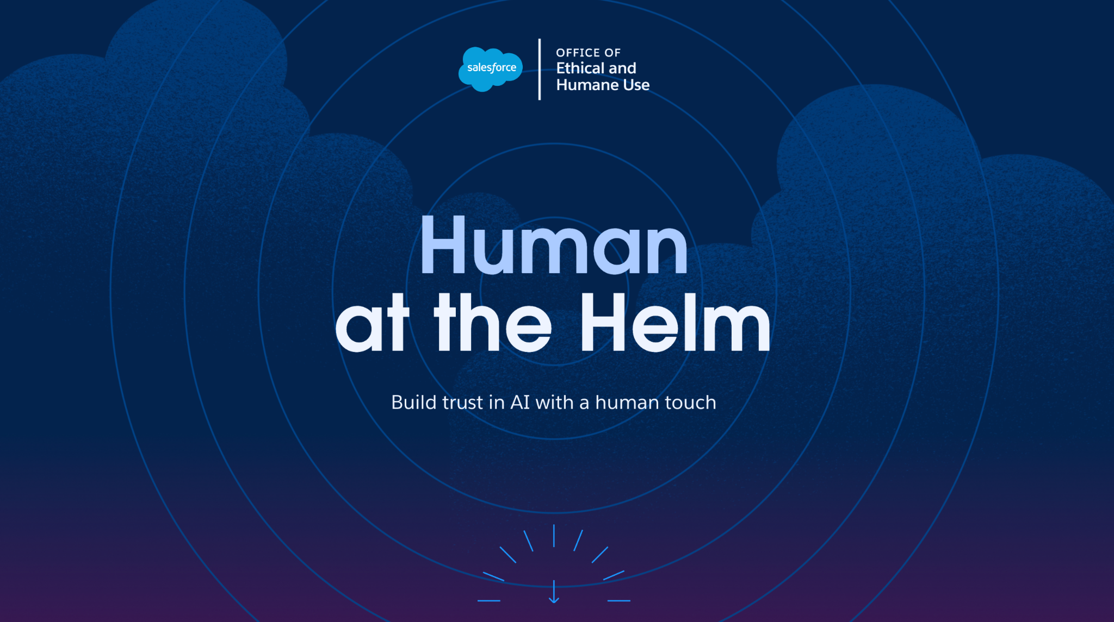
Marc Mathieu
SVP AI Transformation and Vice Chair Salesforce Global AI Advisory Board
X: marcfmath
in: marcmathieu
Notes:
WELCOME TO THE AGE OF HUMANS AT THE HELM

Slide 2
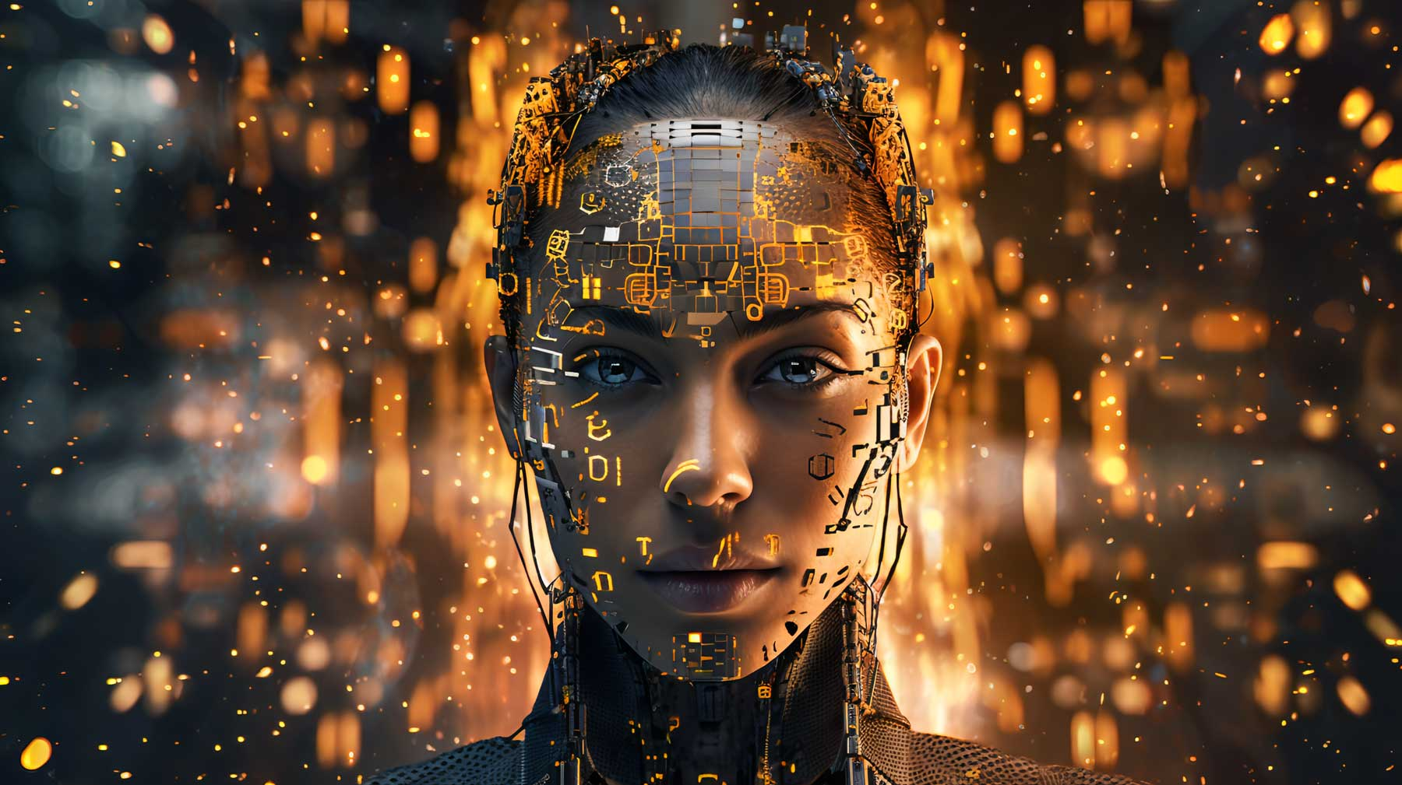
Notes:
As we all know, we are at the brink of the AI Revolution, with all the excitements - and angsts - that come with any revolution!

Slide 3
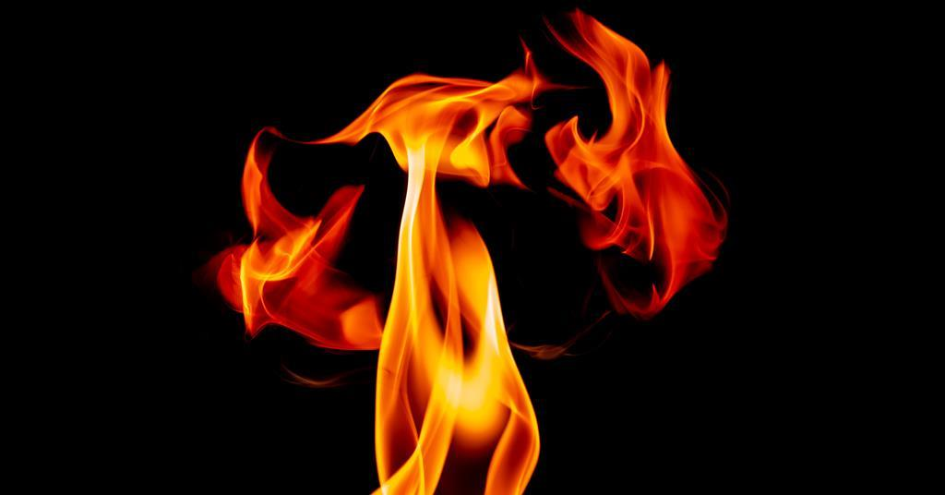
Notes:
But this not just any revolution. I believe we are at the beginning of something as game changing as the mastery of fire

Slide 4
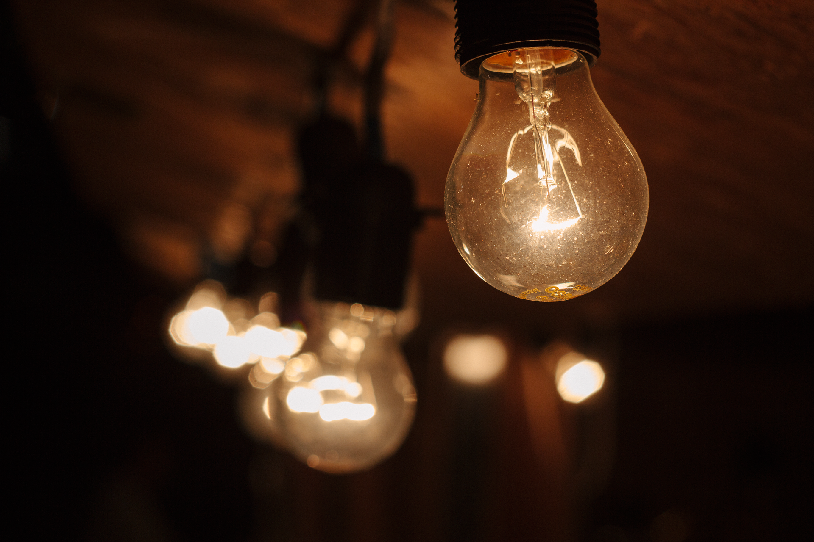
Notes:
Or even more so, maybe, the discovery of electricity.
I know the closest we all can remember the times before electricity is either from watching historical movies, or even better from a romantic dinner But when Edison invented its very first commercial application - the chat GPT of electricity if you will - 145 years ago, little did we know how much change that little artificial candle - and the successive innovations and INVENTIONS it was about to generate! I guess at best we thought “Productivity”: now we won’t need all the people who turn on and off all the candles every night and every morning, les ALLUMEURS DE REVERBERES as we called them in French, and that’s big progress, and lots of savings!

Slide 5
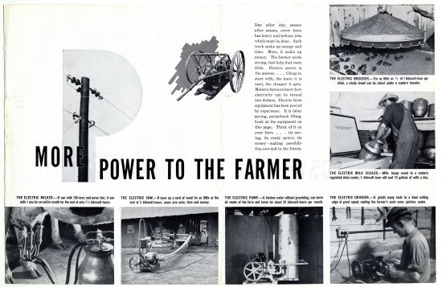
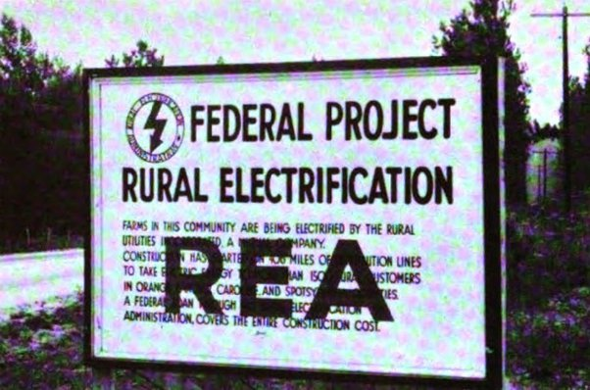
Notes:
When in 1936 the Rural Electrification Act was signed by President Roosevelt, it was all about ‘bringing power to the people - the Farmers actually - because that was how we were living and who we were - and electricity was to empower the people - all the people - one farmer at a time!

Slide 6
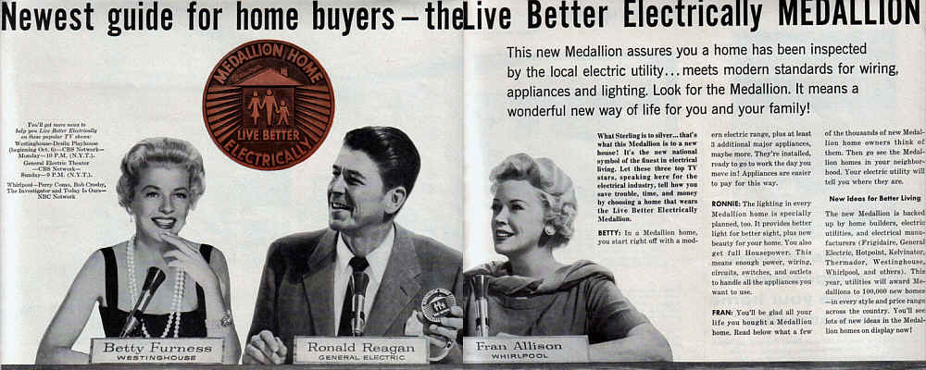
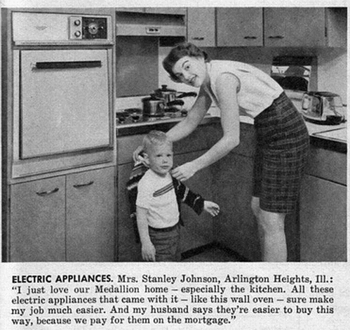
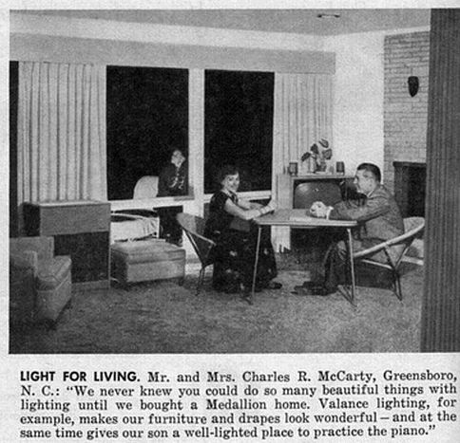
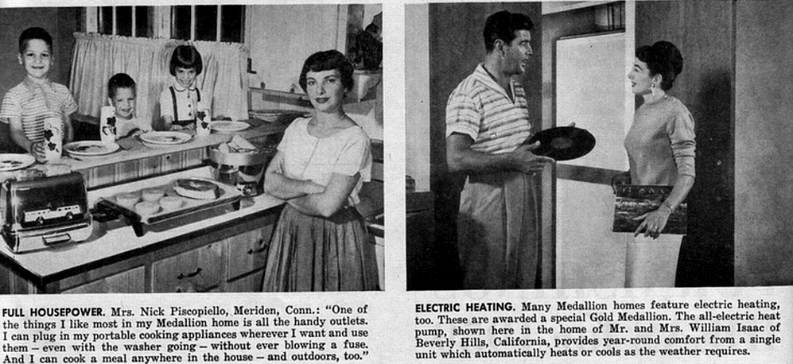
Notes:
But the true Electrical Revolution came from how Electric Appliances revolutionized the way we lived our lives, forever changing - Powering i should say - the American Dream!

Slide 7
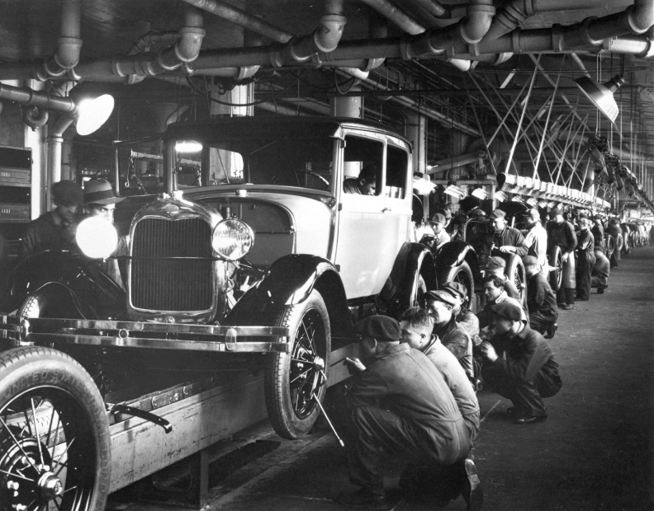
Notes:
And it’s really the Henry Fords of this world, by bringing Electricity to Factories, who radically transformed what we do and how we work with the first Moving Assembly Line… and the 5$ Workday. Long were the days of replacing the candles with light bulbs for productivity, or powering the country - or the world - one farmer at a time: from then on, it was all about innovation and transformation - using electricity to radically transform how we work, how we live… i’d say: who we are as an Electrified Society!

Slide 8
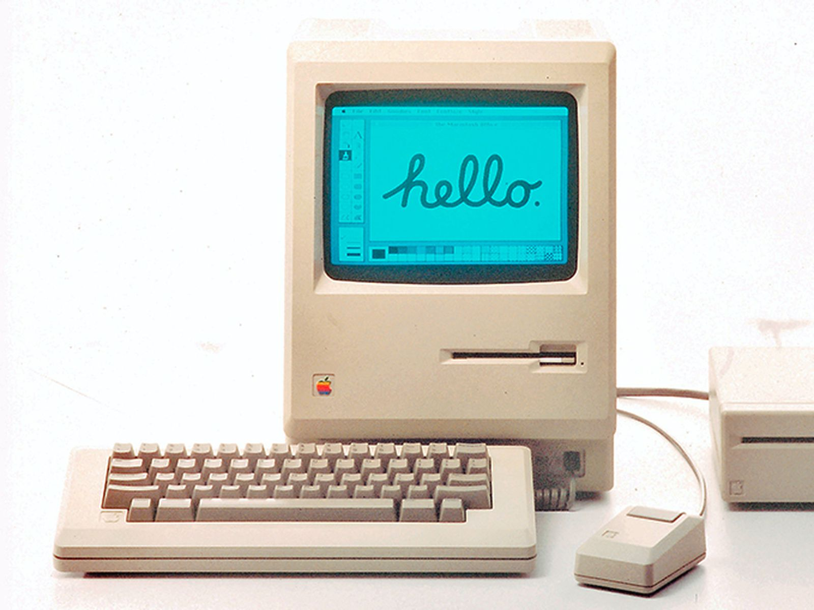
Notes:
And pretty much every invention that succeeded from then on changed our lives: the way we live, the way we work, the way we communicate, the way we we travel, health, education, you can name it - Electricity is there, the real mother of every single invention, everywhere you go!

Slide 9
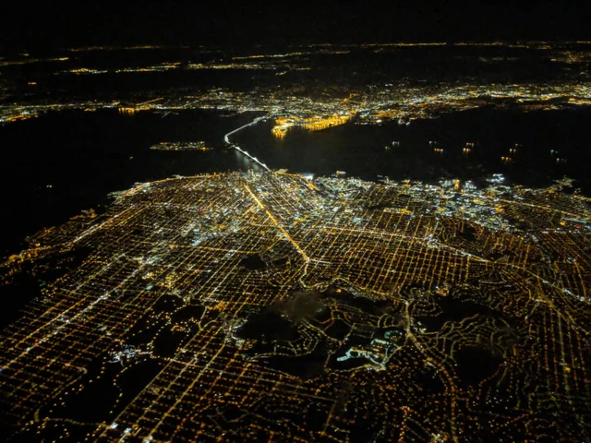
HOW WE
WORK & LIVE TODAY
Notes:
And we couldn't imagine living without it. Period!

Slide 10
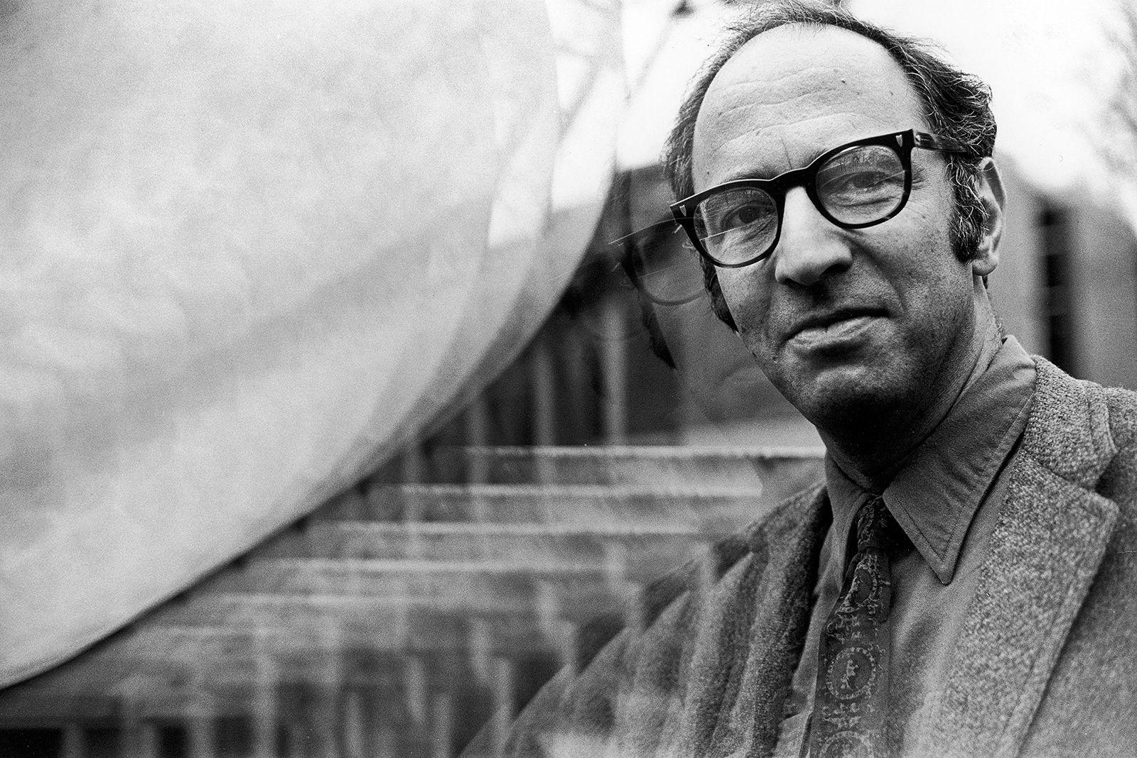
1,600 × 1,068
“The Structure of Scientific Revolutions” - Thomas Kuhn
PARADIGMS
Notes:
Thomas S. Kuhn master’s degrees in physics at Harvard University Ph.D. history of science. taught at Harvard University of California at Berkeley, Princeton University and the Massachusetts Institute of Technology
In his landmark second book, The Structure of Scientific Revolutions, he argued that scientific research and thought are defined by “paradigms,” or conceptual world-views, that consist of formal theories, classic experiments, and trusted methods. Scientists typically accept a prevailing paradigm and try to extend its scope by refining theories, explaining puzzling data, and establishing more precise measures of standards and phenomena. Eventually, however, their efforts may generate insoluble theoretical problems or experimental anomalies that expose a paradigm’s inadequacies or contradict it altogether. This accumulation of difficulties triggers a crisis that can only be resolved by an intellectual revolution that replaces an old paradigm with a new one. Electricity changed the paradigm we had before of how work was done and how lives were lived i’d say mostly for the better, and of course, sometimes not!

Slide 11
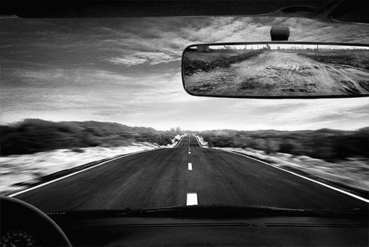
YESTERDAY’S ELECTRIC PAST
TOMORROW’S
AI FUTURE
Notes:
I have always believed that - to pay proper respect to the future, you need to pay equally proper disrespect to the past… it is paramount that we look at Yesterday’s Electric Past, to inform the AI Everywhere Future of tomorrow To understand and possibly anticipate the Paradigm Shifts we are about to experience… that will change not just a thing but everything: what we do, how we live, who we are!!!

Slide 12
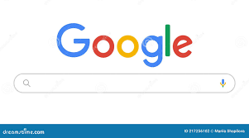
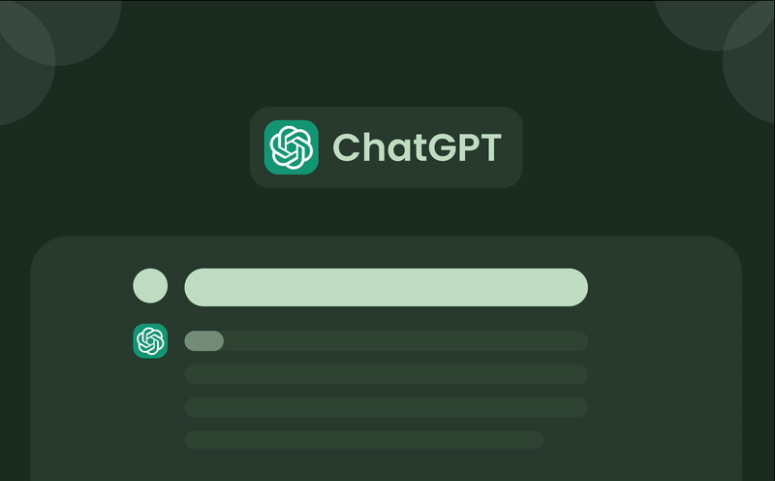
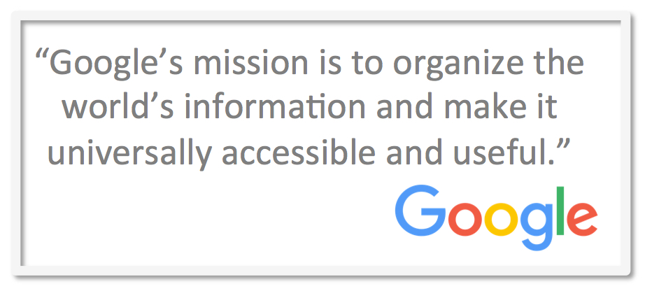
Notes:
At first sight, there isn’t a huge difference between the Google Search Bar, and the Chat GPT Interface. You could argue: on the left is an amazingly powerful and incredibly versatile candle…but on your right is nothing less than a light bulb! On the left: all information draws from existing knowledge, that has been uploaded and now can be pulled easily and universally by the many… but it is limited by the collective knowledge of us all - nothing new, we think our phones are totally unique and personal to us but nothing personal gets generated from these devices or those apps: it’s preexisting knowledge predetermined - sometimes pre-predicted - by humans… for humans!

Slide 13
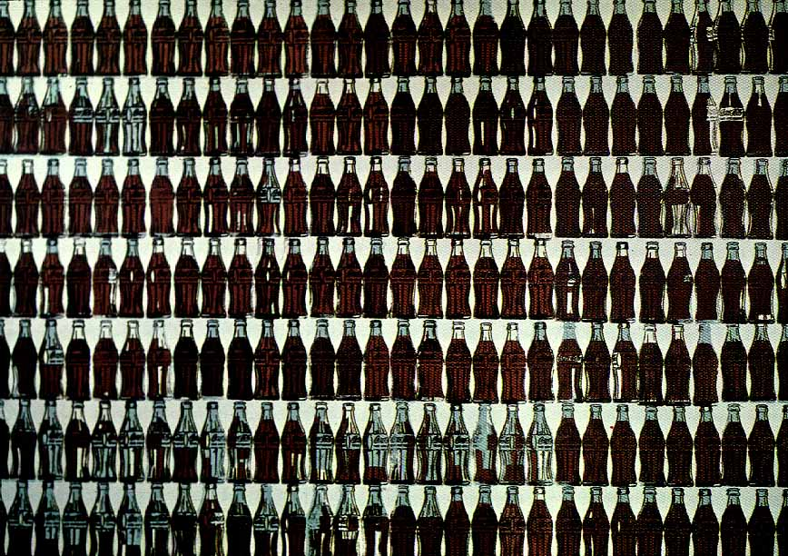
Notes:
As many of you know, I spent over a decade working at Coca-Cola, including leading that amazing ICON, at least that’s how we called it then - for the Globe. And I have always been fascinated by Andy Warhol, and his fascination of course for Marilyn, Elvis, etc but importantly also for Coca-Cola:

Slide 14
Notes:
All the Coke are the same and all the cokes are good etc…
Warhol was fascinated by the Paradigm of the Industrial Revotion…
Working with silkscreens and media imagery, he relentlessly recreated images en masse and, in doing so, celebrated mass culture

Slide 15
SCALE
Notes:
Fundamentally, Warhol was celebrating the new paradigm born from electricity that is called SCALE
Scale in Manufacturing, Scale in Distribution, in Advertising and Media, in Consumption: everything we have known and lived with for over a century follows this single paradigm of SCALE and… that paradigm is about to be gone, for ever… and this time i’d definitely say: for Good!!!

Slide 16
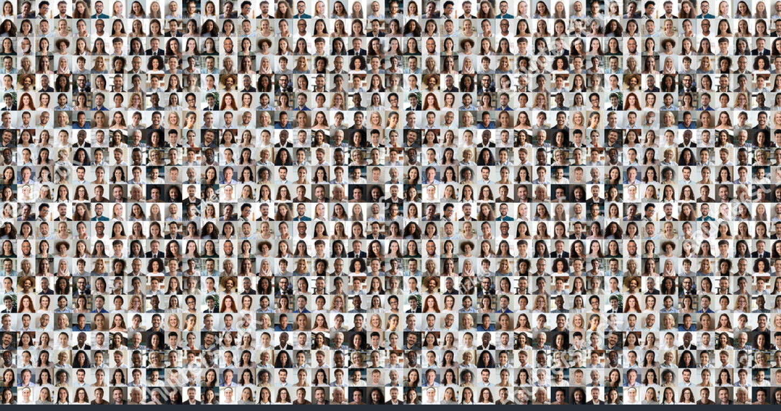
PERSONAL
Notes:
Enter PERSONALIZATION… OR id rather say, intimacy, being personal, simply because… that little Chat GPT Search Bar (and it’s only the beginning) is going to get us used to get everything we want, everything we need, to be delivered to us in a personal way: the content of course, but soon the experience, the design, the product itself: the entire world is about to get turned upside down: welcome to the new age - the new paradigm of EVERYTHING PERSONAL.

Slide 17
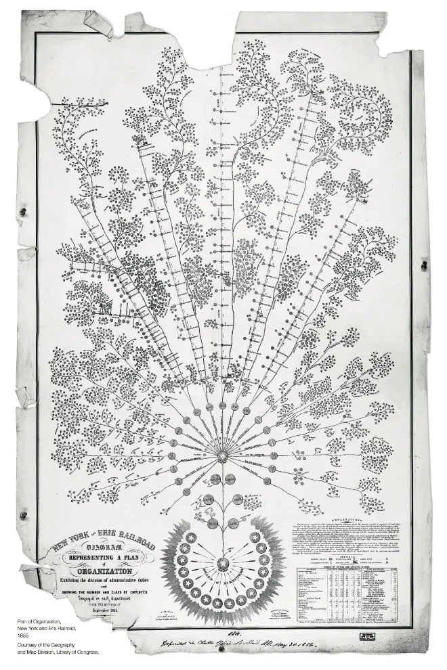
SILOS
Notes:
I ONLY HAVE 20’ SO I WILL NOT GO DEEEP IN OTHER PARADIGM SHIFTS we are ABOUT TO EXPERIENCE, BUT LET ME TALK DATA FOR A SECOND. The First Org Chart Ever Made was actually not meant to be an orgchart but a data access and distribution flow chart - in fact, it was a Masterpiece of Data Design to make sure critical information was efficiently delivered at teh right time to the right person… to avoid train crashes!
From a 19th century railroad company comes the mother of all corporate organizational charts.
LOOK AT MOST of organizational charts today and you’ll see the standard top-down pyramid flowing linearly from the big dog down to lower-level managers and minions. But the first modern-day organizational chart wasn’t made to remind lower-level employees who they really work for. No, one of the first company-wide organizational charts was actually a 19th century invention of necessity.
Back in the mid-1800s, the Erie Railroad was a thriving but disorganized company responsible for transporting goods throughout the Northeast. The railroad company had more than 500 miles of track, making it one of the largest of its time. This was good for business, but bad for organization.
Today we deal with inconceivably large amounts of data that is made comprehensible only by modern technology. Back in the 19th century, big data meant something entirely different, but managing it was as vital then as it is today.
This flowery chart was a way to efficiently deliver critical information to the right person.
As the Erie Railway grew, so did the amount of data it had to wrangle: which superintendents were responsible for which set of tracks; schedule changes; who the various conductors, laborers and brakemen worked under. As Caitlin Rosenthal writes over at McKinsey Quarterly, if any one data point was mismanaged it could bring dire results: “One delayed train, for example, could disrupt the progress of many others. And the stakes were high: with engines pulling cars in both directions along a single set of rails, schedule changes risked the deadly crashes that plagued 19th-century railroads.”
This flowery organizational chart was created by Daniel McCallum, the company’s general manager, to efficiently deliver critical information and delegate tasks to the right person. Instead of a top-down structure, the chart flows from its roots like a tree. The power was centralized with the president and board of directors as its anchor, but much of the day-to-day responsibility over the tracks was allocated to lower-level superintendents. The reasoning for this, Rosenthal writes: “They possessed the best operating data, were closer to the action, and thus were best placed to manage the line’s persistent inefficiencies.”

Slide 18
UNTRAPPED
&
UNIFIED
Notes:
THAT DATA IS ABOUT TO GET OUT OF THE SILOS WE HAVE DELIBERATELY LOCKED IT IN, ABOUT TO BE UNTRAPPED AND UNIFIED… BECAUSE WE CAN, WE MUST… BUT ALSO BECAUSE AIs ARE INCREDIBLY HUNGLY FOR DATA, ACTUALLY THEY FEED OF IT - AND THEIR APPETITE IS AS LARGE AS THEIR NAMES, LLMs… so they will find ways - and it is a good thing - to get us to break our paradigm of INFORMATION IS POWER which has haunted corporate culture for more than 150 years… ever since that beautiful flowchart got turned into a top down corporate governance structure - a chart of power as opposed to a chart of empowerment as it was meant to be in the first place!!! And reason why the AIs will find ways is that without untrapping and unifying that data… the AIs won’t work, it’s as simple as that - and I promise you, from the little i know about humans, we will not let that happen!

Slide 19
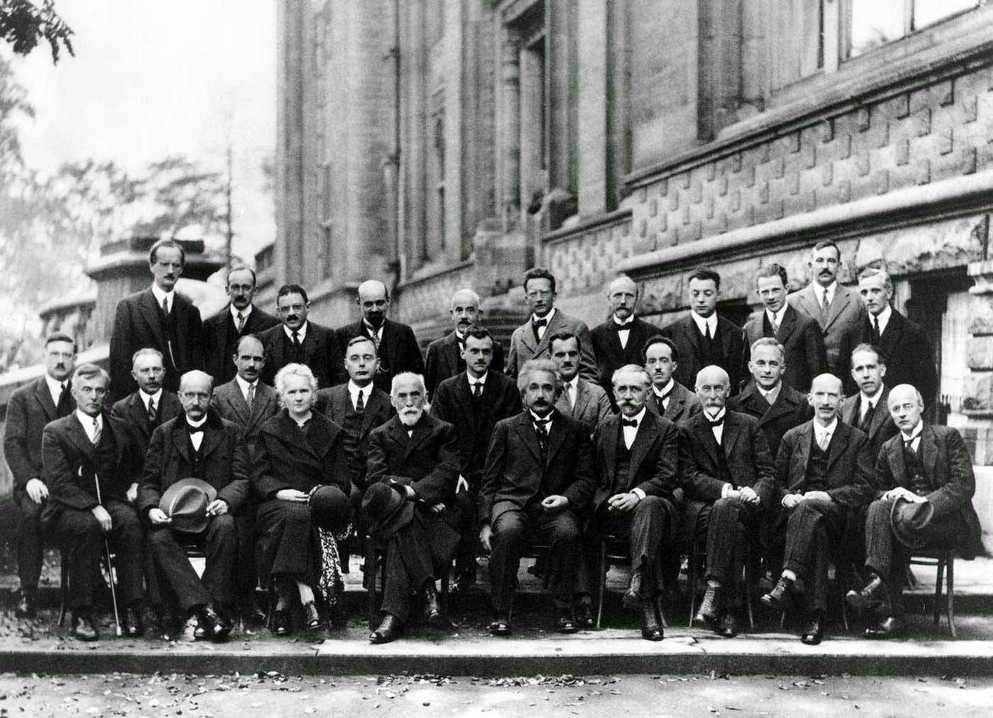
5TH SOLVAY CONFERENCE ON QUANTUM MECHANICS 1927, Belgium
INTELLIGENCE
Notes:
INTELLIGENCE IS ANOTHER PARADIGM THAT WE SOON WILL NEED TO REDEFINE. I USED TO SAY THE 2 THINGS THAT WERE WRONG ABOUT AI WERE 1. ARTIFICIAL - IT AIN’T REAL, IT’S SYNTHETIC, AND INTELLIGENCE - WHICH IS WHO WE ARE, WHAT DEFINES US: THE HOMO SAPIENS FOR THE PAST 300,000 YEARS, OR, 160,000 FOR HOMO SAPIENS SAPIENS WHICH IS SITLL A LONG, A VERY LONG TIME

Slide 20
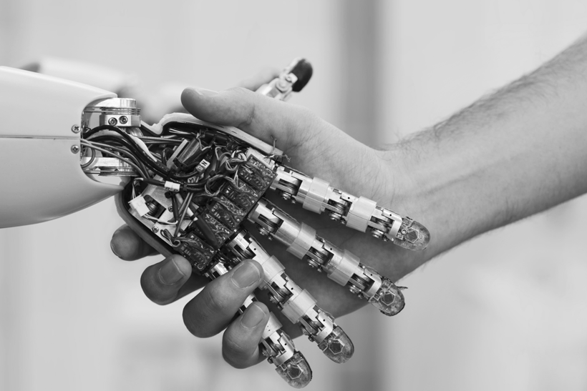
TRUST
Notes:
AND LAST BUT NOT LEAST COMES TRUST - OUR NUMBER ONE VALUE AT SALESFORCE, TRUST WHICH IS GOING TO HAVE TO BE RETHOUGHT FROM SCRATCH…
BORROWING FROM THE MILITARY, WE HAVE ALWAYS BELIEVED TRUST REQUIRED A HUMAN TO BE IN THE LOOP… GUESS WHAT, VERY SOON, THAT’S NOT GOING TO BE PRACTICAL ANYMORE - LIKE ONCE YOU TRUST A GOOD EA, YOU DON’T OVERSEE EVERY MEETING SHE OR HE TAKES FOR YOU, EVERY FLIGHT THAT’S BOOKED, EVERY HOTEL ROOM, ETC…

Slide 21
Notes:
WELCOME TO THE AGE OF HUMANS AT THE HELM, NOT IN THE LOOP… AND THAT IS MAYBE THE MOST RADICAL PARADIGM SHIFT OF ALL

Slide 22
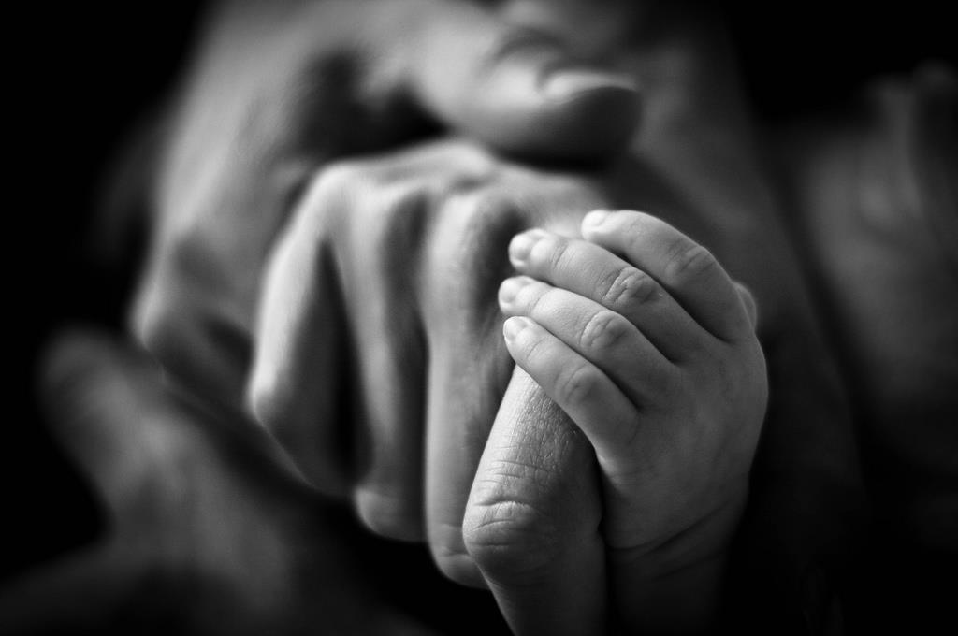
what makes us
HUMAN
Notes:
WHY DO I SAY THE MOST RADICAL PARADIGM SHIFT OF ALL… BECAUSE IF THE AI IS GOING TO FREE US FROM 30 TO 605 OF WHAT WE HAVE BEEN SPENDING OUR TIME DOING, 605 OF OUR WORK…60 % OF OUR LIFE…
WE ARE GOING TO BE FORCED TO ASK OURSELVES THE ONE AND ONLY FUNDAMENTAL QUESTION, THAT IS
WHAT MAKES US HUMAN…

Slide 23
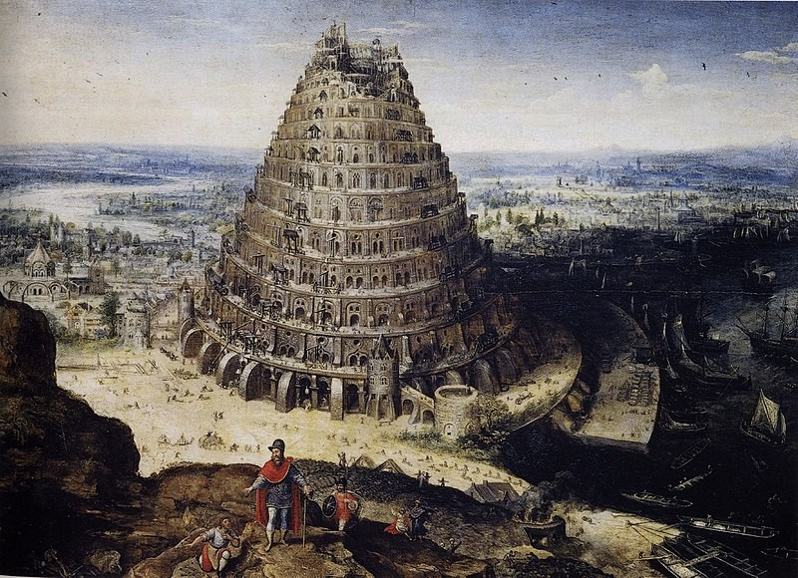
COMMUNICATE
Notes:
AND WE ARE GOING TO HAVE TO REFOCUS, RELEARN HOW TO COMMUNICATE WITH ONE ANOTHER
Fire invites this kind of connection. There is something about gathering around flames, indoors or out, that encourages intimacy. Strangers can become friends. Awkward pauses can become moments of comfortable silence. Staring into the flames, it becomes easier to bare our inner selves. Shrouded in darkness, lit only by the glow of firelight or candlelight, we can admit more to ourselves and others; vulnerability comes more easily and readily.
Research supports the magical, connecting power of fire. Jane Hurly, a researcher at the University of Alberta, in Edmonton, Canada, spent her PhD studying the experiences of leisure with recent Canadian immigrants. Her research brought her to the Long Lake Outdoor Centre in Alberta, where she spent the weekend with 70 refugees who came to the Centre to camp and participate in activities such as snowshoeing, skiing, and ice fishing for the first time. For these refugees, Canada’s winters were an unfamiliar and daunting part of acclimating to their new homes. Many arrived for the camping experience uncertain and hesitant. But, according to Hurly, people were drawn to the campfire. “It was a magnet for conversations to take place,” she said. One woman from the Democratic Republic of Congo talked about how, back home, the fire was the morning gathering place and the evening storytelling place. “Fire was a place of imparting wisdom,” Hurly told me, and having this replicated in an entirely different climate evoked feelings of nostalgia for immigrants in an unfamiliar landscape.

Slide 24
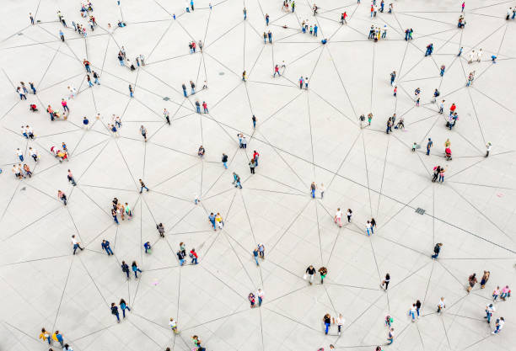
COLLABORATE
Notes:
HOW TO WORK TOGETHER
Fire invites this kind of connection. There is something about gathering around flames, indoors or out, that encourages intimacy. Strangers can become friends. Awkward pauses can become moments of comfortable silence. Staring into the flames, it becomes easier to bare our inner selves. Shrouded in darkness, lit only by the glow of firelight or candlelight, we can admit more to ourselves and others; vulnerability comes more easily and readily.
Research supports the magical, connecting power of fire. Jane Hurly, a researcher at the University of Alberta, in Edmonton, Canada, spent her PhD studying the experiences of leisure with recent Canadian immigrants. Her research brought her to the Long Lake Outdoor Centre in Alberta, where she spent the weekend with 70 refugees who came to the Centre to camp and participate in activities such as snowshoeing, skiing, and ice fishing for the first time. For these refugees, Canada’s winters were an unfamiliar and daunting part of acclimating to their new homes. Many arrived for the camping experience uncertain and hesitant. But, according to Hurly, people were drawn to the campfire. “It was a magnet for conversations to take place,” she said. One woman from the Democratic Republic of Congo talked about how, back home, the fire was the morning gathering place and the evening storytelling place. “Fire was a place of imparting wisdom,” Hurly told me, and having this replicated in an entirely different climate evoked feelings of nostalgia for immigrants in an unfamiliar landscape.

Slide 25
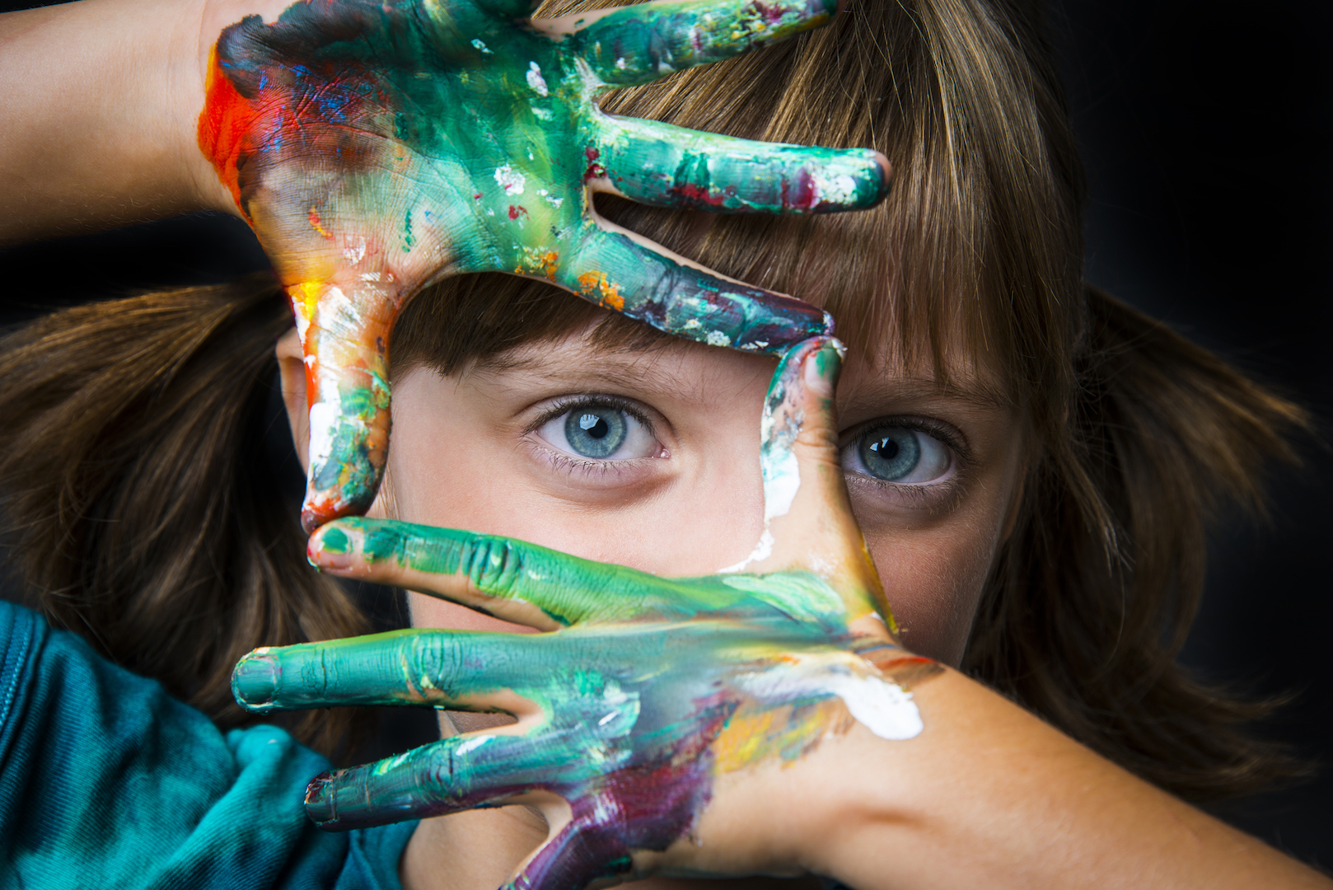
CREATE
Notes:
HOW TO CREATE

Slide 26
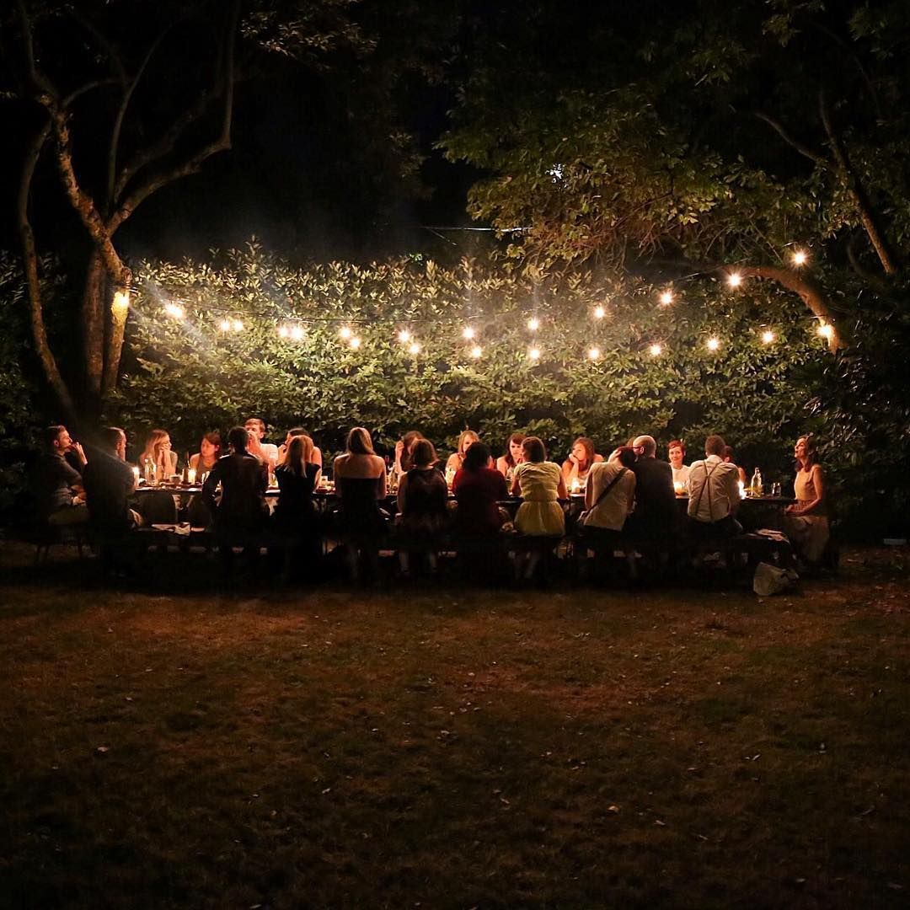
CELEBRATE
Notes:
TO GET TOGETHER AND CELEBRATE

Slide 27
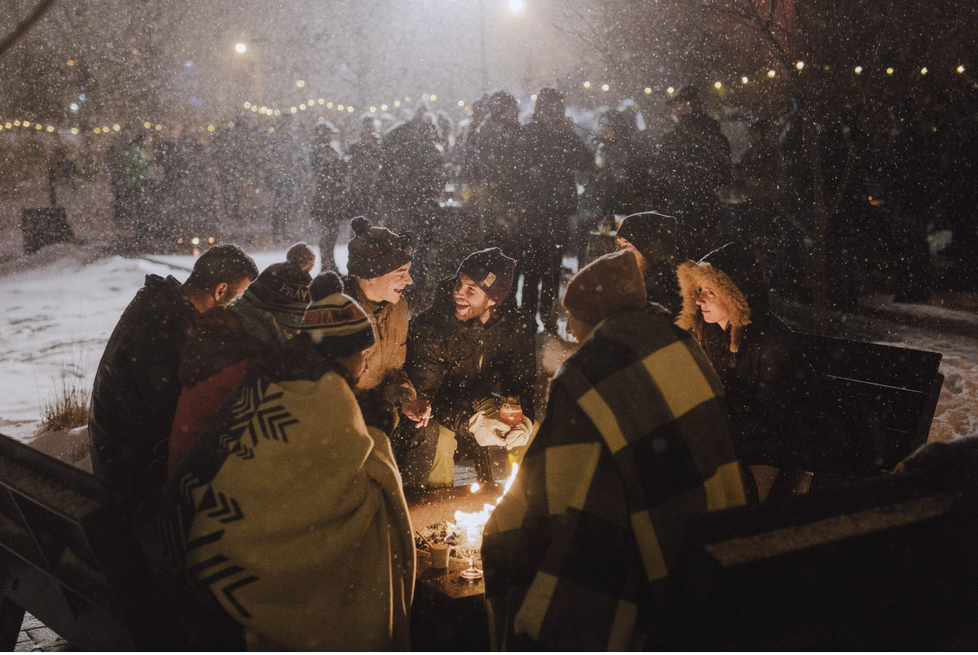
CONNECT
Notes:
HOW TO CONNECT
Fire invites this kind of connection. There is something about gathering around flames, indoors or out, that encourages intimacy. Strangers can become friends. Awkward pauses can become moments of comfortable silence. Staring into the flames, it becomes easier to bare our inner selves. Shrouded in darkness, lit only by the glow of firelight or candlelight, we can admit more to ourselves and others; vulnerability comes more easily and readily.
Research supports the magical, connecting power of fire. Jane Hurly, a researcher at the University of Alberta, in Edmonton, Canada, spent her PhD studying the experiences of leisure with recent Canadian immigrants. Her research brought her to the Long Lake Outdoor Centre in Alberta, where she spent the weekend with 70 refugees who came to the Centre to camp and participate in activities such as snowshoeing, skiing, and ice fishing for the first time. For these refugees, Canada’s winters were an unfamiliar and daunting part of acclimating to their new homes. Many arrived for the camping experience uncertain and hesitant. But, according to Hurly, people were drawn to the campfire. “It was a magnet for conversations to take place,” she said. One woman from the Democratic Republic of Congo talked about how, back home, the fire was the morning gathering place and the evening storytelling place. “Fire was a place of imparting wisdom,” Hurly told me, and having this replicated in an entirely different climate evoked feelings of nostalgia for immigrants in an unfamiliar landscape.

Slide 28
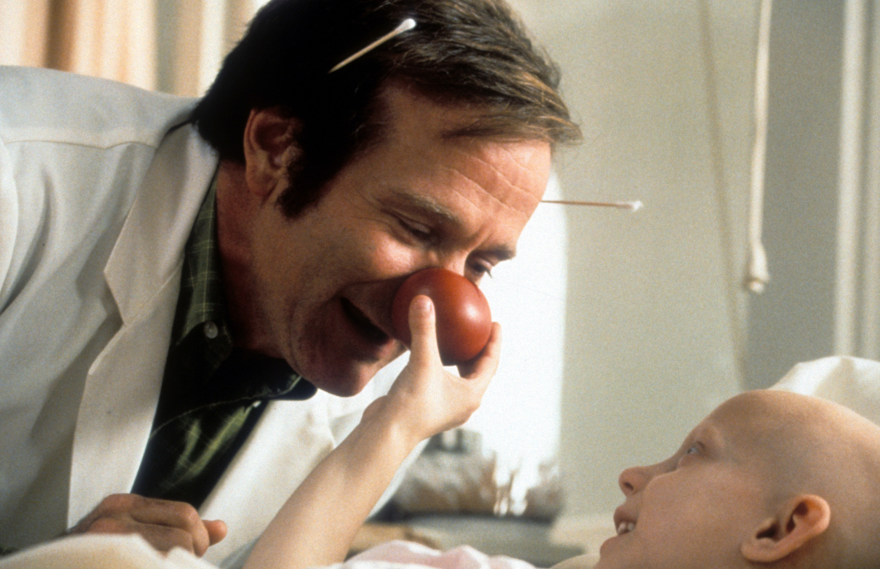
CARE
Notes:
AND LAST BUT NOT LEAST - AND HOPEFULLY WE WILL NOT LET AIs DO THAT BETTER THAN US HUMANS - HOW TO CARE!!!

Slide 29
X: marcfmath
in: marcmathieu
Notes:
THANK YOU!
And for more on Human at the Helm,
Feel free to connect on line or visit us at the Salesforce booth

