Slide 1
Data and AI a superpower

Slide 2
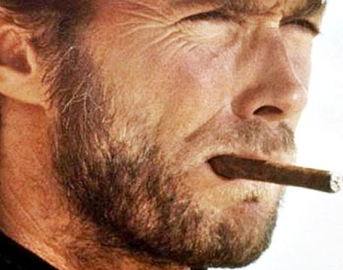
Do you feel lucky?

Slide 3
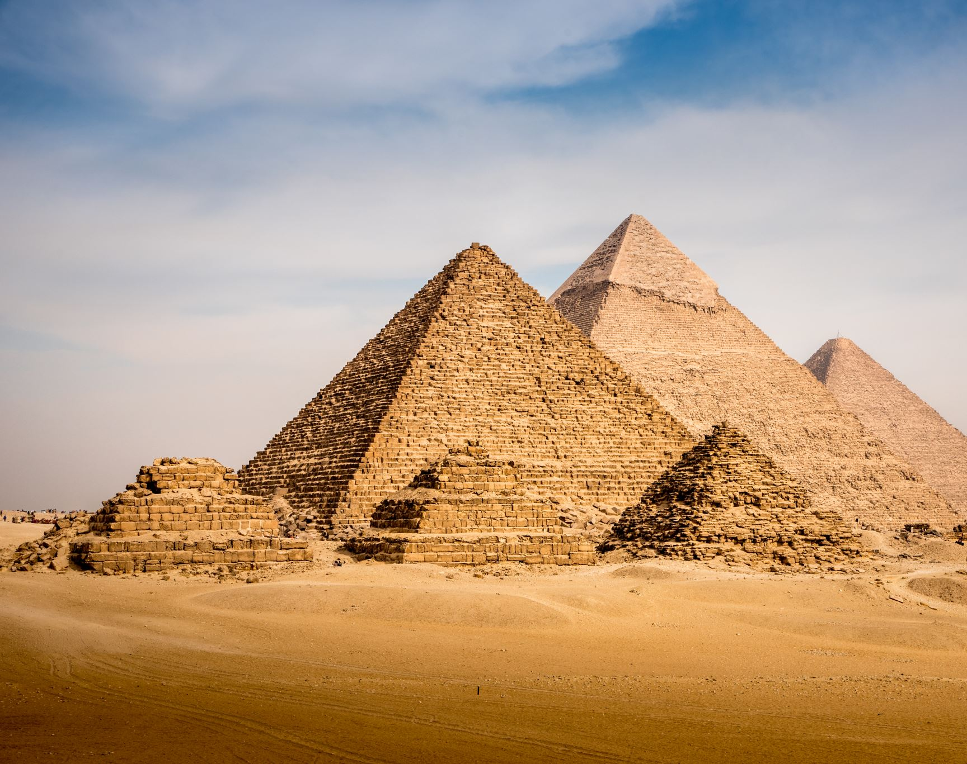
World History

Slide 4
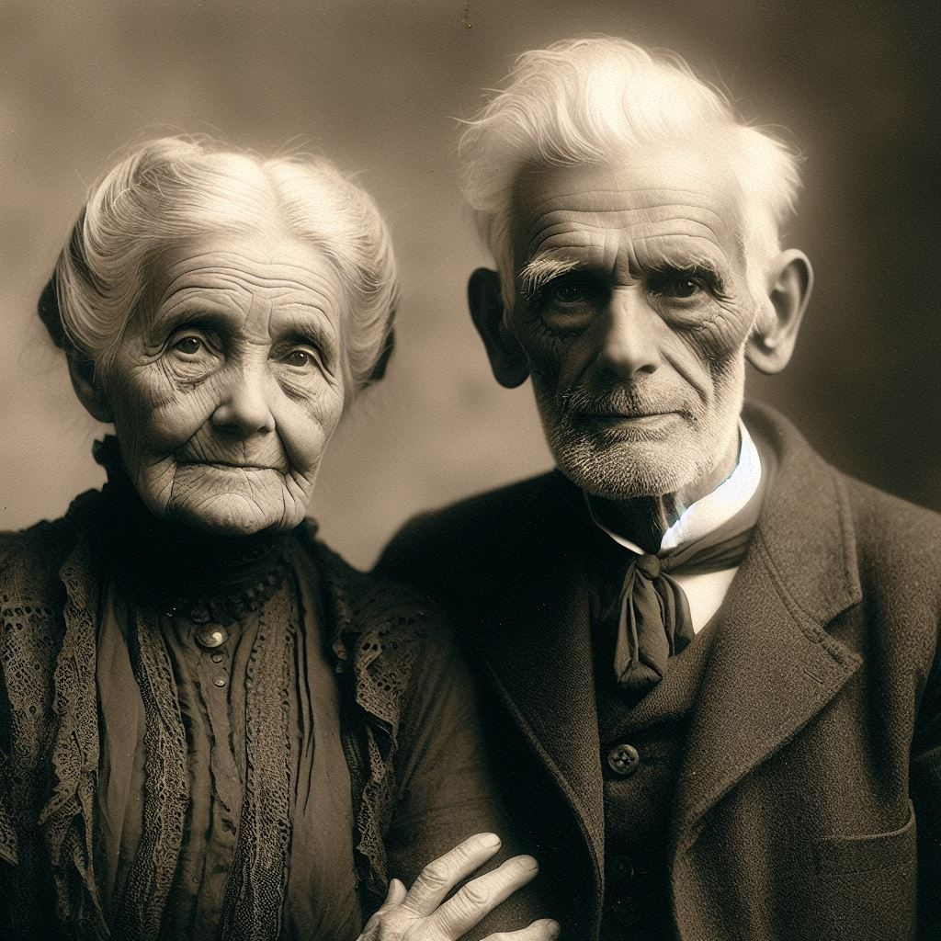

Slide 5
You have a disproportionate impact on the world
AI builders, designers, implementers, regulators…

Slide 6
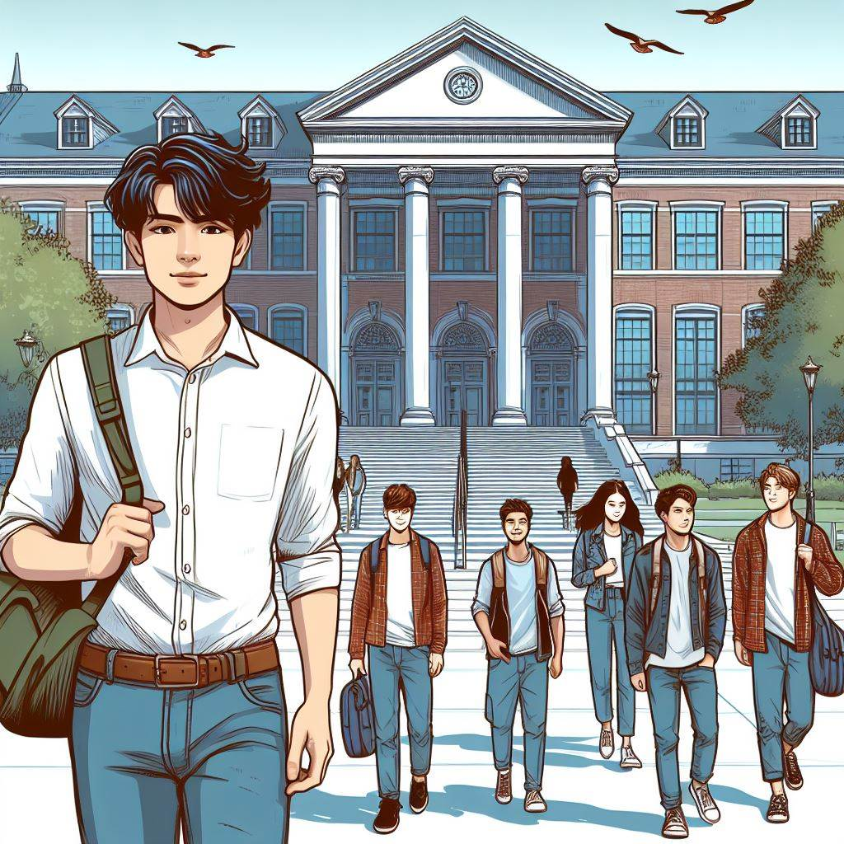
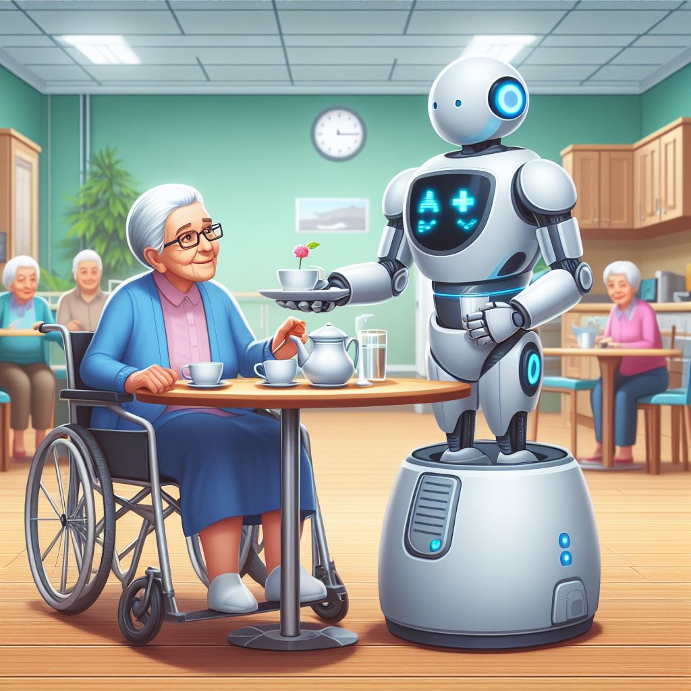
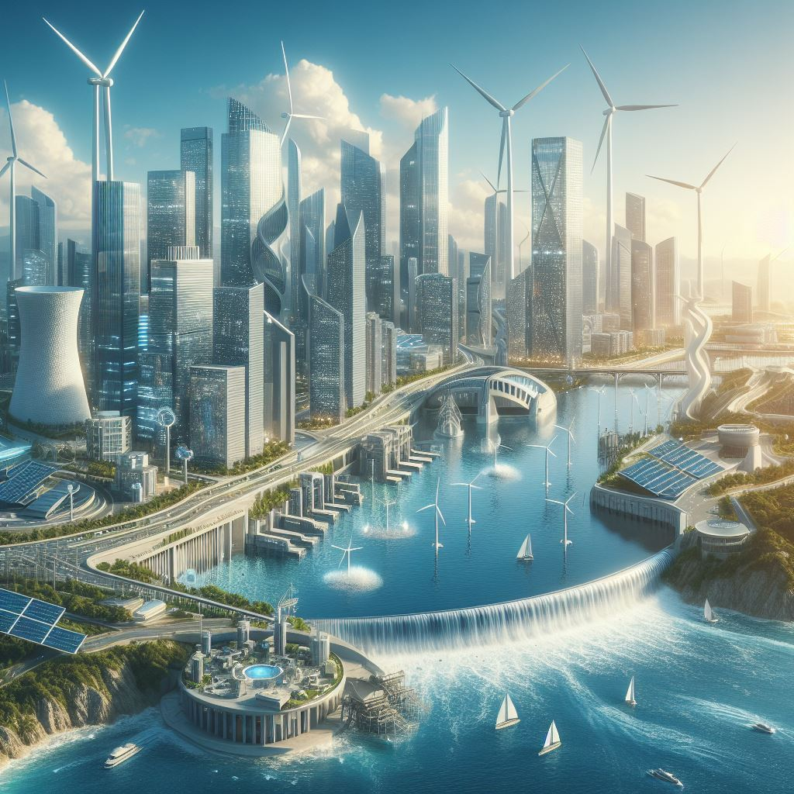
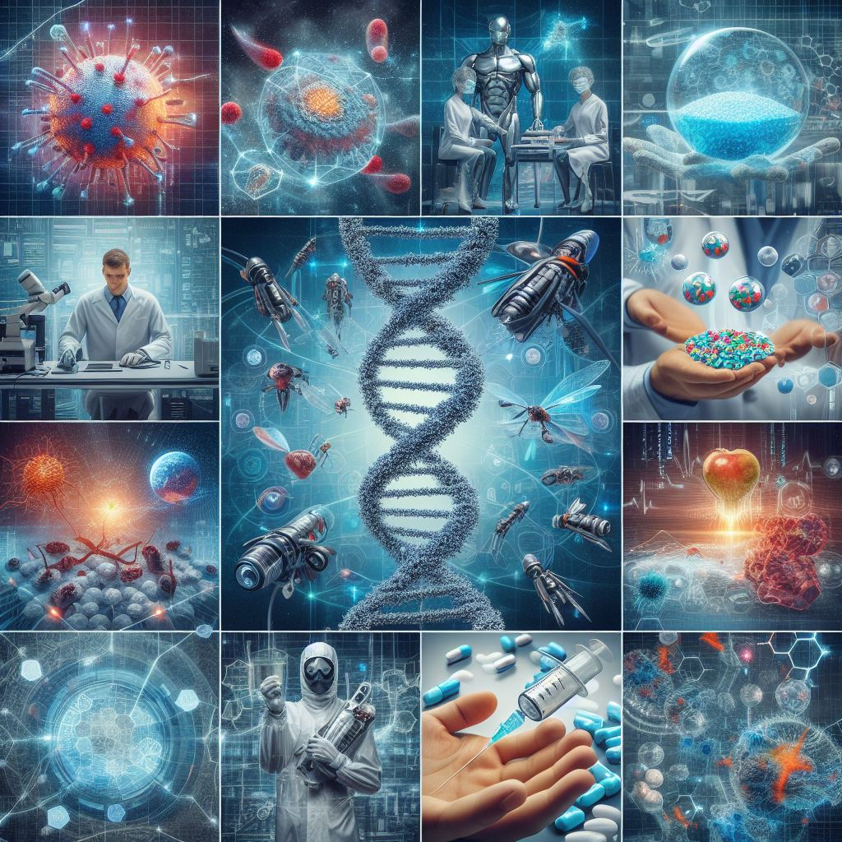
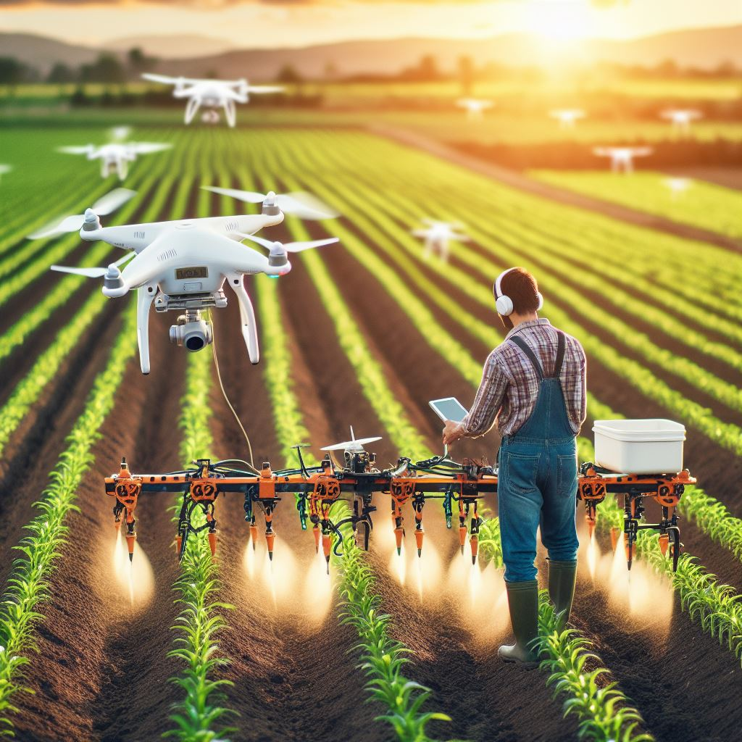
Massive Potential for Good
Education
Elderly Care
Infra Mgm
Biotech
Precision
Agriculture

Slide 7
Massive Potential for Bad Outcomes
Algorithmic Bias and Discrimination
Privacy Violations
Deepfakes and Misinformation
Job Displacement
☹️
Loss of Human Control
Security Risks
Inequality
Market Volatility
Uncontrollable Self-Aware AI
Notes:
Algorithmic Bias and Discrimination (e.g. COMPAS, Amazon hiring algo dicr women)
Privacy violations:
Deepfakes (American election)
Job Displacement:

Slide 8
Jensen Huang:
“Everything that moves, will be robotic in the future.”
Notes:
Jensen Huang from NVIDIA sees everything that moves being replaced with robots. OK, well maybe he is biased – because all they robots will need NVIDIA chips of course.

Slide 9
Amy Webb:
Jensen Huang:
“Everything that moves, will be robotic in the future.”
“We are in a Tech Supercycle. The wave of innovation coming at us is so powerful and pervasive that it will reshape human existence.”
Notes:
Amy Webb, who is a futurist, and who presented her Tech Report at SXSW last month, thinks we are in a super-cycle that is so powerful is will reshape human existence.

Slide 10
Amy Webb:
Jensen Huang:
“Everything that moves, will be robotic in the future.”
“We are in a Tech Supercycle. The wave of innovation coming at us is so powerful and pervasive that it will reshape human existence.”
Joscha Bach:
“Coexisting with AI may require cultural changes and force us to reconsider the role of humanity within life on Earth.”
Notes:
Joscha Bach, a German AI researcher and philosopher, seems to agree with her somewhat. He says AI will force us to reconsider the role of humanity
Wow, those are shocking ideas. Is it really as dramatic as these analysts predict? Are we doomed?

Slide 11
Tracey Follows:
“What happens to humans’ authenticity and autonomy when they are augmented with AI?”
Notes:
Katindi Sivi , Futures Researcher from Kenya thinks that we will relinquish our abilities to think and feel
And remember, this is not people trying to write science fiction, this is based on what is already happening and extrapolating that 5-10 years into the future.

Slide 12
Katindi Sivi :
Tracey Follows:
“What happens to humans’ authenticity and autonomy when they are augmented with AI?”
“The more AI advances, the more I feel that people will relinquish their human abilities to think and feel to machines.”
Notes:
Katindi Sivi , Futures Researcher from Kenya thinks that we will relinquish our abilities to think and feel
And remember, this is not people trying to write science fiction, this is based on what is already happening and extrapolating that 5-10 years into the future.

Slide 13
What can you do?

Slide 14
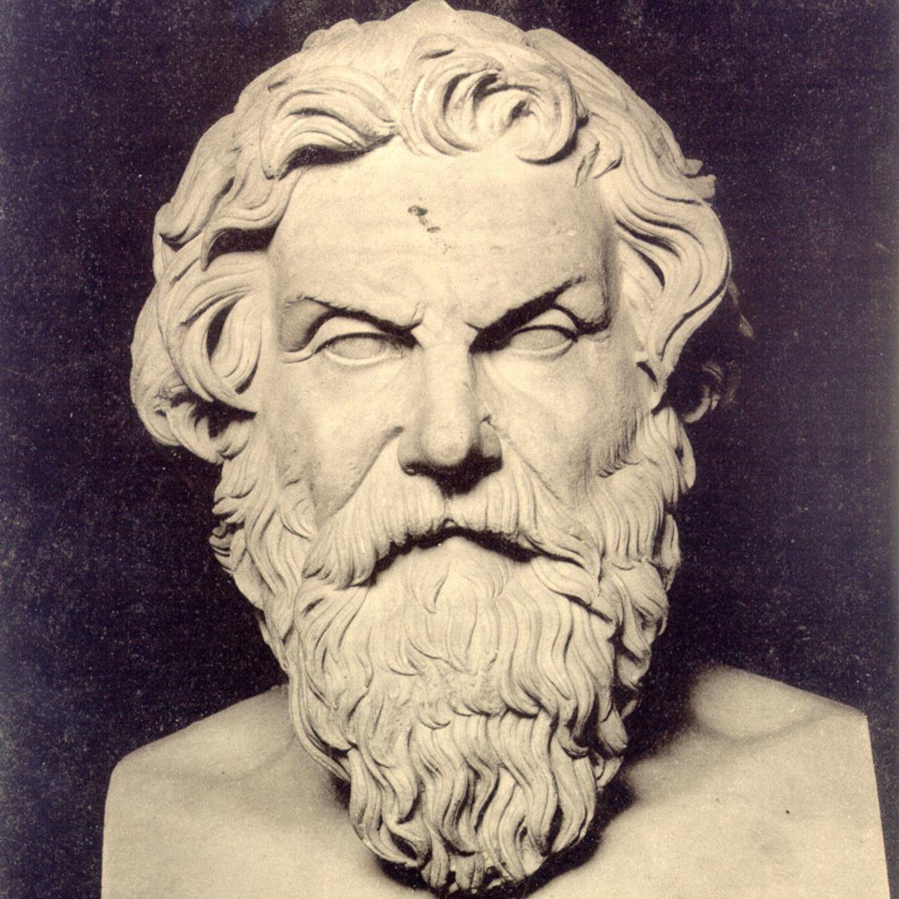
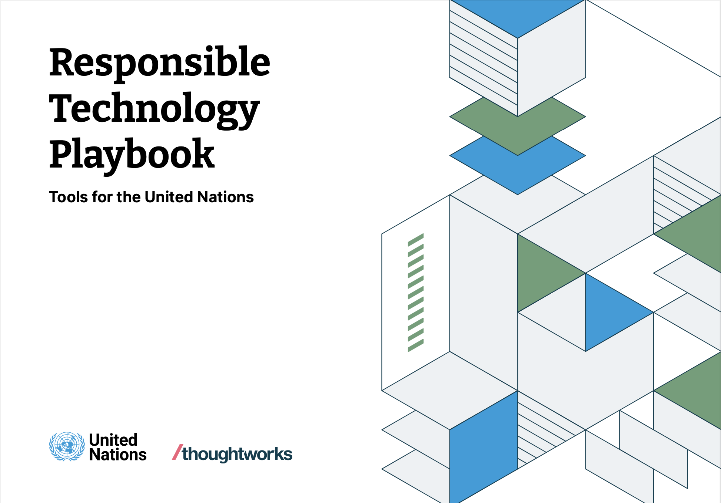
What can you do?
Responsible Tech
Ethics
Foresight

Slide 15
With great power comes great responsibility
Notes:
in the late 18th century, British statesman William Lamb (also known as Lord Melbourne) remarked, "The possession of great power necessarily implies great responsibility."

