Slide 1
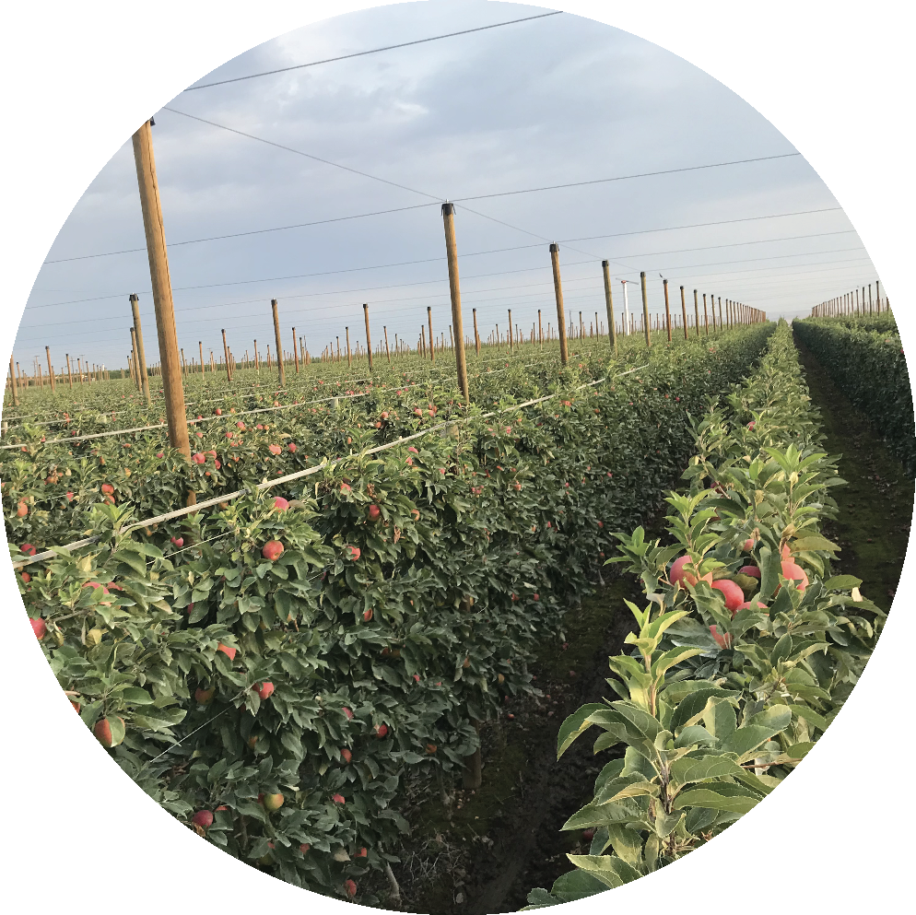
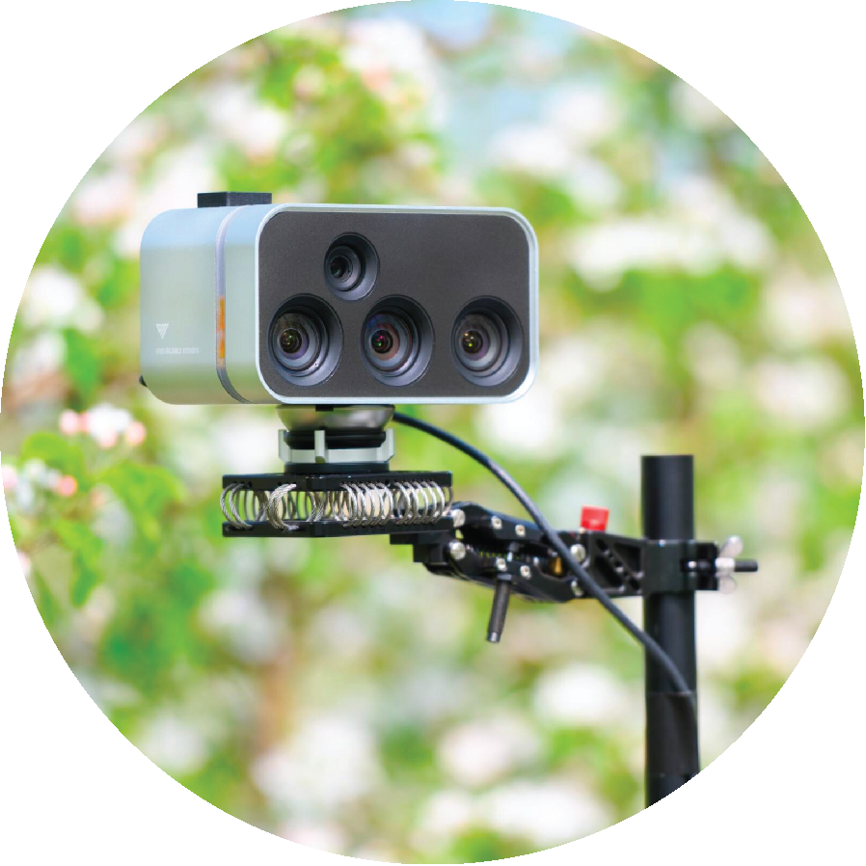
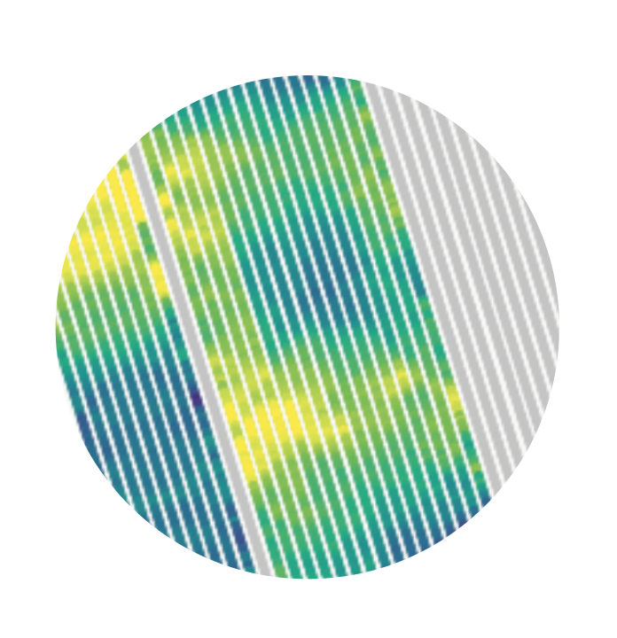
Jonathan Binas
AI at the edge and in the field.

Slide 2
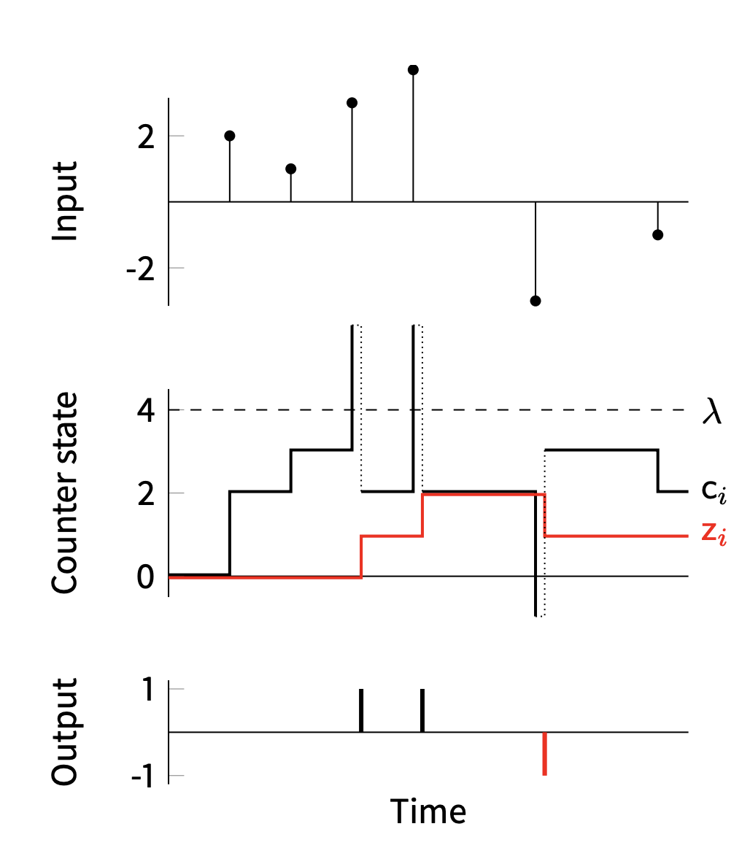
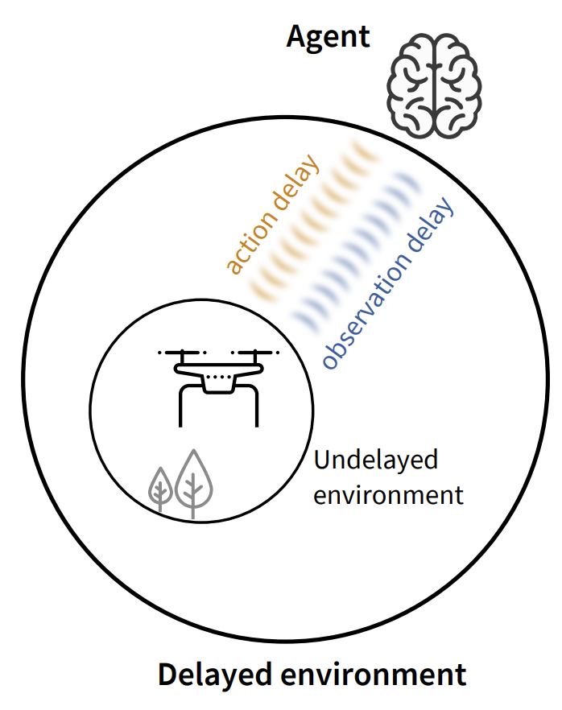
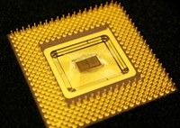
...before Vivid Machines
Deep learning with analog substrates
Event-based neural computation
RL with random delays
Binas et al. 2016
Binas et al. 2016
Ramstedt, Boutellier, Binas, 2020

Slide 3
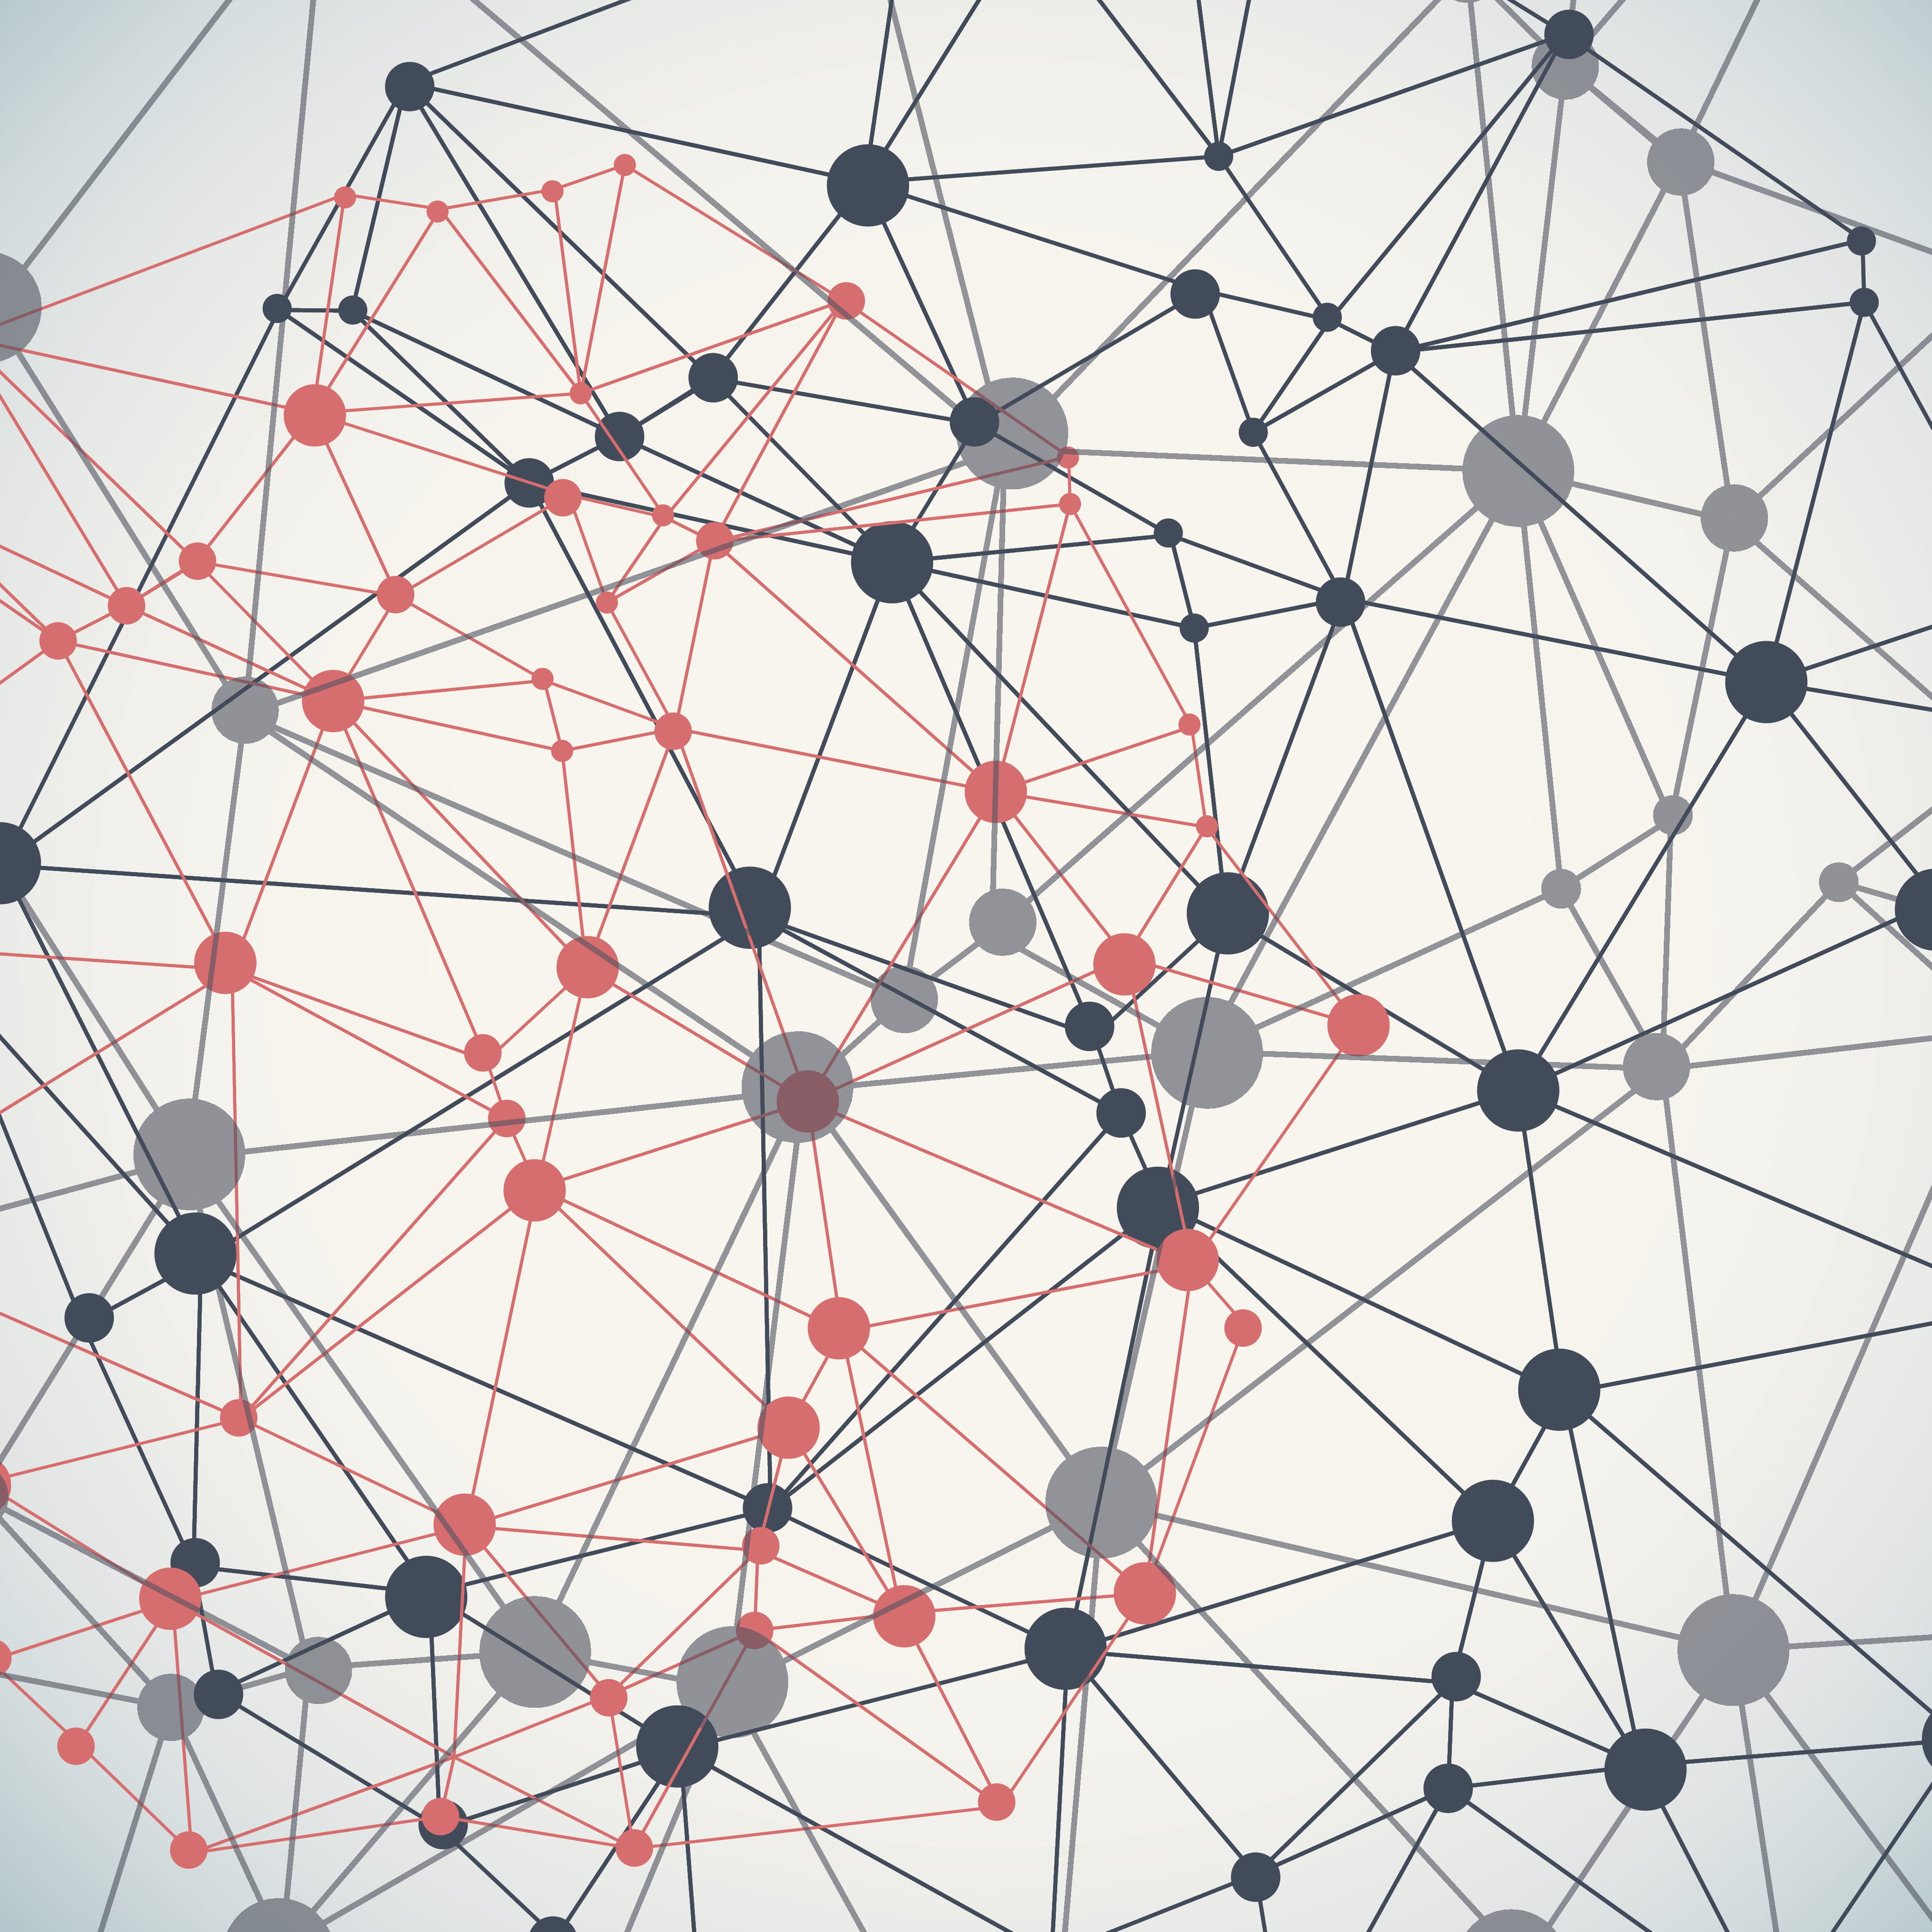
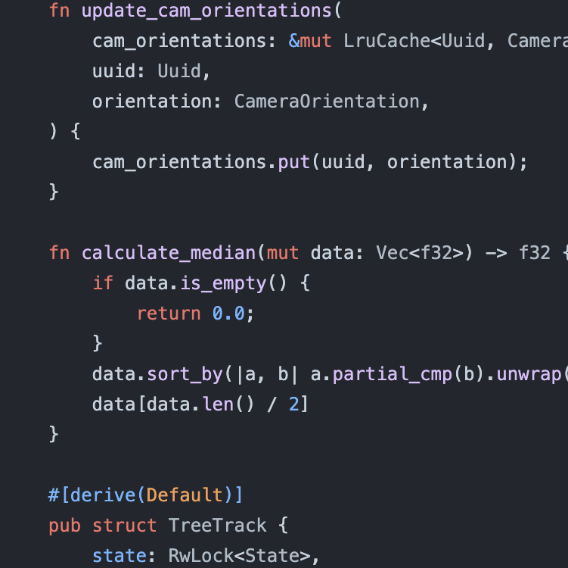

Slide 4
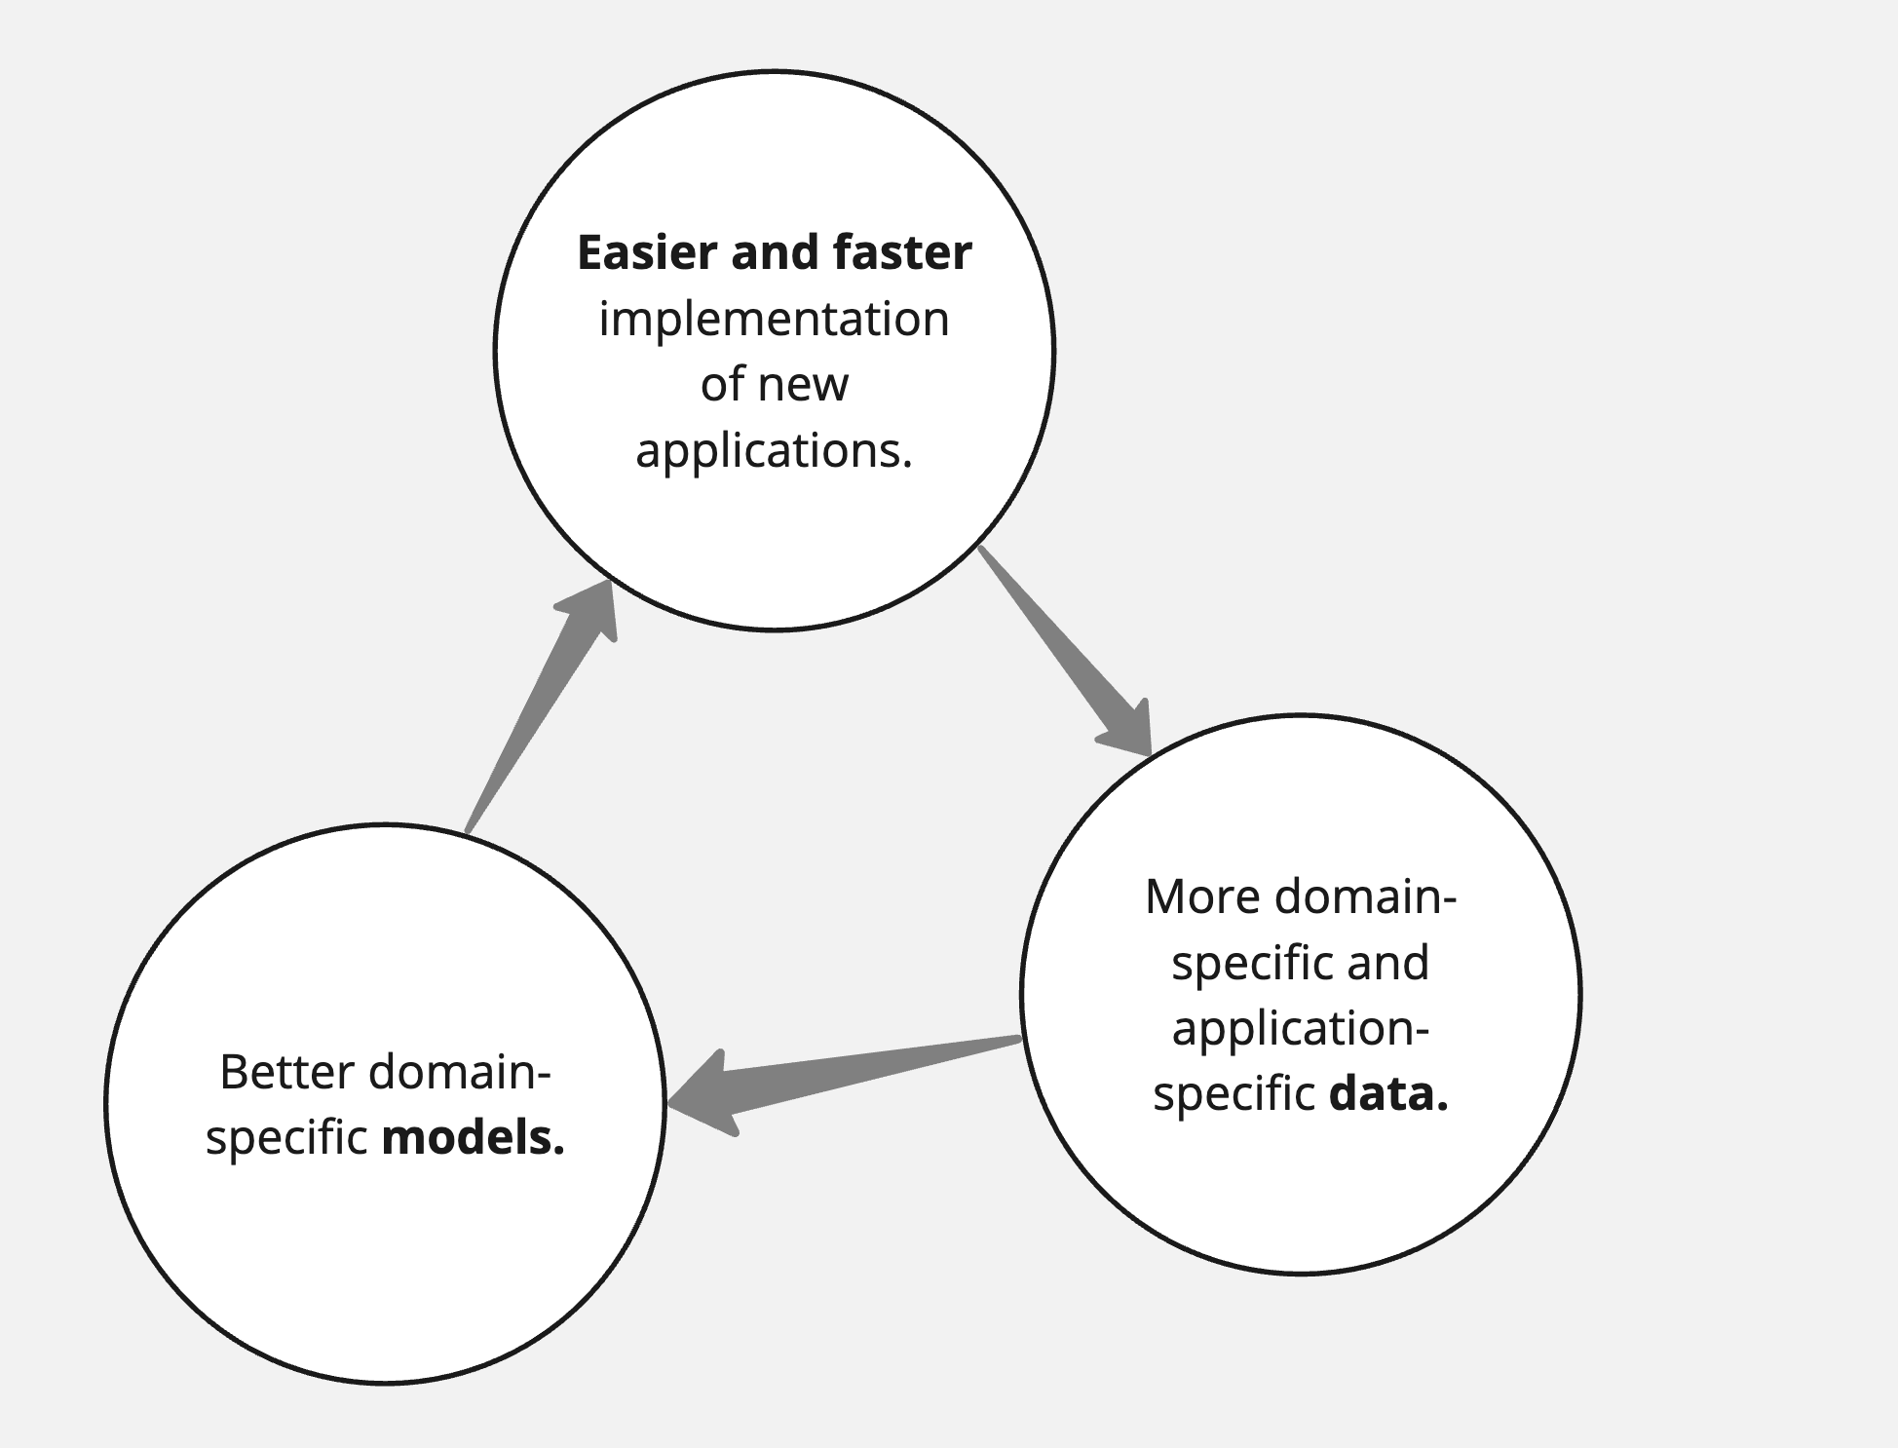

Slide 5
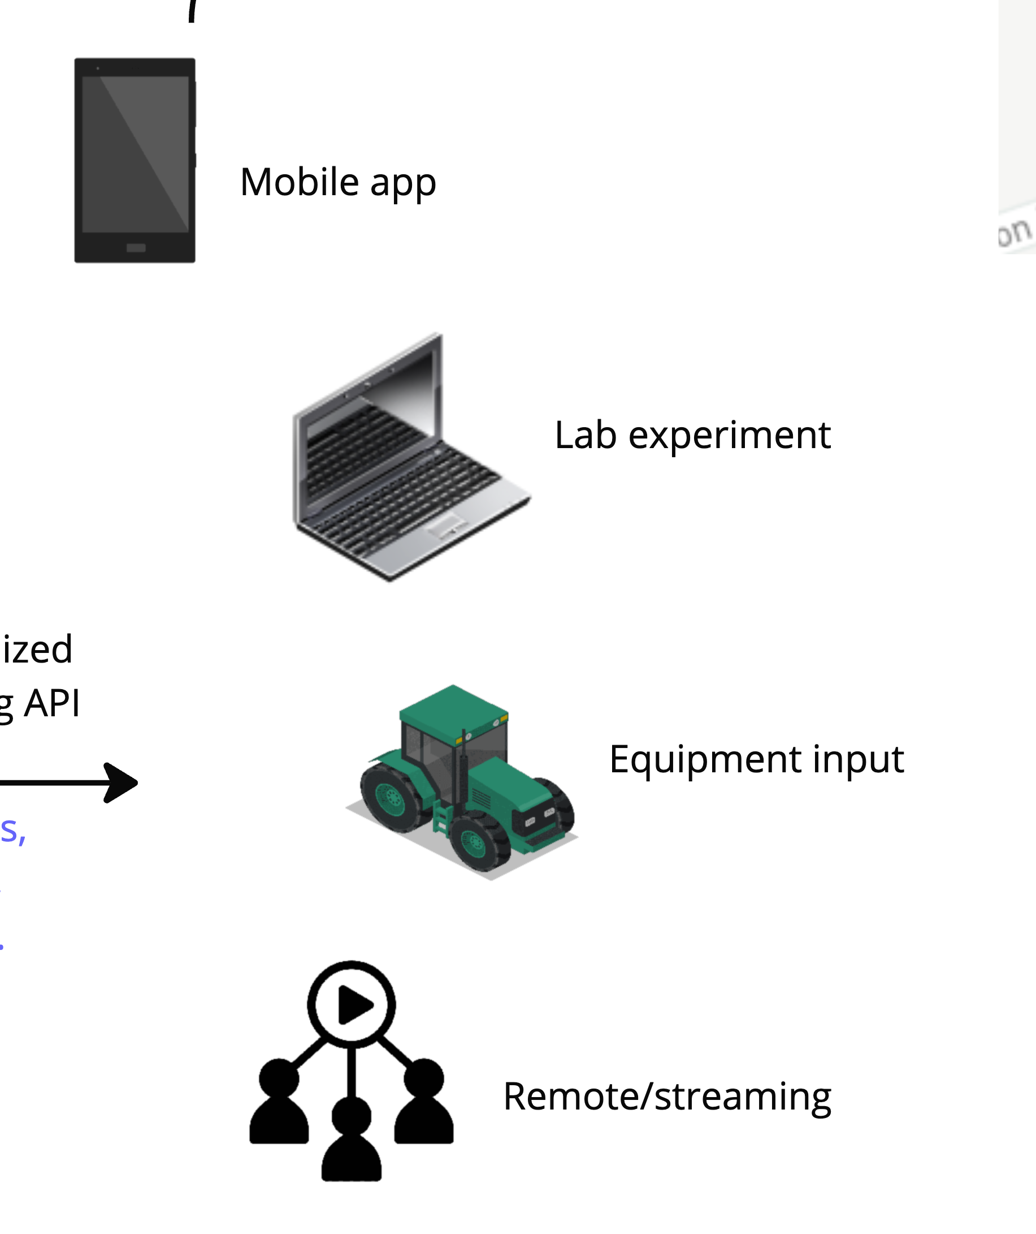

Slide 6
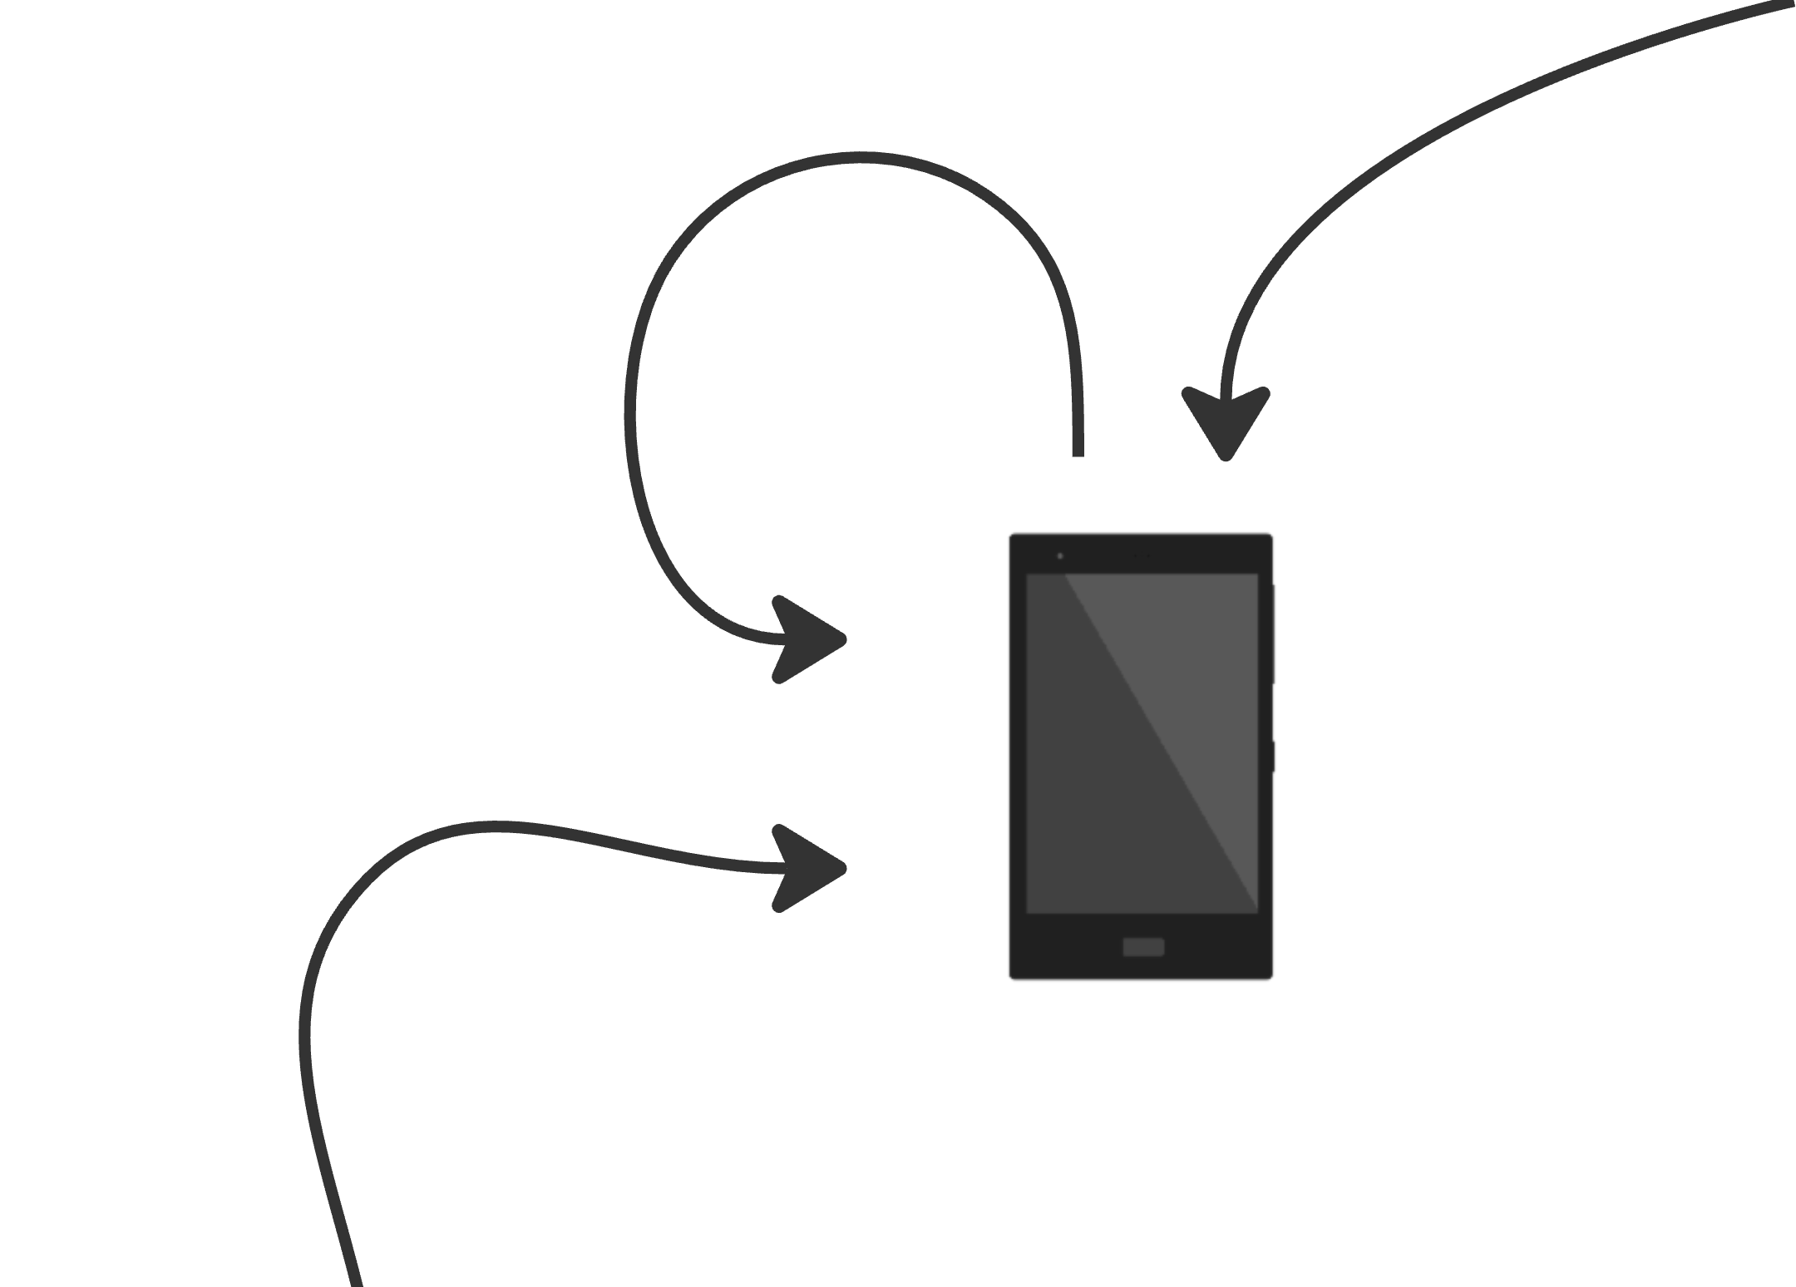
Refine
Local metadata
Real-time predictions

Slide 7
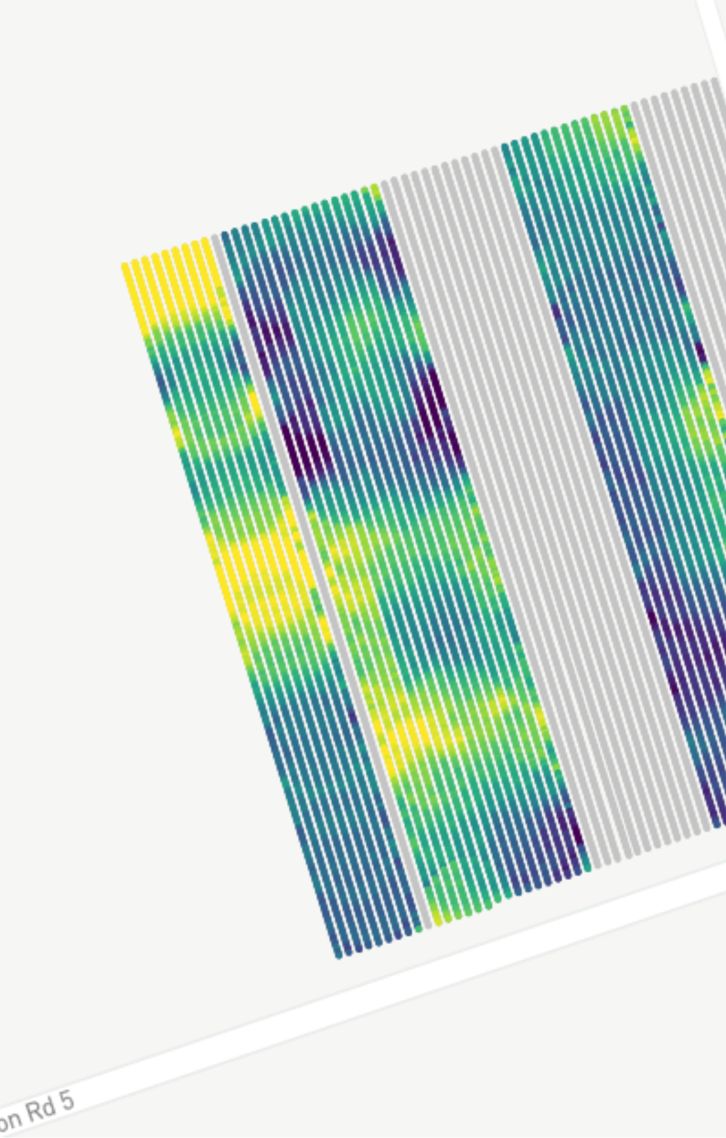
Refine
Local metadata
Blossom cluster count
Block 3A - Ambrosia
Real-time predictions

Slide 8
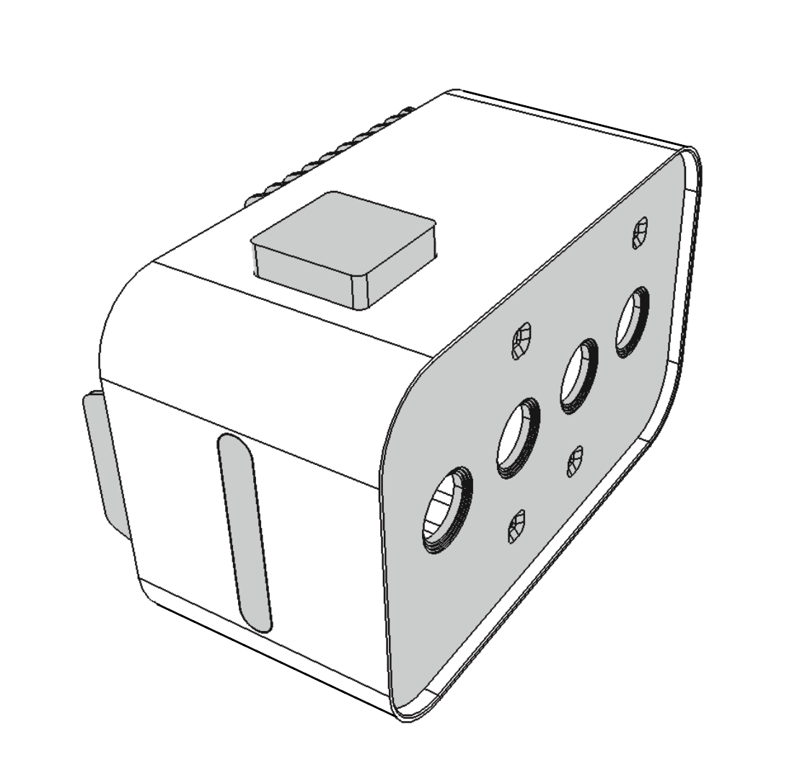
State-of-the-art GPU
High-precision
GNSS + RTK
Waterproof enclosure
WiFi, BT, LTE
Various cameras/optics
Visual indicators

Slide 9
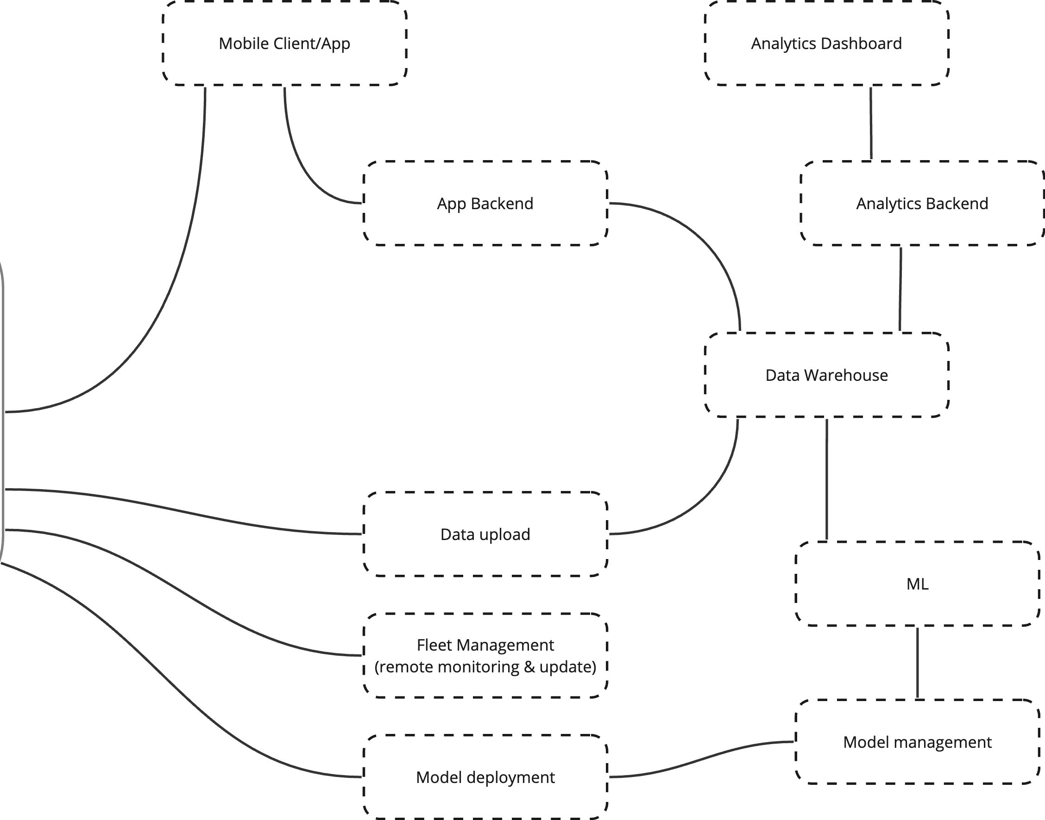
State-of-the-art GPU
High-precision
GNSS + RTK
Waterproof enclosure
WiFi, BT, LTE
Various cameras/optics
Visual indicators

Slide 11
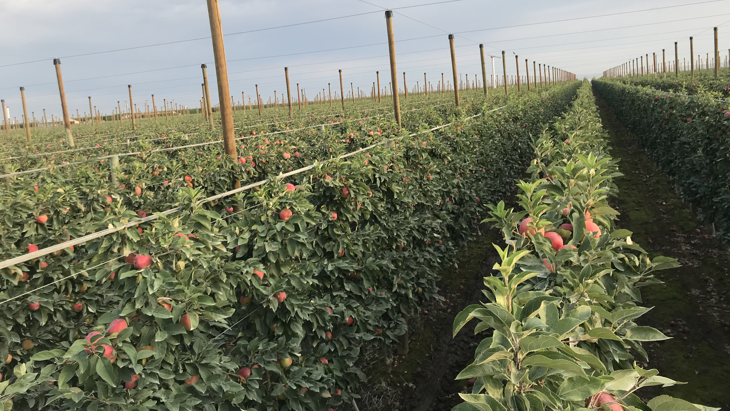

Slide 13
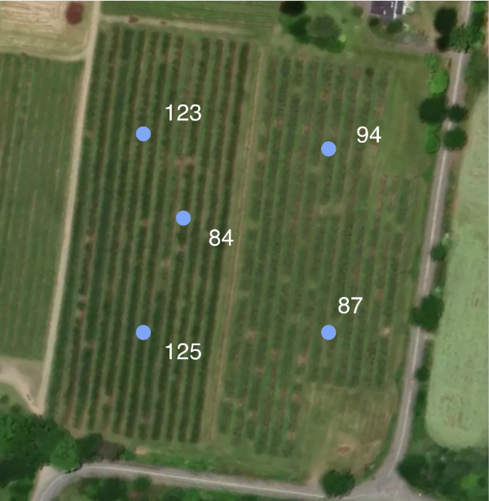
Data gathered manually is very sparse

Slide 14
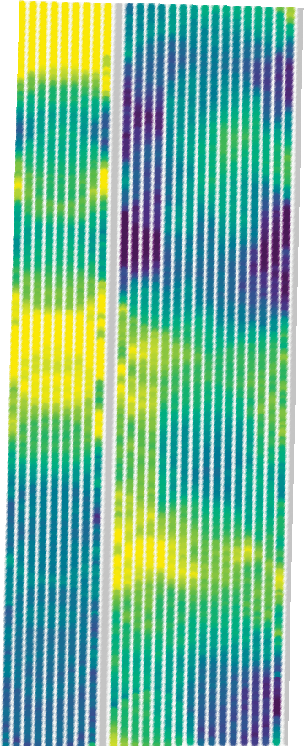
Data gathered manually is very sparse
We provide actionable insights based on per-tree data

Slide 15
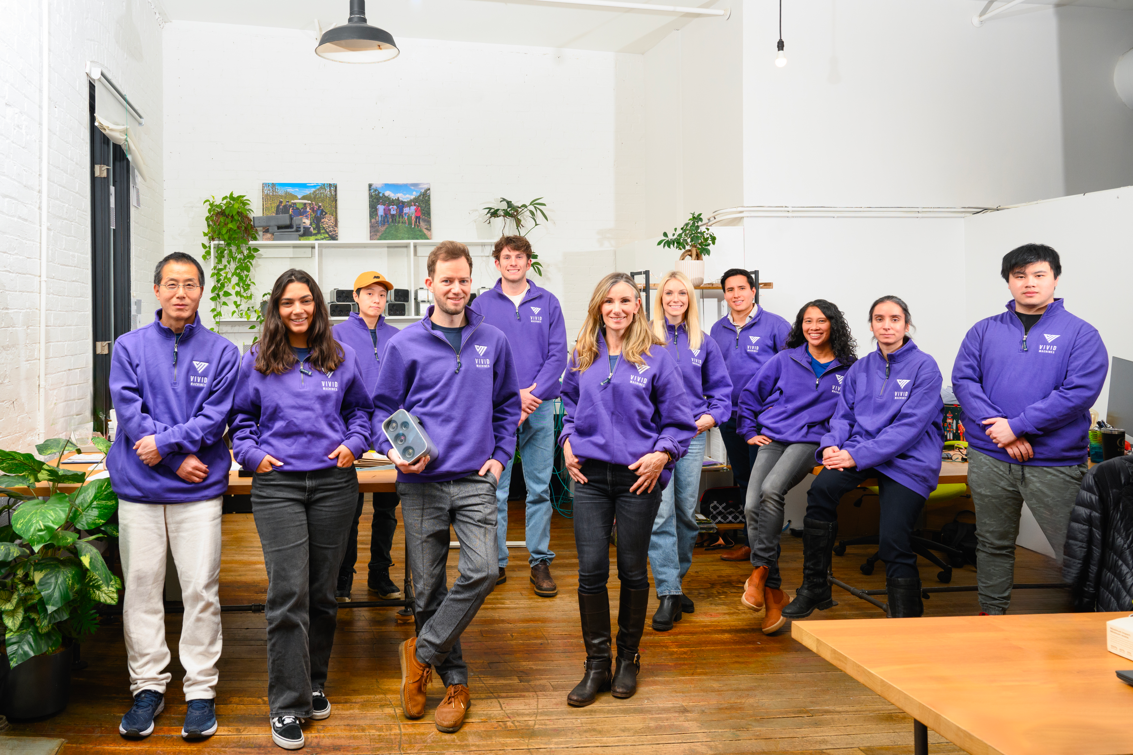
jenny@vivid-machines.com
jonathan@vivid-machines.com

