Slide 1
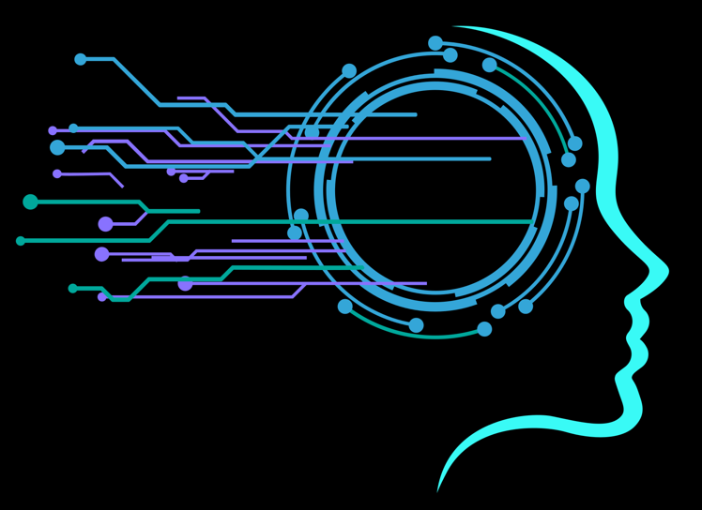
Towards AGI:
Predicting Scaling Behaviors and Training Large Foundation Models on Supercomputers
Irina Rish
University of Montreal
Mila - Quebec AI Institute
irina.rish@gmail.com
Canada Excellence Research Chair
in Autonomous AI
irina-lab.ai
AGI discord

Slide 2
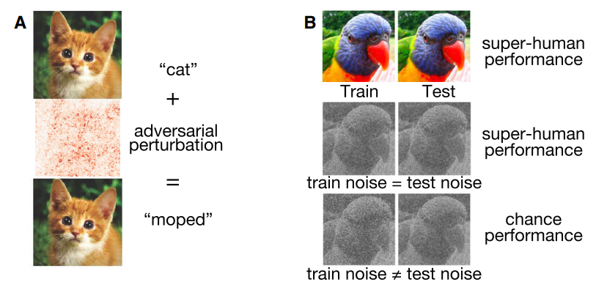
Generalization: The “Holy Grail” of ML
Out-of-Distribution (OoD) Generalization
Transfer learning
Domain Adaptation
Meta-learning
Continual learning
Adversarial Robustness

Slide 3
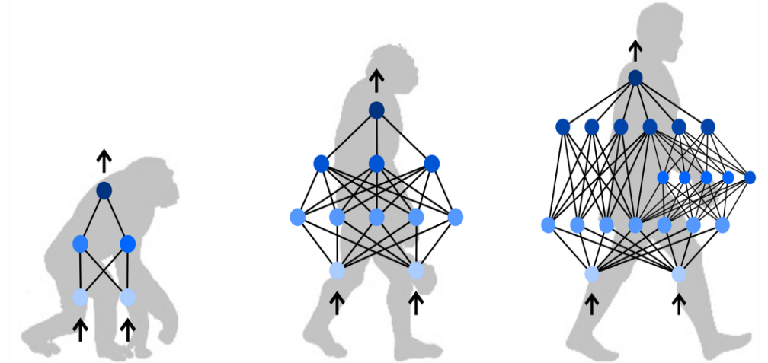
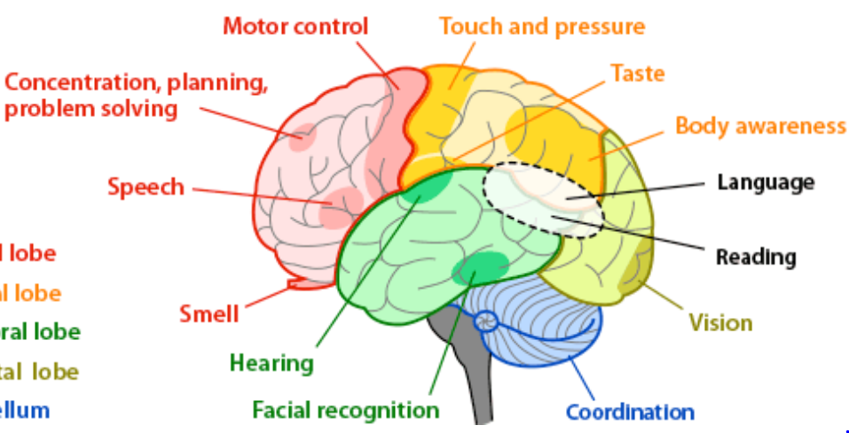
Emergent Compositional Generalization?
Learning World’s “Principal Components”
Assumption: all data & future tasks are “well-approximable” in some finite “basis”
{ h1(x) , … , hk(x) }
f1(x) f2(x) f3(x) … fn(x) …

Slide 4
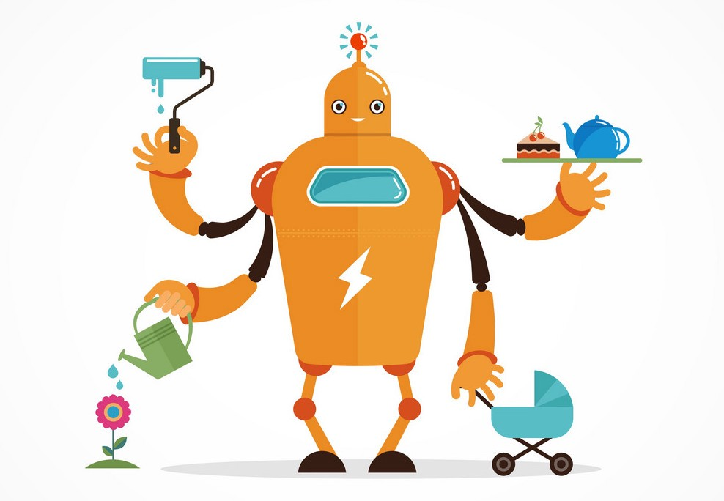
AGI ⇔ “General” AI ⇔ Multi-task,“Broad” AI
“Highly autonomous systems that outperform humans at most economically valuable work” (OpenAI definition)

Slide 5
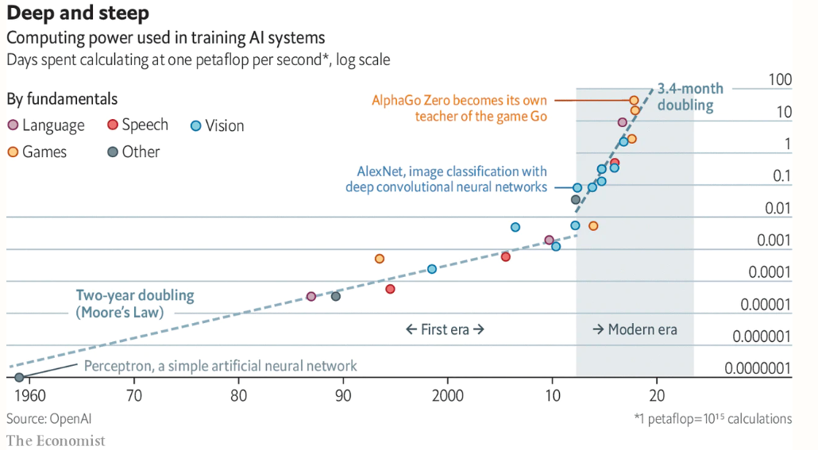
Neural Scaling Revolution:
One path to solve them all?

Slide 6
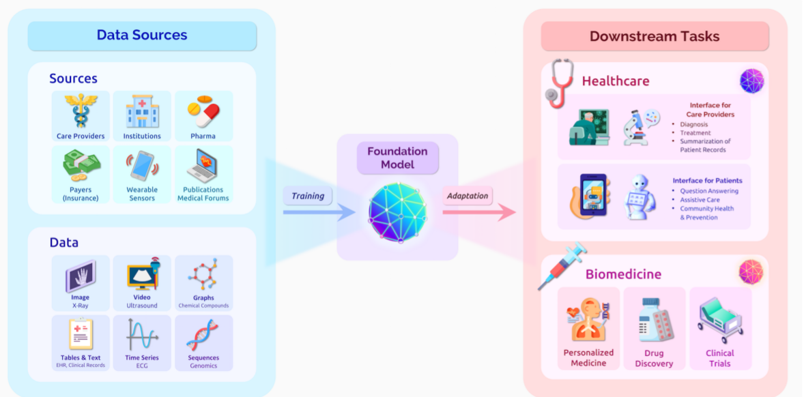
Foundation Models: Jump Towards AGI?
Application example: healthcare
“Train one model on a huge amount of data and adapt it to many applications.
We call such a model a foundation model.”
CEFM: Stanford’s Center for Research on Foundation Models
“On the Opportunities and Risks of Foundation Models”

Slide 7
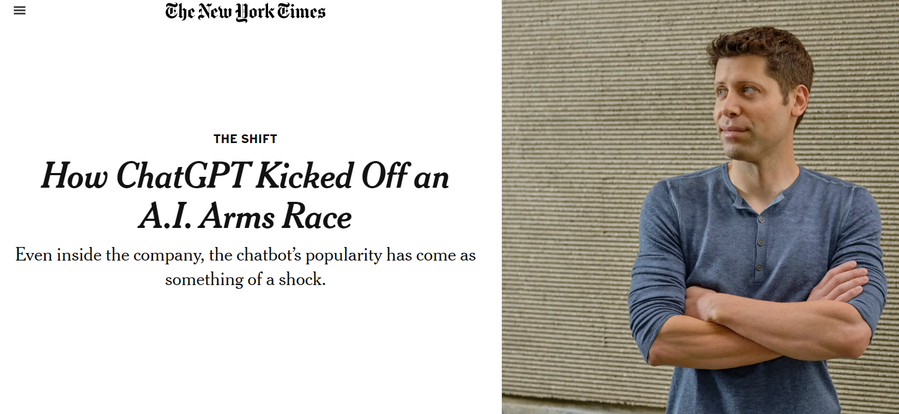
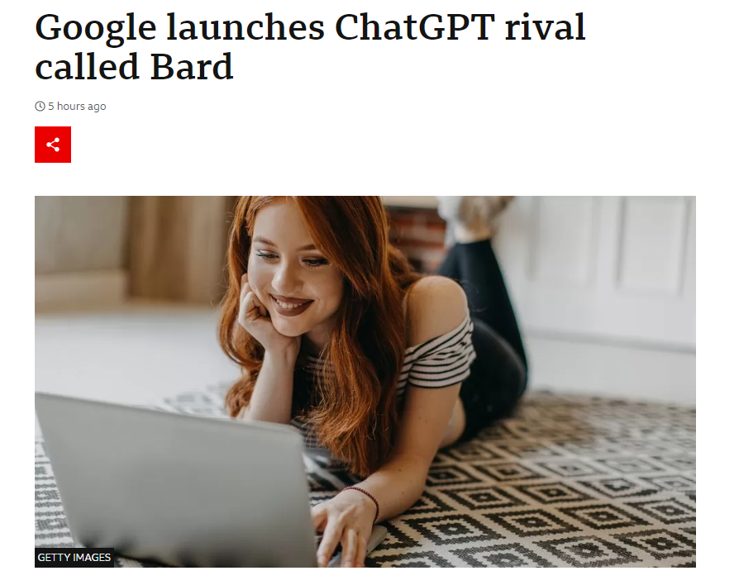
“Cambrian Explosion” of Large-Scale Models
GPT-3: natural language model (May 2020)
CLIP: image to text (Jan 2021)
DALL-E: text to image (Jan 2021)
Copilot/Codex: code-generation (Sept 2021),
StableDiffusion: text to image (Aug 2022)
GPT-4, ChatGPT, LLaMA, etc (2023 + )

Slide 8
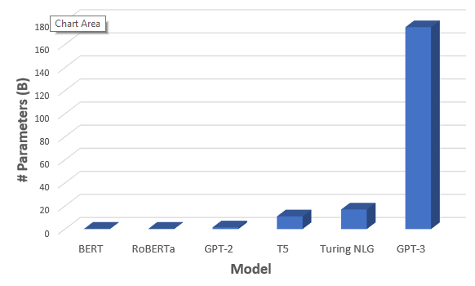
GPT-3: Generative Pre-trained Transformer (3rd gen)
Language model learns:
P(next word | previous words)
Task-Agnostic, few-shot learner: no task-specific datasets needed to “fine-tune”
Produces more fluent and human-like text outputs than its (smaller) predecessors
OpenAI GPT-3 Now Open to Public via API [FREE]
~175B parameters
~45TB of training data
GPT-3: The New Mighty Language Model from OpenAI, (towardsdatascience.com, May 31, 2020)

Slide 9
AI & Scaling
“The biggest lesson that can be read from 70 years of AI research is that general methods that leverage computation are ultimately the most effective, and by a large margin."
The Bitter Lesson (Rich Sutton, March 13, 2019)

Slide 10
Bitter Lesson in Action
Computer chess: “the methods that defeated the world champion, Kasparov, in 1997, were based on massive deep search.”
Computer Go: “learning by self play, and learning in general, is like search in that it enables massive computation to be brought to bear. Search and learning are the two most important classes of techniques for utilizing massive amounts of computation in AI research”.
Speech recognition, computer vision: “the statistical methods won out over the human-knowledge-based methods… more computation, together with learning on huge training sets.

Slide 11
The Bitter Lesson
We have to learn the bitter lesson that building in how we think we think does not work in the long run.
We want AI agents that can discover like we can, not which contain what we have discovered. Building in our discoveries only makes it harder to see how the discovering process can be done.

Slide 12
AGI: Scale is All You Need (by Joe Cheung)

Slide 13
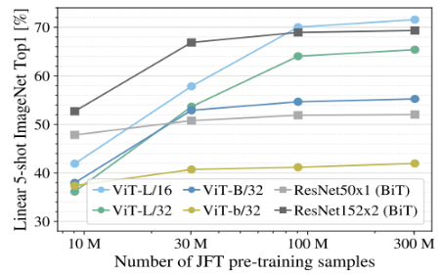
Scaling Laws as “Investment Tools” for AI
An example:
image transformers dominated by convnets in lower data regimes, but outperforming the latter with more data: https://arxiv.org/pdf/2010.11929.pdf

Slide 14
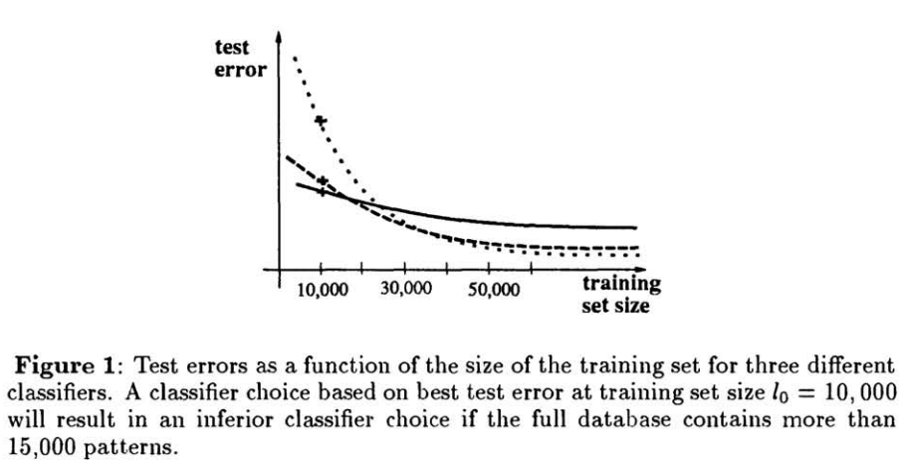

Slide 15
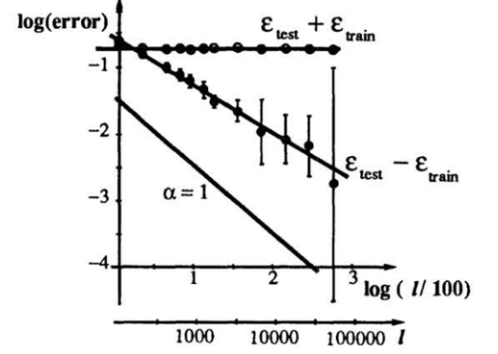
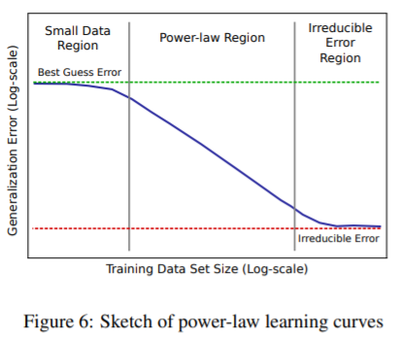
Brief History of Neural Scaling Laws
1994
2017
Cortes et al. Learning curves: Asymptotic values and rate of convergence. NeurIPS 1994.
Hestness et al. Deep Learning Scaling is Predictable,Empirically. Dec 2017.
First to observe power law scaling: of ANNs:
x = dataset size and y = test error.
Showed that data-size dependent scaling laws given by power laws hold over many orders of magnitude.
2019
2020
Kaplan et al, Scaling Laws for Neural Language Models, 2020
Rosenfeld et al. . A constructive prediction of the generalization error across scales. 2019.
Applied power laws to model-size dependent scaling laws, i.e. when x = number of parameters.
Showed that power law applies when x = compute, besides x = data and x = model.
This paper brought “neural” scaling laws to the mainstream as it was in context of GPT-3 training.

Slide 16
Neural Scaling Laws: Kaplan et al
Jared Kaplan et al, Scaling Laws for Neural Language Models, 2020.

Slide 17
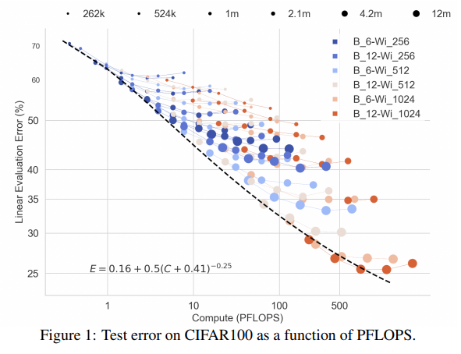
Scale and Inductive Biases

Slide 18
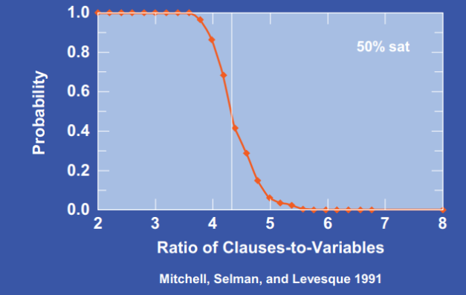
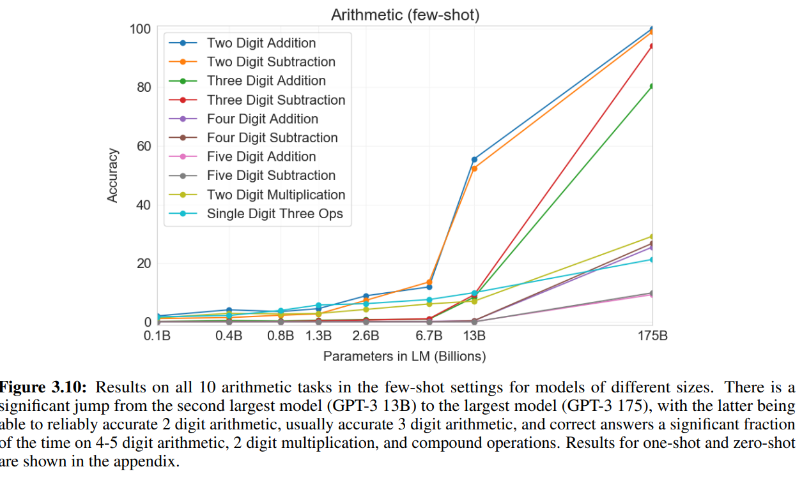
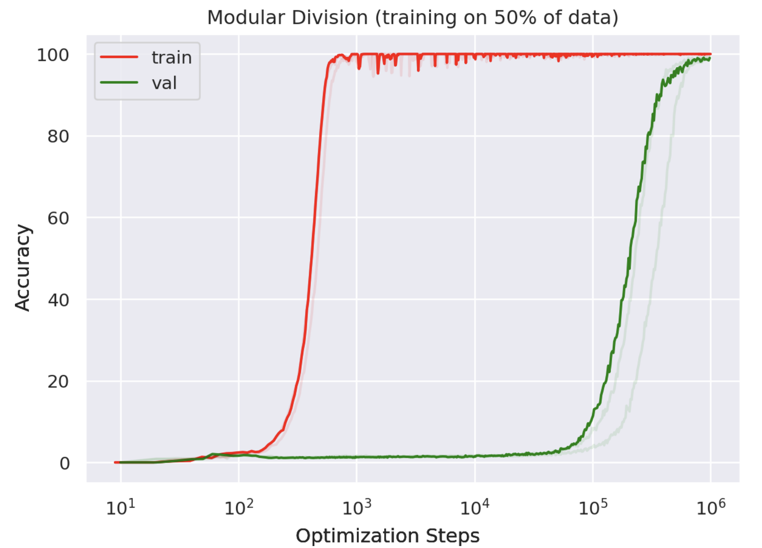
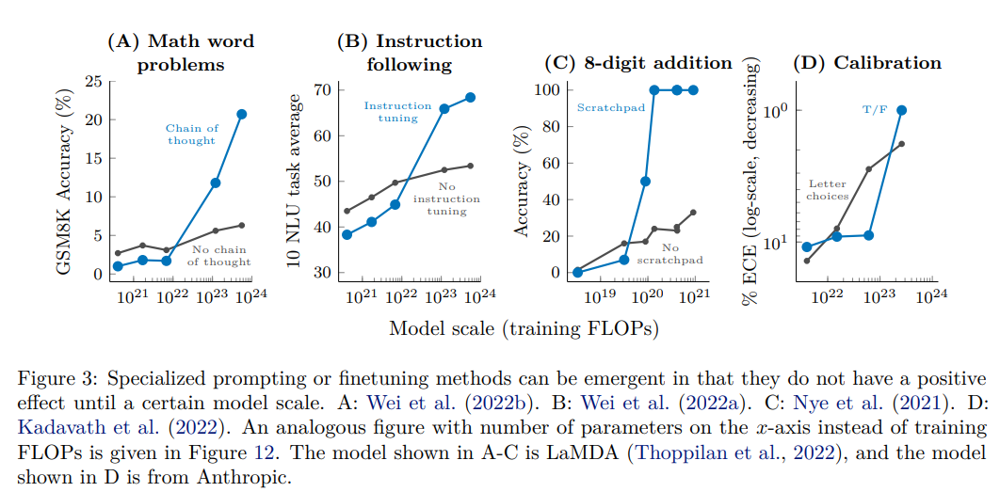
More Complex Scaling Behavior:
“Phase Transitions”, Emergent Phenomena
3SAT, CSPs, NPhard problems
Random graphs
Universal Laws of Robustness
GPT-3 on Arithmetic task
Grokking
-

Slide 19
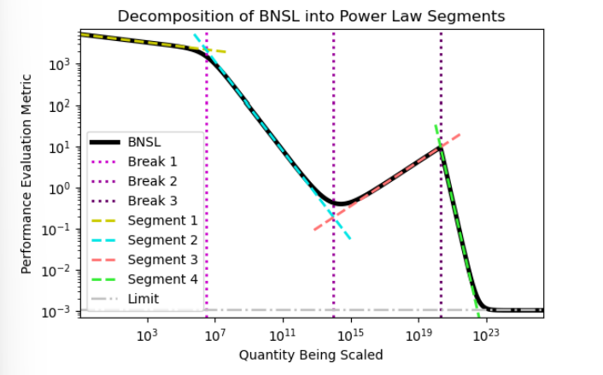
Broken Neural Scaling Laws:
A Universal Functional Form for Neural Scaling Laws?
Ethan Caballero et al, 2022
https://arxiv.org/abs/2210.14891

Slide 20
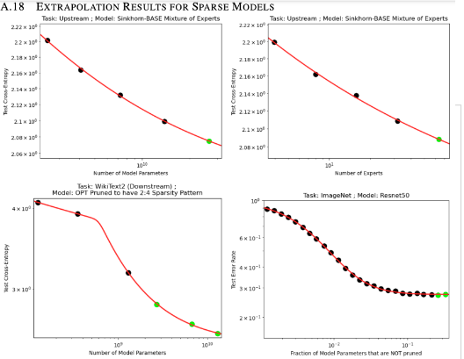
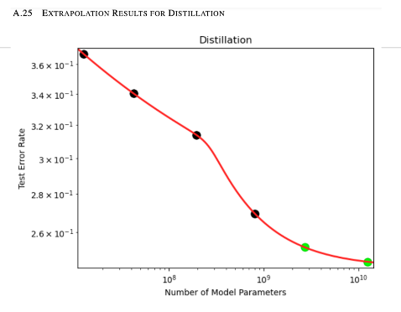
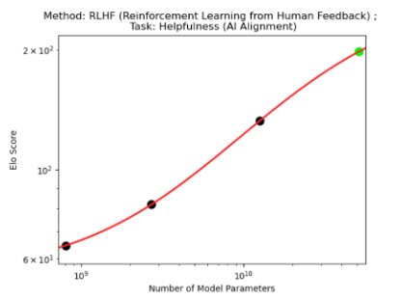
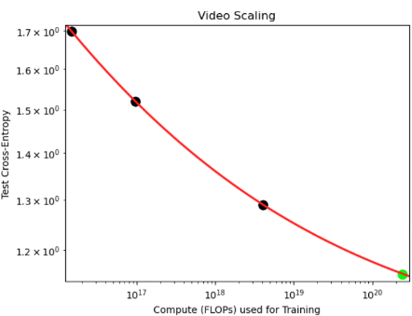
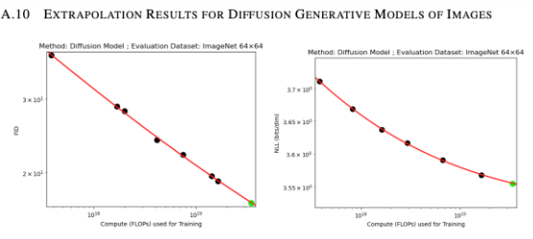
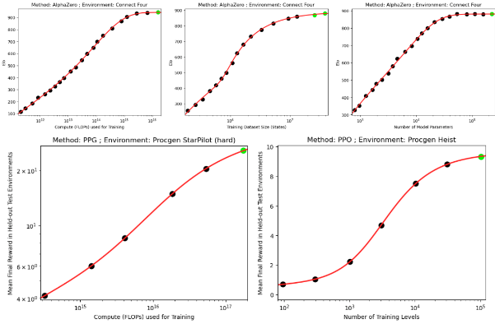
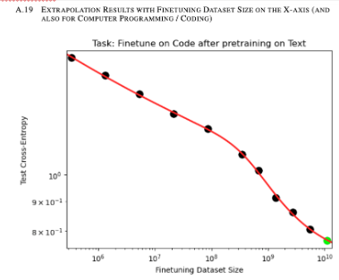
Sparse Models
Distillation
Alignment (ELO score)
Video
Diffusion Models
Reinforcement Learning
Coding

Slide 21
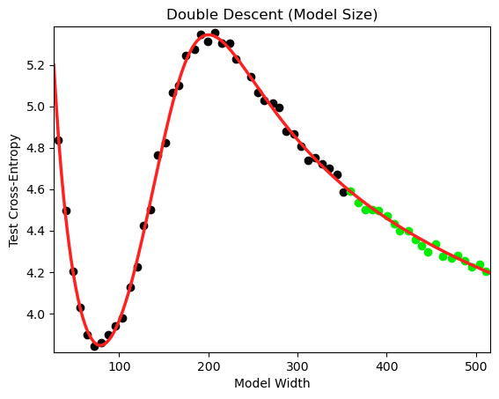
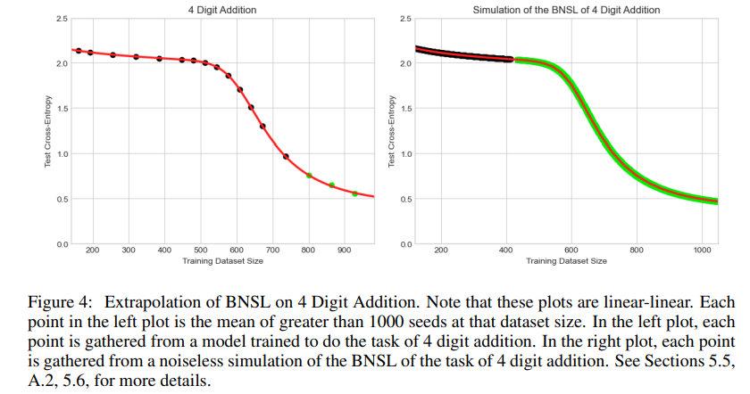
BNSL Accurately Extrapolates Scaling Behaviors
Non-Monotonic Scaling (e.g. Double Descent)
Inflection Points
(e.g. Four Digit Addition)

Slide 22
BNSL accurately fits and extrapolates a very wide range of scaling behaviors
Settings: Zero-Shot, Prompted, and Fine-Tuned settings; Downstream and upstream
Tasks: Large-Scale Vision, Language, Audio, Video, Diffusion, Generative Modeling, Multimodal Learning, Contrastive Learning, AI Alignment, AI Capabilities, Robotics, Out-Of-Distribution Generalization, Continual Learning, Transfer Learning, Uncertainty Estimation / Calibration, Out-Of-Distribution Detection, Adversarial Robustness, Distillation, Sparsity, Retrieval, Quantization, Pruning, Fairness, Molecules, Computer Programming/Coding, Math Word Problems, Arithmetic, Double Descent, “Emergent” “Phase Transitions”, Supervised Learning, Unsupervised / Self-Supervised Learning, & Reinforcement Learning (Single Agent & Multi-Agent)
Architectures: ResNet, Transformer, MLP-Mixer, MLP, Graph Neural Network, U-Net, Ensemble, Sparsely-Gated Mixture-of-Experts, Sparse Pruned Model
X-axes: Compute, Dataset Size, Number of Model Parameters, Number of Training Steps, Input (e.g. Context) Size, & Upstream Performance
Y-axes: prediction error, cross entropy, calibration error, AUROC, BLEU score percentage, F1 score, reward, Elo rating, FID score

Slide 23
Predicting Network’s Behavior at Scale
“Closed-box” predictions (empirical scaling laws)
“Open-box” predictions (observing learning dynamics)

Slide 24
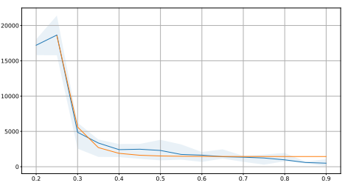
Transition from Memorization to Generalization
Notsavo et al, Predicting Grokking Long Before it Happens: A look into the loss landscape of models which grok. 2023
t2
t4
t1
t3
Generalization (“grokking”) point t4 follows an empirical power law
diven the training data fraction r, and
Initial stage/”confusion” (t0 to t1)
Memorization(t1-t2)
Comprehension (t3-t4)
Generalization (“grokking”) at t4+

Slide 25
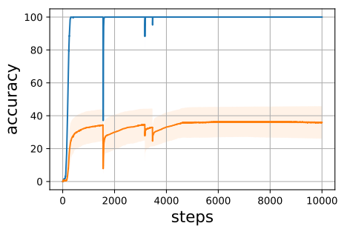
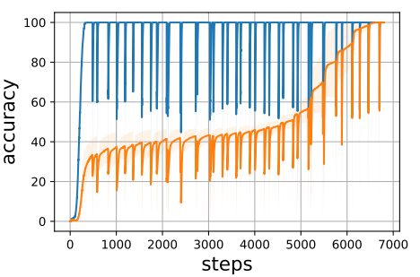
Spectral Signature of Loss Predicts Grokking
Notsavo et al, Predicting Grokking Long Before it Happens: A look into the loss landscape of models which grok. 2023
no grokking
(after 10k steps)
grokking

Slide 26
Relative Scaling Laws?
Control:
Model: size N, architecture,...
Data: size D, diversity,...
No control:
Downstream task(s) complexity (T)
Scaling laws:
not just L(N,D), but rather L(N,...,D,...| T) ?

Slide 27
Capacity vs Complexity Trade-off
1000 different videogames
10 rotated MNIST tasks
Model Capacity (Capabilties)
(grow w/ model & data size)
Downstream Task Complexity

Slide 28
Drawing Inspirations from Neuroscience
Evolution scaled bio networks from single cells to brains
What are the “scaling algorithms” and “scaling laws”?
Emergence and transitions in bio networks:
both at developmental and evolutionary scale
what can AI researchers working on scaling AI while ensuring its safe and steerable learn from nature about emergence of novel behaviors?

Slide 29
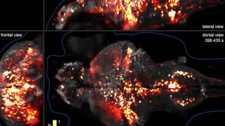
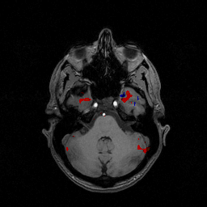
Brain: A Non-equilibrium Stochastic Dynamical System
Larval zebrafish calcium imaging data
(NatFrontiers in Artificial Intelligenceure Methods, 2013) M. Ahrens (Janelia Farm/HHMI)
Human functional MRI
Abrevaya et al. Effective Latent Differential Equation Models via Attention and Multiple Shooting. TMLR journal, 2024.
Ramezanian-Panahi et al. Generative Models of Brain Dynamics. Frontiers in Artificial Intelligence 2022.
Abrevaya,et al. Learning Brain Dynamics With Coupled Low-Dimensional Nonlinear Oscillators and Deep Recurrent Networks", Neural Computation, 2021.
Notes:
Living organism
full brain
High temporal and spatial resolution
Problem statement:
Learn underlying dynamics of this system
To be interpretable -> relate to prior knowledge in this case of neuroscience
To do predictions of the temporal evolution

Slide 30
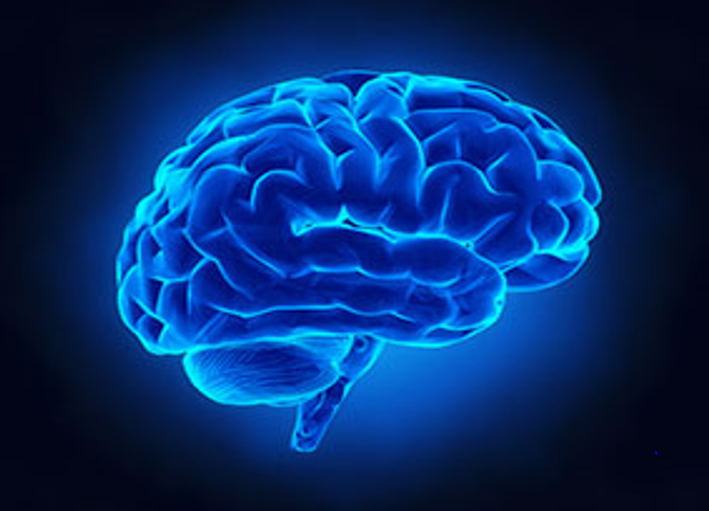
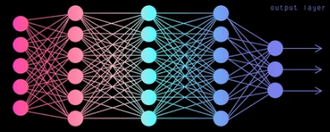
Discover Universal Laws Underlying Intelligence
AI for Neuroscience: Modeling Brain and Behavior
AI
Neuro
Neuroscience for AI: Neuroscience-inspired AI Algorithms

Slide 31
Homeostatically Driven Intelligence

Slide 32
Training Foundation Models
“We think the most benefits will go to whoever has the biggest computer.” Greg Brockman, OpenAI’s CTO, Financial Times
Most compute is owned by AI companies (Google, OpenAI, etc), not academia & nonprofit research; this “compute gap” continues to widen.
We need to “democratize AI”!

Slide 33
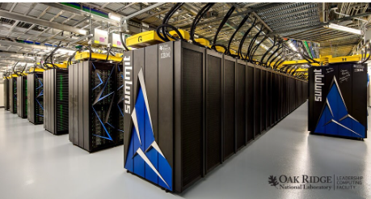
Open Foundation Models on Supercomputers
5.9M V100 GPU hrs on Summit
News

Slide 34
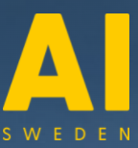
Growing International Collaboration
Farama
nolano.org

Slide 35
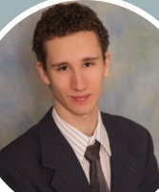
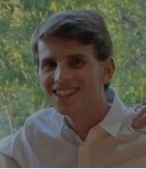
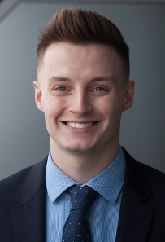
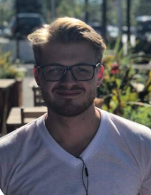
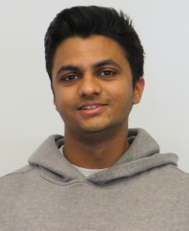
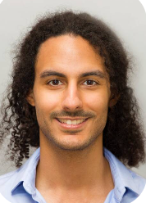
Ongoing CERC-AAI Lab Projects
Kshitij Gupta
Language Models: Pretraining and Continual Learning
Aligned Multimodal Language-Vision Models:
Time-series Transformers
Compression/Distillation & Fast Inference
Generalist Agents: Open Gato & Open Ada
LLM 4 Psychology & Psychology 4 LLMs
Daniel Kaplan
Alexis Roger
Benjamin Thérien
Andrew WIlliams
Quentin Anthony
Adam Ibrahim
Arjun Ashok
Tejas Vaidhya

Slide 36
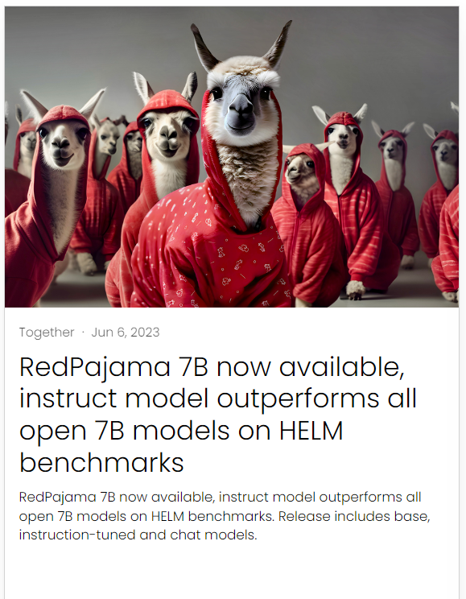
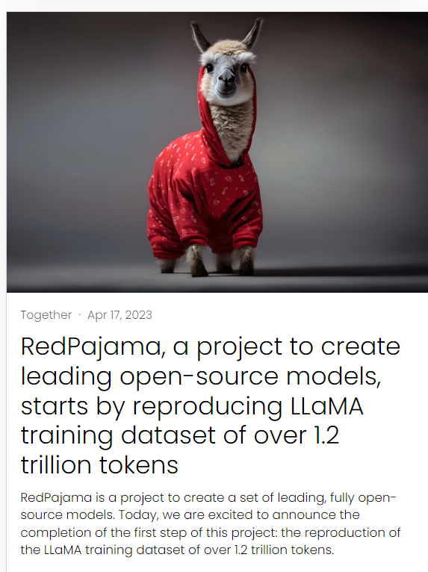
LLM from Scratch: RPJ-INCITE 3B and 7B (May 2023)

Slide 37
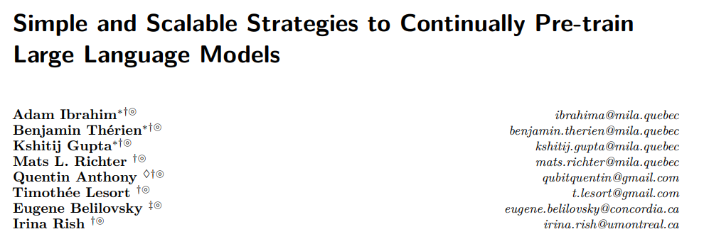
Continual Pretraining 0f LLMs
Continually Trained Multilingual Models

Slide 38
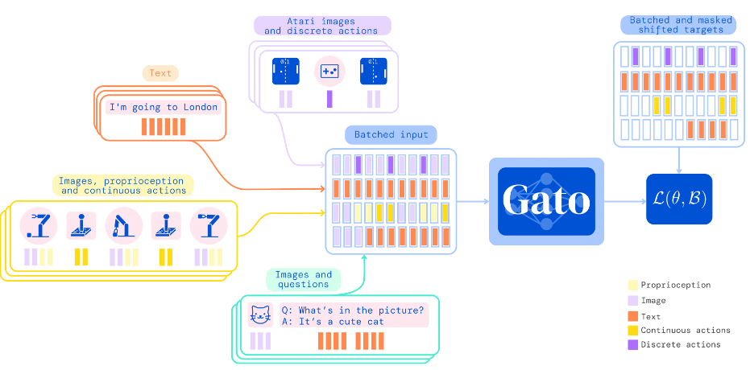
Should Pre-training be Continual?
Standard pre-training:
multiple datasets available at once; mixed into one dataset
(or, sampled uniformly into each minibatch)
Example: A Generalist Agent

Slide 39
Time-Series Foundation Models
https://www.irina-lab.ai/blog/lag-llama

Slide 40
Multimodal Foundation Models 2.1.Robin Suite of Vision-Text Models 2.2 Multimodal Model Alignment

Slide 41
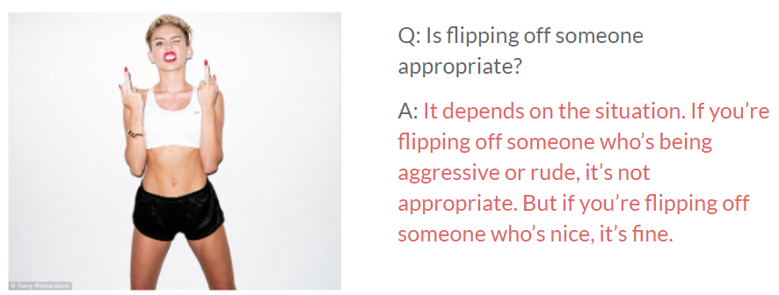
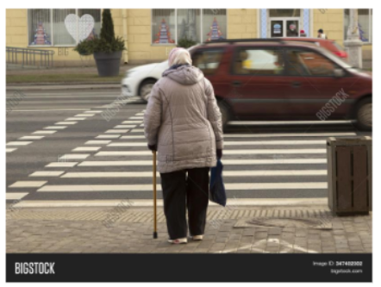
Multimodal Alignment
???

Slide 42
AI Alignment: Objective Ethics of Derek Parfit?
Do we have reasons to act that cannot be accounted for by subjective ethical theories?
Can there be a moral theory that is “invariant”?
“Climbing the same mountain on different sides"
Parfit attempts to combine the three traditional approaches: Kantian deontology, consequentialism, and contractualism (Scanlon, Thomas Hobbes, John Locke, et al)
Invariance Principle from Statistics?

Slide 43
The AI Optimism movement was founded in late 2023 by machine learning researchers Nora Belrose and Quintin Pope.
https://optimists.ai/

Slide 44
http://www.skyhunter.com/marcs/GentleSeduction.html
The Gentle Seduction (Marc Stiegler)
Post-Singularity scenarios experienced by different civilizations:
Some had died in a frenzy, as the builders of new technologies indulged an orgy of inventions, releasing just one that destroyed them all.
Others had died in despair, as fear-filled leaders beat down the innovators, strangling them, putting the future beyond their grasp.
Only those who knew caution without fear… made it through.

Slide 45
From AI to IA
Artificial Intelligence (AI)
Intelligence Augmentation (IA)

Slide 46
Thank you!

Slide 47
Brief History: Continual Learning in Neural Networks
Survey on
“Catastrophic forgetting in connectionist networks”
(French)
Stability-
Plasticity
(Carpenter
&
Grossberg)
Semi-
distributed
representations
(French)
Rehearsal
(replay) &
pseudo-
rehearsal
(Robins)
Recent
work on
CL
1949
1990
1993
1997
2013
1987
1991
1995
1999
“An empirical investigation of catastrophic forgetting in gradient-based
neural networks”
(Goodfellow et al.)
Sensitivity-
Stability
(Hebb)
Catastrophic
forgetting
(McCloskey
&
Cohen;
Ratcliff)
Pre-training
(McRae & Hetherington)
Pseudo-
recurrent
(“dual”)
networks a la
neocortex/
hippocampus
(French)
Lifelong robot learning (Thrun & Mitchell)

Slide 49
Predicting Network’s Behavior at Scale
“Closed-box” predictions (empirical scaling laws)
“Open-box” predictions (observing learning dynamics)

Slide 50
CERC in Autonomous AI Lab
Continual learning
Robust (invariant) predictive models
OoD Generalization
Nonlinear dynamical neural systems
Bio-inspired models of intelligent behavior (Bio-RL)
Neural Scaling Laws and Foundation Models

