Slide 1
Generative AI Integration in Financial Services: A Balancing Act
By Foteini Agrafioti, SVP Data + AI and Chief Science Officer at RBC
Notes:
Generative AI Integration and Financial Services: a Balancing Act” Generative AI is a transformative technology that has a profound impact on various industries and our society as a whole. Although there is a lot of excitement and potential surrounding the use of GenAI, it is necessary to conduct technical and social research to understand and manage any associated risks. In particular, how can Generative AI be used in customer service for financial institutions? Foteini Agrafioti, Chief Science Officer of RBC and Head of Borealis AI, delves into the potential of this technology and shares approaches for responsible use and mitigating potential risks.

Slide 2
Our Mission
At Borealis AI, we create real world impact through scientific pursuit. Borealis AI researches, designs and builds AI technologies that transform RBC businesses and shape the future of finance.

Slide 3
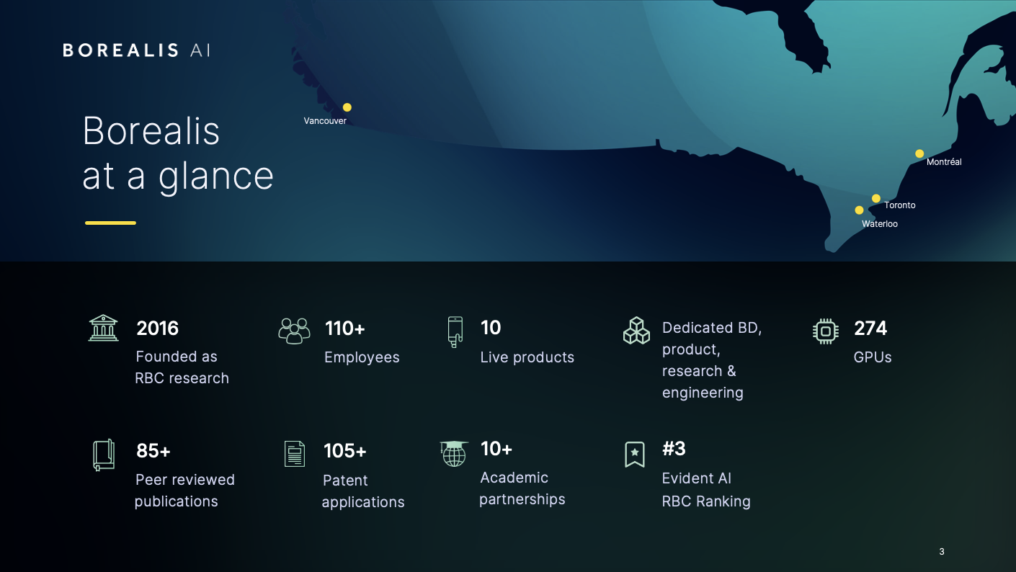
Borealis
at a glance
2016
110+
10
Dedicated BD, product, research & engineering
274
Founded as RBC research
Employees
Live products
GPUs
85+
105+
10+
#3
Peer reviewed publications
Patent applications
Academic partnerships
Evident AI
RBC Ranking

Slide 4
Overall
1 | JP Morgan
3 | RBC
11 | TD
16 | BMO
18 | Scotiabank
41 | CIBC
Advancing AI in Financial Services
Innovation Research, patents, ventures, ecosystem
1 | JP Morgan
3 | RBC
6 | TD
9 | BMO
28 | Scotiabank
29 | CIBC
Leadership In public communications and strategy
1 | DBS
5 | RBC
22 | BMO
23 | Scotiabank
31 | TD
46 | CIBC
Talent Capability & Development
1 | Capital One
7 | RBC
15 | TD
21 | Scotiabank
25 | BMO
40 | CIBC
Transparency Of responsible AI activities
1 | JP Morgan
2 | RBC
3 | Scotiabank
14 | BMO
16 | TD
39 | CIBC
Notes:
Financial services is an industry largely guided by data.
When novel machine learning techniques were introduced into the mix, they held great promise for the industry as they lifted prediction accuracy across the board, and many banks followed suit with sizeable investments.
According to the latest Evident AI Index, banks have increased their employment of AI talent by nearly 10 per cent over just the past year. In essence, a business that is already greatly informed by data can derive direct value from advances in machine learning compared to enterprises that lack this benchmark.
As a result, a report released by Evident AI Index, a global standard benchmark of AI maturity for banks, shows Canadian banks punched above their weight, with RBC ranking first in Canada and amongst the world’s top three globally for AI maturity across several categories
In 2023, RBC was ranked third overall and first nationally at incorporating and advancing AI technology among North American, European and Asia-Pacific banks in the Evident AI Index. The index was published by Evident Insights, an intelligence platform developing a standard benchmark of AI maturity across a variety of sectors. The ranking was based on four key areas: innovation, leadership, transparency and talent.

Slide 5
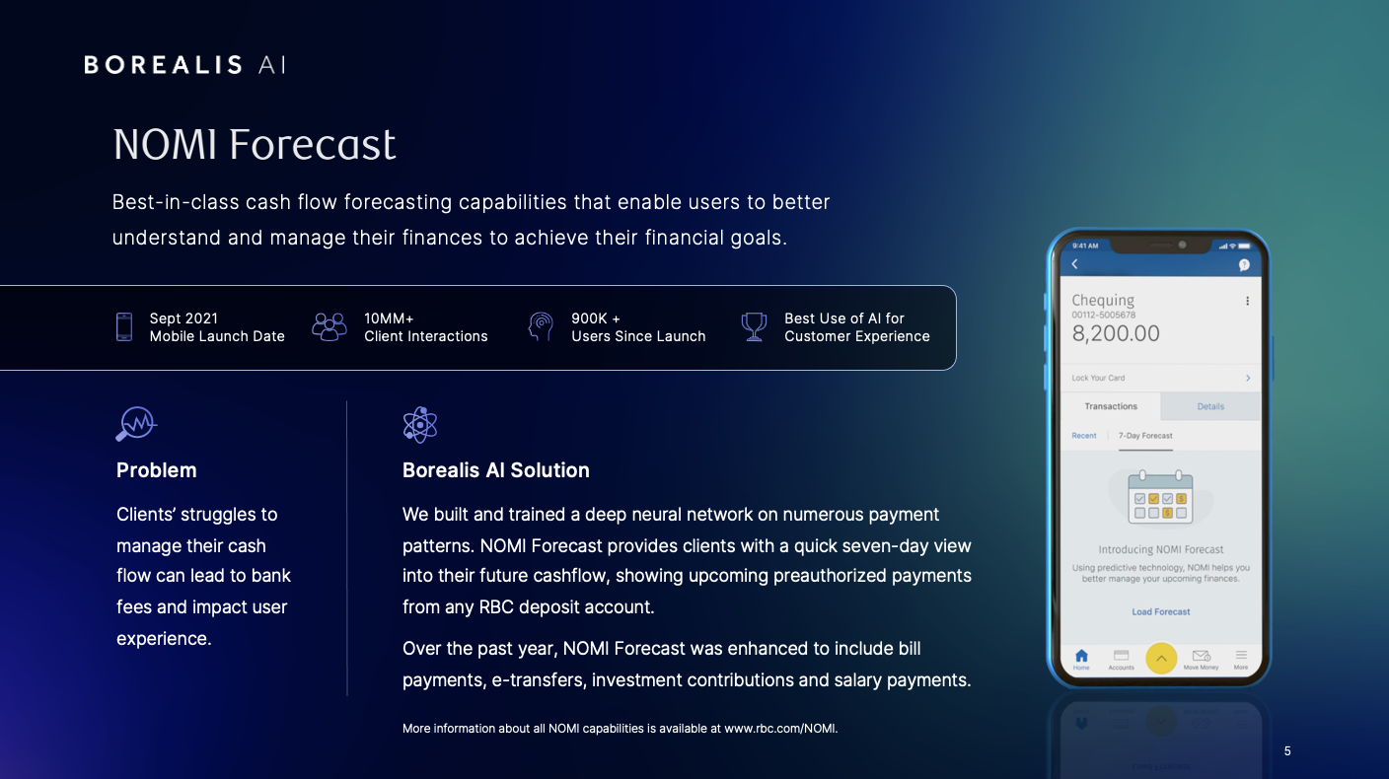
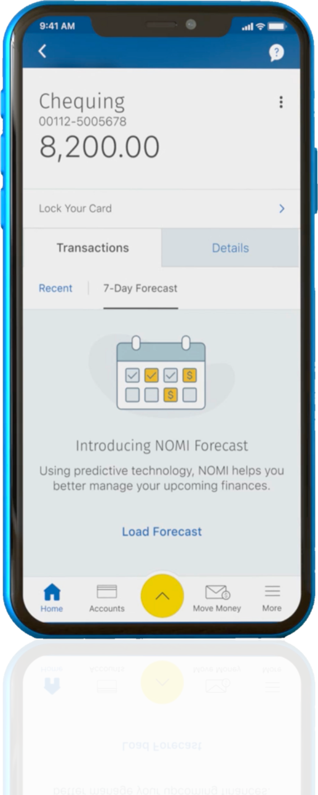
Best-in-class cash flow forecasting capabilities that enable users to better understand and manage their finances to achieve their financial goals.
Sept 2021
Mobile Launch Date
10MM+
Client Interactions
900K +
Users Since Launch
Best Use of AI for Customer Experience
Problem
Clients’ struggles to manage their cash flow can lead to bank fees and impact user experience.
Borealis AI Solution
We built and trained a deep neural network on numerous payment patterns. NOMI Forecast provides clients with a quick seven-day view into their future cashflow, showing upcoming preauthorized payments from any RBC deposit account.
Over the past year, NOMI Forecast was enhanced to include bill payments, e-transfers, investment contributions and salary payments.
More information about all NOMI capabilities is available at www.rbc.com/NOMI.
Notes:
We’ve been using AI at RBC for some time now including, NOMI and Aiden in Capital Markets which many of us are familiar with.
Incorporating AI into digital banking and empowering people to make better financial decisions is a compelling challenge. Borealis AI is creating tools that help RBC clients manage their finances. NOMI RBC’s AI assistant keeps clients connected to their money, offering tailored insights and advice. With NOMI Forecast, Borealis’ AI technology is integrated into a retail banking offering, setting the stage for RBC to deliver next generation advice to clients.
NOMI Forecast shows clients what pre-authorized payments are coming due over a seven-day period, giving clients a more holistic view of their account activity. Now, with forecasting, they will be able to more confidently manage their cash flow—accounting for upcoming and regular obligations like mortgage, loan and subscription service payments. Since its launch in September 2021, more than 900,000 clients have used the feature.
NOMI Forecast, has also been recognized for Best Use of AI for Customer Experience at the 2023 The Digital Banker Digital CX Awards.

Slide 6
What Makes Aiden So Powerful?
Aiden continuously analyzes hundreds of data inputs and utilizes a robust rewards system to improve upon each action it makes and constantly optimize its performance.
A proprietary global framework with four key components enables Aiden to continuously learn from its experiences in the market and adjust dynamically to trading conditions in real-time. Aiden is proactive – it can anticipate changes in the market and respond to leveraging its framework.
Aiden is an AI-powered platform with the goal of delivering improved trading execution quality and insights for our clients globally. RBC Capital Markets partnered with, Borealis AI, to create a solution for today’s complex trading environment.
Deep Neural Network
Over 200+ inputs allow Aiden to continuously learn and gain trading experience over time.
Centralized Learning
Aiden learns with every order it receives across different market events and regions.
Robust Reward System
Aiden gains awareness of its performance and post-trade performance benchmarks.
Proactive Exploration
Freedom to discover new trading patterns and take calculated actions within defined parameters.
Visit rbccm.com/aiden to learn more about Aiden
Notes:
AIDEN, the award-winning electronic trading platform by RBC Capital Markets, leverages advances in reinforcement learning to improve trading quality and earned client trust by offering explainable insights and transparency. Overall, there is a continuum of adoption of AI technology while keeping the bank and our clients safe.
Next-Generation Algorithmic Performance - Aiden’s AI-based algorithms are designed to manage complex data relationships to reduce slippage against key benchmarks, including VWAP and Arrival Price, while minimizing market impact.
Aiden continuously analyzes hundreds of data inputs and utilizes a robust rewards system to improve upon each action it makes and constantly optimize its performance. Aiden also anticipates and proactively adapts to dynamic market conditions using a proprietary global framework. Aiden continues to lead the way in helping clients unlock the possibilities of AI-powered technology.

Slide 7
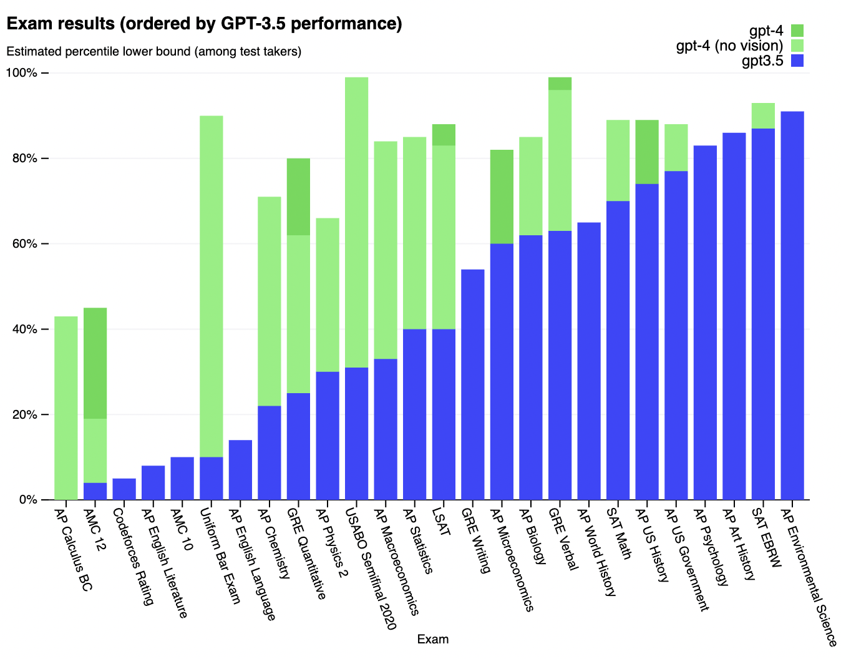
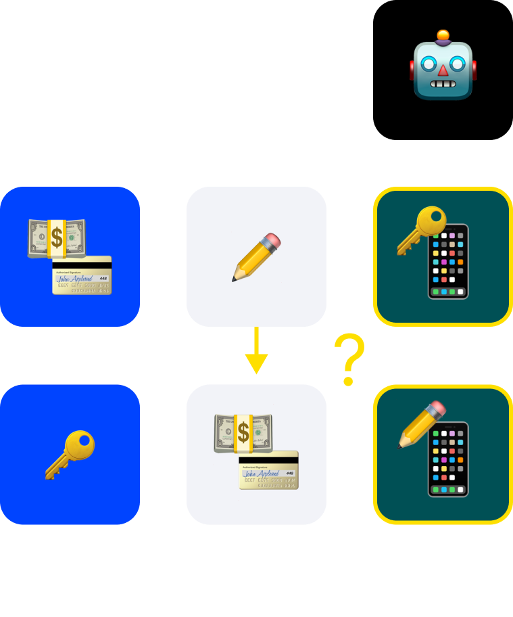
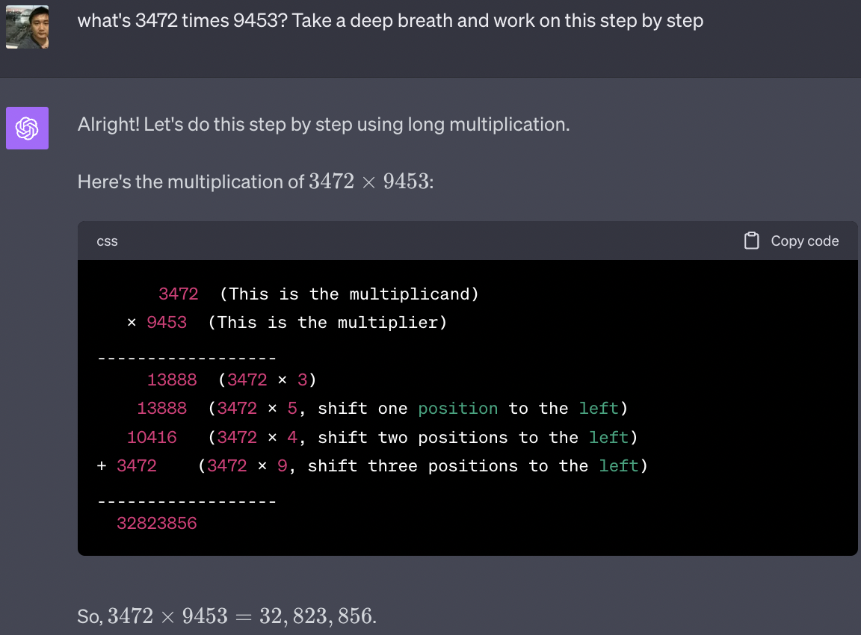
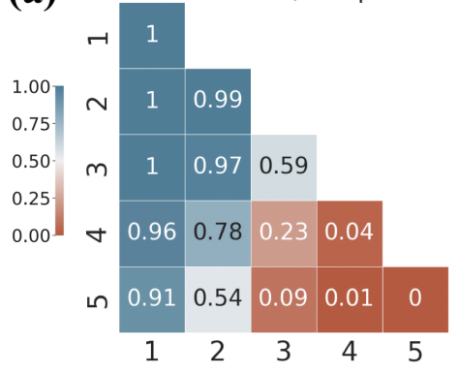
Gen AI has pushed the boundaries of what we thought was possible in human-machine interaction and this holds immense promise for many industries.
(a) GPT4 zero-shot (Multiplication)
Notes:
LLMs have absorbed nearly all that humans have ever produced in text form.
Breadth of knowledge. One’s own experience versus the collective wisdom of all humanity;
Representing knowledge. An LLM does more than just regurgitating content it has seen. Next-token prediction leads to efficient re-usable knowledge and mini-skills.
Application of knowledge. Prompts are mapped to high dimensional embeddings to find the right knowledge and mini-skill. E.g. write as Shakespeare …

Slide 8
Generative AI risks:
Veracity. GenAI systems invent “facts” and can struggle with reasoning and planning.
Intellectual Property. Large models can memorize their training data, leading to plagiarism risks.
Privacy. Machine learning models utilize inputs to the model to retrain, leaking client/sensitive data.
Control. Weak control over the output being produced, toxic speech, regulatory and reputational risk.
Client experience. Discomfort with GenAI communicating in “human” terms -- with language, with speech, with imagery.
Notes:
Currently, use of Gen AI comes with concerns about privacy, security, misinformation, and client experience that necessitate meticulous consideration. Financial services are among the most risk-critical and regulated industries because of the sensitive nature of the information handled and the impact that business practices can have on individuals and their communities. Technology such as this will only be implemented if all risks and concerns are addressed.
When the knowledge, skills, and prompts are not represented in a way that is aligned with human expectations, LLMs can fail: hallucinate facts, specious reasoning, etc.
How to overcome these limitations? In all industries, and especially financial services were client trust is paramount we must embrace the promise of AI while navigating the risk of this technology. How can organizations do this? What checks and balances can support the responsible and safe application of Gen AI technology?

Slide 9
Navigating the Risks
Human-in-the-loop
Understand the risks and mitigations before deploying for direct client-facing interactions in sensitive environments
Prioritize back office operational excellence
Responsible AI Framework
Privacy & Security
Accountability
Fairness
Transparency and Responsible Disclosure
Alignment
AI that's well-aligned with your values could enhance customer service, improve financial decision-making, and boost customer trust
Notes:
We’re excited about the potential of generative AI but understanding the risks this technology poses is essential. It’s an incredible technology that’s going to transform our business, that’s not ready for prime time. To mitigate these risks we have established a development and governance framework that ensures that our use of AI respects diversity and human integrity, and also guides how our teams can consider, explore, and build generative AI tools and bring them to market safely.
An organizations success relies on sustaining client trust. RBC has established principles to guide active risk management and responsible AI. These include Privacy & Security, Accountability, Fairness and Transparency and Responsible Disclosure.
As part of our commitment to advancing the development of responsible AI and Machine Learning (ML), we have also developed RESPECT AI, alongside Borealis AI, our dedicated AI research centre. RESPECT AI is an online hub that brings open source research code, tutorials, academic research and lectures to the AI community, helping to make ethical AI available to all.
When exploring various use cases for Gen AI technology – areas where implementation can draw immediate value are areas there is a human in the loop and implementing this technology into the process can augment this workflow, increase employee productivity and efficiency.
Finding the balance between innovative tech and invaluable human resources is crucial in the process of integrating these tools. While AI and LLMs can often be seamlessly adopted to tackle basic issues (such as a forgotten password or a faulty fraud alert), more complicated questions (such as determining the tax implications of wiring money or weighing the risks of a time-sensitive investment opportunity) typically require more nuanced interpretation. That is why Human oversight is crucial in an effort to mitigate the risks of deploying LLMs. RBC is taking a cautious approach to AI integration, emphasizing the importance of responsible AI and human control.
Alignment in the context of Large Language Model (LLM) research refers to the process of training these models to generate outputs that align with human preferences, intentions, and values. In other words, it's about teaching machines to think and communicate in ways that resonate with us, making their outputs more useful and relatable. Ensuring alignment is crucial for building products with LLMs that adhere to the designer's values and intentions, as it helps prevent unintended behavior, mitigate risks of false narratives, and maintain ethical standard. By focusing on alignment, researchers aim to create AI systems that are more helpful, safe, and ethically responsible. Misalignment between an AI model's objectives and our values could lead to unwanted results. In the banking context, a misaligned AI could make financial recommendations that are not in the best interests of the customer or the bank. Tuning Research & Techniques
Prompt Engineering
Supervised Fine Tuning (SFT)
Retrieval Augmented Generation
RL with Human Feedback (RLHF)
Optimization Algos
Efficient Training

Slide 10
AI Applications in Finance
Borealis AI is building ATOM (Asynchronous Temporal Model), a foundation model for financial services.
Bill Payment Reversal
An AI powered service designed to detect, in real time, when a client is making a bill payment error.
Advice Centre
Advisor AI assisted knowledge retrieval and client support.
Notes:
The Bill Payment Reversal feature in RBC Mobile which helps clients who have made errors in their bill payments, such as selecting the wrong payee, or entering the wrong account number. A machine learning model detects potential errors and warns clients before they submit their payments, allowing them to correct them if needed. This improves the client experience and reduces the costs associated with bill payment reversals. These errors can be costly and inconvenient for clients. __________
With Asynchronous Temporal Models (ATOM), Researchers at Borealis AI, aim to build machine learning models capable of making inferences from asynchronous event sequences. These sequences are ubiquitous in banking applications – from various types of transaction data to client interactions with our banking services. - NOMI’s predictive capabilities follow the ATOM paradigm, analyzing transaction sequences to build a representation of a client’s transacting behaviour. Whether these are common bill payees, patterns of payroll deposits, subscription service payments, or the typical amounts of Interac e-transfers, ATOM can learn representations that can be used to make helpful predictions to aid our clients.
- We are also working with Avion Rewards on AI-powered personalization to offer members a more rewarding shopping experience and seamless access to benefits. The personalized reward offers are made possible by leveraging ATOM. _________ Through RBC’s Advice Centre - We are currently prioritizing back office operational excellence. RBC and Borealis AI are developing solutions that help our advisors and analysts provide timely, accurate, and personalized advice to clients while navigating large volumes of unstructured data in real-time. An agent in sometimes has to navigate complex policies and procedures to resolve client concerns.” This is where we see an opportunity. Off-the-shelf LLMs may not have the capacity to effectively parse a dense, context-contingent procedural document, she notes, but by fine-tuning these models and training them with domain-specific semantic searches, they can be part of generating accurate and efficient solutions. This is a direct enhancement of our advisor’s capabilities and a safer use of the technology that places humans – and our customers – at the centre of the solution.
______
Overall, there is a continuum of adoption of AI technology while keeping the bank and our clients safe.

Slide 11
The Future of Gen AI
Generative AI is transforming our world.
Massive opportunities for productivity gains across a variety of domains are made possible by this technology.
Important work remains to be done to address the risks associated with Generative AI.
Notes:
While the full potential of Generative AI is still being explored, this technology is gaining ground in financial services with solutions that allow immediate productivity gains with direct benefits to clients, all while still under strict human oversight to ensure it is implemented safely and works as intended.
Very few innovations look poised to have such a profound impact on business and society as AI. Canada is at the centre of this incredible development and has an opportunity to lead the world in the safe adoption of this technology. This is not the time to hesitate. Companies must think strategically about AI while also ensuring they have a robust framework in place to address the risks and prioritize responsible development.

Slide 12
Thank you

