Slide 1
Reinforcement Learning for Therapeutics
Doina Precup, PhD, FRSC
Canada-CIFAR AI Chair, McGill University & Mila
Research Director, Google DeepMind
With thanks to Emmanuel Bengio, Sumana Basu, Moksh Jain, Maksym Korablyov, Yoshua Bengio, Adriana Romero-Soriano, Marc-Andre Legault
Notes:
Hello everyone! I’m Dave Abel, a research scientist at DeepMind.
Today I am really excited to present our paper “On the expressivity of markov reward”, joint with Will Dabney, Anna …
Let’s dive in.

Slide 2
Reinforcement Learning

Slide 3
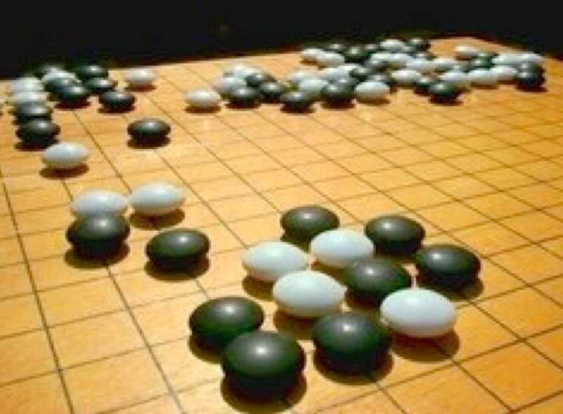
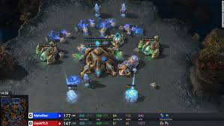
Initial Successes: Games

Slide 4
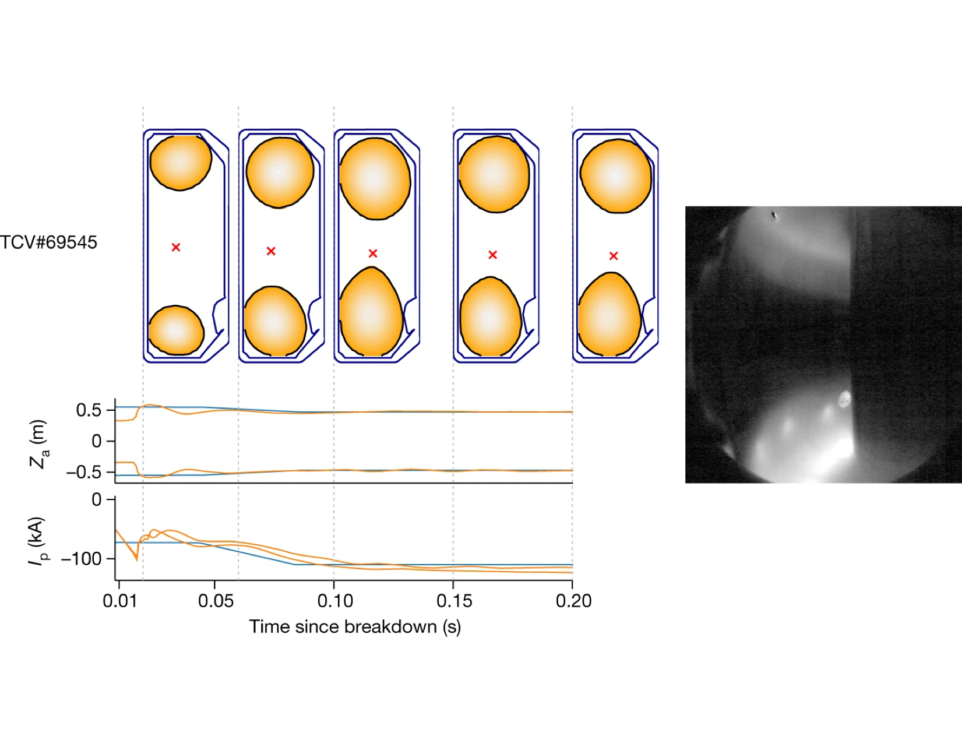
Recent Successes: Complex Control Tasks
Bellemare et al, Nature, 2020
Degrave et al, Nature, 2022

Slide 5
Can Reinforcement Learning Help Therapeutics?
What are the observations, actions, rewards
Is there a simulator or data we can leverage?
Are there RL algorithms adequate / sufficient for the problem at hand?

Slide 6
Case Study 1
Reinforcement Learning for Precision Drug Dosing
On the challenges of using Reinforcement Learning in Precision Drug Dosing: Delay and Prolongdness of Action Effects, Sumana Basu, Marc-Andre Legaut, Adriana Romero-Soriano and Doina Precup, AAAI’2023, arXiv:2301.00512

Slide 7
Motivation

Slide 8
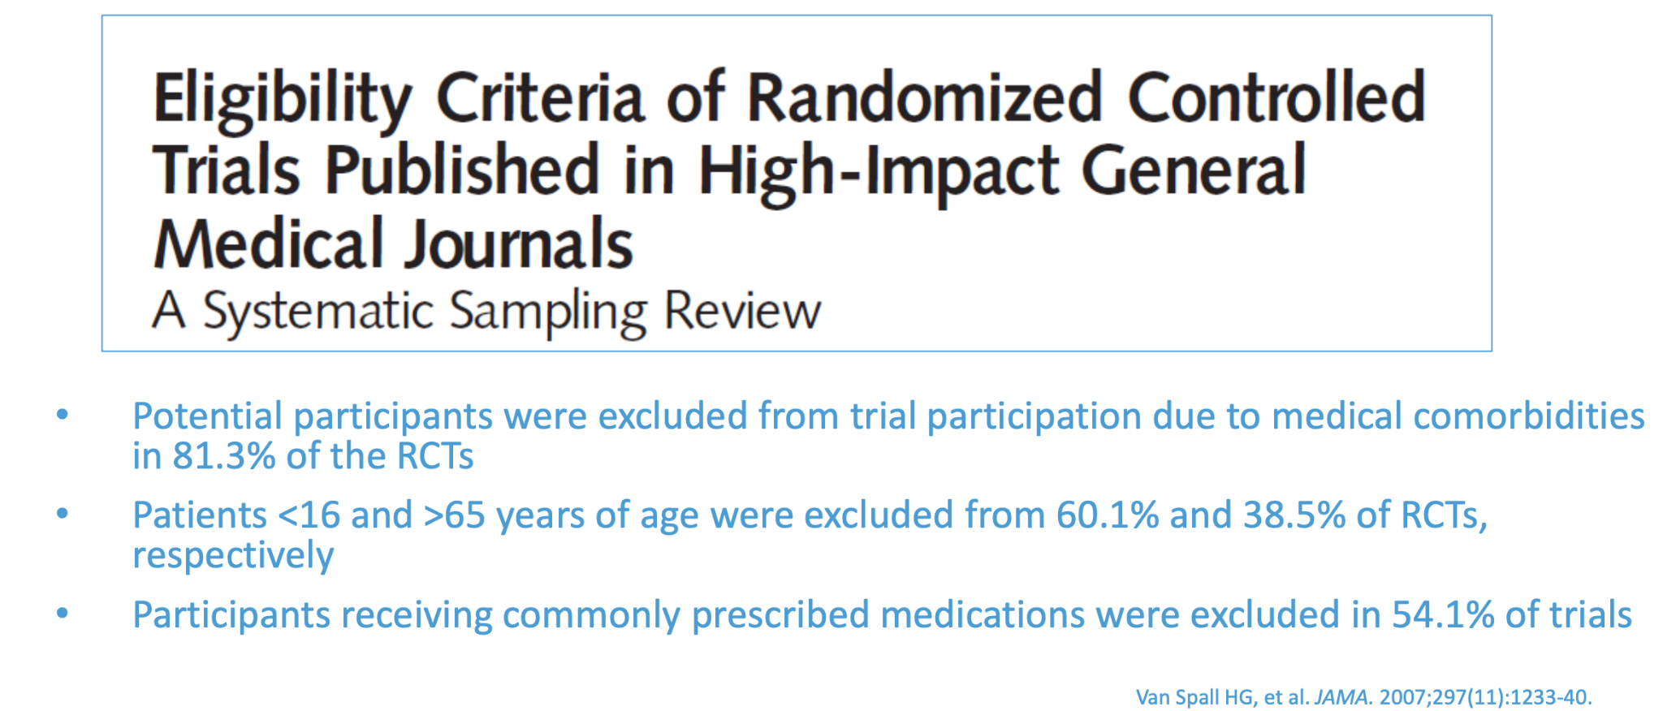
Eligibility Criteria for Clinical Trial Cohort Selection
https://www.fda.gov/drugs/precision-dosing-defining-need-and-approaches-deliver-individualized-drug-dosing-real-world-setting

Slide 9
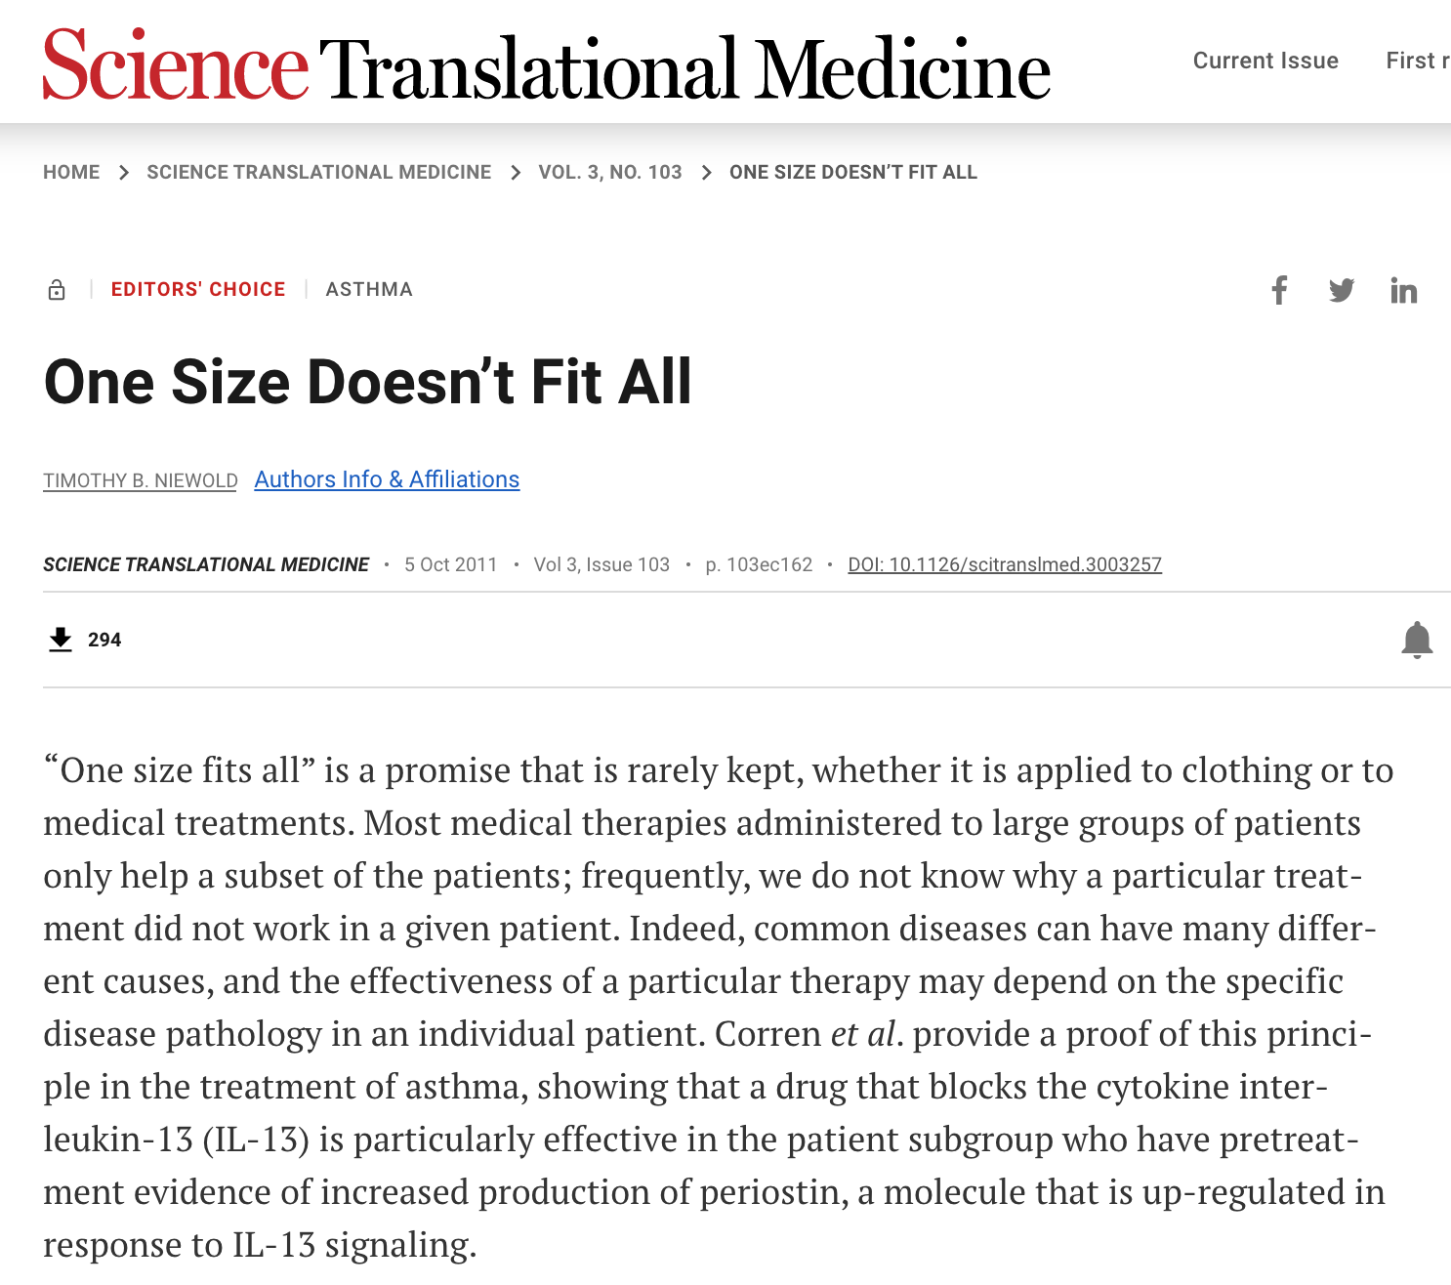
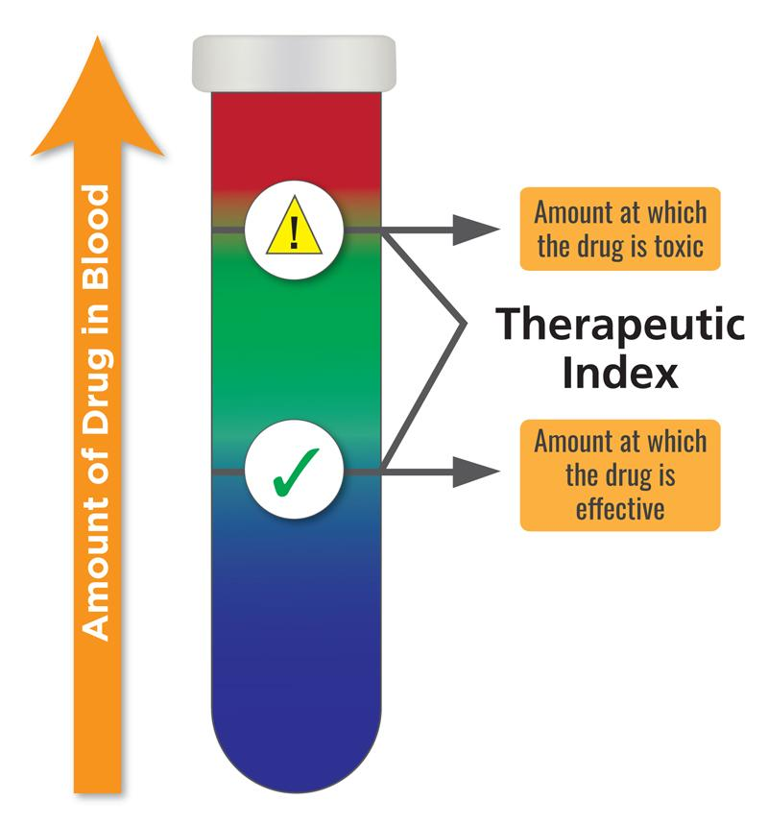
Effects of sub-optimal dosing
Notes:
Image 1: Do you remember any such case where a specific treatment did not work for you, while it works for most of the population?
When it comes to drug dosing, one size does not fit all. Image 2: Did you know women are often overmedicated, because most of the drug dosing trials are done on men?
Omission of certain population in drug dosing trials can lead to overdosing.
Image 3: Optimal drug dosing is crucial for drugs with low therapeutic index, where even a small overdosing can lead to toxicity. Image 4: Precision drug dosing can be formulated as a Reinforcement Learning problem, where every individual is considered as an environment. The RL agent learns the optimal dosing strategy for the patient by interacting with them.

Slide 10
What is Precision Drug Dosing?
Precision dosing is individually tailoring the dose of a drug to ensure the greatest benefit and least risk for each patient.
Can we use reinforcement learning for precision dosing?
Observations: relevant test results (eg diabetes: sugar level, food)
Actions: various doses
Reward: ??
Precision Dosing: An Industry Perspective. Richard W. Peck

Slide 11
Challenge: Action Effects are Delayed and Prolonged!
PAE-POMDP
Introduce Prolonged Action Effect POMDP
Decay Assumption
Inspired by the pharmacology literature
On the Challenges of using Reinforcement Learning in Precision Drug Dosing: Delay and Prolongedness of Action Effects, AAAI’2023
Notes:
Image:
Let's think about the time we popped a pill or took an injection.
Once a dose is administered, there’s a delay period during which the drug won’t have any effect at all. Once the dose starts taking effect, it stays active for a while, before losing effect altogether. We call this prolongedness. Both delay and prolongedness are drug as well as individual specific. In this paper, we identify delay and prolongedness as fundamental roadblock for using RL in precision drug dosing. Why?
Point 1:
Reinforcement Learning uses the formal framework of Markov Decision Process (MDP), or more generally the Partially Observable Markov Decision Process, the foundation of which is the Markov assumption. The Markov assumption states that the future is independent of the past given the present. In the drug dosing context, that means only the most recent dose will be effective, while the previous doses will have no effect on the patient. But that's not true, unless we know exactly when a dose completely wears off for a patient, which is a very difficult information to have at an individual level.
Formally, we now know that the Markov transition dynamics P(s_{t+1}|s_t, a_t) is not valid. Instead, the next state is conditioned on not just the current state, but a sequence of past actions. Not all of them, but some of them.
Point2:
We introduce Prolonged action effect POMDP, a subclass of POMDPs where the transition dynamics are conditioned on past actions. Why are we introducing a new name? Because all drug dosing problems fall under this category.
Point 3:
Now the most intuitive way to solve a PAE-POMDP is to use a recurrent net on the past actions. But are there any alternative solution that exploits the knowledge of how drugs work? Inspired by pharmacology literature, we assume that the past actions will decay exponentially. Using this assumption we can keep track of the effective action at any given time. Augmenting the states with the effective action converts the PAE-POMDP back to an MDP. There onwards, we can use any existing RL algorithm.

Slide 12
Modelling delayed action effects
Effective action impact:
Augment the observation with the effective action

Slide 13
Illustration: Glucose Control
Observation: continuous blood glucose readings from 70 mg/dL and 200 mg/dL
Action: discretized insulin doses (0, 5)
Reward:

Slide 14
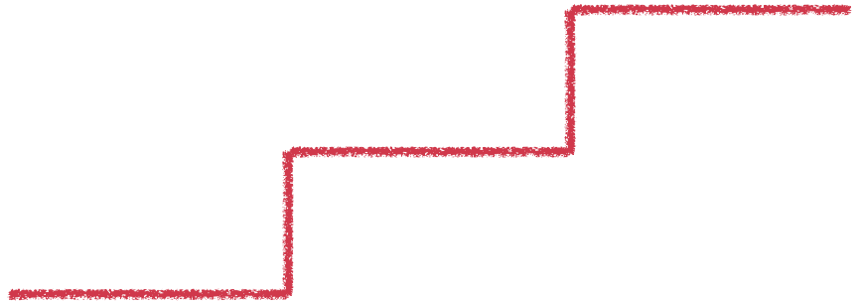
Methods
Fixed Dose - Thresholded policy
DQN - Deep Q Network
input: s_{t}
ADRQN¹ - Action-specific Deep Recurrent Q Network
input: action-observation pairs
<(a₀, s₁), (a₁, s₂), …, (a_{t-1}, s_{t})>
Effective-DQN
input: (s_{t}, a_{t𝝐})
1On Improving Deep Reinforcement Learning for POMDPs
Notes:
Actions are encoded via a fully connected layer and coupled with their associated observations to form action-observation pairs.
The time series of action-observation pairs is processed by an LSTM layer that learns latent states based on which a fully connected layer computes Q-values as in conventional DQNs

Slide 15
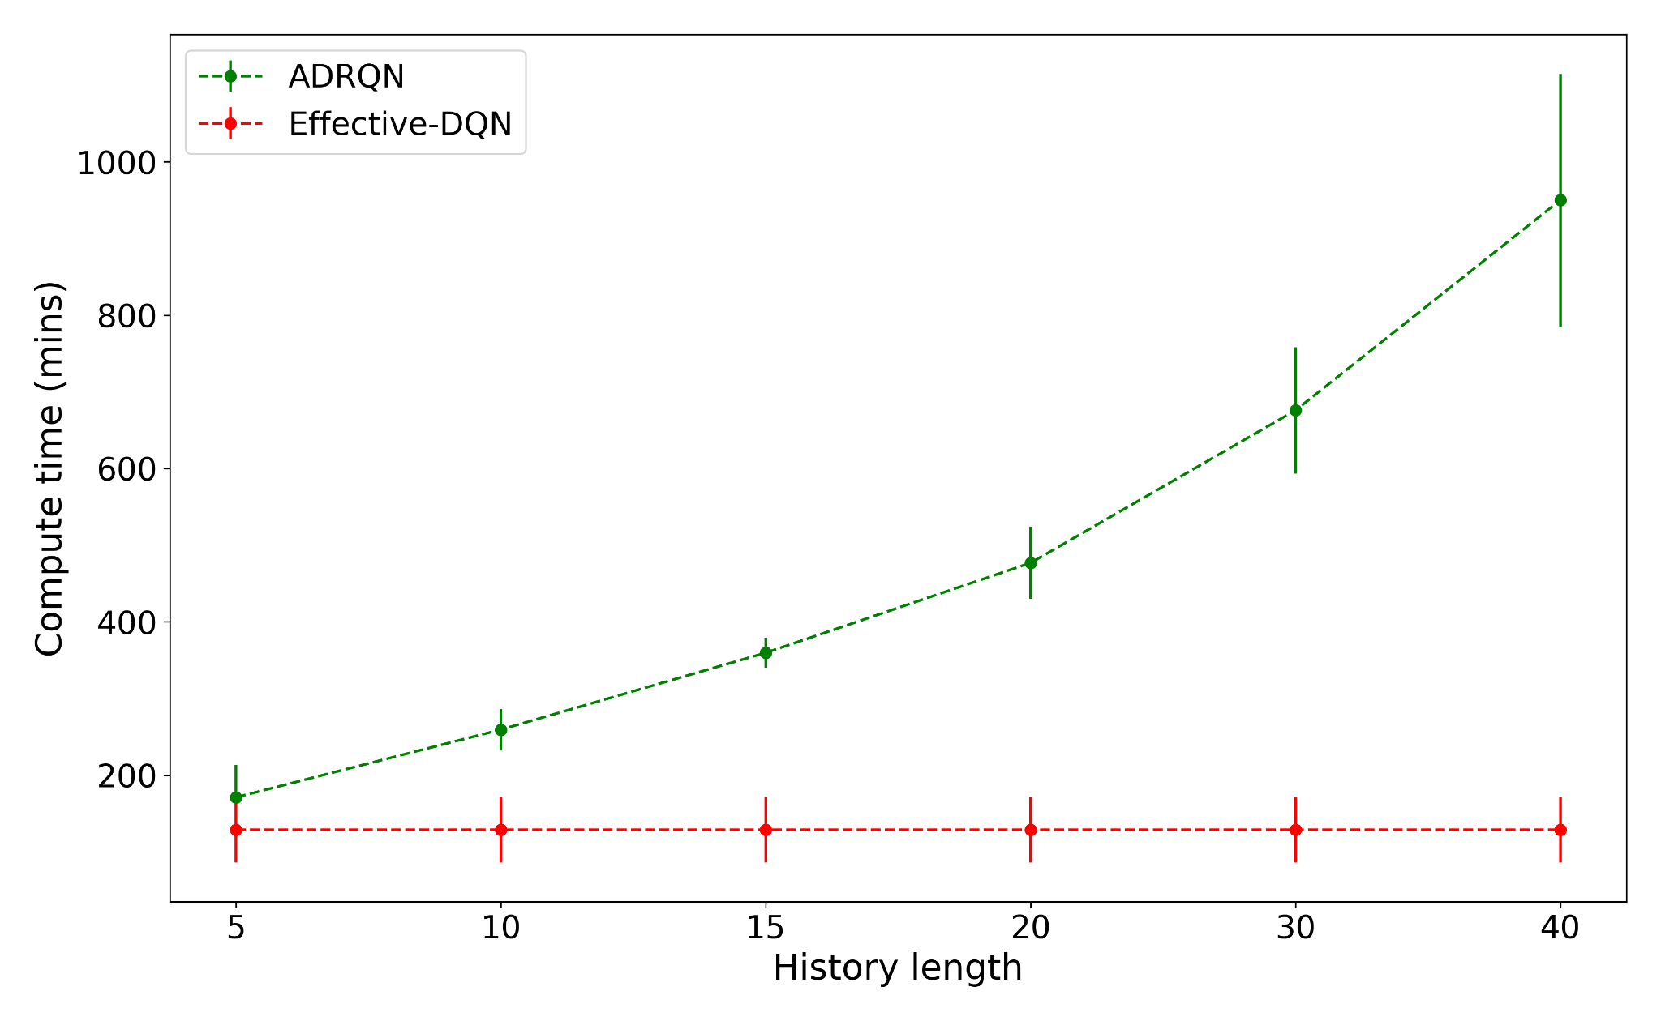
Insulin treatment: Good performance, reduced cost
Computational cost
Notes:
We validate the proposed approach on a toy environment and a glucose control environment. For the glucose control environment, we designed a clinically motivated reward function that inherently avoids overdosing.
For both the tasks, on comparing performance, i.e. discounted return, the proposed method outperforms the Q learning baseline.
On the glucose control task, it even outperforms a threshold based fixed dose policy and an action history based recurrent ADRQN policy.
Since real time control systems are limited by memory and are time sensitive, we compare the memory and compute requirement of ADRQN and our Effective-DQN. For our method, the memory and compute is independent of the history length. While, for ADRQN they increase linearly and exponentially with the history length. This makes our agent more suitable for real-time dosing control systems.

Slide 16
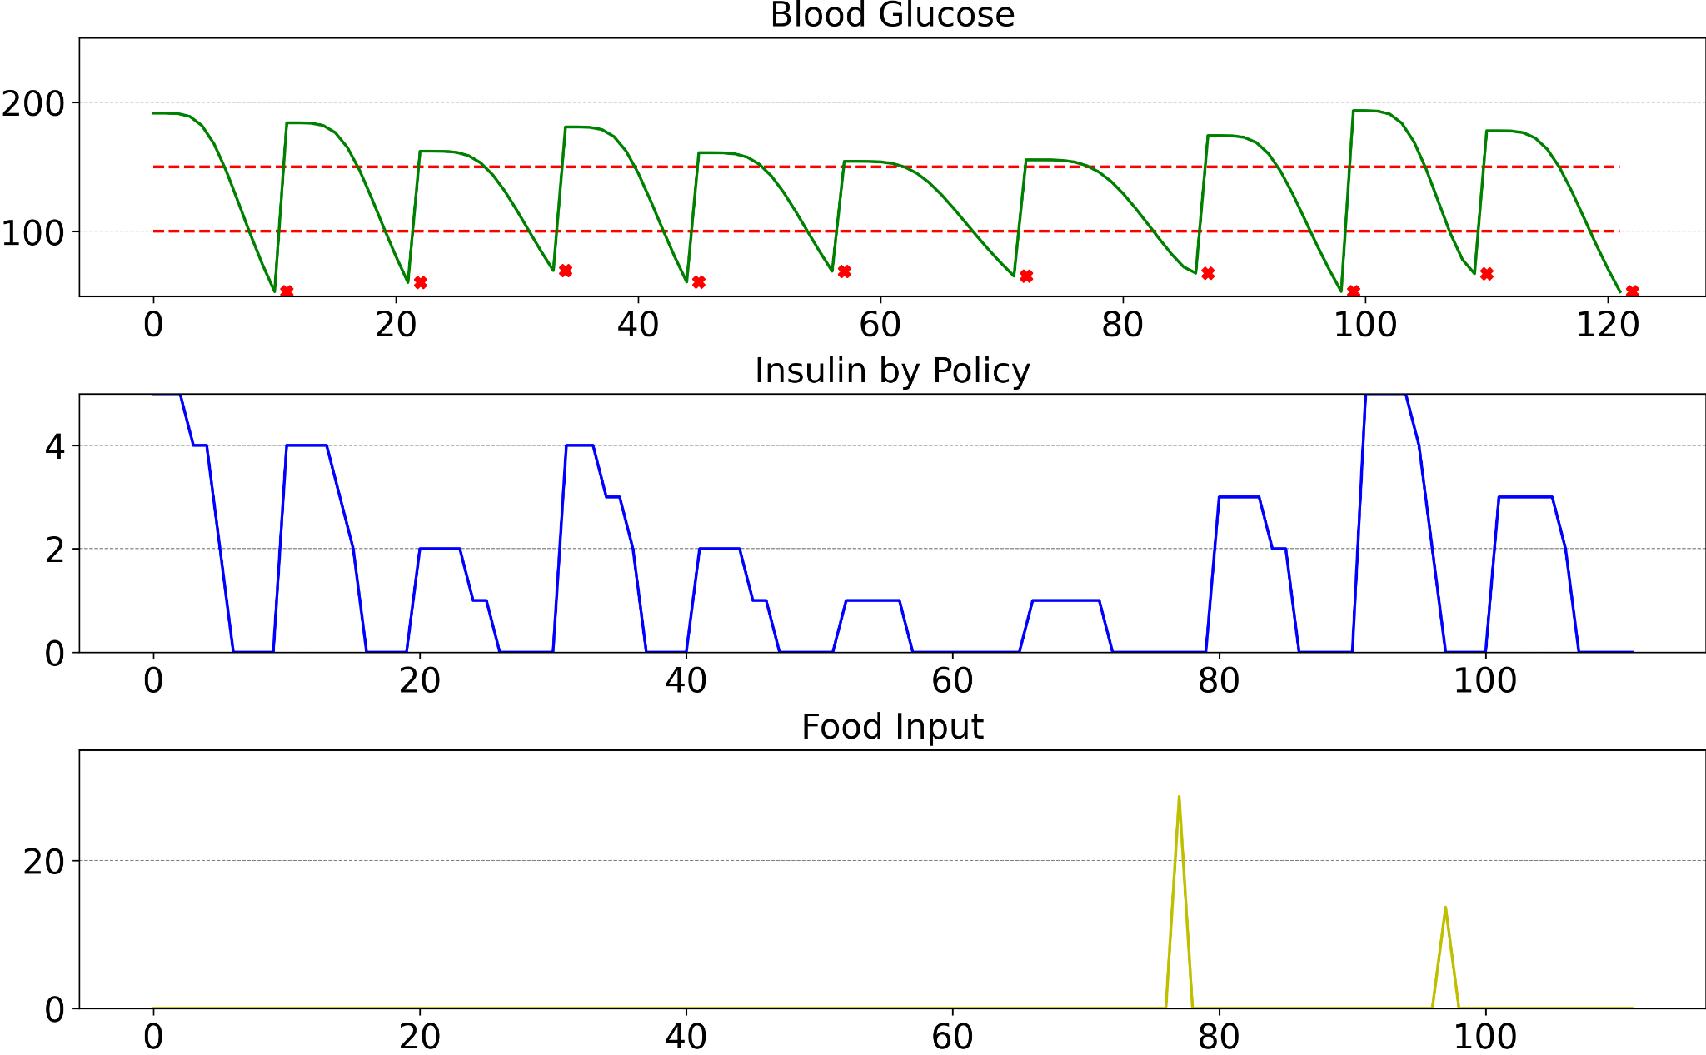
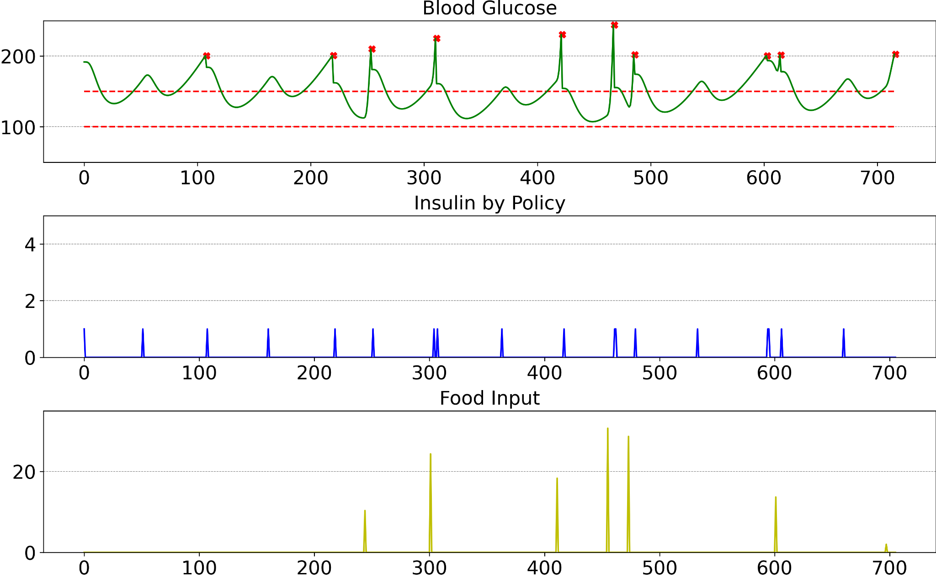
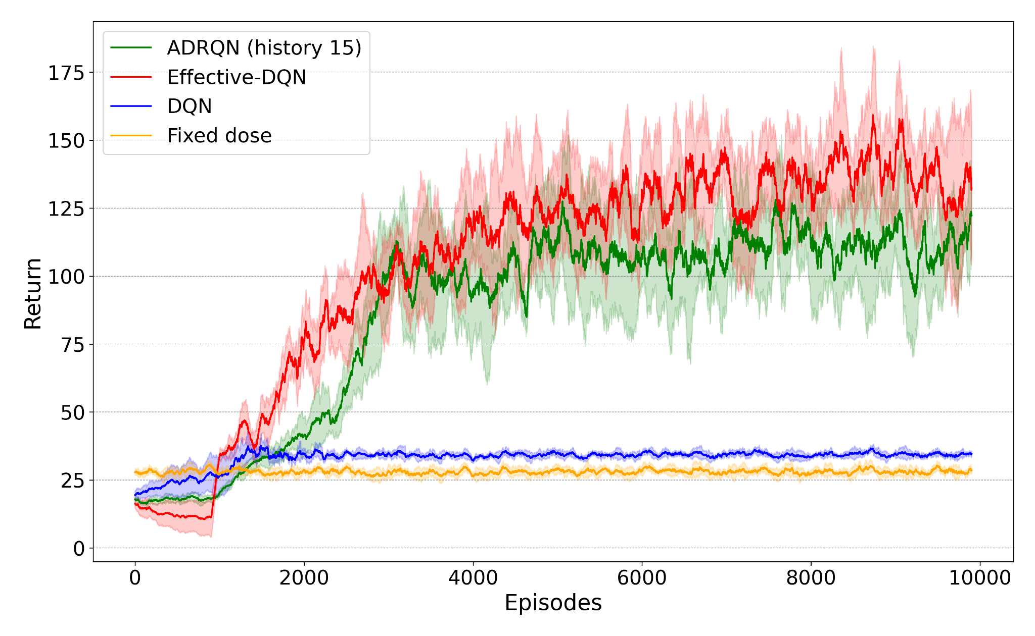
Results: Less aggressive treatment, less overdose
Fixed
Effective DQN
Performance
Notes:
Finally, we analyze the behavior of different policies. We compare them on 10 episodes, where the starting state and food schedule are kept same across the agents.
The fixed policy administers the same dose given the same blood glucose level, so all the episodes terminate in hypoglycemia i.e. low blood glucose, due to the prolonged effect of the doses injected at higher glucose levels.
The DQN agent learns not administering any dose will incur penalty. Without the knowledge of prolonged action effect, it thinks higher doses are bad too. So, it chooses a middle ground and sticks to a steady low dose.
The ADRQN has access to insulin history, so injects insulin sparingly. But it administers bursts of doses around food intake to handle the sudden glucose level increase. This leads to quick episode termination due to hypoglycemia right after food consumption.
Effective-DQN agent has information about the residual insulin in the blood from previous doses and hence learns when not to administer further doses. It also chooses to administer insulin around food intake, when blood glucose spikes, but the dose magnitude remains small. As a result, it never ended an episode due to hypoglycemia

Slide 17
Conclusions and Opportunities
RL can provide effective learning of precision dosing policies
Reward design is crucial
Incorporating specifics of drug dynamics is useful
Sample efficiency of RL needs to be improved
Using a better simulator would be useful
Need better ways to evaluate!

Slide 18
Case Study 2
Reinforcement Learning for Drug Discovery
Emmanuel Bengio’s blog (NeurIPS paper): https://folinoid.com/w/gflownet/
GFlowNet Foundations, Yoshua Bengio, Tristan Deleu, Edward J. Hu, Salem Lahlou, Mo Tiwari, Emmanuel Bengio, arXiv:2111.09266, JMLR, 2023.
Biological Sequence Design with GFlowNets, Moksh Jain, Emmanuel Bengio, Alex Hernandez-Garcia, Jarrid Rector-Brooks, Bonaventure Dossou, Chanakya Ekbote, Jie Fu, Tianyu Zhang, Michael Kilgour, Dinghuai Zhang, Lena Simine, Payel Das, Yoshua Bengio, In submission

Slide 19
Drug Discovery as Reinforcement Learning Problem
“empty molecule”
Build molecules block by block
Episodes end with terminal R > 0
(no intermediate rewards)

Slide 20
Just apply Reinforcement Learning?
We have an environment (actions = build molecule)
We have a (noisy, learned) reward
RL! (Segler et al., 2017; De Cao & Kipf, 2018; Popova et al., 2019; Gottipati et al., 2020; Angermueller et al., 2020)
But RL greedily looks for one mode, even when we encourage entropy! Not great for diverse batch oracle queries
Notes:
So, we have an MDP, and we could simply apply RL. The action set is well defined, we have a reward. In fact, many papers tackle the problem of molecule generation with RL.
One problem with RL methods is that, even though they are fairly fast, they are fairly greedy, even when regularized. They usually only find a few good modes and then converge.
This isn’t great for our diversity criterion.

Slide 21
Just apply MCMC?
We have a Markov Chain (actions = edit molecule)
We have a reward = unnormalized probability, want to sample from it
MCMC! (Seff et al., 2019; Xie et al., 2020)
But MCMC is slow, gets stuck in modes easily (lack of diversity!), requires mode-mixing for any new sample
Not great for diverse batch oracle queries!
Notes:
We could also simply apply MCMC, it’s easy to build a Markov Chain out of this, we have a reward, and in fact several papers apply this method to molecule generation.
But MCMC requires a lot of sampling, and just like RL, MCMC does get stuck in good modes easily.
Again, this doesn’t seem ideal for diverse batch queries.

Slide 22
What about the usual generative models?
Trained from positive samples only (e.g. existing drugs) But we have a more informative (non-binary) signal! (reward)
We don’t just want high reward, we want to avoid low reward (and have the data)
Still possible to do well: Jin et al., 2018; Shi et al., 2020; Luo et al., 2021
Notes:
Finally, we could also use the usual generative models, but these have a weakness which we’re trying to avoid, because they usually rely on having a more binary notion of what is a positive sample (and what isn’t) to learn representations. We’d like to leverage our access to bad samples to train our models. Of course many papers succeed in this approach, but we believe we can do better.

Slide 23
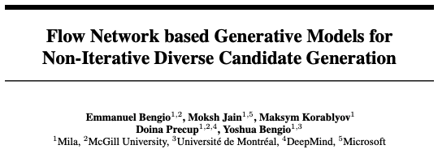
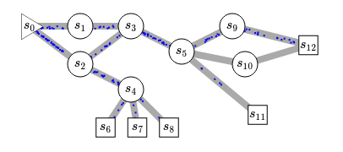
GFlowNet
Generative framework for discrete objects which have a reward (or energy).
Reward-proportional sampling!
NeurIPS 2021
Notes:
Generative flow networks provide a framework to train generative models of discrete objects for which we have a reward.
What we’d like to do is reward-proportional sampling, so we’d like to generate objects x with some probability which matches their reward. Traditionally, the only good way to achieve this properly was with monte carlo markov chain methods, but here we show how to do without. We call these generative flow networks because they’re based around learning a flow, here capital F, and here I mean a flow in the graph-theoretic sense, so think like a flow of water.
For a flow network to be valid, we know that all of the flow the enters of node, a state here s’, should be equal to all the flow that exits that node.
The cool thing we noticed was that if we’re able to correctly approximate the flow, then we get for free an iid reward proportional sampler, which is pretty cool.

Slide 24
Flow consistency
We want a valid flow, given the rewards (“#particles") of the terminal states
in flow of s’
out flow of s’
This is very similar to a Bellman Equation, the bread and butter of RL!
Notes:
Here’s one more visualization. One way to think about our method is that we’re trying to find a valid flow F, given the rewards of the terminal nodes, such that the flow in all edges is consistent. This flow kind of represents moving particles, with terminal states being sinks and the initial state being the unique source of the network.

Slide 25
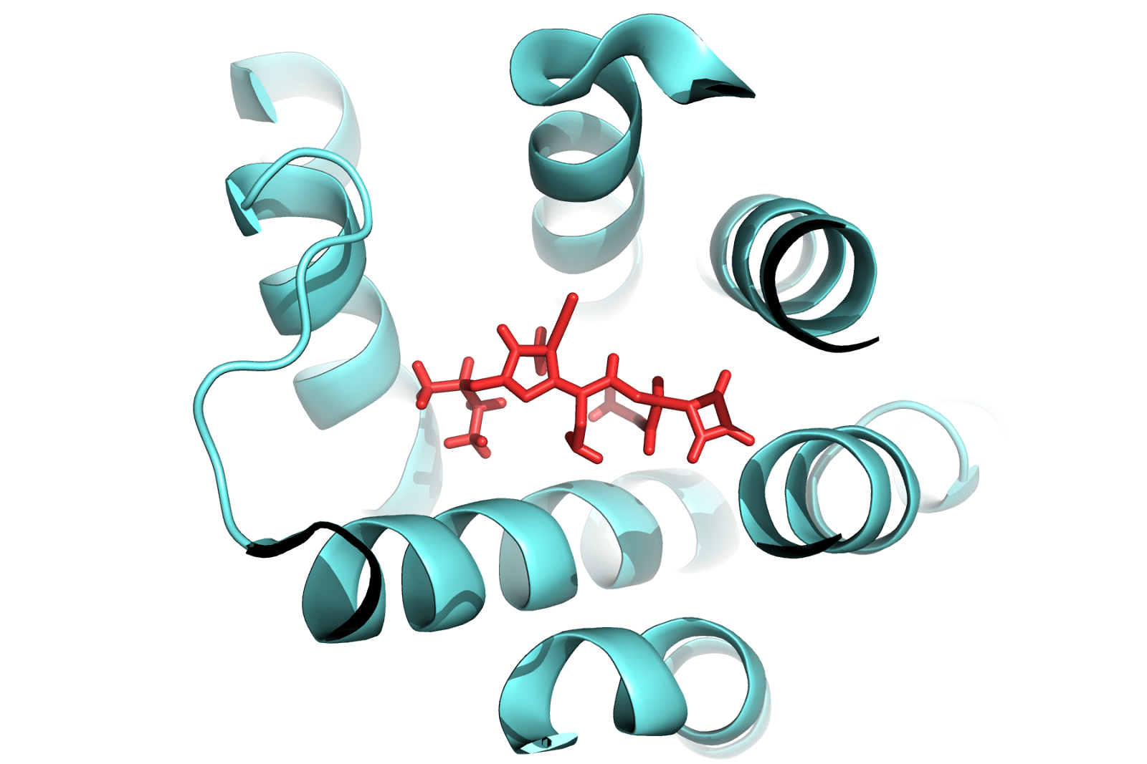
What is the reward?
Protein
Initial data {(x,y),..}
Drug
Ideal: send diverse batches (10-100k) of candidates to a lab, O(weeks)
For now: use noisy physics simulator, O(15 CPUs)/molecule
occasionally query “oracle"
generate molecule(s)
predict reward
cheaply (DNN)
compute “real” reward
growing dataset
This part is expensive and/or noisy! (w/ biased noise)
train generator
>10^{16~20} space (simplified + for one protein) most molecules are bad: - not chemically feasible - not binders - toxic Needles in a haystack!
train reward predictor
Notes:
The motivation for this project was small-molecule drug discovery. In this setup, the goal is to find small molecules which bind well to a given protein.
We start from a dataset of molecule binding-energy pairs, train a reward predictor, and then train a generator based on this proxy reward.
Occasionally, we’d like to query an oracle to improve our dataset, and for this it is ideal to have a diverse set of candidates. One way to think about it is that we want to maximize the odds of having a viable candidate, but because the reward is very noisy we can’t trust one single mode, so we have to be diverse.

Slide 26
How to train GFlowNet
Instead, learn the log, and match flows in log-space
with an epsilon (care less about tiny flows)
Notes:
Instead, we train a neural network to predict the log of the flow, and move the loss to be in log space. That way, optimization will be just as important for large flows and small flows, although we do add an epsilon to lower bound this. If flows are smaller than epsilon, then the loss will be smaller as well and less capacity will be spent on that part of the state space.

Slide 27
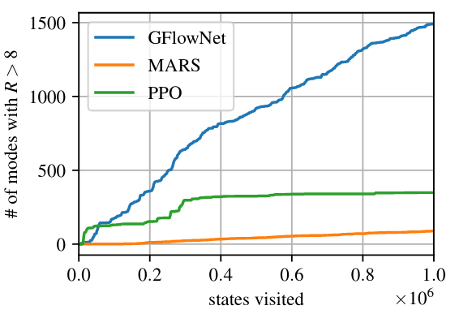
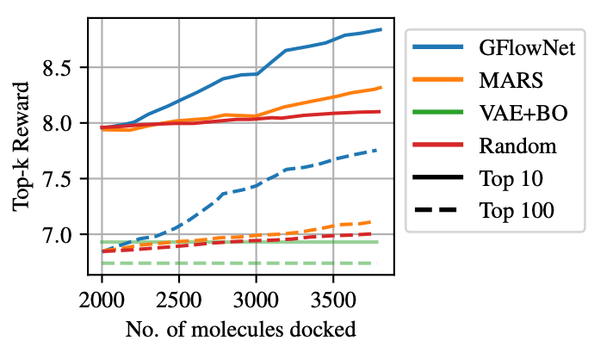
Works well - both with pre-training and active learning
Pre-train reward function once on 300k molecules (computed on CPU simulator)
Modes are found faster, with better rewards
Modes = Bemis-Murcko scaffolds
Active
Notes:
Then we show that on a molecule generation domain, GFlowNet finds better and more diverse molecules faster. This is visible by looking at the top-k reward on the right. This is the average value of the best candidates found so far.
On the left, we count the number of modes of high-reward molecules we’ve found, and see that GFlowNet does not appear to be converging, as it keeps exploring by design.

Slide 28
Works for Batch Active Learning too!
Average return over 3 runs of the top-k candidates in an iterative batch generation approach
Notes:
What we find, both on the hypergrid task and the molecule task, is that GFlowNet generates better candidates faster, making the most out of calls to the oracle to refine its reward.

Slide 29
Conclusion and Opportunities
Generative model for discrete objects based on a reinforcement learning-like learning objective
General setup for solving black box optimization! And for black-box exploration
We obtain diverse batches with amortized computation
Can be used more broadly for causal modelling, discovering data explanations
Some learning and tweaking of reward necessary
Notes:
So to recap, we propose GFlowNet a generative model for discrete objects which samples them with probability proportional to their reward. We train this model using a Bellman-like learning objective, and find that it explores and generates diverse samples by virtue of this property. Some downsides are that some reward design appears necessary to get the right balance of exploration and exploitation. Reliance on this local TD-like update could also be an issue that leads to learning instabilities. Finally, we find that GFlowNet tends to be a bit too optimistic, giving more weight to small rewards than it should.

Slide 30
Reinforcement Learning for therapeutics
Very big, largely untapped potential!
Reward design is crucial
Need to consider specifics of the problem
Sample efficiency of RL needs to be improved
Great opportunity to improve existing algorithms!

