Slide 1

Time to Get Savvy About AI
Why a different approach is needed to monetize the value of generative AI capabilities

Slide 2

3 things to takeaway from this session...
Dream big and be resilient
Pursue value every time
Focus on scalable solutions and services
AtkinsRéalis
2
AtkinsRéalis
2

Slide 3

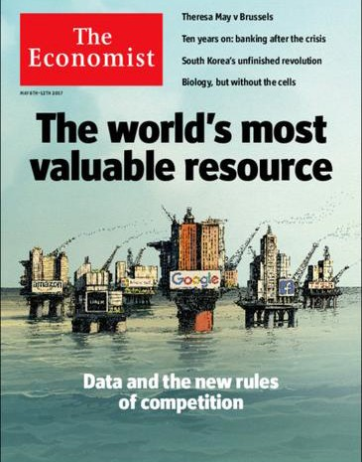
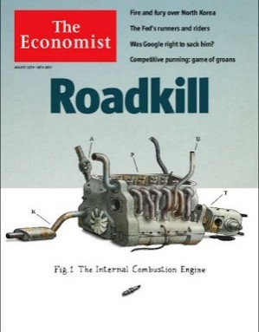
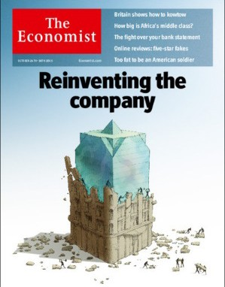
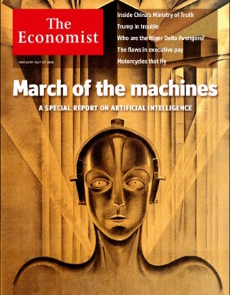
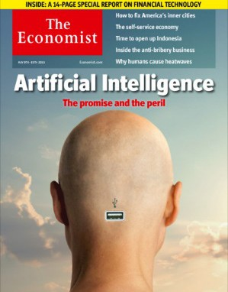

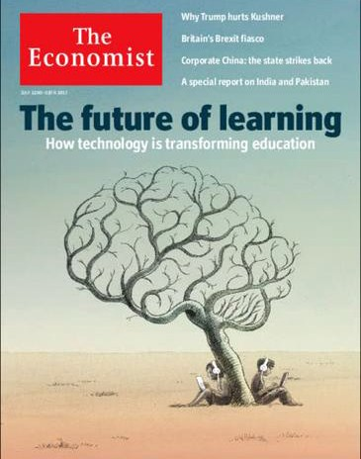
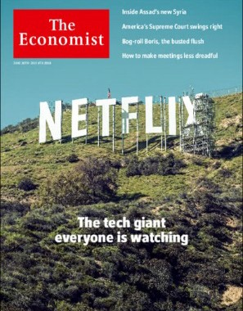
Times are changing...
3
AtkinsRéalis

Slide 4










4
AtkinsRéalis
Notes:
For AI Summit only
AI therapy apps: mindspa / Wysa / Youper
(add details on the apps in notes)
AI doctors: Ada

Slide 5
Architecture
Engineering
Construction
$17.5 TRILLION
Notes:
What is the AEC industry:​
​
Size: In 2030 the market will be worth $17.5 trillion per annum (Construction 2030 by Ciob & Ocford Economics, 2015).​
Role in society: building thriving communities, urbanization, net zero, infrastructure, engineering a better future for our planet and its people!​
​
​
NB: https://www.mckinsey.com/capabilities/operations/our-insights/imagining-constructions-digital-future​
​

Slide 6






But
Labour productivity
Index 100 = 1995
130
Other industries
Contracting models
120
Fragmented
industry​
110
Construction
100
Mindsets
0
1995
2014
McKinsey 2016 report
6
AtkinsRéalis
Notes:
But there are big challenges in industry
- Industry has been historically one of the slowest to digitize and innovate (see famous and oft-quoted hunting and fishing McKinsey report!)
- Construction sites in 2023 might in many ways resemble those in 1923, with manual bricklaying, paper blueprints, and scaffold towers
Challenges around:
- Contracts and commercials (risks and rewards + low margins for contractors)
- Fragmented industry (that includes different approaches , different data standards etc.)
- Mindset- accountability, heads buried in sand, limited visions
Update with graph from hunting and fishing report (McKinsey)

Slide 7

Exhibit 3 - The construction industry is among the least digitized
McKinsey Global Institute industry digitization index; 2016
Overall digitization* | Digital spending | Digital asset stock | Transactions | Interactions | Business processes | Market making | Digital spending on workers | Digital capital deepening | Digitization of work
Sector
ICT**
Media
Professional services Finance and insurance Wholesale trade Advanced manufacturing Oil and gas
Utilities
Chemicals and pharmaceuticals Basic goods manufacturing Mining
Real estate
Transportation and warehousing Education
Retail trade
Entertainment and recreation Personal and local services Government
Healthcare Hospitality
Construction
Agriculture and hunting
Relatively low
digitization
Relatively high
digitization
Digital leaders within relatively undigitized sectors
*- Based on a set of metrics to assess digitization of assets (8 metrics), usage (11 metrics), and labor (8 metrics). ** Information and communications technology.
Source: AppBrain; Bluewolf; Computer Economics; eMarketer; Gartner; IDC Research; LiveChat; US Bureau of Economic Analysis; US Bureau of Labor Statistics; US Census Bureau; McKinsey Global Institute analysis
McKinssey & Company
7
AtkinsRéalis
Notes:
As of 2016 report: NB: https://www.mckinsey.com/capabilities/operations/our-insights/imagining-constructions-digital-future​

Slide 8
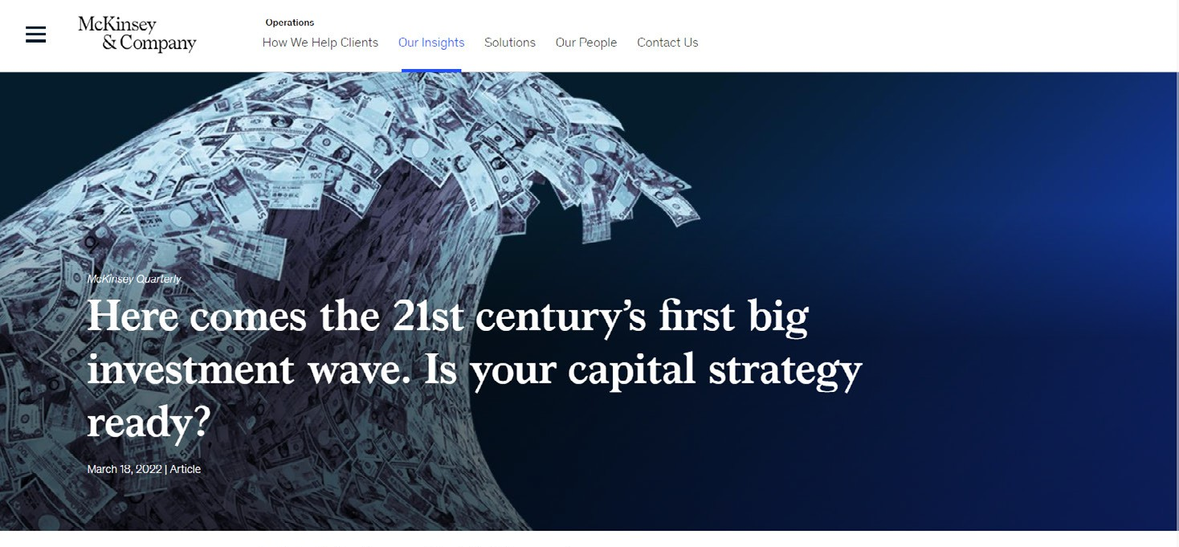
8
AtkinsRéalis
Notes:
looking forward, on current trajectory, roughly $130 trillion capital investment (McKinsey) will flood into projects to decarbonize and renew critical infrastructure by the end of 2027
Here comes the 21st century’s first big investment wave. Is your capital strategy ready?
A surge of investment in hard assets will pressure already strained supply chains. CEOs who can transform their capital strategy may find a competitive edge.

Slide 9

Global investment in architecture, engineering and construction tech grew to $50 billion between 2020 and 2022
Global deals in AEC tech
Funding, $ billion
50
Number of deals
1,229
85%
944
30%
27
2017-19
2020-22
2017-19
2020-22
McKinssey & Company
9
AtkinsRéalis
Notes:
An estimated $50 billion was invested in AEC tech between 2020 to 2022, 85 percent higher During the same period, the number of deals in the industry increased 30 percent to 1,229 (Exhibit 1).
Accelerating growth in construction technology | McKinsey

Slide 10




?
So how do we get
from here to here?
10
AtkinsRéalis

Slide 11




How AI will revolutionize the way we deliver
Generate
Automate
Optimize
11
AtkinsRéalis
Notes:
AI can revolutionize the way we deliver
Out of all the new technologies, AI is at the forefront, and it has unlimited possibilities.
It can totally revolutionize how we operate as organisations and how we deliver projects and value for our clients.
Generate
Easily generate concept designs for new buildings
Automate
Identify high-value or at risk projects, allocate resources etc. (alt. automate plants)
Optimize
Project Management Tasks to Be Eliminated as AI Takes Over | Gartner
Tech consultancy Gartner predicts 80% of project management tasks will be completed by AI by 2030

Slide 12


Low and slow
vs
Fast and frivolous
12
AtkinsRéalis
Notes:
So why are so many organizations racing to create AI capability when there’s as much risk in “low and slow” adoption as there is in moving too fast and frivolous?
Everyone is either going too slow and cautious or too fast and without enough planning. We need to find a middle path.

Slide 13





Assessing Hurricane Damage
with Machine Learning
Evaluated structures
146,039
Recommended for inspection structures
30,640
Saved approximately
$10 million
13
AtkinsRéalis
Notes:
AI in action
Federal Emergency Management Agency
Overall, Atkins and FEMA evaluated 146,039 structures using the model.
Of these, only 30,640 were recommended for FEMA to inspect, cutting their inspections to approximately 1/5th of the total.
A reasonable estimate is that this reduction in inspections saved FEMA approximately $10 million in conserved resources.
As a result, FEMA was able to prioritize its efforts and direct resources to those in need quicker, helping residents rebuild their lives more efficiently.
As a result, FEMA was able to prioritize its efforts and direct resources to those in need quicker, helping residents rebuild their lives more efficiently.

Slide 14

How to apply outcome to your business?
You can spend a lot of money on tech
but is it going to solve your problem?
USA APPROACH,
Fisher Pen: “Can write in space, upside down, underwater”
Cost $1M in 1969
($13.8M today)
Notes:
$13.8M today for the pen

Slide 15

How to apply outcome to your business?
You can spend a lot of money on tech
but is it going to solve your problem?
USSR APPROACH,
Pencil: “Can write in space, upside down, underwater”
Cost in 1969 $0.00000004M
($0.55 cent in today’s money)
15
AtkinsRéalis
Notes:
~55 cent per pencil

Slide 16






AI will impact our industry in many ways
Commodity Workloads
Turning AI disruption into Shareholder Value
Focus AI on Value
Workload Exits
Commercial strategy
Governance
16
AtkinsRéalis
Notes:
Commodity Workloads
Some Traditional Time and Material (T&M) workloads will be automated in a race to the bottom
Turning AI disruption into Shareholder Value
Early adopters and scalers of proven AI technology will benefit the most
Focus AI on Value
How can we harness AI to accelerate workloads in new markets where our headcount & skills are low.
Workload Exits
We need to plan ahead and potentially exit when traditional margin sources reduce, to avoid margin dilution
Commercial strategy
Lower Price to gain market share Increasing Fixed Price Outcome based Gain Share
Governance
Bring risk-aware and ensuring we make responsible decisions powered by AI but with human oversight

Slide 17
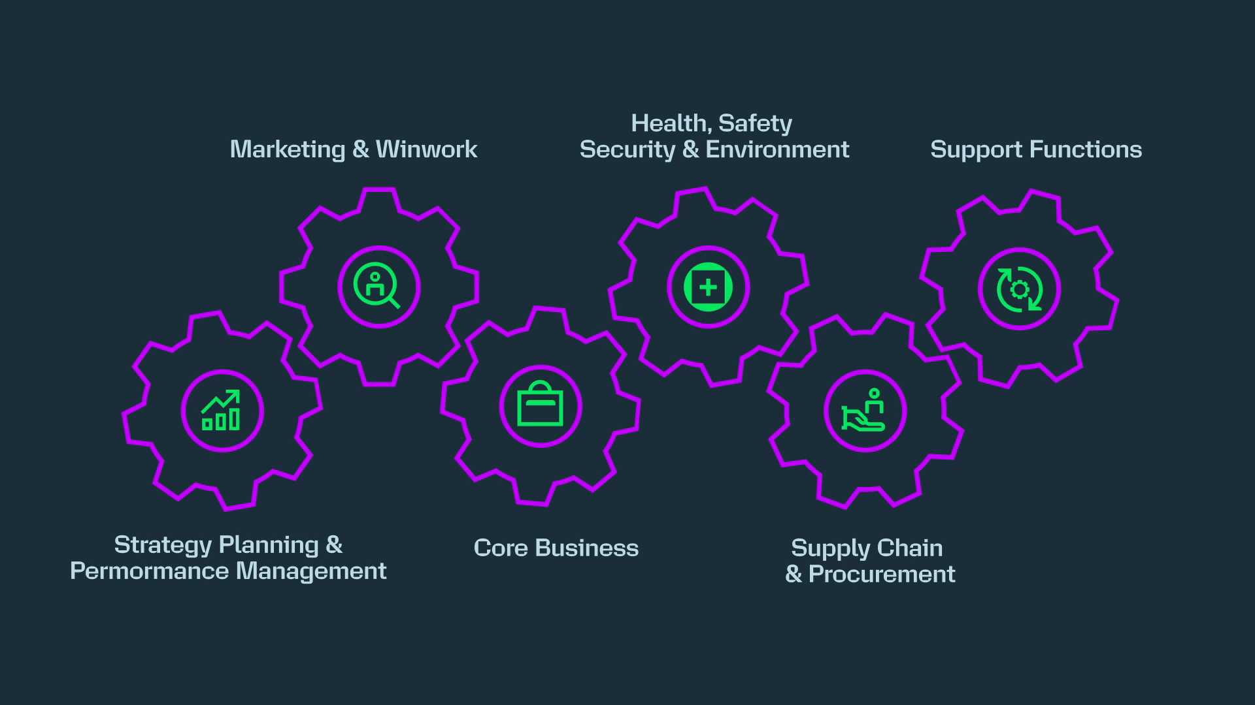
Why System approach is the answer?
17
AtkinsRéalis
Notes:
From EM podcast:
The owner isn't saying to the industry, I want you to take a long time, I'm going to pay you a lot of money and I want you to take a long time and you've really got to earn every penny. But we've got into a master slave arrangement where there are long contracts, fixed margins. And often things like open book in some government contracts and, certainly time and material type commissioning processes, that don't really allow the professionals services organisations to innovate and get rewarded at the same time.
Professional services firms—lawyers, accountants, as well as engineers—will need to find a new way to demonstrate their value. They’ll need to move away from hourly billing, towards sharing in the outcomes of their work.

Slide 18
3 things to remember for us all...
Dream big and resilient
Pursue value every time
Focus on scalable solutions and services
18
AtkinsRéalis

Slide 19


Thank you

Slide 20
Do you currently have
AI projects underway?

Slide 21
Do you have a bankable plan to translate AI technology to value in your organization?

