Slide 1
Generative models as queryable
world models
Adriana Romero Soriano
Research Scientist, FAIR, Meta AI
Adjunct professor, McGill University
Core Industry Member, Mila
Canada CIFAR AI Chair

Slide 2
Training ML models without static datasets
Query the world model
ML model 2.0
World model
Generate data to learn a new task/skill
ML model 2.0:
A recognition, representation learning, or foundation model
Is data hungry and has ability to come up with queries (active learning/acquisition) to gather data
Never stops learning – uses acquired knowledge to decide what is useful to improve its performance
World model:
A conditional generative model
Provides an infinite data source
Can be queried by steering the model to generate useful images

Slide 3
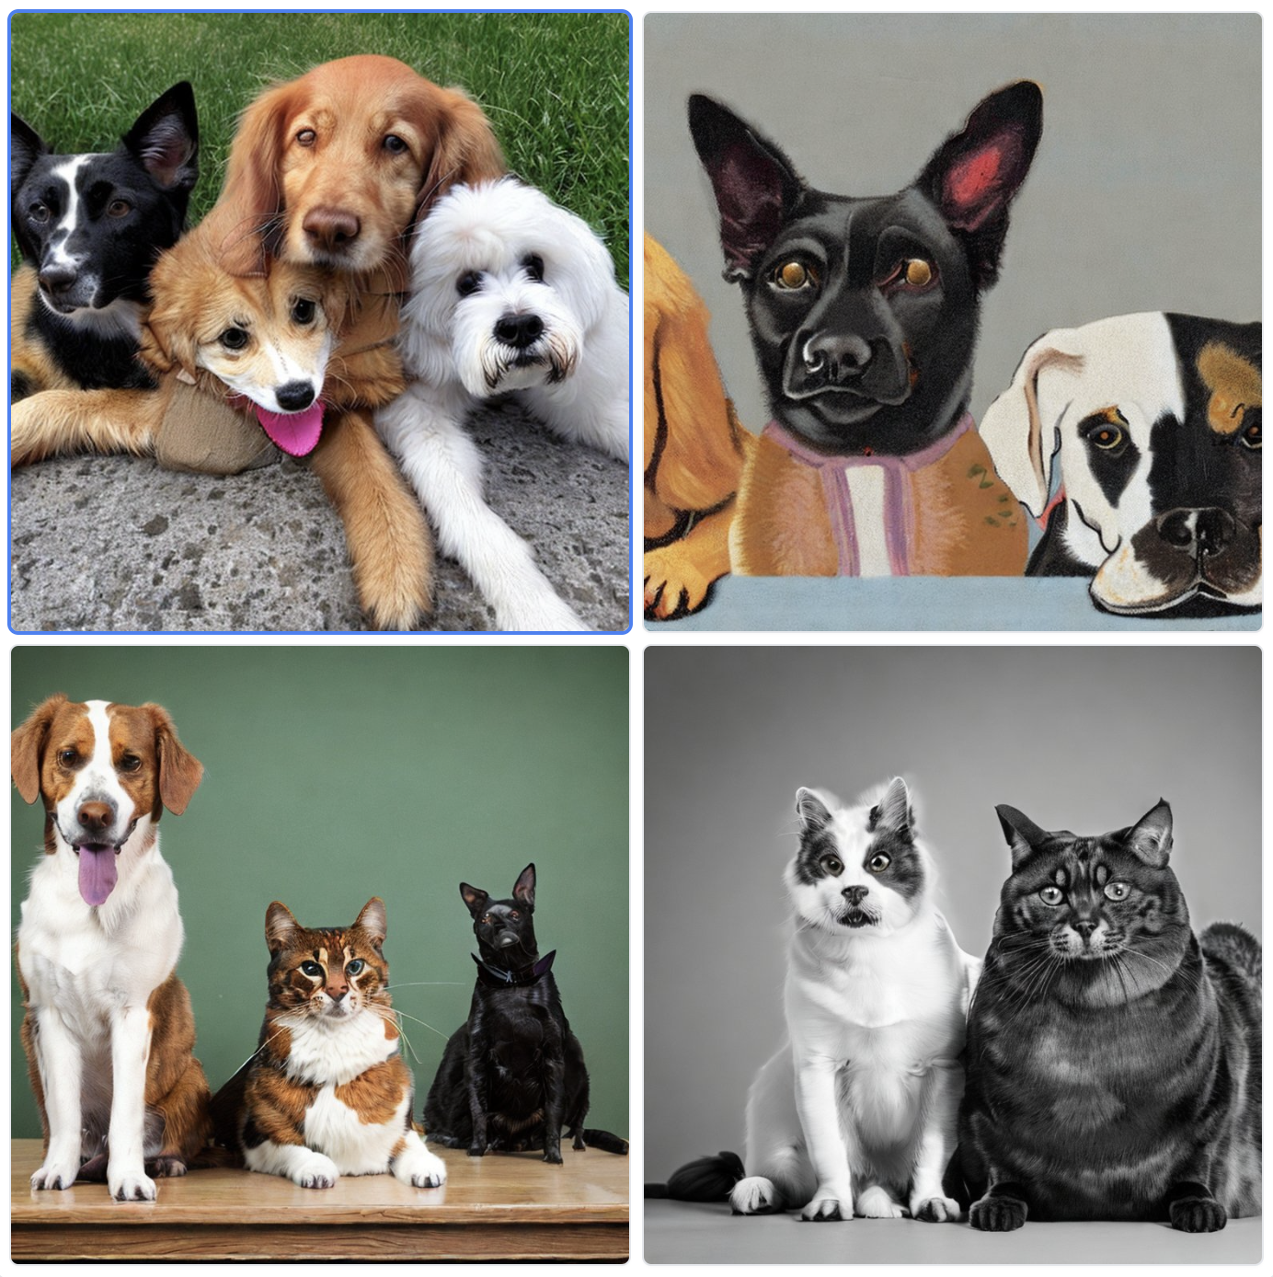
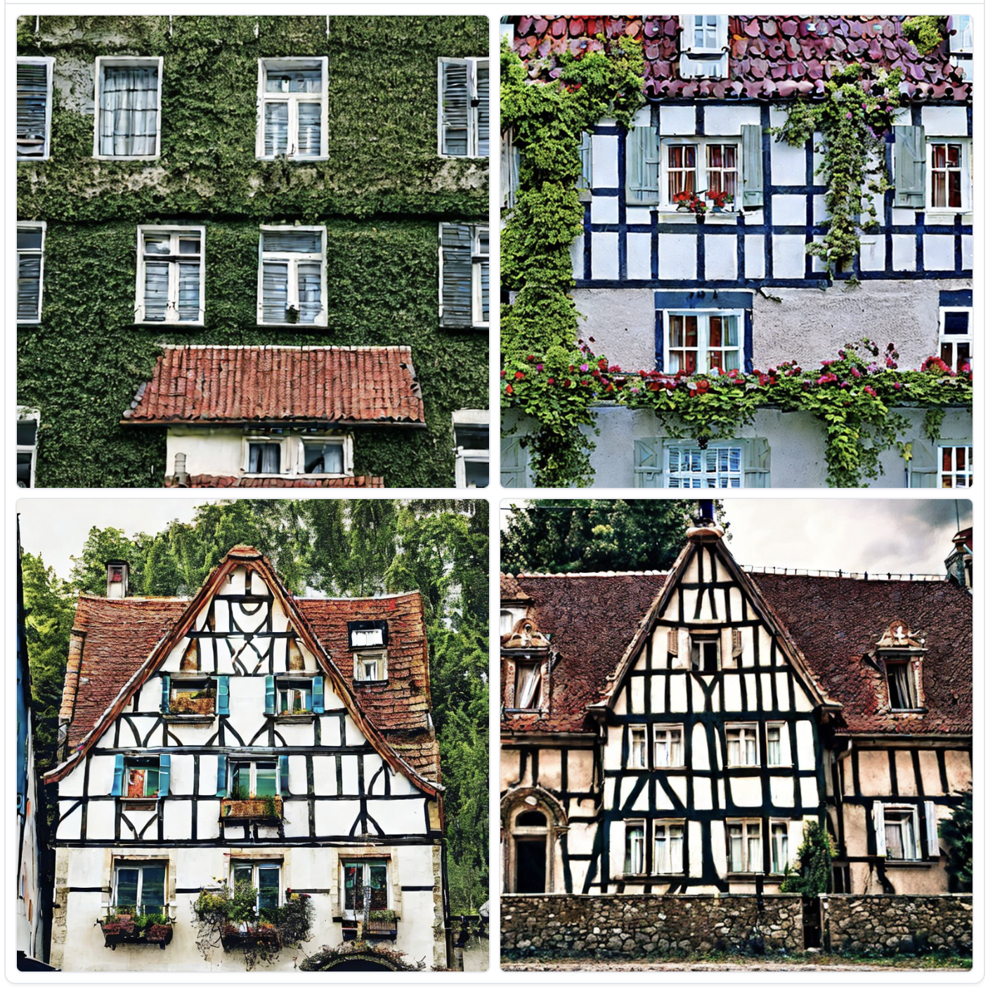
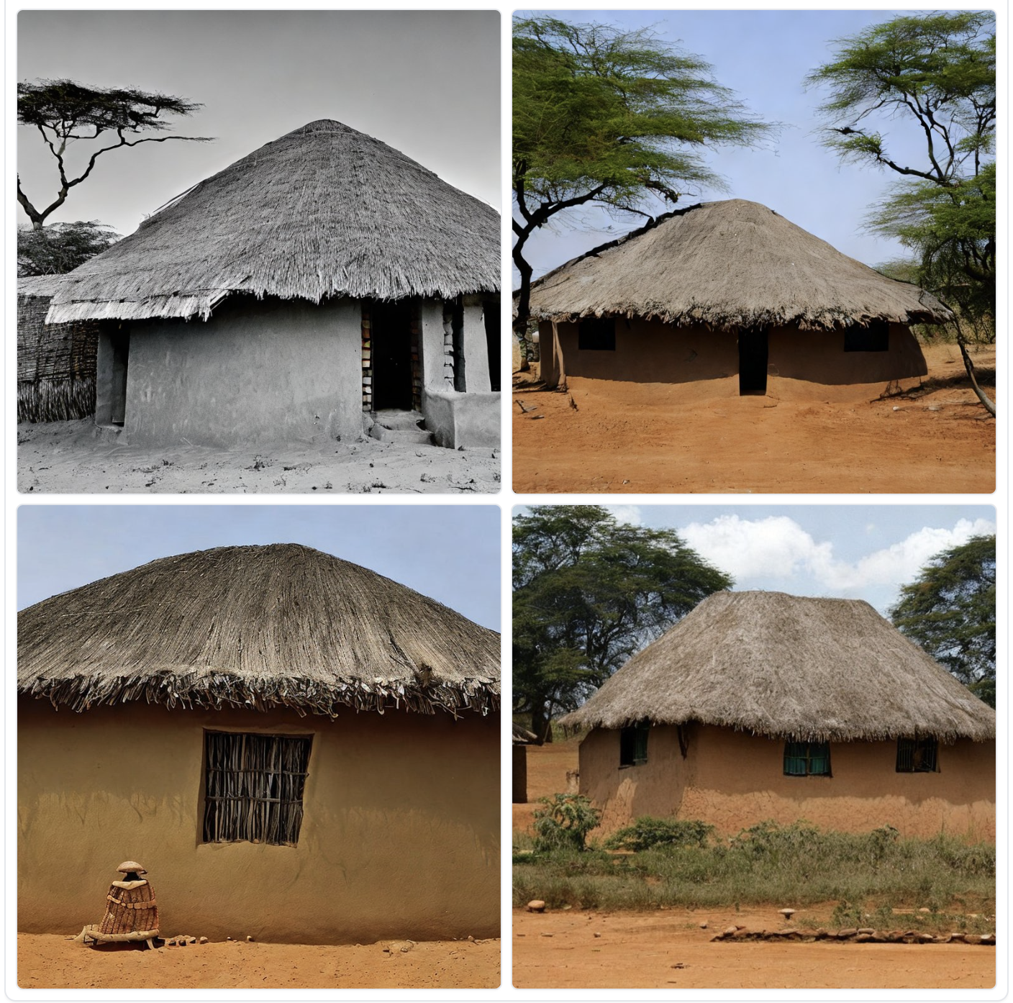
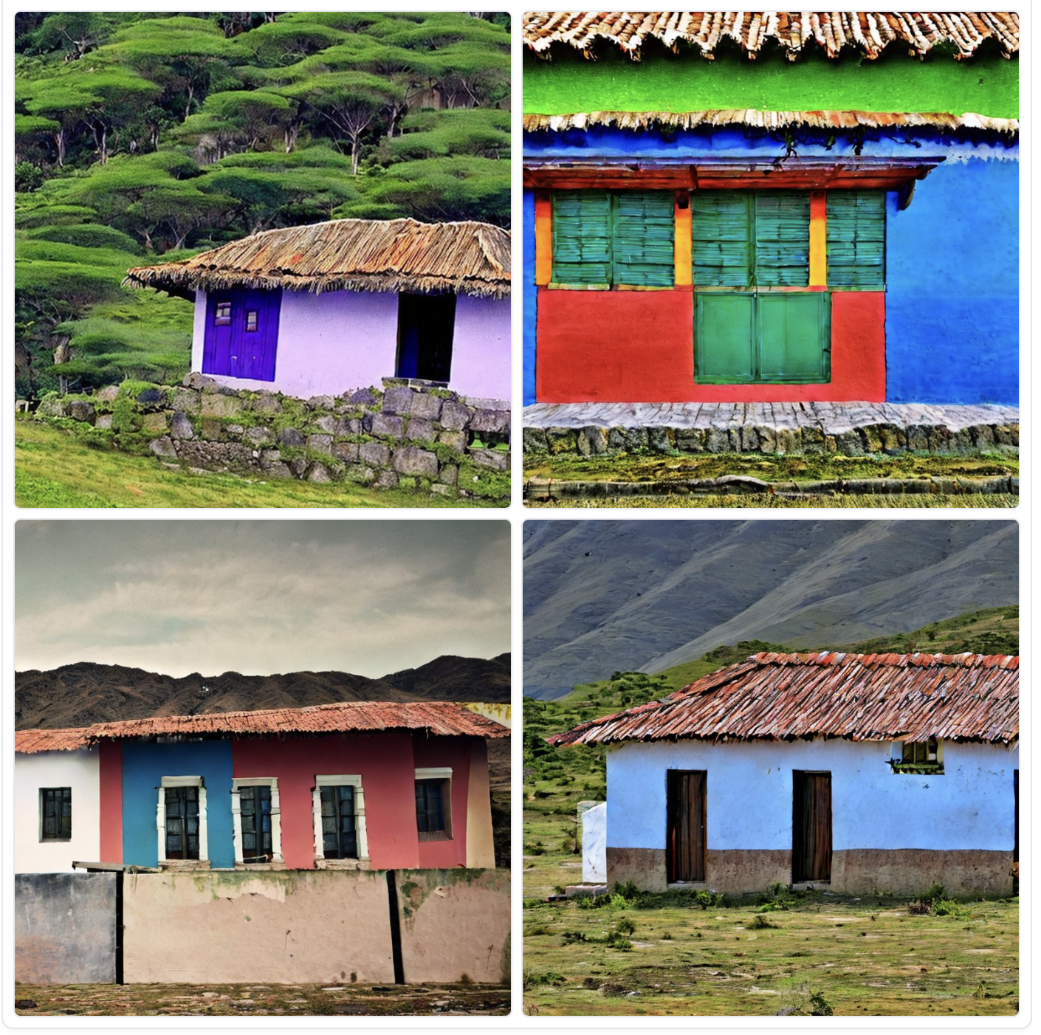
In light of the recent progress…
Yet, SOTA generative models mostly optimize for user satisfaction (mostly quality, some consistency).
Are state-of-the-art image generative models optimized to work as world models?
World models should:
Yield high quality images
Be consistent with the input conditioning
Produce diverse samples
“Two dogs and a cat”
“A house in Europe”
“A house in Africa”
“A house in South America”

Slide 4
In light of the recent progress…
Yet, SOTA generative models mostly optimize for user satisfaction (mostly quality, some consistency).
Are state-of-the-art image generative models optimized to work as world models?
World models should:
Yield high quality images
Be consistent with the input conditioning
Produce diverse samples
What’s the most effective way to query/control the generative model to produce samples that are useful for the ML model 2.0?

Slide 5
High quality, consistent, and diverse generations
→ DIG In: Evaluating geographic disparities in image generations, M. Hall et al., 2023, TMLR 2023, featured certification.

Slide 6
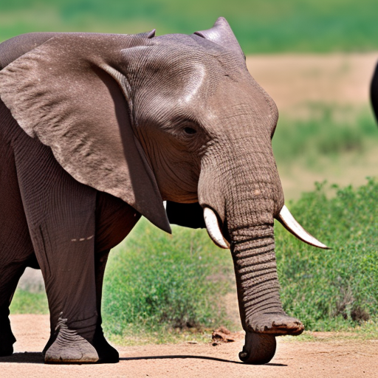
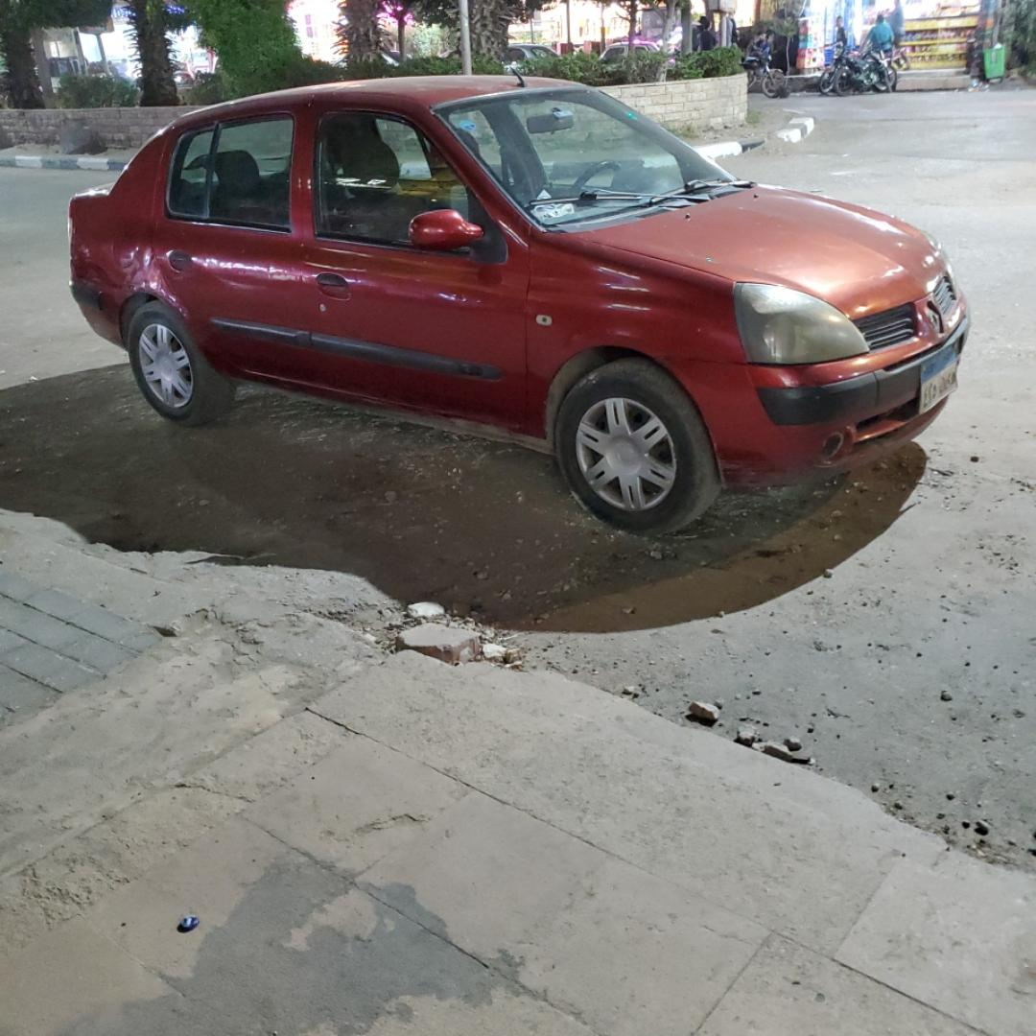
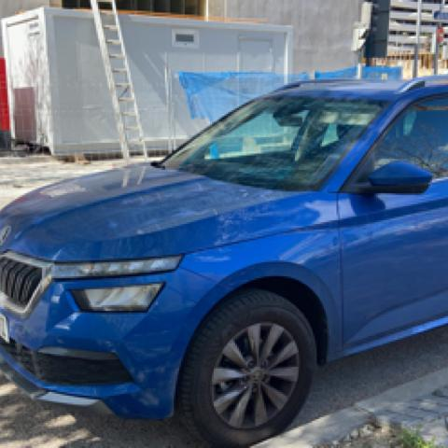
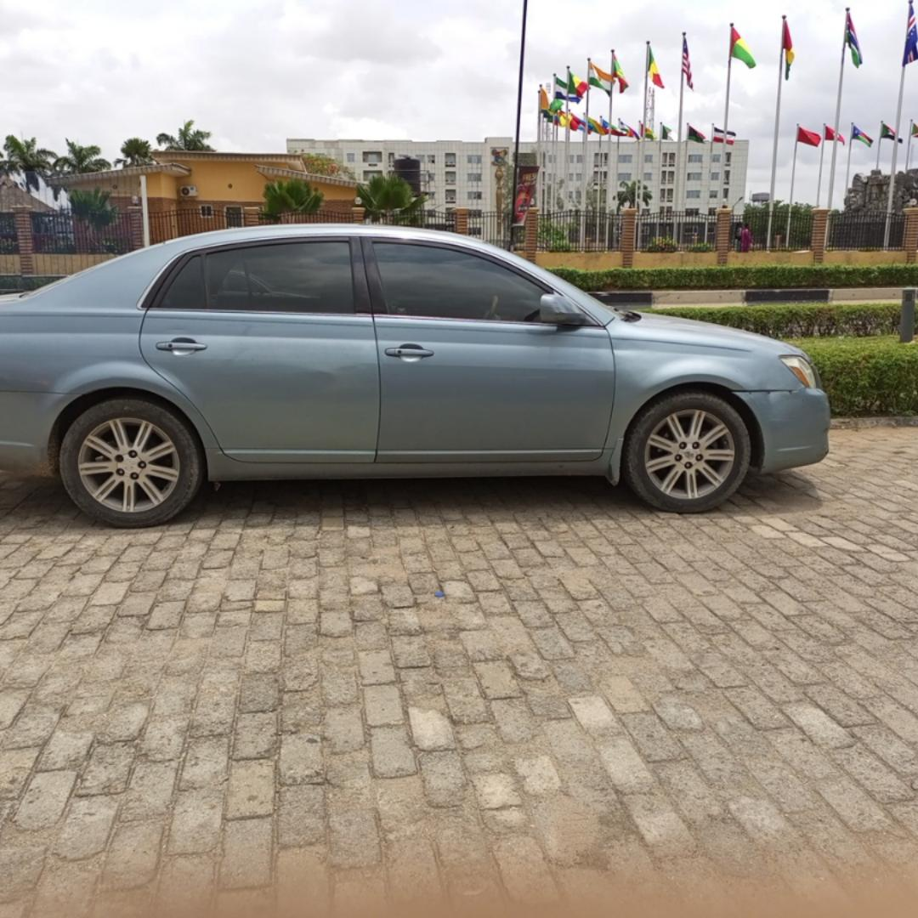
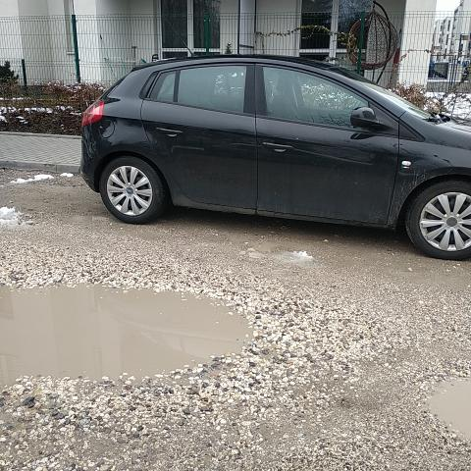
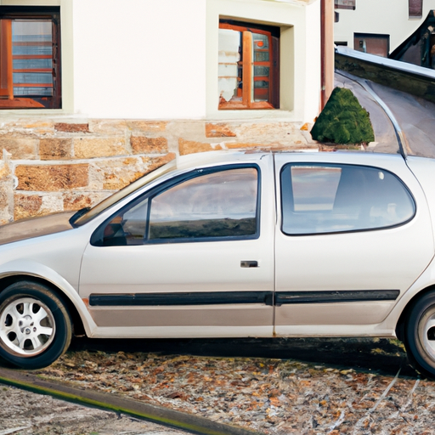
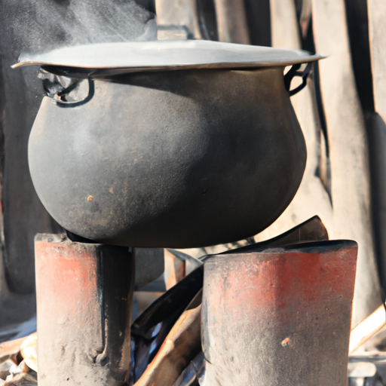
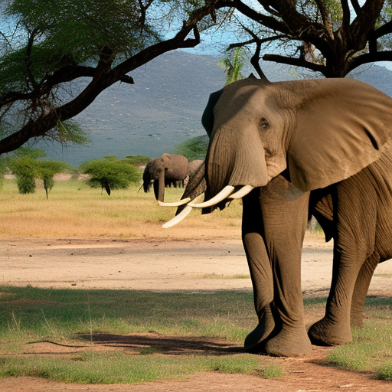
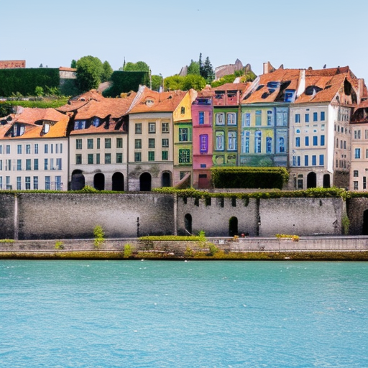
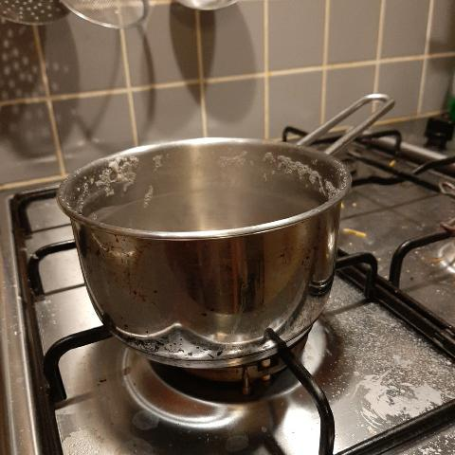
DIG In: Quantifying geographic disparities in text-to-image models
Melissa Hall, Candace Ross, Adina Williams, Nicolas Carion, Michal Drozdzal, Adriana Romero-Soriano
Region Indicator
Region-Object Indicator
Object Consistency Indicator
Low
Realism & Diversity Region-Objects
High
Realism & Diversity Region-Objects
Generated:
"bag in Africa"
Generated:
"bag in Europe"
Low
Realism & Diversity Region
High
Realism & Diversity
Region
Africa
Europe
Real
Generated
Real
Generated
Low Consistency Model
Africa
Europe
Car
High Consistency Model
"hat in Africa"
"hat in Europe"
Low Consistency Model
Cooking pot
* Data points denote different prompt templates and generative models.
High Consistency Model
Notes:
We developed three indicators focused on geographic diversity. We call these the DIG Indicators, since we measure disparities in image generation.
Region indicator – compare a reference dataset of images with a set of generated images.
Precision is used to measure realism. We calculate it as the proportion of generated images that fall in the manifold of real images.
Coverage used to measure diversity. Proportion of real images that have a generated image close to it.
We aggregate images of objects for each geographic region and measure disparities across regions.
We find that Africa tends to have lower realism and diversity than Europe.
Region-object indicator is the same, except we disaggregate at the object level to better identify patterns.
For example, car and cooking pot are both objects that tend to have lower realism and diversity for generated images of objects in Africa than in Europe.
For real images of cars, Africa and Europe both show sedan like cars on city streets.
While the generations for Europe are similar, we see that generations of cars for Africa tend to show stereotypical boxy SUVS and rural desert like backgrounds.
The same is true of pots, where generated images of African pots are quite rudimentary and shown in outdoor settings unlike the real images.
Finally, we have the object consistency indicator, which allows us to measure whether the generated image contains the object used for prompting.
Examples here of “bag in Africa/Europe” and “hat in Africa/Europe”
We compare across models and find that some models struggle to show the object when region information is included in the prompt.
For example, the low consistency model struggles to show bags and hats in images and instead shows primarily geographic settings, while the high consistency model more reliably depicts the objects.

Slide 7
DIG In: Results
Melissa Hall, Candace Ross, Adina Williams, Nicolas Carion, Michal Drozdzal, Adriana Romero-Soriano
2021
2022
2023
LDM
v1.5
LDM
v2.1
LDM
API
Image realism (quality)
Image diversity
Prompt-image consistency
+/-
+/-
+/-
+
-
-
+
-
-
+
-
-
Progress in image quality has come at the cost of geographic diversity and consistency.

Slide 8
DIG In: Wrap Up
Melissa Hall, Candace Ross, Adina Williams, Nicolas Carion, Michal Drozdzal, Adriana Romero-Soriano
We introduced geodiversity indicators to measure the quality, diversity and consistency of state-of-the-art text-to-image generative models.
We benchmarked 5 SOTA models.
Our indicators highlighted disparities in real-world geographic representation, notably:
Existing models often have less realism and diversity of generations of objects when prompting with Africa and West Asia than Europe.
Prompting with geographic information (“object” vs “object in region”) comes at a cost of prompt-consistency and diversity of generated images.
Models exhibit more region-level disparities for some objects than others.
Of notable concern, we see from all three indicators that progress in image quality has come at the cost of real-world geographic representation.

Slide 9
Querying the generative model to produce samples that are useful for the ML model 2.0
→ Feedback-guided data synthesis for imbalanced classification, R. Askari Hemmat et al., arXiv 2023.

Slide 10
Leveraging pre-trained generative models as world models
Reyhane Askari, Mohammad Pezeshki, Florian Bordes, Michal Drozdzal, Adriana Romero-Soriano
Query the world model
ML model 2.0
World model
Generate data to improve the performance of ML model 2.0

Slide 11
LDM-FG: Feedback-guided data synthesis
Reyhane Askari, Mohammad Pezeshki, Florian Bordes, Michal Drozdzal, Adriana Romero-Soriano

Slide 12
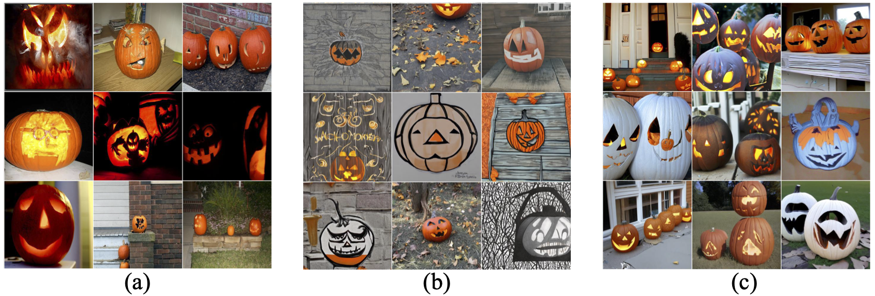
LDM-FG: Results (1)
Reyhane Askari, Mohammad Pezeshki, Florian Bordes, Michal Drozdzal, Adriana Romero-Soriano
Effect of leveraging feedback from the classifier to generate data:
Real data
LDM generated data
Feedback-guided generated data

Slide 13
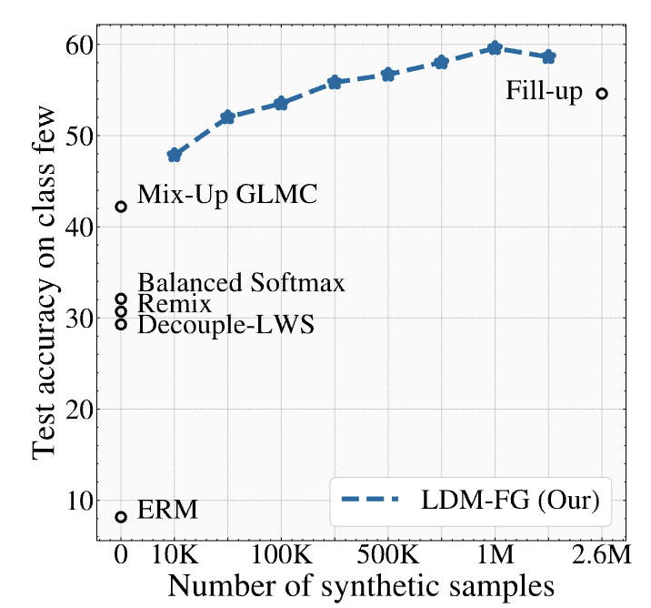
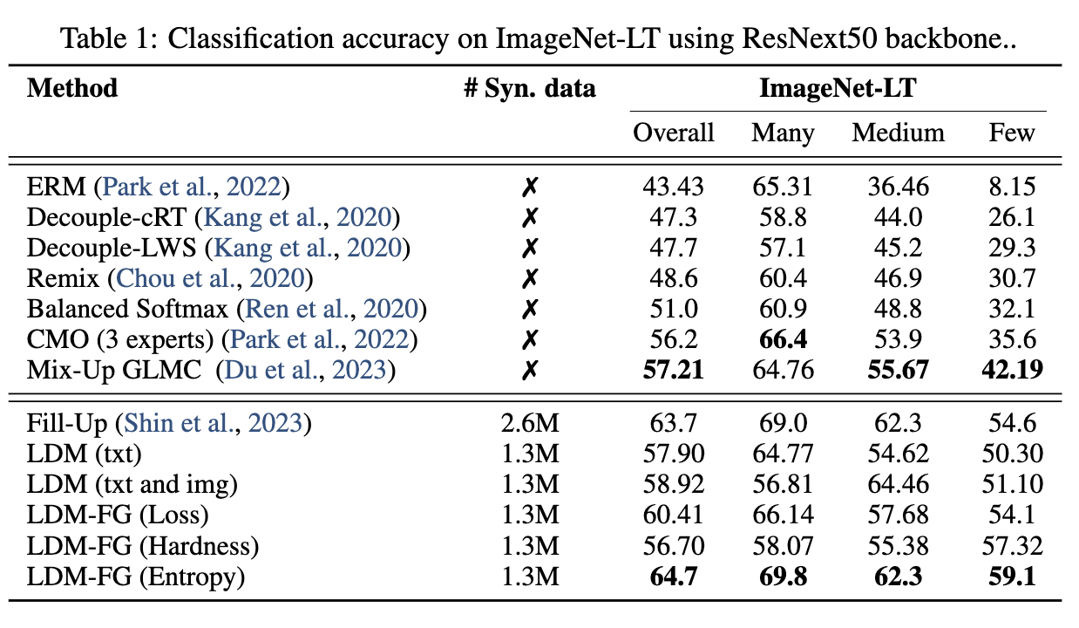
LDM-FG: Results (1)
Reyhane Askari, Mohammad Pezeshki, Florian Bordes, Michal Drozdzal, Adriana Romero-Soriano
ImageNet-LT

Slide 14
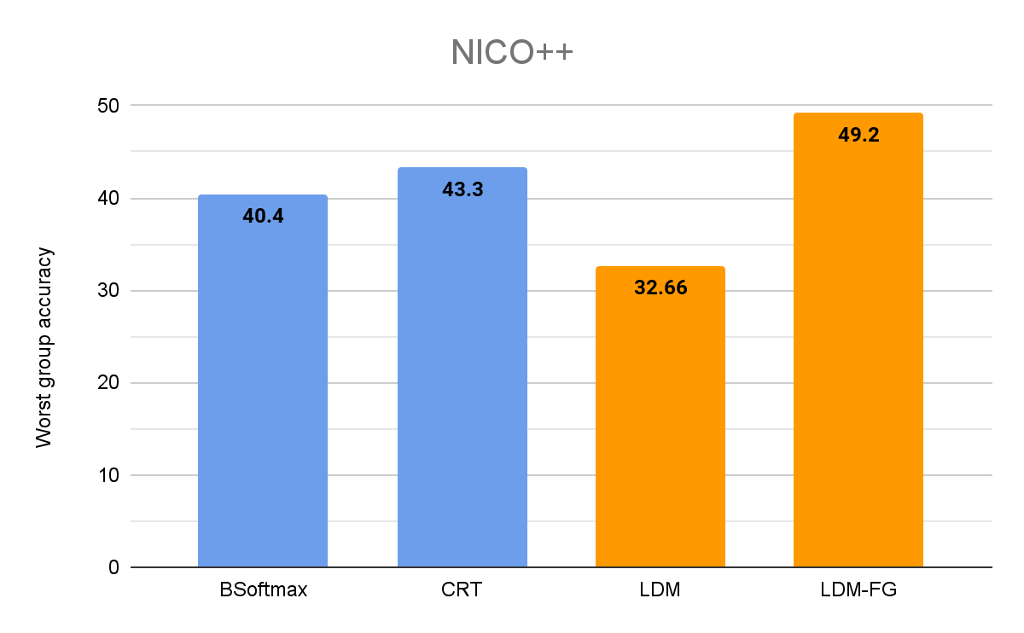
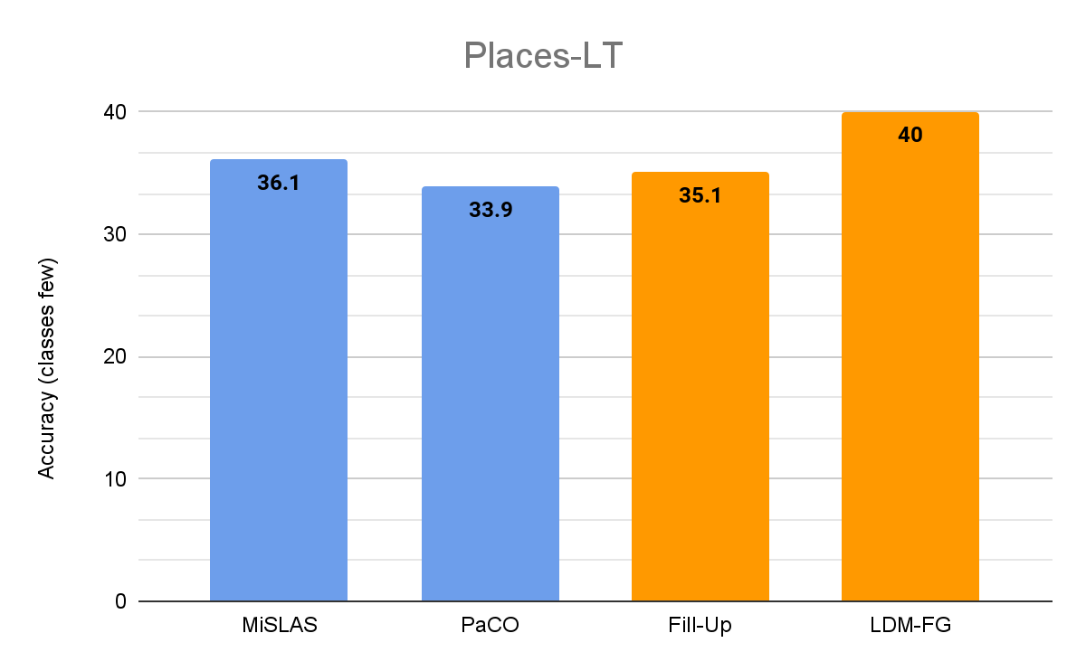
LDM-FG: Results (2)
Reyhane Askari, Mohammad Pezeshki, Florian Bordes, Michal Drozdzal, Adriana Romero-Soriano

Slide 15
LDM-FG: Wrap Up
Reyhane Askari, Mohammad Pezeshki, Florian Bordes, Michal Drozdzal, Adriana Romero-Soriano
Effect of leveraging feedback from the classifier to generate data:
We achieve SOTA results on ImageNet-LT, with over 4% improvement on underrepresented classes while being twice efficient in terms of the number of generated synthetic samples.
We achieve SOTA on NICO++, with over 5% improvement in worst group accuracy.
We achieve SOTA on Places-LT, with a 3.9% improvement on underrepresented classes.
Our framework paves the path towards effectively leveraging high performing text-to-image models as data sources that can be queried to improve downstream applications.

Slide 16
Takeaways
Are state-of-the-art image generative models optimized to work as world models?
Progress in T2I models has been driven by image quality improvements.
Progress in image quality has come at the cost of representation diversity and prompt-image consistency.
What’s the most effective way to query/control the generative model to produce samples that are useful for the ML downstream model?
Leveraging feedback guidance from a pre-trained classifier to drive the generation process results in samples that are more likely to improve the performance of the downstream task.
Different criteria yield notably different results and further effort should be devoted to devising effective criteria for feedback guidance.

Slide 17
Generative models as queryable
world models
Adriana Romero Soriano
Research Scientist, FAIR, Meta AI
Adjunct professor, McGill University
Core Industry Member, Mila
Canada CIFAR AI Chair

